Slide 1
www.ArduGuitar.org
Wireless control of an Electric Guitar

Slide 2
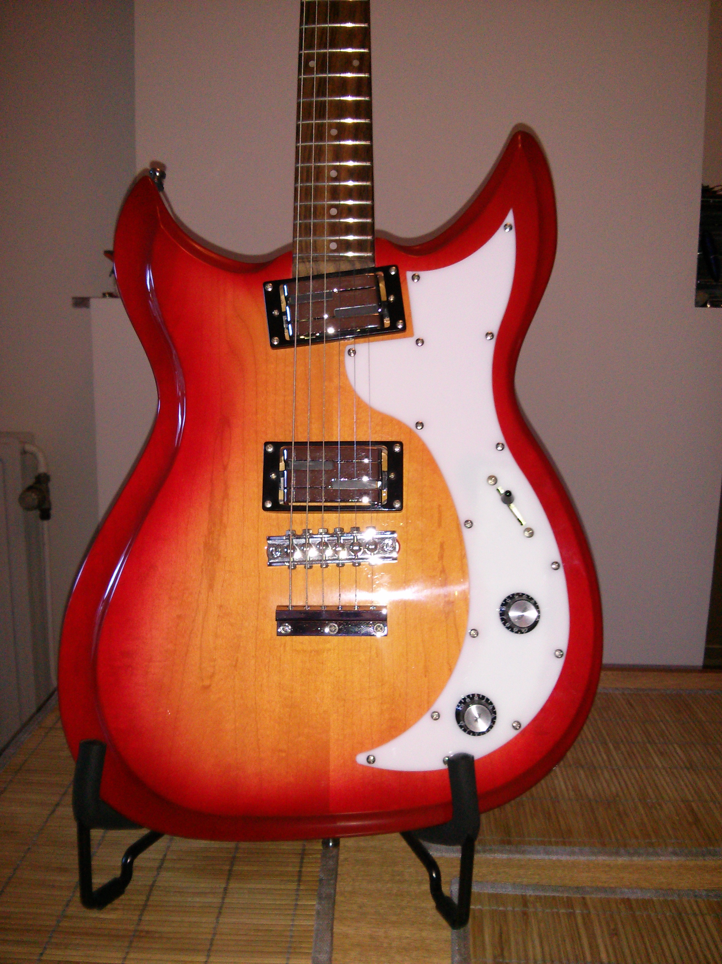
Electric Guitar

Slide 3
All I knew...
V = IR

Slide 4
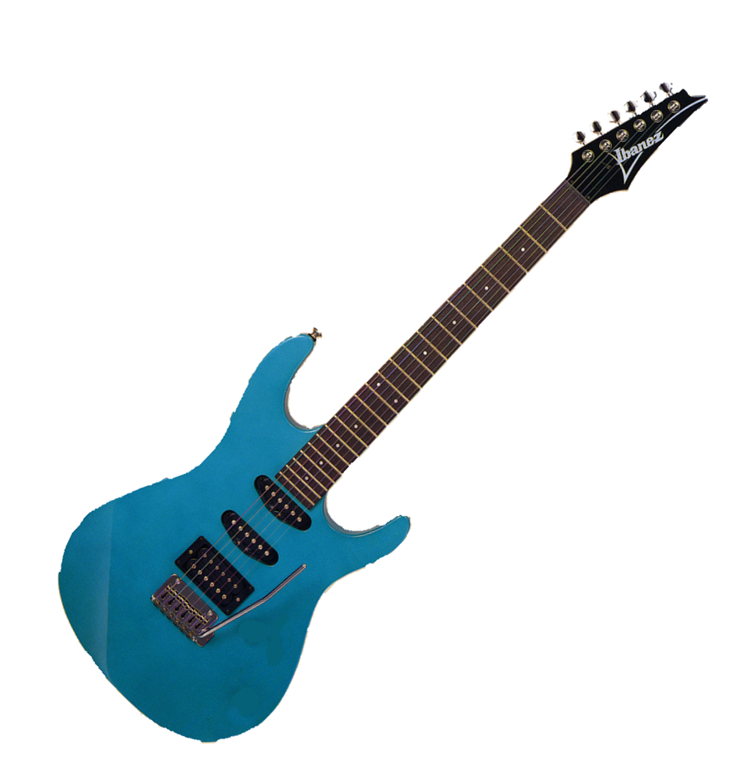
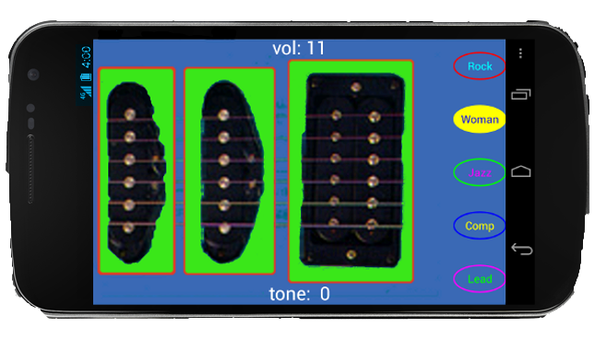
Vision
Control this
Android Phone
remote
No Knobs
or Buttons !
Play this
Electric Guitar

Slide 5
But, why didn't this already exist?
  Too difficult to build
  Nobody wants it

Slide 6
TED
a Community of Inspiration

Slide 7
Marshall McLuhan (1962)
“In this new age, humankind will move from individualism and fragmentation to a collective identity, the global village.”
and
"When faced with a totally new situation we tend to always attach ourselves to the objects, to the flavor of the most recent past. We look at the present through a rear-view mirror. We march backwards into the future."

Slide 8
Thanks, Mitch!

Slide 9
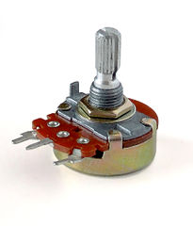
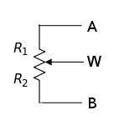
the Pot
Potentiometer
Manually
turn knob
R1 and R2
Vary
Analog Pot

Slide 10
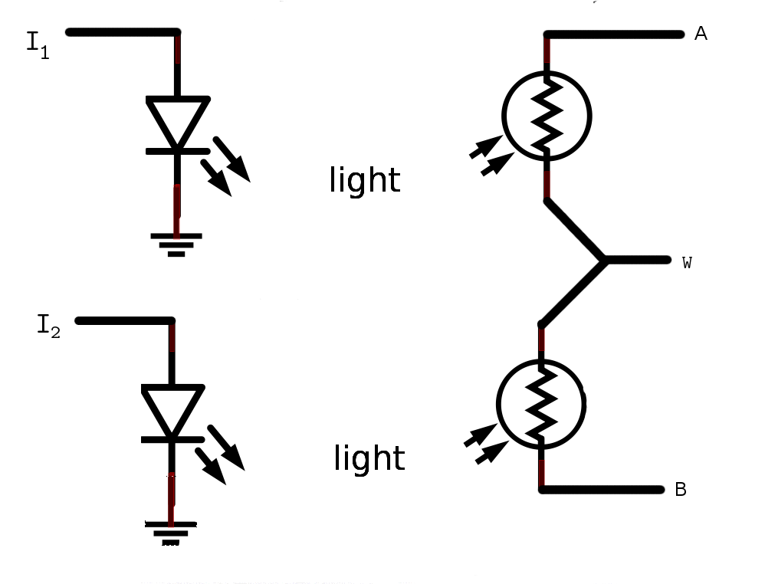
the Pot
Potentiometer
Vactrols
R1
R2
Manually
turn knob
R1 and R2
Vary
Electronically apply current
R1 and R2
Vary
Digital control - Analog Pot

Slide 12
ArduGuitar Technology
Processing
Android
Bluetooth
Vactrols
Arduino Micro C++
Bluetooth
wireless

Slide 13
Thanks!
www.arduguitar.org

