Slide 1
Web Development for “Java Web Developers”
Subjective and Simplified View
on
Java Web Development
and
HTML Markup

Slide 2


Web Applications this is how it started
Framework, Tools
Application Type
Servlet, JSP,
JSTL, Custom TL
Internet,
Web
Usability
Accessibility
Multi Browser
Notes:
At the beginning there has been users and the Web
From the beginning users has been using different machines, OS and different browsers (1 then 2 of them)
The cared about basic things U,A, and MB
This was satisfied by Java Web Developers using basic technologies. Almost everyone understood HTTP, URI and HTML.
Then Users demanding more interactivity appeared, with their rich desktops, and required rich experience.
This sort of applications has been targeted for more closed environments and we started to call them Intranets, and later RIA.
To satisfy this with existing JSP stack required new skills and was hardly achievable by average already large and lazy group of Java Web coders.
So frameworks has been invented shifting from HTML, request response, into abstracted Component and Interaction Model
And new type of Java Web Developers has been born and Customers satisfied.
This brought technological trade-offs for typical Web development. (POSTs instead of GETs, Bloated GENERATED Presentational Markup, later lame quality JavaScript and CSS) as a result final pages become less accessible and usable
specially in expanding MB environment.
To speed things UP, then the mobile devices came,
We had new users and new requirements
So we made new markup languages and frameworks for mobile devices
And started to produce mobile applications (mobile web applications)
With satisfactory results from Mobile Frameworks, but poor results from original ones.
New wave of Java Web Developers has been born, died, born, died with different mobile platforms, languages and vendors
To mess this even more at the same time Fielding reinvented his own basic web principles (URI, resources, HTTP) + HTML and other simple formats and stared to talk
about machine web and Services
And about semantics and standardized protocols
Of course this was almost unachievable by JSF,
difficult to achieve by JSP developers
So new framework, new programming styles, new Java Web Developers
Of Course this line of development is disconnected from original Human Web and mostly used for machines now
And this situation continues until now with
Higher demands on each set of requirements
More diverse browser and devices market
More existing frameworks and coding styles
Diverse
Far from standards (HTTP, URI, HTML,…)
and
best practices

Slide 3




Web Applications …and continues ….
Framework, Tools
Application Type
JSF, …
Intranet,
RIA
Rich “Desktop” Style
Experience
Developer 1
Skills, Style 1
Servlet, JSP,
JSTL, Custom TL
Internet,
Web
Usability
Accessibility
Multi Browser
Developer 2
Skills, Style 2
XDIME
Devices,
Mobile,
…
Device Limits
Device Specifics
Developer 3
Skills, Style 3
JAX-RS,
Restlet
Services,
REST
Semantics
Standard Protocols
Developer 4
Skills, Style 4
Notes:
At the beginning there has been users and the Web
From the beginning users has been using different machines, OS and different browsers (1 then 2 of them)
The cared about basic things U,A, and MB
This was satisfied by Java Web Developers using basic technologies. Almost everyone understood HTTP, URI and HTML.
Then Users demanding more interactivity appeared, with their rich desktops, and required rich experience.
This sort of applications has been targeted for more closed environments and we started to call them Intranets, and later RIA.
To satisfy this with existing JSP stack required new skills and was hardly achievable by average already large and lazy group of Java Web coders.
So frameworks has been invented shifting from HTML, request response, into abstracted Component and Interaction Model
And new type of Java Web Developers has been born and Customers satisfied.
This brought technological trade-offs for typical Web development. (POSTs instead of GETs, Bloated GENERATED Presentational Markup, later lame quality JavaScript and CSS) as a result final pages become less accessible and usable
specially in expanding MB environment.
To speed things UP, then the mobile devices came,
We had new users and new requirements
So we made new markup languages and frameworks for mobile devices
And started to produce mobile applications (mobile web applications)
With satisfactory results from Mobile Frameworks, but poor results from original ones.
New wave of Java Web Developers has been born, died, born, died with different mobile platforms, languages and vendors
To mess this even more at the same time Fielding reinvented his own basic web principles (URI, resources, HTTP) + HTML and other simple formats and stared to talk
about machine web and Services
And about semantics and standardized protocols
Of course this was almost unachievable by JSF,
difficult to achieve by JSP developers
So new framework, new programming styles, new Java Web Developers
Of Course this line of development is disconnected from original Human Web and mostly used for machines now
And this situation continues until now with
Higher demands on each set of requirements
More diverse browser and devices market
More existing frameworks and coding styles
Diverse
Far from standards (HTTP, URI, HTML,…)
and
best practices

Slide 4
Personal Findings:
HIGHER
server side Java framework
more
Web Best Practices
broken

Slide 5
Personal Findings
Bottom-Up Web Development
is harmful
Top-down design
is not supported well
by
main stream
frameworks and tools

Slide 6
Reasons for having “Bad Web” with “Good” Java Web Frameworks
Java Web Developer Goals:
Rapid and Easy Development
Nice Looking and Working UI
Achieved by:
Libraries and Frameworks
Using abstractions:
No HTML skills needed (components)
No HTTP skills needed (request-response hidden)
No JS, CSS (generated by server side components)
No URL design (who cares about link bar?, one URI for whole app)

Slide 7
Reasons for having “Bad Web” with “Good” Java Web Frameworks
Previous results in:
Bad Markup
Non semantic, large, non accessible, invalid
Unusable without JS, Cookies, Flash and desktop screens
HTTP principles violated
Method semantics, caching, content-negotiation
URL principles violated
?,;/ (each part of URI has some semantics)
Bandwidth waste
X00 MB - aggregated page size
X0 MB - markup size
X0 - request to download scripts
Server performance problems
Output buffering, state handling, serving useless requests

Slide 8
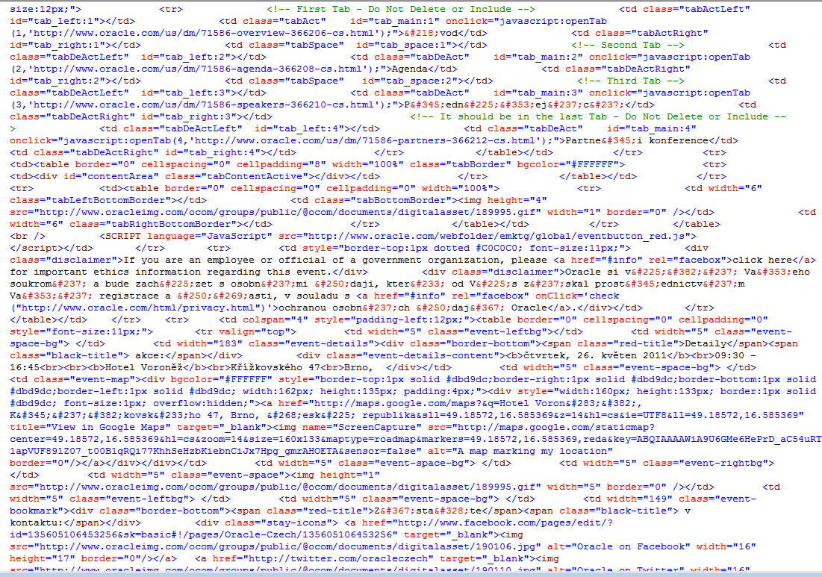
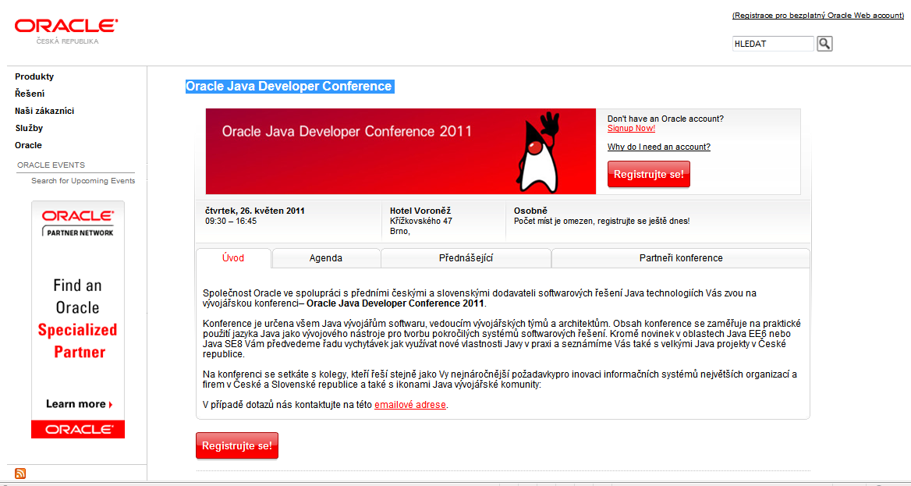
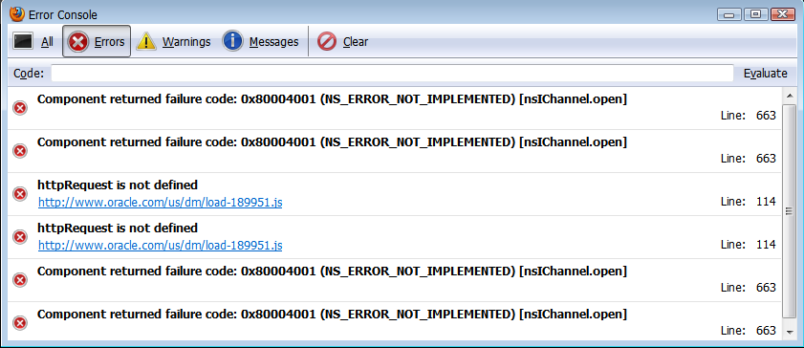
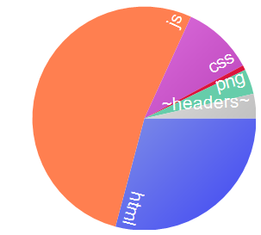
Bad Markup – Good Markup Oracle Java Developer Conference
No DOCTYPE detected ?
BackCompat obsolette compatibility deprecated tag FONT
Deepest Nesting Level 45
9 comments found (226 bytes)
Inconsistent class naming conventions, 4 different conventions found
Duplicate IDs on the page
17 inline scripts found (6270 bytes of code is inline in the page)
1 Sensitive Script Accessible Cookies
Server Banner Found
0 lang attributes found
31 images (31/41) without alt found
RESPONSE BYTES (by Content-Type)
--------------
application/js: 227 910
text/html: 126 180
text/css: 44 584
application/png: 15 585
~headers~: 15 380
application/gif: 3 053
Request Count: 44
Bytes Sent: 26 444 (headers:26444; body:0)
Bytes Received: 432 692 (headers:15380; body:417312)

Slide 9
Bad Markup – Good Markup very raw statistics
Bad (mix from MS, Oracle, IBM, Apple)
Size calculated from serialized DOM is: 139406
Deepest Nesting Level 24
63% of elements (1074/1726) has css class specified (29385 bytes overhead)
24% of elements (240/1025) has ID specified (4710 bytes overhead)
39% of elements (666/1726) are DIVs and SPANs (10392 bytes overhead)
61 images (61/73) without alt found
174 comments found (4167 bytes)
Duplicate IDs on the page
36% of elements (595/1665) has Inline Event Handler (40072 bytes overhead)
16 inline scripts found (12969 bytes of code is inline in the page)
Lot of info ? NO just bad markup !
Really bad markup, crashes VS 2010 ;-)
Learn some CSS please !
So many scriptable elements? id based CSS?
Better than tables, try also old <P>
Content or decoration ? CSS background ?
Thanx for waste and hacking hints
Super-long ids and still have duplicates ?
DHTML Lower or bad components ?
12K of code unique per page/request ?

Slide 10
Can We Get Here ? Lunatic ?! But maybe some “reuse” is possible
Good
Web
Framework
Tools
Good
Web
Rich Experience
Web Developer
Tech Skills:
HTML
JavaScript
CSS
HTTP
URI
Design Skills:
Responsive,
Unobtrusive
Progressive
Degradation
Polyfills
Framework:
Notepad++
Usability
Accessibility
Multi Browser
Device Limits
Device Specifics
Java Web Developer
Tech Skills:
HTML
Design Skills:
Framework
Framework:
“Black Magic”
Semantics
Protocols

Slide 11
Must Start With Basics
HTML Markup
Language of Web
Language of Browsers
and
Language of Machines

Slide 12
Markup Genesis
JSP Page, .jsp
Free Syntax
HTML 4
SGML Syntax
Text/html
Legacy
Browsers
XML Machines
JSPX Page, .jspx
XML Syntax
XHTML 1.0, 1.1
XML Syntax
application/xhtml+xml
MSIE 7,8
Ajax, XML (+XSLT)
XHTML 1.0, 1.1
XML Syntax + Comp.
text/html
Ajax, DOM+CSS Sel.
HTML5
HTML Syntax
Common
Browsers
Ajax, DOM+CSS Sel.
HTML5
XML Syntax
MSIE 9
Code
Streams, Builders, Components
Edge
Browsers
HTML5
XML Syntax+Comp.
Notes:
HTML + Browsers appeared
And of course worked together
JSP has been invented
to generate HTML from Java
At that time we also had Code (Servlets, CGI)
to generate HTML, usually using streams or simple builders
XML became popular and XML Machines greedy to parse HTML appeared,
they could but with troubles
So they have invented XHTML and JSPX
XML Machines could be happy
And good browsers used XML syntax for stricter parsing and error reporting
But Evil MSIE
Did not support XHTML content-type
Luckily there has been an option called Compatibility Guideline (Appendix of XHTML) which allows to send XML syntax over text/html. We call this XHTML/HTML (read XHTML over HTML content-type).
This is understood by MSIE. But your tags MUST follow certain rules. If the don’t, MSIE
as well as common browsers will display blank page, do not download script or create invalid DOM. Also Strict error handling is OFF in this case.
To generate XML or XML+Comp from JSP is easy, requires only discipline. Stricter syntax of XML+Comp renders lax, full XML syntax useless.
MS Client Side Developers could benefit from XML syntax, because MS Browser supported well XML, XSLT development (with XHR+MSXML default parser),
just content type was (is) wrong (text/xml required)
Then JSPX. I don’t get the reason to have XML strict markup on server. Maybe to generate and manupulate source code but it brought more trouble then benefit in this context.
While it is easy to generate XHTML
It is almost impossible to generate HTML from XML syntax (text tricks needed)
And to generate XHTML+Comp. it requires tricks (even with Cross Container differencies).
Looking at this, the Code is still immune to big troubles, and difficulties exists only in duplicated code for each markup.
While MSIE invested mostly into XML, others invested into CSS selectors and native DOM manipulations.
The Ajax Stack actually started to prefer HTML or XHTML/HTML format. But worked well with all 3.
While MSIE failed miserably with direct XML syntax insertion into HTML dom.
Then: HTML5, 2+1 syntaxes ?
Technology Edge browsers
And MSIE 9,
Should not have any trouble with all syntaxes
XML machines can consume HTML5 XML Syntax
To generate HTML 5 from JSP , JSPX and CODE the same applies. JSP and code, OK but duplicit code.
From JSPX, HTML almost impossible
XML syntax OK
XML+Compat. Possible but quirks
Now usability of HTML 5 in older browsers: MSIE 8 and XML Syntax : impossible
HTML Syntax with new tags, possible only with client side JS polyfil (html5shim)
Same
This is almost complete mess (could be simplified, many are duplicit) but there are 3 basic outcomes:
To make everyone happy, you must produce multiple representations (markup syntax+content-type) and have redundant code.
HTML syntax OK (only XML machines complain)
XML syntax without Comp. is redundant, use XML+Comp. always
JSPX is harmful
Almost Fixed, hard to change decision about server markup, client markup, content type
Redundant and quirky code

Slide 13
What is HTML ?
JSP Syntax
HTML 4
HTML Syntax
Legacy
Browsers
text/html
JSPX Syntax
XHTML 1.0
XML Syntax
MSIE 7,8
Tag Libraries
XHTML 1.0
XML Syntax + C
Ajax, XML (+XSLT)
Other Text Syntax
application/
xhtml+xml
XHTML 1.1, 2.0
XML Syntax
Java HTML Builder
XHTML
Browsers
HTML 5
HTML Syntax
text/xml
Java XML Builder
Ajax, DOM+CSS Sel.
HTML 5
XML Syntax
MSIE 9
Java Components
HTML 5
XML Syntax + C
HTML5
Browsers
XML Machines
Notes:
HTML + Browsers appeared
And of course worked together
JSP has been invented
to generate HTML from Java
At that time we also had Code (Servlets, CGI)
to generate HTML, usually using streams or simple builders
XML became popular and XML Machines greedy to parse HTML appeared,
they could but with troubles
So they have invented XHTML and JSPX
XML Machines could be happy
And good browsers used XML syntax for stricter parsing and error reporting
But Evil MSIE
Did not support XHTML content-type
Luckily there has been an option called Compatibility Guideline (Appendix of XHTML) which allows to send XML syntax over text/html. We call this XHTML/HTML (read XHTML over HTML content-type).
This is understood by MSIE. But your tags MUST follow certain rules. If the don’t, MSIE
as well as common browsers will display blank page, do not download script or create invalid DOM. Also Strict error handling is OFF in this case.
To generate XML or XML+Comp from JSP is easy, requires only discipline. Stricter syntax of XML+Comp renders lax, full XML syntax useless.
MS Client Side Developers could benefit from XML syntax, because MS Browser supported well XML, XSLT development (with XHR+MSXML default parser),
just content type was (is) wrong (text/xml required)
Then JSPX. I don’t get the reason to have XML strict markup on server. Maybe to generate and manupulate source code but it brought more trouble then benefit in this context.
While it is easy to generate XHTML
It is almost impossible to generate HTML from XML syntax (text tricks needed)
And to generate XHTML+Comp. it requires tricks (even with Cross Container differencies).
Looking at this, the Code is still immune to big troubles, and difficulties exists only in duplicated code for each markup.
While MSIE invested mostly into XML, others invested into CSS selectors and native DOM manipulations.
The Ajax Stack actually started to prefer HTML or XHTML/HTML format. But worked well with all 3.
While MSIE failed miserably with direct XML syntax insertion into HTML dom.
Then: HTML5, 2+1 syntaxes ?
Technology Edge browsers
And MSIE 9,
Should not have any trouble with all syntaxes
XML machines can consume HTML5 XML Syntax
To generate HTML 5 from JSP , JSPX and CODE the same applies. JSP and code, OK but duplicit code.
From JSPX, HTML almost impossible
XML syntax OK
XML+Compat. Possible but quirks
Now usability of HTML 5 in older browsers: MSIE 8 and XML Syntax : impossible
HTML Syntax with new tags, possible only with client side JS polyfil (html5shim)
Same
This is almost complete mess (could be simplified, many are duplicit) but there are 3 basic outcomes:
To make everyone happy, you must produce multiple representations (markup syntax+content-type) and have redundant code.
HTML syntax OK (only XML machines complain)
XML syntax without Comp. is redundant, use XML+Comp. always
JSPX is harmful
Almost Fixed, hard to change decision about server markup, client markup, content type
Redundant and quirky code

Slide 14
Coding with HTML 5 tags
JSP: XML | HTML syntax
JSPX: XML syntax
JSP/JSPX/TAG/TAGX mix
Configured, Explicit, Request Bases
Tags, Syntax, Content-Type
Any output with single code
No Duplicate Codes
No Quirk Codes
No Fixed Decisions
All Satisfied ?
Including w3 validator ?
HTML5
Tag Lib
+
HTML5
HAIKU
“No red or dashed lines”
?
JSP Page, .jsp
Free Syntax
Legacy
Browsers
HTML 4
XHTML 1.0, 1.1
HTML 5
XML Machines
JSPX Page, .jspx
XML Syntax
MSIE 7,8
SGML
XML
Ajax, XML (+XSLT)
XML+Compat
Ajax, DOM+CSS Sel.
Tiles2
SGML Optimized
Spring
XML Optimized
Common
Browsers
JSF
text/html
Ajax, DOM+CSS Sel.
JEE Codes
Streams, Builders, Components
application/xhtml+xml
text/xml
MSIE 9
…
Edge
Browsers
JSE Code
Notes:
HTML and Browsers appeared
And of course worked together
JSP has been invented
to generate HTML from Java
At that time we also had Code (Servlets, CGI)
to generate HTML, usually using streams or simple builders
XML became popular and XML Machines greedy to parse HTML appeared,
they could but with troubles
So they have invented XHTML and JSPX
XML Machines could be happy
And good browsers used XML syntax for stricter parsing and error reporting
But Evil MSIE
Did not support XHTML content-type
Luckily there has been an option called Compatibility Guideline (Appendix of XHTML) which allows to send XML syntax over text/html. We call this XHTML/HTML (read XHTML over HTML content-type).
This is understood by MSIE. But your tags MUST follow certain rules. If the don’t, MSIE
as well as common browsers will display blank page, do not download script or create invalid DOM. Also Strict error handling is OFF in this case.
To generate XML or XML+Comp from JSP is easy, requires only discipline. Stricter syntax of XML+Comp renders lax, full XML syntax useless.
MS Client Side Developers could benefit from XML syntax, because MS Browser supported well XML, XSLT development (with XHR+MSXML default parser), just content type was (is) wrong (text/xml required)
Then JSPX. I don’t get the reason to have XML strict markup on server. Maybe to generate and manupulate source code but it brought more trouble then benefit in this context.
While it is easy to generate XHTML
It is almost impossible to generate HTML from XML syntax (text tricks needed)
And to generate XHTML+Comp. it requires tricks (even with Cross Container differencies).
Looking at this, the Code is still immune to big troubles, and difficulties exists only in duplicated code for each markup.
While MSIE invested mostly into XML, others invested into CSS selectors and native DOM manipulations.
The Ajax Stack actually started to prefer HTML or XHTML/HTML format. But worked well with all 3.
While MSIE failed miserably with direct XML syntax insertion into HTML dom.
Then: HTML5, 2+1 syntaxes ?
Technology Edge browsers
And MSIE 9,
Should not have any trouble with all syntaxes
XML machines can consume HTML5 XML Syntax
To generate HTML 5 from JSP , JSPX and CODE the same applies. JSP and code, OK but duplicit code.
From JSPX, HTML almost impossible
XML syntax OK
XML+Compat. Possible but quirks
Now usability of HTML 5 in older browsers: MSIE 8 and XML Syntax : impossible
HTML Syntax with new tags, possible only with client side JS polyfil (html5shim)
Same
This is almost complete mess (could be simplified, many are duplicit) but there are 3 basic outcomes:
To make everyone happy, you must produce multiple representations (markup syntax+content-type) and have redundant code.
HTML syntax OK (only XML machines complain)
XML syntax without Comp. is redundant, use XML+Comp. always
JSPX is harmful
Almost Fixed, hard to change decision about server markup, client markup, content type
Redundant and quirky code

Slide 15
“One” Web Web developers already have some ideas how to reunify Web
Progressive Enhancement
Graceful Degradation
Responsive Web Design
Cross Browser Libraries
Semantic XHTML
….

Slide 16
Solution Starts With:
Learn HTML
and
Write HTML
in
HTML

