Slide 1
Web Development for “Java Web Developers”
Reasonable
HTML Markup
with
HTML5TagLib and HTML5DSL

Slide 2
HTML5TagLib
+
HTML5DSL (HAIKU)
JSP Tag Library and Java API
to
clean your server code
and
improve client markup

Slide 3
Feature List
One Server Side Markup - Multiple outputs
JSPX producing XHTML/HTML and HTML
XHTML/HTML Compatibility Guidelines
“Full” XHTML
HTML5
XHTML5 (Full XHTML, polyglot)
HTML5 server side tags – No Abstraction Needed
Simplification
Hide differences (HTML4, XHTML, HTML5)
Backward compatibility
TIME tag Formatting Support,
And more tags to come …

Slide 4
Feature List
Suppress Bad Practices
Content-Type, Charset, DOCTYPE Consistency
Removable client comments
Deprecated tags
Auto-generate required defaults
Warnings/errors for incomplete/incorrect tags
Satisfy W3C Validation
Empty self closing tags (HTML Compatibility Guidelines)
Prevent Minimization

Slide 5
Feature List
XML/HTML Escaping
Automatic attribute value escaping
innerText, innerHtml server side attributes
Correct (X)HTML escaping (SMP, entities, charset switching)
URI Reference Building Support
ContextPath (~/,//~,://~)
template parameters in <a>, <link>, etc. (available only in spring)
Server Side CSS classes
Modify/extend markup based on CSS class
Integrate with client CSS

Slide 6
Feature List
Custom tags (code, tagx)
XHTML Compounds
Extend/Fix Spring Tags
Output client side JavaScript fragments
HTML5 Form Tags (with polyfills)
Accessibility aware tags
Extended INPUT with LABEL attribute, that put LABEL tag according to type (radio, checkbox ==> right) (http://www.w3.org/TR/2008/NOTE-WCAG20-TECHS-20081211/G162)
Automatic TH scope in tables (<table class="scope_auto">) (http://www.w3.org/TR/WCAG20-TECHS/H63)
Microformats
Integration/Coexistence with 3party
Lightweight and standalone (JSTL)
Tiles2, Spring, JSF or other integration

Slide 7
Feature List
Streaming markup - minimized needed server side buffering
Script deferring
Joining multiple inline scripts
Placing scripts at the end of body
Reducing markup size (experimental)
Omitting end tags in HTML
Minimizing tags in XHTML

Slide 8
Feature List
Alternative View Technologies
Enemy of JSP View Layer ?
Try HTML5DSL (HAIKU) !

Slide 9
HTML5TagLib
+
HTML5DSL (HAIKU)
Basic
Samples

Slide 10
JSPX producing XHTML/HTML and HTML Typical JSPX Source Code (buggy)
<jsp:root xmlns:jsp="http://java.sun.com/JSP/Page" version="2.0">
<jsp:directive.page language="java"
contentType="text/html; charset=UTF-8" pageEncoding="UTF-8" />
<jsp:output doctype-root-element="html"
doctype-system="http://www.w3.org/TR/xhtml1/DTD/xhtml1-transitional.dtd"
doctype-public="-//W3C//DTD XHTML 1.0 Transitional//EN" />
<html xmlns="http://www.w3.org/1999/xhtml">
<head>
<title>${title}</title>
<meta content="text/html; charset=UTF-8" http-equiv="Content-Type" />
</head>
<body>
<script type="text/javascript" src="script.js"></script>
<script type="text/javascript">alert('message');</script>
</body>
</html>
</jsp:root>
Notes:
Fixed decision for ContentType, charset and doctype
Anti DRY
No consistency check contentType-doctype combination

Slide 11
JSPX producing XHTML/HTML and HTML Typical JSPX output (buggy)
<!DOCTYPE html PUBLIC "-//W3C//DTD XHTML 1.0 Transitional//EN" "http://www.w3.org/TR/xhtml1/DTD/xhtml1-transitional.dtd">
<html xmlns="http://www.w3.org/1999/xhtml">
<head>
<title/>
<meta content="text/html; charset=UTF-8" http-equiv="Content-Type"/>
</head>
<body>
<script src="script.js" type="text/javascript"/>
<script type="text/javascript">alert('message');</script>
</body>
</html>

Slide 12
JSPX producing XHTML/HTML and HTML Our JSPX Source Code…..Easy
TAGLIB->Correct XHTML/HTML
<jsp:root xmlns:jsp="http://java.sun.com/JSP/Page" version="2.0“
xmlns="http://gratex.com/gjaxXB/tags/html" >
<DOCTYPE/>
<html>
<head>
<title>${title}</title>
</head>
<body>
<script src="script.js“ />
<script>alert('message');</script>
</body>
</html>
</jsp:root>
Notes:
No commitment for doctype or contentType, charset
No redundancy
No care about minimized non minimized form of tags
Simplified Tag syntax (ala HTML5)
No risk of empty ${title}

Slide 13
JSPX producing XHTML/HTML and HTML Our JSPX XHTML Output…..Correct
<!DOCTYPE html PUBLIC "-//W3C//DTD XHTML 1.0 Strict//EN" "http://www.w3.org/TR/xhtml1/DTD/xhtml1-strict.dtd">
<html xmlns="http://www.w3.org/1999/xhtml">
<head>
<title></title>
<meta http-equiv="Content-Type" content="text/html;charset=UTF-8" />
</head>
<body>
<script type="text/javascript" src="script.js"></script>
<script type="text/javascript">
/*<![CDATA[*/alert('message');/*]]>*/</script>
</body>
</html>
web.xml:
<context-param>
<param-name>com.gratex.gjaxXB.tags.html.markup</param-name>
<param-value>XHTML</param-value>
</context-param>

Slide 14
JSPX producing XHTML/HTML and HTML Our JSPX HTML Output…..Correct
<!DOCTYPE HTML PUBLIC "-//W3C//DTD HTML 4.01//EN" "http://www.w3.org/TR/html4/strict.dtd">
<HTML>
<HEAD>
<TITLE></TITLE>
<META http-equiv="Content-Type" content="text/html;charset=UTF-8">
</HEAD>
<BODY>
<SCRIPT type="text/javascript" src="script.js"></SCRIPT>
<SCRIPT type="text/javascript">alert('message');</SCRIPT>
</BODY>
</HTML>
web.xml:
<context-param>
<param-name>com.gratex.gjaxXB.tags.html.markup</param-name>
<param-value>HTML4</param-value>
</context-param>

Slide 15
JSPX producing XHTML/HTML and HTML Fix problems without taglibrary
Without HTML5TagLib = JSPX hacking
(Optional Homework,
beware Cross Container Differences)

Slide 16
Content-Type, Charset, Consistency Choice is yours… source code
JSPX:
<DOCTYPE markup="HTML4" encoding="UTF-8"/>
<html>
<head>
<title>Content-Type Sample</title>
</head>
HTML:
<!DOCTYPE HTML PUBLIC "-//W3C//DTD HTML 4.01//EN"
"http://www.w3.org/TR/html4/strict.dtd">
<HTML>
<HEAD>
<TITLE>META sample</TITLE>
<META content="text/html;charset=UTF-8“ http-equiv="Content-Type">
</HEAD>
HTTP response:
HTTP/1.1 200 OK
Content-Type: text/html;charset=UTF-8

Slide 17
Content-Type, Charset, Consitency Choice is yours… or web config
web.xml:
<context-param>
<param-name>com.gratex.gjaxXB.tags.html.encoding</param-name>
<param-value>UTF-8</param-value>
</context-param>
<context-param>
<param-name>com.gratex.gjaxXB.tags.html.markup</param-name>
<param-value>HTML4</param-value>
</context-param>
.jsp:
<DOCTYPE/>
<html>
<head>
<title>META sample</title>
</head>

Slide 18
HTML5 Source – HTML 5/4 Output Demo for simplification and backward compatibility
<DOCTYPE markup="HTML5" />
<html>
<head>
<title>HTML5 test</title>
<style>
body { background-color: gray; }
</style>
</head>
<body>
<header>Header section</header>
<article>Page content</article>
<footer>
<time>2011-05-08 12:05:25</time>
</footer>
<script src="/resources/script.js" />
</body>
</html>
<!DOCTYPE HTML>
<HTML>
<HEAD>
<TITLE>HTML5 test</TITLE>
<META charset="UTF-8">
<STYLE>
body { background-color: gray; }
</STYLE>
</HEAD>
<BODY>
<HEADER>Header section</HEADER>
<ARTICLE>Page content</ARTICLE>
<FOOTER>
<TIME>2011-05-08 12:05:25</TIME>
</FOOTER>
<SCRIPT src="/res/script.js"></SCRIPT>
</BODY>
</HTML>

Slide 19
HTML5 Source – HTML 5/4 Output Demo for simplification and backward compatibility
<DOCTYPE markup="HTML4" />
<html>
<head>
<title>HTML5 test</title>
<style>
body { background-color: gray; }
</style>
</head>
<body>
<header>Header section</header>
<article>Page content</article>
<footer>
<time>2011-05-08 12:05:25</time>
</footer>
<script src="/resources/script.js" />
</body>
</html>
<!DOCTYPE HTML PUBLIC "-//W3C//DTD HTML 4.01//EN"
"http://www.w3.org/TR/html4/strict.dtd">
<HTML>
<HEAD>
<TITLE>HTML5 test</TITLE>
<META http-equiv="Content-Type"
content="text/html;charset=UTF-8">
<STYLE type="text/css">
body { background-color: gray; }
</STYLE>
</HEAD>
<BODY>
<DIV class="html5-header">Header section</DIV>
<DIV class="html5-article">Page content</DIV>
<DIV class="html5-footer">
<SPAN class="html5-time">2011-05-08 12:05:25</SPAN>
</DIV>
<SCRIPT type="text/javascript"
src="/resources/script.js"></SCRIPT>
</BODY>
</HTML>
Notes:
In HTML5 you don’t see too much
Wait for HTML4 !

Slide 20
HTML5 Tags – TIME We generate localized text content and add typed support
3 attributes of type Calendar or Date
<x:time datetime="${date}"/>
<x:time datetime="${calendar}"/> (calendar with EST TZ)
<x:time date="${date}" />
<x:time time="${date}"/>
Locales (sk-SK) + User TimeZone (Europe/Bratislava) are in request attributes:
<TIME datetime="2011-05-16T09:39:20+02:00">16.5.2011 9:39</TIME>
<TIME datetime="2011-05-16T09:39:20+02:00">16.5.2011 9:39</TIME>
<TIME datetime="2011-05-16">16.5.2011</TIME>
<TIME datetime="09:39:20">9:39</TIME>
User TimeZone not specified:
<TIME datetime="2011-05-16T07:59:54+00:00">16.5.2011 7:59 GMT</TIME>
<TIME datetime="2011-05-16T02:59:54-05:00">16.5.2011 2:59 EST</TIME>

Slide 21
XML/HTML Escaping
XML/HTML Escaping
Automatic attribute value escaping
innerText, innerHtml server side attributes
View:
Without taglib:
<div class="${fn:escapeXml('a&b')}"><c:out value="${plainText}" /></div>
With taglib:
<div class="a&b" innerText="${plainText}“/>
Controller:
mav.addObject("plainText", "<P>plain text</P>");
Output:
<DIV class="a&amp;b">&lt;P&gt;plain text&lt;/P&gt;</DIV>
Notes:
Mergni nasledovne 3 slides please

Slide 22
Client Side HTML Comments
<! – section 1 -->
Useful for client side “debugging”
Different syntax in JSP, JSPX
CWE-615: Information Leak Through Comments
XSS Attacks on Comments
Size overhead

Slide 23

Client Side HTML Comments horror samples from reality
Example: example.shop.cz
<!-- 7E975C04D5 like '%test%') 97E975C04D5 like '%test%') and IsNull(LevelsVisibility.Hidden, 0) = 0 And IsNull(LevelsVisibility2.Hidden, 0) = 0 AND (IsNull(Store.Hidden,0) = 0) and ( ((Levels.Department_ID is Null or Levels.Department_ID=2) and (Levels.Categorization_ID=3)) OR (Levels.Department_ID is not Null and Levels.Department_ID<>2) ) GROUP BY Store.ItemID ) as S1 LEFT JOIN Store WITH (NOLOCK) ON S1.ItemID = Store.ItemID LEFT JOIN Orders WITH (NOLOCK) ON Orders.ItemID = Store.ItemID AND IsNull(Orders.OrderNumber,0)=0 AND IsNull(Orders.GroupOrder,0)=0 AND Orders.SessionID=623438626 ORDER BY -IsNull(Store.StayOnTop,0), Category, S1.Level_ID, Store.Producer ASC, Store.Name, Store.CatalogueNumber
….
Generating : 00:00,250
ConnectingTime : 00:00,000
OpeningTime : 00:00,078
GettingLevelProps : 00:00,000
SearchingLevelProps : 00:00,000
LoadingValues : 00:00,032
GettingText : 00:00,046
TotalItems : 107
SearchedItems : 1
CachedItems : 22
LoadedItems : 109
Count of opening children : 1
Cached time = 00:00,015
Total time = 00:00,015 …. -->
Example: www.oracle.com
183 comments found (4403 bytes)
SS_BEGIN_SNIPPET(fragment3,head_tags) SS_END_SNIPPET(fragment3,head_tags) <link media="screen" href="/ocom/fragments/externalnavhorizontal/horiz-nav.css" type="text/css" rel="stylesheet" /> SS_BEGIN_SNIPPET(fragment3,code) SS_END_SNIPPET(fragment3,code) SS_BEGIN_SNIPPET(fragment14,ocom translation) ** retrieve cache lifespan parameter: ** **override root for testing purposes:** ** Header Logo ** ** Header Search ** ** Welcome SignIn ** ** Footer ** ** Header Logo ** MOSAIC Communities User Category User Intrest Navigation starts here User Community SC code User Category SC code User Interest SC code SS_END_SNIPPET(fragment14,ocom translation) SS_BEGIN_SNIPPET(fragment22,ocom translation) ** retrieve cache lifespan parameter: ** **override root for testing purposes:** ** Header Logo ** ** Header Search ** ** Welcome SignIn ** ** Footer ** ** Header Logo ** MOSAIC Communities User Category User Intrest Navigation starts here User Community SC code User Category SC code User Interest SC code Date: 7 Sep 2010 Author: Girish Gowdar, web Technology Comment : Logo img url and link customized. Variable declared in each Country translation file if need to customize. SS_END_SNIPPET(fragment22,ocom translation) SS_BEGIN_SNIPPET(fragment15,ocom translation) ** retrieve cache lifespan parameter: ** **override root for testing purposes:**

Slide 24
Removable HTML Comments Funny tag <_>, same syntax in .jsp and .jspx, turn them all on/off
.jsp:
…
<body>
<div><_>This is a comment.</_></div>
</body>
…
web.xml:
…
<context-param>
<param-name>
com.gratex.gjaxXB.tags.html.commentsOutput
</param-name>
<param-value>true</param-value>
</context-param>
…
Output:
…
<BODY>
<DIV></DIV>
</BODY>
…
Output:
…
<BODY>
<DIV><!--This is a comment.--></DIV>
</BODY>
…

Slide 25
URI Reference Building Support
How much code do you need to generate
8 lines of correct <script><script> and <link/> tags ?
Spring-Roo: 16
HTML5TagLib: 8
Expected output:
<SCRIPT type="text/javascript" src="/SampleRooMvc/resources/spring/Spring-Dojo.js">
</SCRIPT>
Spring (or JSTL) style:
<spring:url value="/resources/spring/Spring-Dojo.js" var="spring_dojo_url" />
<script src="${dojo_url}" type="text/javascript"><jsp:text/></script>
Our Style:
<script src="~/resources/spring/Spring-Dojo.js"/>
Spring Roo – complete load-scripts.tagx code review avaliable in: samples\Spring-Roo-Load-Script

Slide 26
URI Reference Building Support
Templates
JSP without taglib
<spring:url value="/a/{var}/c" var="href">
<spring:param name="var" value="b"/>
</spring:url>
<a href="${href}">Link</a>
JSP with taglib
<a href=“~/a/{var}/c"><spring:param name="var" value="b"/>Link</x:a>
Output
<A href="/SampleRooMvc/a/b/c">Link</A>

Slide 27

Server Side CSS classes avoid new attributes, reuse css classes, generate semantics
.jspx:
<table class="th-scope-auto">
<thead>
<tr>
<td></td>
<th>Bolts</th>
<th>Nuts</th>
<th>Screws</th>
</tr>
</thead>
<tbody>
<tr>
<th>Wholesale</th>
<td>$1.00</td>
<td>$1.25</td>
<td>$1.20</td>
</tr>
<tr>
<th>Retail</th>
<td>$2.00</td>
<td>$3.00</td>
<td>$1.80</td>
</tr>
</tbody>
</table>
output:
<TABLE class="th-scope-auto">
<THEAD>
<TR>
<TD></TD>
<TH scope="col">Bolts</TH>
<TH scope="col">Nuts</TH>
<TH scope="col">Screws</TH>
</TR>
</THEAD>
<TBODY>
<TR>
<TH scope="row">Wholesale</TH>
<TD>$1.00</TD>
<TD>$1.25</TD>
<TD>$1.20</TD>
</TR>
<TR>
<TH scope="row">Retail</TH>
<TD>$2.00</TD>
<TD>$3.00</TD>
<TD>$1.80</TD>
</TR>
</TBODY>
</TABLE>

Slide 28
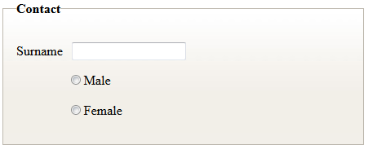
Custom Tags – Extending & Fixing Spring Spring tags generate only XHTML, but we love their functionality…
various tags generated by various tag libraries are compliant with the XHTML-1.0-Strict specification and usually not XHTML/HTML compatible, and mostly not able to produce pure HTML
Added label also for input=text
<xform:form modelAttribute="model">
..
<ul>
<li>
<xform:input path="surname" label="Surname" />
</li>
<li>
<xform:radiobuttons path="sex" items="${sex}" />
</li>
</ul>
..
</xform:form>

Slide 29
Custom Tags – Extending & Fixing Spring Our library wraps spring tags and generates also HTML
<FORM id="model" action="/app/test/xform" method="post">
<UL>
<LI>
<LABEL for="surname">Surname</LABEL>
<INPUT id="surname" name="surname" type="text" value="Black">
</LI>
<LI>
<SPAN>
<INPUT id="sex1" name="sex" type="radio" value="male" checked="checked">
<LABEL for="sex1">male</LABEL>
</SPAN>
<SPAN>
<INPUT id="sex2" name="sex" type="radio" value="female">
<LABEL for="sex2">female</LABEL>
</SPAN>
</LI>
</UL>
</FORM>
Notes:
TODO: screenshot

Slide 30
Custom Tags – Tag Files With solid markup base, you can now create HTML compounds
hCard adr (tag file example):
<jsp:root xmlns:jsp="http://java.sun.com/JSP/Page" version="2.0"
xmlns="http://gratex.com/gjaxXB/tags/html" >
<jsp:directive.attribute name="address" required="true" type="com.gratex.gjax.Address"/>
<div class="adr">
<span class="type">${address.type}</span>:
<div class="street-address">${address.street}</div>
<span class="locality">${address.locality}</span>,
<abbr class="region" title="${address.region}">
${address.region.abbr}
</abbr>
<span class="postal-code"> ${address.zip}</span>
<div class="country-name">${address.country}</div>
</div>
</jsp:root>

Slide 31
Custom Tags – Tag Files
.jsp:
<tag:address address="${address}"></tag:address>
output:
<DIV class="adr">
<SPAN class="type">Work</SPAN>:
<DIV class="street-address">169 University Avenue</DIV>
<SPAN class="locality">Palo Alto</SPAN>,
<ABBR class="region" title="California">CA</ABBR>
<SPAN class="postal-code"> 94301</SPAN>
<DIV class="country-name">USA</DIV>
</DIV>
Rendering (use different CSS to change layout not different markup !):
Work:
169 University Avenue
Palo Alto, CA 94301
USA
169 University Avenue, Palo Alto

Slide 32
Script Deferring Most of the components output inline handlers or scattered JavaScript blocks, …..both is wrong
Inline handlers
Script Blocks
Inline Event Handlers
33% of elements (608/1892) has Inline Event Handler (40699 bytes overhead) showclose(); navTrack('ocom','en','footer','privacy rights'); navTrack('ocom','en','footer','terms of use'); navTrack('ocom','en','footer','legal notices'); navTrack('ocom','en','footer','site maps'); navTrack('ocom','en','footer','contact us'); navTrack('ocom','en','footer','careers'); navTrack('ocom','en','footer','subscribe'); navTrack('ocom','en','footer','rss'); navTrack('ocom','en','footer','oracle and sun'); navTrack('ocom','en','footer','about oracle');
….
<div id="a12312"></div>
<script>a1234.validation="";</script>
<div id="b12312"></div>
<script>b1234.validation="";</script>
<div id="c12312"></div>
<script>c1234.validation="";</script>
<div id="d12312"></div>
<script>d1234.validation="";</script>
Notes:
TODO: lepsi priklad pre SCRIPT BLOCKS (INPUT)

Slide 33
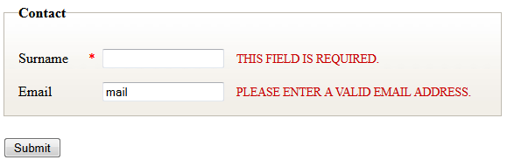
Script Deferring HTML 5 Forms source
<x:form action="/Samples/1" id="fm1">
…
<x:input label="Surname" name="surname" required="true"/>
<x:input label="Email" name="email" type="email" />
…
</x:form>
HTML4:
<LABEL for="surname">Surname<ABBR title="Required">*</ABBR></LABEL>
<INPUT id="surname" name="surname">
<LABEL for="email">Email</LABEL>
<INPUT id="email" name="email">
…
<SCRIPT type="text/javascript">
$(document).ready(function() {
$("#fm1").validate({
rules: { surname: {required:true},email: {email:true}}
});
});
</SCRIPT>
</BODY>

Slide 34
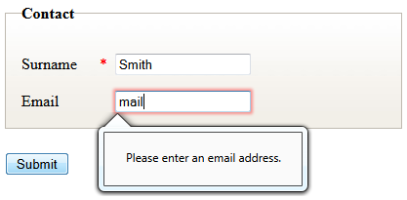
Script Deferring HTML 5 Forms source
<x:form action="/Samples/1" id="fm1">
…
<x:input label="Surname" name="surname" required="true"/>
<x:input label="Email" name="email" type="email" />
…
</x:form>
HTML5:
<LABEL for="surname">Surname<ABBR title="Required">*</ABBR></LABEL>
<INPUT id="surname" name="surname" required="required">
<LABEL for="email">Email</LABEL>
<INPUT id="email" name="email" type="email">

Slide 35
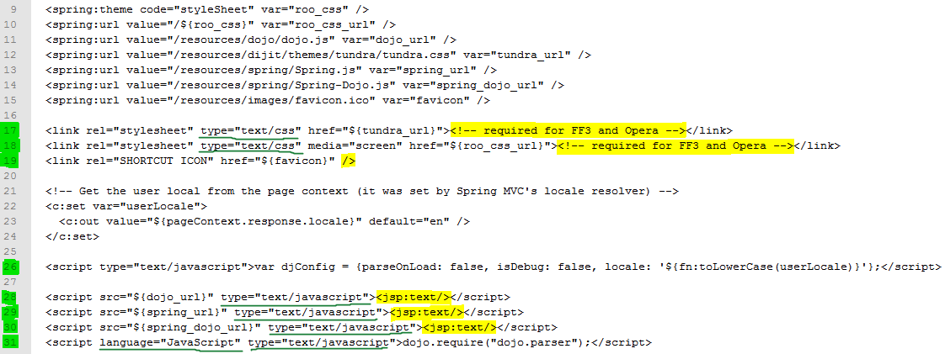
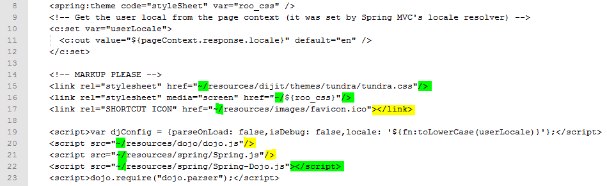
Reducing Markup Markup and model binding buried inside unreadable jspx source code
Half #lines for URL Building
Shorter lines (type=…)
Less <script></script> blocks
Label + Input is now one line
Meta charset omitted
…

Slide 36
Lightweight and Standalone
2 jars
GjaxTagLibrary (JSTL dep, to be removed)
GjaxTagLibrarySpring (Spring Forms extensions)
Use in
Simple JSP(X) based projects
Spring based projects
JSF or any frameworks using JSP(X) view engine
Extend/Combine using includes, tiles or tags

Slide 37
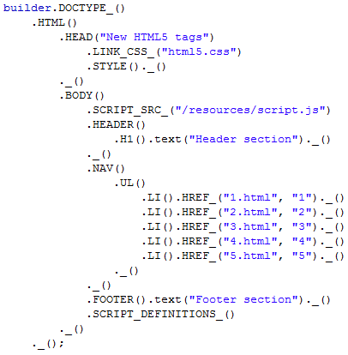
Alternative View Technology
Do you hate JSP ?
Do you hate other text based view engines ?
Love Java ? Refactoring ? Type Safety ?
Then have a look at our “HTML poetry” in Java:

Slide 38
Credits
Credits to my patient university (FIIT) students and colleagues
Adrián Rakovský
Zboroň Lukáš
Thanx to
Oracle – for invitation to this conference
Gratex International a.s – for allowing us to experiment and research

