Slide 1
Web Development for “Java Web Developers”
I’m Web Developer
“Java Web Developer”
=
Enemy of Web ?

Slide 2
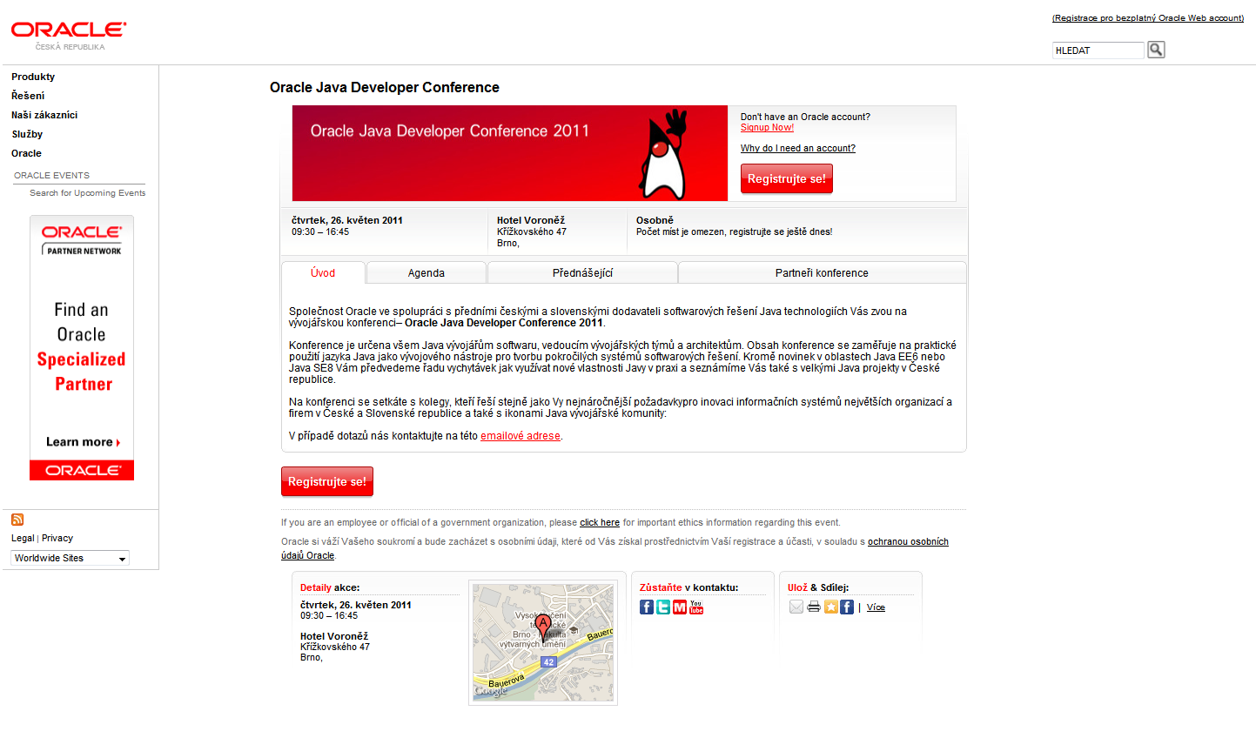
Demo Oracle Java Developer Conference – nice page ?

Slide 3
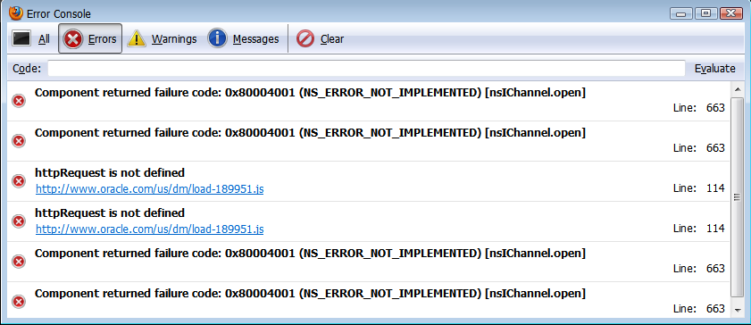
Demo Oracle Java Developer Conference – just errors, don’t want to see warnings !

Slide 4
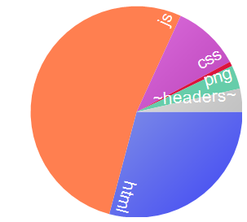
Demo Oracle Java Developer Conference – resources, network
RESPONSE BYTES (by Content-Type)
--------------
application/js: 227 910
text/html: 126 180
text/css: 44 584
application/png: 15 585
~headers~: 15 380
application/gif: 3 053
Request Count: 44
Bytes Sent: 26 444 (headers:26444; body:0)
Bytes Received: 432 692 (headers:15380; body:417312)

Slide 5
Demo Oracle Java Developer Conference – various raw markers
No DOCTYPE detected ?
BackCompat obsolette compatibility
Deprecated tag FONT
Deepest Nesting Level 45
9 comments found (226 bytes)
Inconsistent class naming conventions, 4 different conventions found
Duplicate IDs on the page
17 inline scripts found (6270 bytes of code is inline in the page)
1 Sensitive Script Accessible Cookies
Server Banner Found
0 lang attributes found
31 images (31/41) without alt found

Slide 6
Demo Oracle Java Developer Conference – usability, accessibility
Try to use the web site (to “register for conference”):
Without mouse
With CSS disabled
With JavaScript disabled
With small screen
With slow network

Slide 7
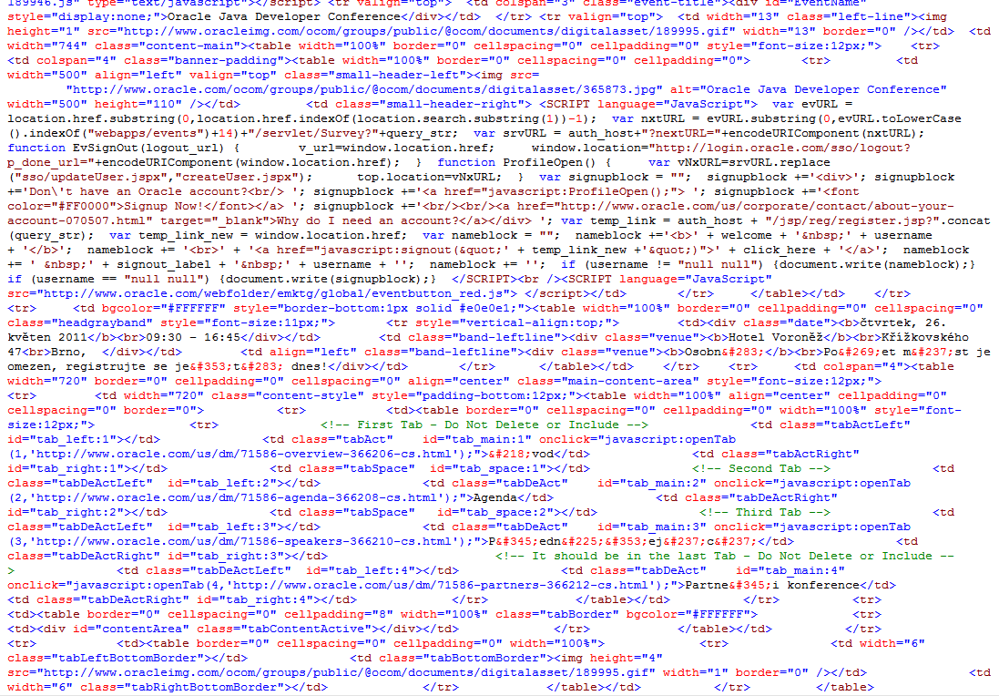
Demo Oracle Java Developer Conference – random code review

Slide 8
More horror very raw statistics
Bad (mix from MS, Oracle, IBM, Apple)
Size calculated from serialized DOM is: 139406
Deepest Nesting Level 24
63% of elements (1074/1726) has css class specified (29385 bytes overhead)
24% of elements (240/1025) has ID specified (4710 bytes overhead)
39% of elements (666/1726) are DIVs and SPANs (10392 bytes overhead)
61 images (61/73) without alt found
174 comments found (4167 bytes)
Duplicate IDs on the page
36% of elements (595/1665) has Inline Event Handler (40072 bytes overhead)
16 inline scripts found (12969 bytes of code is inline in the page)
Lot of info ? NO just bad markup !
Really bad markup, crashes VS 2010 ;-)
Learn some CSS please !
So many scriptable elements? id based CSS?
Better than tables, try also old <P>
Content or decoration ? CSS background ?
Thanx for waste and hacking hints
Super-long ids and still have duplicates ?
DHTML Lower or bad components ?
12K of code unique per page/request ?

Slide 9
Java Web Developers Enemies Of Web
All this horror is “supported” by most of the “commercial Java Web Development Frameworks” abstracting away from
HTML, HTTP, URI, CSS, JavaScript and other Web Technologies
Created and used by
Coders hopefully educated in Java and OO but
But almost surely uneducated in Web

Slide 10
Personal Findings:
HIGHER
server side Java framework
more
Web Best Practices
broken

Slide 11
Java Web Developers Enemies Of Web
Java “Web Developer”
Web Developer
Components, Abstractions
Generated client scripts, server side “ajaxified” components
Inline Styles (by CMS) customization, presentation class names
Everything is POST
Defaults: 200, 500, 404
Generated links, single URI APPs
What ? Oh, text version
Use mobile framework and tools
By more servers and bandwidth
Code = Java, Templates, Libraries
Semantic HTML Markup
Unobtrusive JavaScript, client side XB libraries
Progressive Enhancement with CSS, semantic CSS class names, markup independence
HTTP Method Semantics
HTTP Error Codes
URI design and semantics
Design for Accessibility
Responsive Design
Page Load Performance
Code: HTML, CSS, JS, HTTP

Slide 12
Personal Findings
Bottom-Up Web Development
is harmful
Top-down design
is not supported well
by
main stream
frameworks and tools

Slide 13
Can We Find Common Language ? Java Web Developers vs. Web Developers
HTML Markup
Language of Web
Language of Browsers
and
Language of Machines

Slide 14
Solution Starts With:
Learn HTML
and
Write HTML
in
HTML

Slide 15
What is HTML ?
JSP Page, .jsp
Free Syntax
HTML 4
SGML Syntax
Text/html
Legacy
Browsers
XML Machines
JSPX Page, .jspx
XML Syntax
XHTML 1.0, 1.1
XML Syntax
application/xhtml+xml
MSIE 7,8
Ajax, XML (+XSLT)
XHTML 1.0, 1.1
XML Syntax + Comp.
text/html
Ajax, DOM+CSS Sel.
HTML5
HTML Syntax
Common
Browsers
Ajax, DOM+CSS Sel.
HTML5
XML Syntax
MSIE 9
Code
Streams, Builders, Components
Edge
Browsers
HTML5
XML Syntax+Comp.
Notes:
HTML + Browsers appeared
And of course worked together
JSP has been invented
to generate HTML from Java
At that time we also had Code (Servlets, CGI)
to generate HTML, usually using streams or simple builders
XML became popular and XML Machines greedy to parse HTML appeared,
they could but with troubles
So they have invented XHTML and JSPX
XML Machines could be happy
And good browsers used XML syntax for stricter parsing and error reporting
But Evil MSIE
Did not support XHTML content-type
Luckily there has been an option called Compatibility Guideline (Appendix of XHTML) which allows to send XML syntax over text/html. We call this XHTML/HTML (read XHTML over HTML content-type).
This is understood by MSIE. But your tags MUST follow certain rules. If the don’t, MSIE
as well as common browsers will display blank page, do not download script or create invalid DOM. Also Strict error handling is OFF in this case.
To generate XML or XML+Comp from JSP is easy, requires only discipline. Stricter syntax of XML+Comp renders lax, full XML syntax useless.
MS Client Side Developers could benefit from XML syntax, because MS Browser supported well XML, XSLT development (with XHR+MSXML default parser),
just content type was (is) wrong (text/xml required)
Then JSPX. I don’t get the reason to have XML strict markup on server. Maybe to generate and manupulate source code but it brought more trouble then benefit in this context.
While it is easy to generate XHTML
It is almost impossible to generate HTML from XML syntax (text tricks needed)
And to generate XHTML+Comp. it requires tricks (even with Cross Container differencies).
Looking at this, the Code is still immune to big troubles, and difficulties exists only in duplicated code for each markup.
While MSIE invested mostly into XML, others invested into CSS selectors and native DOM manipulations.
The Ajax Stack actually started to prefer HTML or XHTML/HTML format. But worked well with all 3.
While MSIE failed miserably with direct XML syntax insertion into HTML dom.
Then: HTML5, 2+1 syntaxes ?
Technology Edge browsers
And MSIE 9,
Should not have any trouble with all syntaxes
XML machines can consume HTML5 XML Syntax
To generate HTML 5 from JSP , JSPX and CODE the same applies. JSP and code, OK but duplicit code.
From JSPX, HTML almost impossible
XML syntax OK
XML+Compat. Possible but quirks
Now usability of HTML 5 in older browsers: MSIE 8 and XML Syntax : impossible
HTML Syntax with new tags, possible only with client side JS polyfil (html5shim)
Same
This is almost complete mess (could be simplified, many are duplicit) but there are 3 basic outcomes:
To make everyone happy, you must produce multiple representations (markup syntax+content-type) and have redundant code.
HTML syntax OK (only XML machines complain)
XML syntax without Comp. is redundant, use XML+Comp. always
JSPX is harmful
Almost Fixed, hard to change decision about server markup, client markup, content type
Redundant and quirky code

Slide 16
Coding with HTML 5 tags
JSP: XML | HTML syntax
JSPX: XML syntax
JSP/JSPX/TAG/TAGX mix
Configured, Explicit, Request Bases
Tags, Syntax, Content-Type
Any output with single code
No Duplicate Codes
No Quirk Codes
No Fixed Decisions
All Satisfied ?
Including w3 validator ?
JSP Page, .jsp
Free Syntax
HTML5
Tag Lib
+
HTML5
HAIKU
?
Legacy
Browsers
HTML 4
XHTML 1.0, 1.1,2.0
HTML 5
XML Machines
JSPX Page, .jspx
XML Syntax
MSIE 7,8
SGML
XML
Ajax, XML (+XSLT)
XML+Compat
Ajax, DOM+CSS Sel.
Tiles2
SGML Optimized
Spring
XML Optimized
Common
Browsers
JSF
text/html
Ajax, DOM+CSS Sel.
JEE Codes
Streams, Builders, Components
application/xhtml+xml
text/xml
MSIE 9
…
Edge
Browsers
JSE Code
Notes:
HTML and Browsers appeared
And of course worked together
JSP has been invented
to generate HTML from Java
At that time we also had Code (Servlets, CGI)
to generate HTML, usually using streams or simple builders
XML became popular and XML Machines greedy to parse HTML appeared,
they could but with troubles
So they have invented XHTML and JSPX
XML Machines could be happy
And good browsers used XML syntax for stricter parsing and error reporting
But Evil MSIE
Did not support XHTML content-type
Luckily there has been an option called Compatibility Guideline (Appendix of XHTML) which allows to send XML syntax over text/html. We call this XHTML/HTML (read XHTML over HTML content-type).
This is understood by MSIE. But your tags MUST follow certain rules. If the don’t, MSIE
as well as common browsers will display blank page, do not download script or create invalid DOM. Also Strict error handling is OFF in this case.
To generate XML or XML+Comp from JSP is easy, requires only discipline. Stricter syntax of XML+Comp renders lax, full XML syntax useless.
MS Client Side Developers could benefit from XML syntax, because MS Browser supported well XML, XSLT development (with XHR+MSXML default parser), just content type was (is) wrong (text/xml required)
Then JSPX. I don’t get the reason to have XML strict markup on server. Maybe to generate and manupulate source code but it brought more trouble then benefit in this context.
While it is easy to generate XHTML
It is almost impossible to generate HTML from XML syntax (text tricks needed)
And to generate XHTML+Comp. it requires tricks (even with Cross Container differencies).
Looking at this, the Code is still immune to big troubles, and difficulties exists only in duplicated code for each markup.
While MSIE invested mostly into XML, others invested into CSS selectors and native DOM manipulations.
The Ajax Stack actually started to prefer HTML or XHTML/HTML format. But worked well with all 3.
While MSIE failed miserably with direct XML syntax insertion into HTML dom.
Then: HTML5, 2+1 syntaxes ?
Technology Edge browsers
And MSIE 9,
Should not have any trouble with all syntaxes
XML machines can consume HTML5 XML Syntax
To generate HTML 5 from JSP , JSPX and CODE the same applies. JSP and code, OK but duplicit code.
From JSPX, HTML almost impossible
XML syntax OK
XML+Compat. Possible but quirks
Now usability of HTML 5 in older browsers: MSIE 8 and XML Syntax : impossible
HTML Syntax with new tags, possible only with client side JS polyfil (html5shim)
Same
This is almost complete mess (could be simplified, many are duplicit) but there are 3 basic outcomes:
To make everyone happy, you must produce multiple representations (markup syntax+content-type) and have redundant code.
HTML syntax OK (only XML machines complain)
XML syntax without Comp. is redundant, use XML+Comp. always
JSPX is harmful
Almost Fixed, hard to change decision about server markup, client markup, content type
Redundant and quirky code

Slide 17
Web Development for “Java Web Developers”
Reasonable
HTML Markup
with
HTML5TagLib and HTML5DSL

Slide 18
HTML5TagLib
+
HTML5DSL (HAIKU)
JSP Tag Library and Java API
to
clean your server code
and
client markup

Slide 19
Feature List
One Server Side Markup - Multiple outputs
JSPX producing XHTML/HTML and HTML
XHTML/HTML Compatibility Guidelines
“Full” XHTML
HTML5
XHTML5 (Full XHTML, polyglot)
HTML5 server side tags – No Abstraction Needed
Simplification
Hide differences (HTML4, XHTML, HTML5)
Backward compatibility
TIME tag Formatting Support,
And more tags to come …

Slide 20
Feature List
Suppress Bad Practices
Content-Type, Charset, DOCTYPE Consistency
Removable client comments
Deprecated tags
Auto-generate required defaults
Warnings/errors for incomplete/incorrect tags
Satisfy W3C Validation
Empty self closing tags (HTML Compatibility Guidelines)
Prevent Minimization

Slide 21
Feature List
XML/HTML Escaping
Automatic attribute value escaping
innerText, innerHtml server side attributes
Correct (X)HTML escaping (SMP, entities, charset switching)
URI Reference Building Support
ContextPath (~/,//~,://~)
template parameters in <a>, <link>, etc. (available only in spring)
Server Side CSS classes
Modify/extend markup based on CSS class
Integrate with client CSS

Slide 22
Feature List
Custom tags (code, tagx)
XHTML Compounds
Extend/Fix Spring Tags
Output client side JavaScript fragments
HTML5 Form Tags (with polyfills)
Accessibility aware tags
Extended INPUT with LABEL attribute, that put LABEL tag according to type (radio, checkbox ==> right) (http://www.w3.org/TR/2008/NOTE-WCAG20-TECHS-20081211/G162)
Automatic TH scope in tables (<table class="scope_auto">) (http://www.w3.org/TR/WCAG20-TECHS/H63)
Microformats
Integration/Coexistence with 3party
Lightweight and standalone (JSTL)
Tiles2, Spring, JSF or other integration

Slide 23
Feature List
Streaming markup - minimized needed server side buffering
Script deferring
Joining multiple inline scripts
Placing scripts at the end of body
Reducing markup size (experimental)
Omitting end tags in HTML
Minimizing tags in XHTML

Slide 24
Feature List
Alternative View Technologies
Enemy of JSP View Layer ?
Try HTML5DSL (HAIKU) !

Slide 25
HTML5TagLib
+
HTML5DSL (HAIKU)
Basic
Samples

Slide 26
JSPX producing XHTML/HTML and HTML Typical JSPX Source Code (buggy)
<jsp:root xmlns:jsp="http://java.sun.com/JSP/Page" version="2.0">
<jsp:directive.page language="java"
contentType="text/html; charset=UTF-8" pageEncoding="UTF-8" />
<jsp:output doctype-root-element="html"
doctype-system="http://www.w3.org/TR/xhtml1/DTD/xhtml1-transitional.dtd"
doctype-public="-//W3C//DTD XHTML 1.0 Transitional//EN" />
<html xmlns="http://www.w3.org/1999/xhtml">
<head>
<title>${title}</title>
<meta content="text/html; charset=UTF-8" http-equiv="Content-Type" />
</head>
<body>
<script type="text/javascript" src="script.js"></script>
<script type="text/javascript">alert('message');</script>
</body>
</html>
</jsp:root>
Notes:
Fixed decision for ContentType, charset and doctype
Anti DRY
No consistency check contentType-doctype combination

Slide 27
JSPX producing XHTML/HTML and HTML Typical JSPX output (buggy)
<!DOCTYPE html PUBLIC "-//W3C//DTD XHTML 1.0 Transitional//EN" "http://www.w3.org/TR/xhtml1/DTD/xhtml1-transitional.dtd">
<html xmlns="http://www.w3.org/1999/xhtml">
<head>
<title/>
<meta content="text/html; charset=UTF-8" http-equiv="Content-Type"/>
</head>
<body>
<script src="script.js" type="text/javascript"/>
<script type="text/javascript">alert('message');</script>
</body>
</html>

Slide 28
JSPX producing XHTML/HTML and HTML Our JSPX Source Code…..Easy
TAGLIB->Correct XHTML/HTML
<jsp:root xmlns:jsp="http://java.sun.com/JSP/Page" version="2.0“
xmlns="http://gratex.com/gjaxXB/tags/html" >
<DOCTYPE/>
<html>
<head>
<title>${title}</title>
</head>
<body>
<script src="script.js“ />
<script>alert('message');</script>
</body>
</html>
</jsp:root>
Notes:
No commitment for doctype or contentType, charset
No redundancy
No care about minimized non minimized form of tags
Simplified Tag syntax (ala HTML5)
No risk of empty ${title}

Slide 29
JSPX producing XHTML/HTML and HTML Our JSPX XHTML Output…..Correct
<!DOCTYPE html PUBLIC "-//W3C//DTD XHTML 1.0 Strict//EN" "http://www.w3.org/TR/xhtml1/DTD/xhtml1-strict.dtd">
<html xmlns="http://www.w3.org/1999/xhtml">
<head>
<title></title>
<meta http-equiv="Content-Type" content="text/html;charset=UTF-8" />
</head>
<body>
<script type="text/javascript" src="script.js"></script>
<script type="text/javascript">
/*<![CDATA[*/alert('message');/*]]>*/</script>
</body>
</html>
web.xml:
<context-param>
<param-name>com.gratex.gjaxXB.tags.html.markup</param-name>
<param-value>XHTML</param-value>
</context-param>

Slide 30
JSPX producing XHTML/HTML and HTML Our JSPX HTML Output…..Correct
<!DOCTYPE HTML PUBLIC "-//W3C//DTD HTML 4.01//EN" "http://www.w3.org/TR/html4/strict.dtd">
<HTML>
<HEAD>
<TITLE></TITLE>
<META http-equiv="Content-Type" content="text/html;charset=UTF-8">
</HEAD>
<BODY>
<SCRIPT type="text/javascript" src="script.js"></SCRIPT>
<SCRIPT type="text/javascript">alert('message');</SCRIPT>
</BODY>
</HTML>
web.xml:
<context-param>
<param-name>com.gratex.gjaxXB.tags.html.markup</param-name>
<param-value>HTML4</param-value>
</context-param>

Slide 31
JSPX producing XHTML/HTML and HTML Fix problems without taglibrary
Without HTML5TagLib = JSPX hacking
(Optional Homework,
beware Cross Container Differences)

Slide 32
Content-Type, Charset, Consistency Choice is yours… source code
JSPX:
<DOCTYPE markup="HTML4" encoding="UTF-8"/>
<html>
<head>
<title>Content-Type Sample</title>
</head>
HTML:
<!DOCTYPE HTML PUBLIC "-//W3C//DTD HTML 4.01//EN"
"http://www.w3.org/TR/html4/strict.dtd">
<HTML>
<HEAD>
<TITLE>META sample</TITLE>
<META content="text/html;charset=UTF-8“ http-equiv="Content-Type">
</HEAD>
HTTP response:
HTTP/1.1 200 OK
Content-Type: text/html;charset=UTF-8

Slide 33
Content-Type, Charset, Consitency Choice is yours… or web config
web.xml:
<context-param>
<param-name>com.gratex.gjaxXB.tags.html.encoding</param-name>
<param-value>UTF-8</param-value>
</context-param>
<context-param>
<param-name>com.gratex.gjaxXB.tags.html.markup</param-name>
<param-value>HTML4</param-value>
</context-param>
.jsp:
<DOCTYPE/>
<html>
<head>
<title>META sample</title>
</head>

Slide 34
HTML5 Source – HTML 5/4 Output Demo for simplification and backward compatibility
<DOCTYPE markup="HTML5" />
<html>
<head>
<title>HTML5 test</title>
<style>
body { background-color: gray; }
</style>
</head>
<body>
<header>Header section</header>
<article>Page content</article>
<footer>
<time>2011-05-08 12:05:25</time>
</footer>
<script src="/resources/script.js" />
</body>
</html>
<!DOCTYPE HTML>
<HTML>
<HEAD>
<TITLE>HTML5 test</TITLE>
<META charset="UTF-8">
<STYLE>
body { background-color: gray; }
</STYLE>
</HEAD>
<BODY>
<HEADER>Header section</HEADER>
<ARTICLE>Page content</ARTICLE>
<FOOTER>
<TIME>2011-05-08 12:05:25</TIME>
</FOOTER>
<SCRIPT src="/res/script.js"></SCRIPT>
</BODY>
</HTML>

Slide 35
HTML5 Source – HTML 5/4 Output Demo for simplification and backward compatibility
<DOCTYPE markup="HTML4" />
<html>
<head>
<title>HTML5 test</title>
<style>
body { background-color: gray; }
</style>
</head>
<body>
<header>Header section</header>
<article>Page content</article>
<footer>
<time>2011-05-08 12:05:25</time>
</footer>
<script src="/resources/script.js" />
</body>
</html>
<!DOCTYPE HTML PUBLIC "-//W3C//DTD HTML 4.01//EN"
"http://www.w3.org/TR/html4/strict.dtd">
<HTML>
<HEAD>
<TITLE>HTML5 test</TITLE>
<META http-equiv="Content-Type"
content="text/html;charset=UTF-8">
<STYLE type="text/css">
body { background-color: gray; }
</STYLE>
</HEAD>
<BODY>
<DIV class="html5-header">Header section</DIV>
<DIV class="html5-article">Page content</DIV>
<DIV class="html5-footer">
<SPAN class="html5-time">2011-05-08 12:05:25</SPAN>
</DIV>
<SCRIPT type="text/javascript"
src="/resources/script.js"></SCRIPT>
</BODY>
</HTML>
Notes:
In HTML5 you don’t see too much
Wait for HTML4 !

Slide 36
HTML5 Tags – TIME We generate localized text content and add typed support
3 attributes of type Calendar or Date
<x:time datetime="${date}"/>
<x:time datetime="${calendar}"/> (calendar with EST TZ)
<x:time date="${date}" />
<x:time time="${date}"/>
Locales (sk-SK) + User TimeZone (Europe/Bratislava) are in request attributes:
<TIME datetime="2011-05-16T09:39:20+02:00">16.5.2011 9:39</TIME>
<TIME datetime="2011-05-16T09:39:20+02:00">16.5.2011 9:39</TIME>
<TIME datetime="2011-05-16">16.5.2011</TIME>
<TIME datetime="09:39:20">9:39</TIME>
User TimeZone not specified:
<TIME datetime="2011-05-16T07:59:54+00:00">16.5.2011 7:59 GMT</TIME>
<TIME datetime="2011-05-16T02:59:54-05:00">16.5.2011 2:59 EST</TIME>

Slide 37
XML/HTML Escaping
XML/HTML Escaping
Automatic attribute value escaping
innerText, innerHtml server side attributes
View:
Without taglib:
<div class="${fn:escapeXml('a&b')}"><c:out value="${plainText}" /></div>
With taglib:
<div class="a&b" innerText="${plainText}“/>
Controller:
mav.addObject("plainText", "<P>plain text</P>");
Output:
<DIV class="a&amp;b">&lt;P&gt;plain text&lt;/P&gt;</DIV>
Notes:
Mergni nasledovne 3 slides please

Slide 38
XML/HTML Escaping
XML/HTML Escaping
Automatic attribute value escaping
innerText, innerHtml server side attributes
Controller:
@RequestMapping(value = "/test/escaping")
public ModelAndView innerTest() {
ModelAndView mav=new ModelAndView("/escaping");
mav.addObject("plainText", "<P>plain text</P>");
mav.addObject("htmlContent", "<P>html content</P>");
return mav;
}

Slide 39
XML/HTML Escaping
XML/HTML Escaping
Automatic attribute value escaping
innerText, innerHtml server side attributes
Output:
<DIV class="a&amp;b">
&lt;P&gt;plain text&lt;/P&gt;
</DIV>

Slide 40
Client Side HTML Comments
<! – section 1 -->
Useful for client side “debugging”
Different syntax in JSP, JSPX
CWE-615: Information Leak Through Comments
XSS Attacks on Comments
Size overhead

Slide 41

Client Side HTML Comments horror samples from reality
Example: example.shop.cz
<!-- 7E975C04D5 like '%test%') 97E975C04D5 like '%test%') and IsNull(LevelsVisibility.Hidden, 0) = 0 And IsNull(LevelsVisibility2.Hidden, 0) = 0 AND (IsNull(Store.Hidden,0) = 0) and ( ((Levels.Department_ID is Null or Levels.Department_ID=2) and (Levels.Categorization_ID=3)) OR (Levels.Department_ID is not Null and Levels.Department_ID<>2) ) GROUP BY Store.ItemID ) as S1 LEFT JOIN Store WITH (NOLOCK) ON S1.ItemID = Store.ItemID LEFT JOIN Orders WITH (NOLOCK) ON Orders.ItemID = Store.ItemID AND IsNull(Orders.OrderNumber,0)=0 AND IsNull(Orders.GroupOrder,0)=0 AND Orders.SessionID=623438626 ORDER BY -IsNull(Store.StayOnTop,0), Category, S1.Level_ID, Store.Producer ASC, Store.Name, Store.CatalogueNumber
….
Generating : 00:00,250
ConnectingTime : 00:00,000
OpeningTime : 00:00,078
GettingLevelProps : 00:00,000
SearchingLevelProps : 00:00,000
LoadingValues : 00:00,032
GettingText : 00:00,046
TotalItems : 107
SearchedItems : 1
CachedItems : 22
LoadedItems : 109
Count of opening children : 1
Cached time = 00:00,015
Total time = 00:00,015 …. -->
Example: www.oracle.com
183 comments found (4403 bytes)
SS_BEGIN_SNIPPET(fragment3,head_tags) SS_END_SNIPPET(fragment3,head_tags) <link media="screen" href="/ocom/fragments/externalnavhorizontal/horiz-nav.css" type="text/css" rel="stylesheet" /> SS_BEGIN_SNIPPET(fragment3,code) SS_END_SNIPPET(fragment3,code) SS_BEGIN_SNIPPET(fragment14,ocom translation) ** retrieve cache lifespan parameter: ** **override root for testing purposes:** ** Header Logo ** ** Header Search ** ** Welcome SignIn ** ** Footer ** ** Header Logo ** MOSAIC Communities User Category User Intrest Navigation starts here User Community SC code User Category SC code User Interest SC code SS_END_SNIPPET(fragment14,ocom translation) SS_BEGIN_SNIPPET(fragment22,ocom translation) ** retrieve cache lifespan parameter: ** **override root for testing purposes:** ** Header Logo ** ** Header Search ** ** Welcome SignIn ** ** Footer ** ** Header Logo ** MOSAIC Communities User Category User Intrest Navigation starts here User Community SC code User Category SC code User Interest SC code Date: 7 Sep 2010 Author: Girish Gowdar, web Technology Comment : Logo img url and link customized. Variable declared in each Country translation file if need to customize. SS_END_SNIPPET(fragment22,ocom translation) SS_BEGIN_SNIPPET(fragment15,ocom translation) ** retrieve cache lifespan parameter: ** **override root for testing purposes:**

Slide 42
Removable HTML Comments Funny tag <_>, same syntax in .jsp and .jspx, turn them all on/off
.jsp:
…
<body>
<div><_>This is a comment.</_></div>
</body>
…
web.xml:
…
<context-param>
<param-name>
com.gratex.gjaxXB.tags.html.commentsOutput
</param-name>
<param-value>true</param-value>
</context-param>
…
Output:
…
<BODY>
<DIV></DIV>
</BODY>
…
Output:
…
<BODY>
<DIV><!--This is a comment.--></DIV>
</BODY>
…

Slide 43
URI Reference Building Support
How much code do you need to generate
8 lines of correct <script><script> and <link/> tags ?
Spring-Roo: 16
HTML5TagLib: 8
Expected output:
<SCRIPT type="text/javascript" src="/SampleRooMvc/resources/spring/Spring-Dojo.js">
</SCRIPT>
Spring (or JSTL) style:
<spring:url value="/resources/spring/Spring-Dojo.js" var="spring_dojo_url" />
<script src="${dojo_url}" type="text/javascript"><jsp:text/></script>
Our Style:
<script src="~/resources/spring/Spring-Dojo.js"/>
Spring Roo – complete load-scripts.tagx code review avaliable in: samples\Spring-Roo-Load-Script

Slide 44

Server Side CSS classes avoid new attributes, reuse css classes, generate semantics
.jspx:
<table class="th-scope-auto">
<thead>
<tr>
<td></td>
<th>Bolts</th>
<th>Nuts</th>
<th>Screws</th>
</tr>
</thead>
<tbody>
<tr>
<th>Wholesale</th>
<td>$1.00</td>
<td>$1.25</td>
<td>$1.20</td>
</tr>
<tr>
<th>Retail</th>
<td>$2.00</td>
<td>$3.00</td>
<td>$1.80</td>
</tr>
</tbody>
</table>
output:
<TABLE class="th-scope-auto">
<THEAD>
<TR>
<TD></TD>
<TH scope="col">Bolts</TH>
<TH scope="col">Nuts</TH>
<TH scope="col">Screws</TH>
</TR>
</THEAD>
<TBODY>
<TR>
<TH scope="row">Wholesale</TH>
<TD>$1.00</TD>
<TD>$1.25</TD>
<TD>$1.20</TD>
</TR>
<TR>
<TH scope="row">Retail</TH>
<TD>$2.00</TD>
<TD>$3.00</TD>
<TD>$1.80</TD>
</TR>
</TBODY>
</TABLE>

Slide 45
Custom Tags – Extending & Fixing Spring Spring tags generate only XHTML, but we love their functionality…
various tags generated by various tag libraries are compliant with the XHTML-1.0-Strict specification and usually not XHTML/HTML compatible, and mostly not able to produce pure HTML
Added label also for input=text
<xform:form modelAttribute="model">
<ul>
<li>
<xform:input path="surname" label="Surname" />
</li>
<li>
<xform:radiobuttons path="sex" items="${sex}" />
</li>
</ul>
</xform:form>

Slide 46
Custom Tags – Extending & Fixing Spring Our library wraps spring tags and generates also HTML
<FORM id="model" action="/app/test/xform" method="post">
<UL>
<LI>
<LABEL for="surname">Surname</LABEL>
<INPUT id="surname" name="surname" type="text" value="Black">
</LI>
<LI>
<SPAN>
<INPUT id="sex1" name="sex" type="radio" value="male" checked="checked">
<LABEL for="sex1">male</LABEL>
</SPAN>
<SPAN>
<INPUT id="sex2" name="sex" type="radio" value="female">
<LABEL for="sex2">female</LABEL>
</SPAN>
</LI>
</UL>
</FORM>

Slide 47
Custom Tags – Tag Files With solid markup base, you can now create HTML compounds
hCard adr (tag file example):
<jsp:root xmlns:jsp="http://java.sun.com/JSP/Page" version="2.0"
xmlns="http://gratex.com/gjaxXB/tags/html" >
<jsp:directive.attribute name="address" required="true" type="com.gratex.gjax.Address"/>
<div class="adr">
<span class="type">${address.type}</span>:
<div class="street-address">${address.street}</div>
<span class="locality">${address.locality}</span>,
<abbr class="region" title="${address.region}">
${address.region.abbr}
</abbr>
<span class="postal-code"> ${address.zip}</span>
<div class="country-name">${address.country}</div>
</div>
</jsp:root>
Notes:
TODO: tu sme skoncili review v stredu

Slide 48
Custom Tags – Tag Files
.jsp:
<tag:address address="${address}"></tag:address>
output:
<DIV class="adr">
<SPAN class="type">Work</SPAN>:
<DIV class="street-address">169 University Avenue</DIV>
<SPAN class="locality">Palo Alto</SPAN>,
<ABBR class="region" title="California">CA</ABBR>
<SPAN class="postal-code"> 94301</SPAN>
<DIV class="country-name">USA</DIV>
</DIV>
Rendering (use different CSS to change layout not different markup !):
Work:
169 University Avenue
Palo Alto, CA 94301
USA

Slide 49
Script Deferring Most of the components output inline handlers or scattered JavaScript blocks, …..both is wrong
Inline handlers
Script Blocks
Inline Event Handlers
33% of elements (608/1892) has Inline Event Handler (40699 bytes overhead) showclose(); navTrack('ocom','en','footer','privacy rights'); navTrack('ocom','en','footer','terms of use'); navTrack('ocom','en','footer','legal notices'); navTrack('ocom','en','footer','site maps'); navTrack('ocom','en','footer','contact us'); navTrack('ocom','en','footer','careers'); navTrack('ocom','en','footer','subscribe'); navTrack('ocom','en','footer','rss'); navTrack('ocom','en','footer','oracle and sun'); navTrack('ocom','en','footer','about oracle');
….
<div id="a12312"></div>
<script>a1234.validation="";</script>
<div id="b12312"></div>
<script>b1234.validation="";</script>
<div id="c12312"></div>
<script>c1234.validation="";</script>
<div id="d12312"></div>
<script>d1234.validation="";</script>

Slide 50
Script Deferring Most of the components output inline handlers or scattered JavaScript blocks, out tags output smart snippets, deferred to script block before </BODY>
.jspx
<x:form action="/Samples/1" id="fm1">
<x:input label="Surname" name="surname" required="true"/>
<x:input label="Email" name="email" type="email" />
HTML4:
<LABEL for="surname">Surname<ABBR title="Required">*</ABBR></LABEL>
<INPUT id="surname" name="surname">
<LABEL for="email">Email</LABEL>
<INPUT id="email" name="email">
<SCRIPT type="text/javascript">
$(document).ready(function() {
$("#fm1").validate({
rules: {
surname: {required:true},
email: {email:true}}
});
});
</SCRIPT></BODY>
Notes:
TODO: rozanimovat po polickach

Slide 51
Script Deferring HTML 5 Forms source
<x:form action="/Samples/1" id="fm1">
<x:fieldset legend="Contact">
<x:input label="Surname" name="surname" required="true"/>
<x:input label="Email" name="email" type="email" />
</x:fieldset>
<div>
<input type="submit" value="Submit" />
</div>
</x:form>

Slide 52
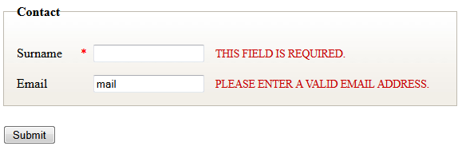
Script Deferring producing HTML 4 + unobtrusive and compact JS Code
HTML4:
<LI>
<LABEL for="surname">Surname<ABBR title="Required">*</ABBR></LABEL>
<INPUT id="surname" name="surname">
</LI>
<LI>
<LABEL for="email">Email</LABEL>
<INPUT id="email" name="email">
</LI>
…
<SCRIPT type="text/javascript">
$(document).ready(function() {
$("#fm1").validate({
rules: { surname: {required:true},email: {email:true}}
});
});
</SCRIPT>
</BODY>
Notes:
TODO: rozanimovat po polickach

Slide 53
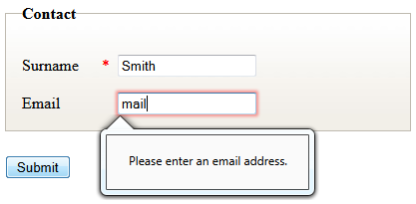
Script Deferring producing HTML 5 + optional JS Code
HTML5:
<LI>
<LABEL for="surname">Surname<ABBR title="Required">*</ABBR></LABEL>
<INPUT id="surname" name="surname" required="required">
</LI>
<LI>
<LABEL for="email">Email</LABEL>
<INPUT id="email" name="email" type="email">
</LI>
…
<SCRIPT type="text/javascript">
$(document).ready(function() {
$("#fm1").validate({
rules: { surname: {required:true},email: {email:true}}
});
});
</SCRIPT>

Slide 54
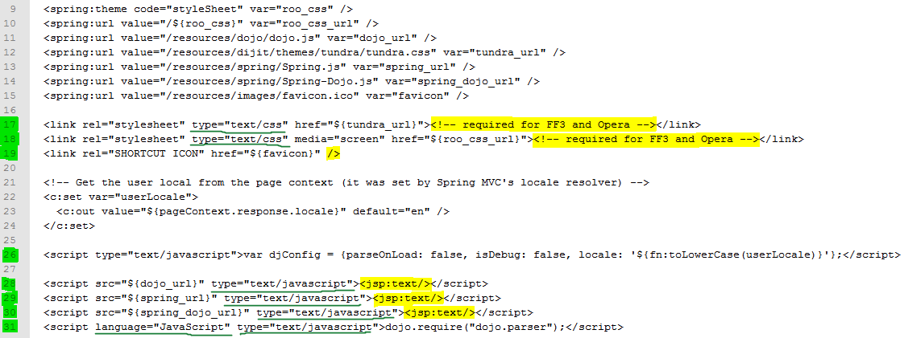
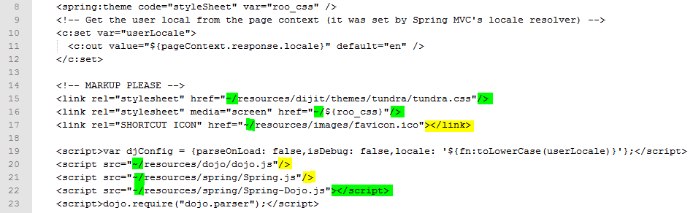
Reducing Markup Markup and model binding buried inside unreadable jspx source code
Half #lines for URL Building
Shorter lines (type=…)
Less <script></script> blocks
Label + Input is now one line
Meta charset omitted
Optional attributes omitted
…

Slide 55
Lightweight and Standalone
2 jars
GjaxTagLibrary (JSTL dep, to be removed)
GjaxTagLibrarySpring (Spring Forms extensions)
Use in
Simple JSP(X) based projects
Spring based projects
JSF or any frameworks using JSP(X) view engine
Extend/Combine using includes, tiles or tags

Slide 56
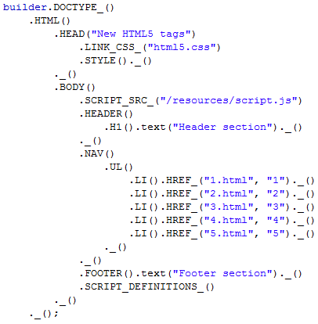
Alternative View Technology
Do you hate JSP ?
Do you hate other text based view engines ?
Love Java ? Refactoring ? Type Safety ?
Then have a look at our “HTML poetry” in Java:

Slide 57
Web Development for “Java Web Developers”
HTML5DSL
Writing markup with Java code

Slide 58
Intro
DOCTYPE_()
.HTML()
.HEAD("HTML5DSL")
.STYLE()._()
._()
.BODY()
.HEADER()
.H1().text("Header section")._()
._()
.NAV()
.UL()
.LI().HREF_("index.html ", “Home")._()
.LI().HREF_("info.html ", “Info")._()
.LI().HREF_("about.html ", “About")._()
.LI().HREF_("help.html ", “Help")._() ._()
._()
.FOOTER()
.text("Footer section")
._()
._()
._();
<!DOCTYPE html>
<HTML>
<HEAD>
<META charset="utf-8">
<TITLE>HTML5DSL</TITLE>
<STYLE></STYLE>
</HEAD>
<BODY>
<HEADER>
<H1>Header section</H1>
</HEADER>
<NAV>
<UL>
<LI><A href="index.html">Home</A></LI>
<LI><A href="info.html">Info</A></LI>
<LI><A href="about.html">About</A></LI>
<LI><A href="help.html">Help</A></LI>
</UL>
</NAV>
<FOOTER>
Footer section
</FOOTER>
</BODY>
</HTML>
Notes:
Text source code

Slide 59
Readable markup in java code
Functions named by tags
Method chaining
Code Formatting
DOCTYPE_()
.HTML()
.HEAD("HTML5DSL")
.STYLE()._()
._()
.BODY()
.HEADER()
.H1().text("Header section")._()
._()
.NAV()
.UL()
.LI().HREF_("index.html ", “Home")._()
.LI().HREF_("info.html ", “Info")._()
.LI().HREF_("about.html ", “About")._()
.LI().HREF_("help.html ", “Help")._() ._()
._()
.FOOTER()
.text("Footer section")
._()
._()
._();
Notes:
Source code + bubles

Slide 60
HTML5DSL Best of Both Worlds (HTML, Java) – Feature List
Readable HTML markup in java code (DSL for HTML)
Functions named by tags, method chaining, code indentation
Object oriented
Inheritance, Polymorphism, Template pattern, Aggregation, Adapters,…
Strongly typed views
Pure java code - Easy to write and maintain, IDE Support
Code Assist, Refactoring, Searching usage, Debugging
Compile time checks (required attributes, types, …)
No JEE Web dependencies – usable in JSE
Integration with other frameworks
Spring MVC
Tiles2
Markup improvements and simplification (see HTML5TagLib)

Slide 61
HTML5DSL basic usage, standalone java (main method snipped)
HtmlBuilder
Appendable
HTML
BODY
H1,ARTICLE,NAV
HTML5Ext h5=new HTML5Ext();
h5.setOut(System.out);
String heading="This is Heading";
String text="This is Text";
h5.DOCTYPE_()
.HTML()
.HEAD("Minimal sample")._()
.BODY()
.ARTICLE()
.H1().text(heading)._()
.P().text(text)._()
._()
._()
._();
HtmlBuilderImpl
HTML5Ext

Slide 62
HTML5DSL refactoring – extract method
HtmlBuilder
Appendable
HTML
BODY
H1,ARTICLE,NAV
HTML5Ext h5=new HTML5Ext();
h5.setOut(System.out);
String heading="This is Heading";
String text="This is Text";
h5.DOCTYPE_()
.HTML()
.HEAD("Minimal sample")._()
.BODY()
.ARTICLE(heading,text)._()
._()
._();
HtmlBuilderImpl
HTML5Ext
ARTICLE(h,txt)

Slide 63
HTML5DSL refactoring – extract method, new ARTICLE method
public class HTML5Ext extends HtmlBuilderImpl<HTML5Ext> {
public HTML5Ext ARTICLE(String heading, String text) {
return this.
ARTICLE()
.H1().text(heading)._()
.P().text(text)._()
._();
}
}

Slide 64
HTML5DSL Template pattern
Parent class
public abstract class Template extends HtmlView {
@Override
protected void write(Map<String, Object> model) {
h5.DOCTYPE_().HTML();
head();
body();
h5._();
}
protected void head() {
h5.HEAD("Title")._();
}
protected abstract void body();
}
<!DOCTYPE html>
<HTML>
<HEAD>
<TITLE>Title</TITLE>
</HEAD>
<BODY>
<H1>Hello, world.</H1>
</BODY>
</HTML>
Child class
public class TemplatePage extends Template {
@Override
protected void body() {
h5.BODY()
.H1().text("Hello, world.")._()
._();
}
}

Slide 65



HTML5DSL Other possible usage
HtmlBuilder
New Tag Signatures
New Tags and compounds
Template Pattern
Override
Model Adapters
HtmlBuilderImpl
HTML5Ext
ARTICLE(h,txt)
HTML5Layouts
iPad,iPhone
x1024

Slide 66
HTML5DSL Compile time constraints enforcement
Required tag attributes enforced by method signature
public T IMG(String src, String alt);
Opposed to:
HTML – no enforcement
JSPX – TLD
HTML5TagLib – runtime validation

Slide 67
HTML5DSL Spring integration
HtmlBuilder
Appendable
HTML
BODY
H1,ARTICLE,NAV
AbstractView
HtmlBuilderImpl
ViewBuilder
HTML5DSLView
write
HCardView
write
Controller
handleRequest

Slide 68
HTML5DSL Spring Controller Code With HTML5DSL (sample of loose coupling)
<beans:bean name="hCard" class="com.gratex.samples.haiku.HCardView" />
@RequestMapping(value="/haikuHCard", method=RequestMethod.GET)
public ModelAndView handleRequest() {
HCard hCard = new HCardImpl("John", "", "Smith", "email@domain.com", "123456789");
return new ModelAndView("hCard", "hCard", hCard);
}
HCardView
write
Controller
handleRequest

Slide 69
HTML5DSL Spring Controller Code With HTML5DSL (sample of typed view)
@RequestMapping(value="/haikuHCard", method=RequestMethod.GET)
public View handleRequest(ModelMap model) {
HCard hCard = new HCardImpl("John", "", "Smith", "email@domain.com", "123456789");
return new HCardView(hCard);
}
HCardView
write
Controller
handleRequest

Slide 70

HTML5DSL Strongly typed views
Views can enforce type of required model attributes
correct usage:
@RequestMapping(value="/haikuHCard", method=RequestMethod.GET)
public ModelAndView handleRequest() {
HCard hCard = new HCardImpl("John", "", "Smith", "email@domain.com", "123456789");
return new ModelAndView("hCard", "hCard", hCard);
}
@RequestMapping(value="/haikuHCard", method=RequestMethod.GET)
public View handleRequest(ModelMap model) {
HCard hCard = new HCardImpl("John", "", "Smith", "email@domain.com", "123456789");
return new HCardView(hCard);
}

Slide 71
HTML5DSL Strongly typed views
Views can enforce type of required model attributes
incorrect usage:
@RequestMapping(value="/haikuHCard", method=RequestMethod.GET)
public ModelAndView handleRequest() {
String hCard = “John Smith”;
return new ModelAndView("hCard", "hCard", hCard);
}
ClassCastException => 500
@RequestMapping(value="/haikuHCard", method=RequestMethod.GET)
public View handleRequest(ModelMap model) {
String hCard = “John Smith”;
return new HCardView(hCard);
}
Compile error

Slide 72
HTML5DSL Packaging (compared, sample structure)
Mixed artifact types, scattered folder structure (typical MVC with tiles),
Difficult packaging and distribution
Only Java artifacts, single route structure,
Easier packaging and distribution
src/main/java
Controller.java
src/main/webapp/WEB-INF/views
Person.jspx
src/main/webapp/WEB-INF/tiles
layout.xml
src/main/java
Controller.java
/views/Person.java
src/main/java/hCard/model/
HCard.java
src/main/webapp/WEB-INF/views
hCard.jspx
src/main/webapp/WEB-INF/tags
hCard.tagx
src/main/java/hCard
/model/HCard.java
/views/HCard.java

Slide 73
Credits
Credits to my university (FIIT) students and colleagues
Adrián Rakovský
Zboroň Lukáš
Thanx to
Oracle – for invitation to this conference
Gratex International a.s – for allowing us to experiment and research

Slide 74
Questions ?

Slide 75
Web Development for “Java Web Developers”
Year 2011
We Can Finally
Write HTML
and
Output HTML 4, XHTML
from
JSPX and Java
What Next ?

Slide 76
Java Web Layer Next Evolution Steps
Form/Validation support
Accessibility Support
Create more Correct and Semantic Compounds
Support ideas/integrate other good web frameworks
html5boilderplate, Compass, Sass, Blueaprint
Semantic HTML markup for REST services
Support POSH, microformats, microdata
Model and Controller Patterns

