Slide 1
Intégration de PTFlash dans Geoxim
28/06/2023

Slide 2
PTFlash to Geoxim FlashMultiLaw
FlashMultiLaw
Input Variables
Output Variables
PTFlash
θp
Np
AmountPhase[ip][cell]
Pressure[cell]
P
P
X
Compute
or
Network
Y
θv
Temperature[cell]
T
T
Xl
Xkp
Xj
MolarFraction[j][cell]
AmountCompo[ic][cell]
Nk
Zk
Xv
Direct copy/reference
Physical Laws
Derivatives
Scaling factor
Ys
Mp
Chain Rule
Calculation ?
Rhop
dXOut_dXIn
Merge, reindexing
dY_dX
Fugaj
Hp
Mup

Slide 3
PTNet to PTFlash Chain Rule
PTFlash
unstable
PTNet
Classifier
Ctx
P
project
θv
T
Xileq
Xil
PTNet
Initializer
LnKi
Ki
solveRR
θvx
norma
Zi
exp
XEquil
Xiveq
norma
Xiv

Slide 4
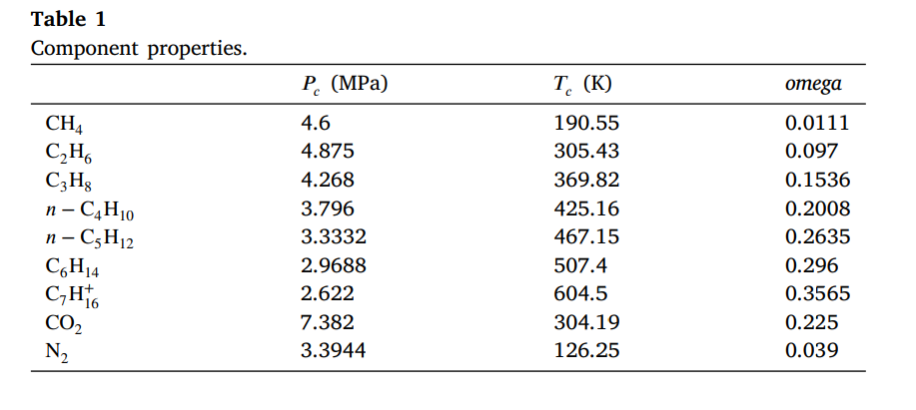
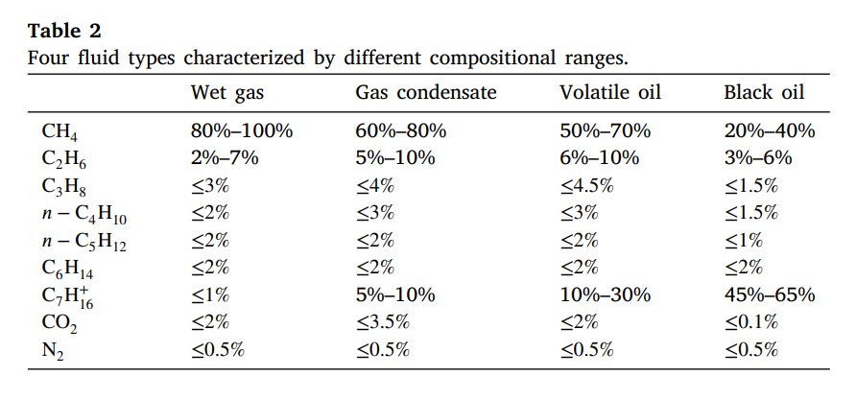
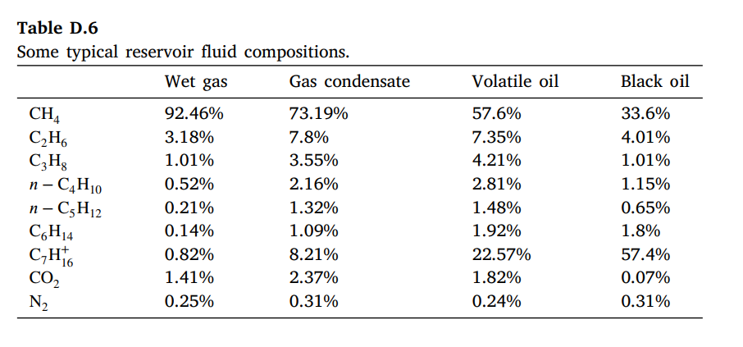
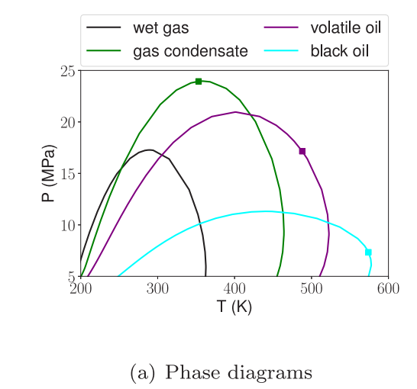
PTFlash Article - 9 Components
Components Critical Parameters
Sampling of Compositions
Typical Phase Diagrams
Examples of Compositions

