Slide 1
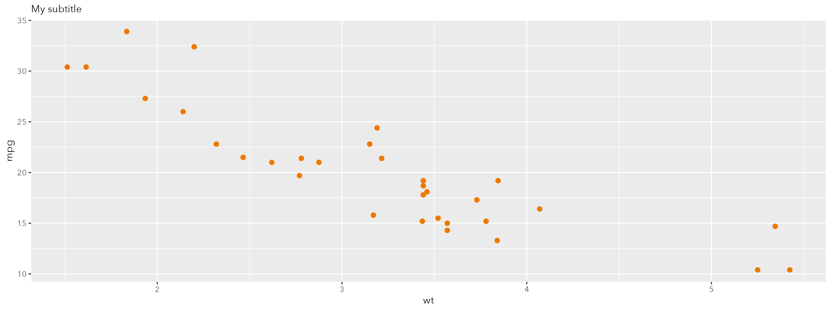
My title
Notes: notes. Source: source
Notes:
Powerpoint file location: /Users/mbbowes/Documents/GitHub/grattantheme/tests/testthat/temp_rich_fullslide.pptx

