Slide 1
Public
Public
Total
Total
Tradeable
Non-traded private economy
Tradeable
Low
barriers
Low
barriers
Heavy
regulation
Heavy
regulation
Scale
economies
Scale
economies
Natural
monopolies

Slide 2
Natural monopolies
Scale economies
Heavy regulation
Low barriers to entry
0
20
40
60
80
100
Value added, percentage

Slide 3
Value added ($b):
2
10
50

Slide 4
Largest firms:
1st
2nd
3rd
4th
Value added:

Slide 5
Revenue market share (%)

Slide 6
Largest firms:
1st
2nd
3rd
4th
Value added:
20
40
60
80
100
Revenue market share (%)

Slide 7
Other economies Australia
Banksª
Supermarkets^{b}
Mobileª
Telecom.
ISPs^{b}
Whl.^{b}
Fuel
Rtl.^{c}
General^{c}
Insurance
Life^{b}
Health^{c}
Low concentration
High concentration

Slide 8
2011 Population, millions (log scale)
Notes:
Source: World Bank, Financial Development and Structure Dataset (updated Nov. 2013)
http://econ.worldbank.org/WBSITE/EXTERNAL/EXTDEC/EXTRESEARCH/0,,contentMDK:20696167~pagePK:64214825~piPK:64214943~theSitePK:469382,00.html
3 firm bank concentration (average 2007-2011) and population (log scale)
And population: OECD.stat

Slide 9
Largest firms:
1st
2nd
3rd
4th
Population (millions):
Australia
Notes:
Supermarkets

Slide 10
Largest firms:
1st
2nd
3rd
Population (millions):
Australia
Notes:
Mobile operators – MNOs

Slide 11
Top 500
Top 200
Top 100
Top 50
Top 20
Notes:
All Australian ASX firms, excluding ETFs and mining and metals
Largest firms by revenue as % of all reported revenue, nominal, financial years
Some negative values due to write downs?
Source: Morningstar
Data: Dropbox (Grattan Institute)\Productivity Growth\Reports\Competitive pressure\Data and analysis\Morningstar\Lucy\Concentration – Australian firms only exc miners.xlsx
Sheet: “Revenue – Aust exc ETFs”

Slide 12
All Australian firms
Non-mining
Non-mining, excluding Woolworths, Telstra, AMP
Notes:
Top 100 Australian ASX firms (by market capitalisation), excluding ETFs
As a % of GDP, nominal, financial years
Source: Morningstar
Data: Dropbox (Grattan Institute)\Productivity Growth\Reports\Competitive pressure\Data and analysis\Morningstar\Lucy\Trends data – take 2.xlsx
Sheet: “Summary”

Slide 13
2001
2016
Vodafone
2005
2017
2017
2002
WBC
Optus
Coles
CBA
ANZ
Telstra
W’worths
NAB
Wireless telecom.
Supermarkets
Banks
Notes:
Market share by mobile subscribers, 2001-2016
Source: ACCC telecommunications reports

Slide 14
2003
2006
2013
2012
2017
2016
Mobil/
Shell
Mobil
2006
2014
Allianz
Hannover
BP
Caltex
QBE
Swiss
BP
Shell/
Viva
Sun
Coles
Munich
Caltex
IAG
W’worths
Consolidated insurers
Reinsurers
Retail
Wholesale
General Insurance
Fuel
Notes:
Market share by mobile subscribers, 2001-2016
Source: ACCC telecommunications reports

Slide 15
Return on equity:
>35%
25–35%
20–25%
15–20%
10–15%
5–10%
<5%
Notes:
Data from “Chart 4”
Revenue share by ROE Equity weighted
Earlier years excluded due to poorer quality data and a number of big listings

Slide 16
Entry rate
Exit rate

Slide 18
Average
Notes:
Profit margins, % of revenue

Slide 19
Natural monopolies
Low barriers to entry
Scale economies
Heavy regulation
Super-
normal
profit
Normal
profit
0
20
40
60
80
100
Profit, percentage

Slide 20
Low-barrier sectors
High-barrier sectors
No major players
Equity ($b):
Natural monopolies
10
30
100
0
20
40
60
80
100
Four-firm concentration ratio (%)

Slide 21
Initial percentile:
>90
75−90
50−75
25−50
10−25
<10
Year after initial time period
Notes:
Largest 100 Australian ASX firms by market cap at any time between 2005 and 2015, excluding ETFs and mining and metals
Decay analysis: for any ROE between 2001 and 2015, the ROE in each subsequent year up to 10 years after. ROE not adjusted for goodwill
Median ROE in t = n for each category of firms at t = 0
Source: Morningstar
Data: Dropbox (Grattan Institute)\Productivity Growth\Reports\Competitive pressure\Data and analysis\Morningstar\Lucy\Decay analysis.xlsx
Sheet: “ROE Decay (2)”

Slide 22
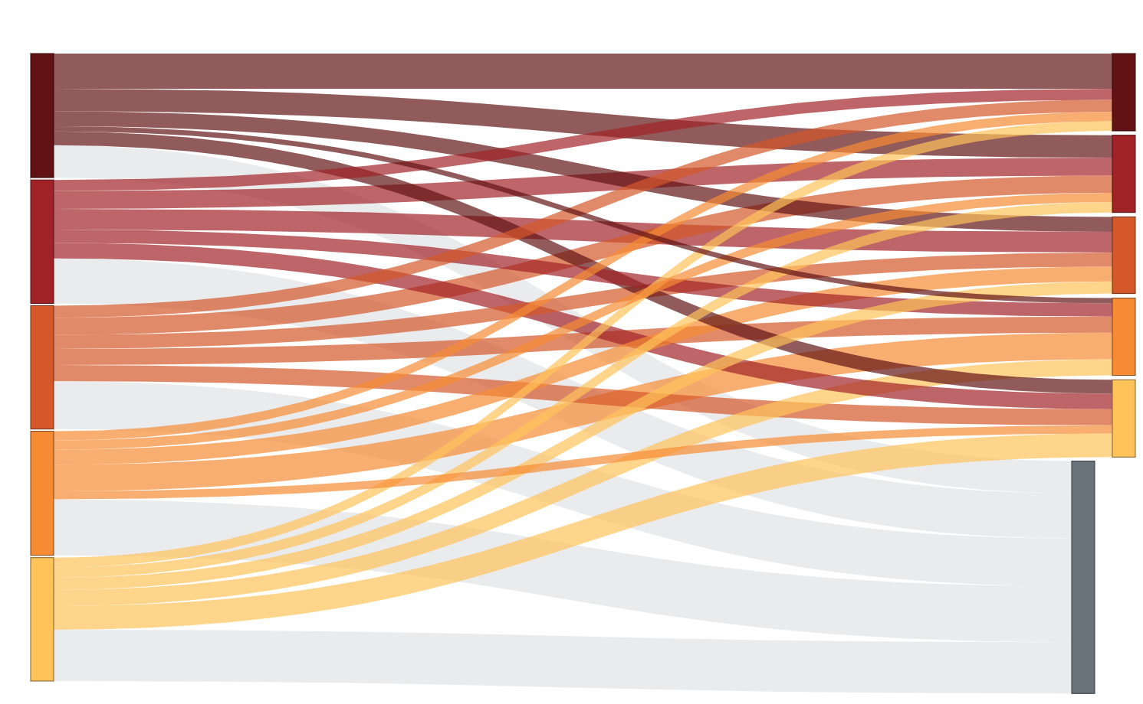
Top
Top
4th
4th
3rd
2nd
3rd
Bottom
2nd
No data*
Bottom

Slide 23
Firms in low-barrier sectors
Firms in high-barrier sectors
Return on equity, percentage
Notes:
Tobin’s Q (with equity adjusted for goodwill) against ROE (risk-adjusted)

Slide 24
Average
Notes:
Profit margins, % of revenue

Slide 25
5
10
15
20
25
Natural monopoly
Scale economies
Heavy regulation

Slide 27
Mean
Median

Slide 29
Super-
normal
profit
($4.5b)
Normal
profit
($6.0b)
0
Equity ($billion)
86

Slide 30
Super-
normal
profit
($5.8b)
Normal
profit
($5.5b)
0
Equity ($billion)
95

Slide 31
Super-
normal
profit
($6.4b)
Normal
profit
($37.8b)
0
Equity ($billion)
343

Slide 32
2011 Population, millions (log scale)
Notes:
Source: World Bank, Financial Development and Structure Dataset (updated 12 June 2017)
https://data.worldbank.org/data-catalog/global-financial-development
5 firm bank concentration (average 2011-2015) and population (log scale)
And population: OECD.stat

