Slide 1
Quick instructions
To create a new chart:
select ‘Home → New slide → Chart’ (shortcut: Ctrl + M)
select ‘Insert → Chart’, and choose a chart from ‘Templates’ (ensure that the Grattan templates are saved in your local directory – see the Chart Guidebook for more details); the chart should appear in the correct position (but ensure y-axis text is almost touching the left border, and x-axis text almost touching the bottom border)
the charts in this presentation can be used as a guide, but should not be used to create new charts
To copy and paste a chart from a presentation:
select ‘Home → New slide → Blank’
in the presentation, select all objects that appear on the chart (including the chart), copy (Ctrl + C), and paste into the newly-generated slide; the chart should fit nicely into the slide

Slide 2
Off-peak
Off-peak
Off-peak

Slide 6
 | Minimum | Maximum | Average | Early Bird Average
Sydney CBD | $25.00 | $89.00 | $70.85 | $27.74
Melbourne CBD | $15.00 | $89.00 | $63.61 | $17.74
Brisbane CBD | $40.00 | $89.00 | $69.03 | $25.25

Slide 8
Train
Tram
Bus
Time of Day

Slide 9
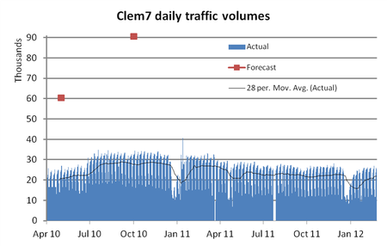

Slide 10
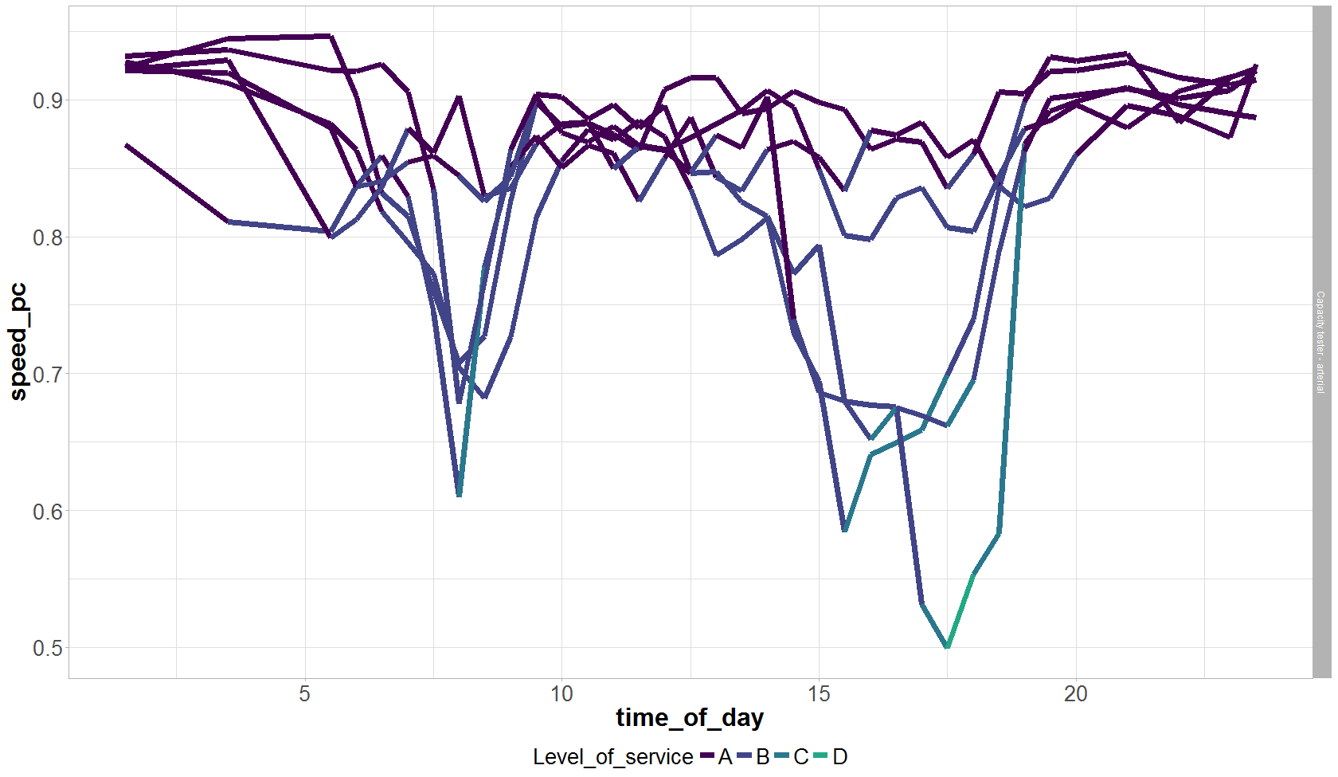

Slide 11
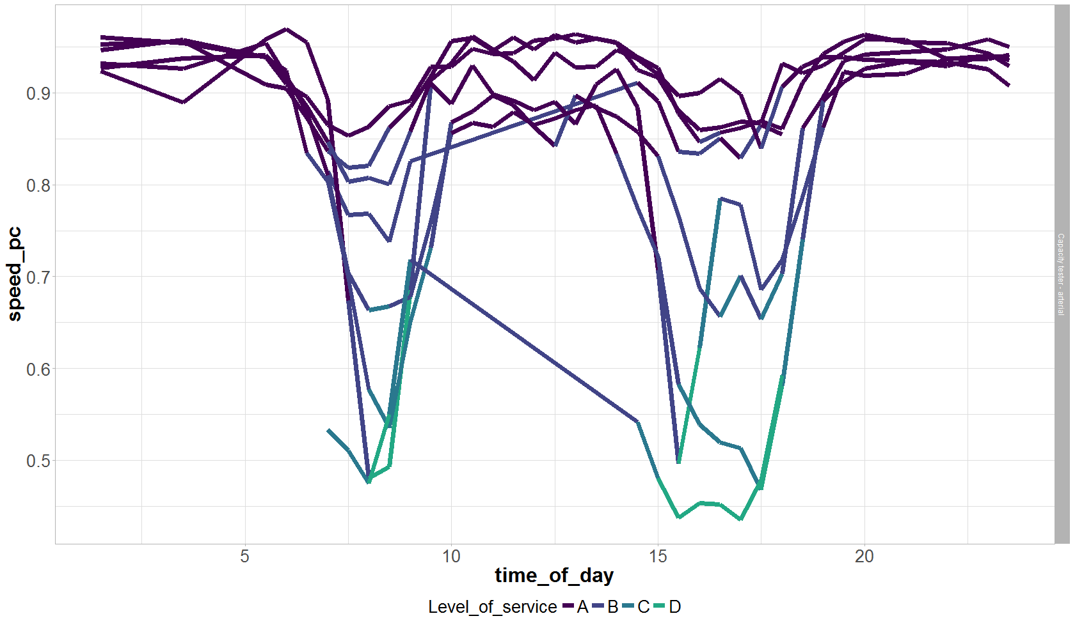

Slide 13
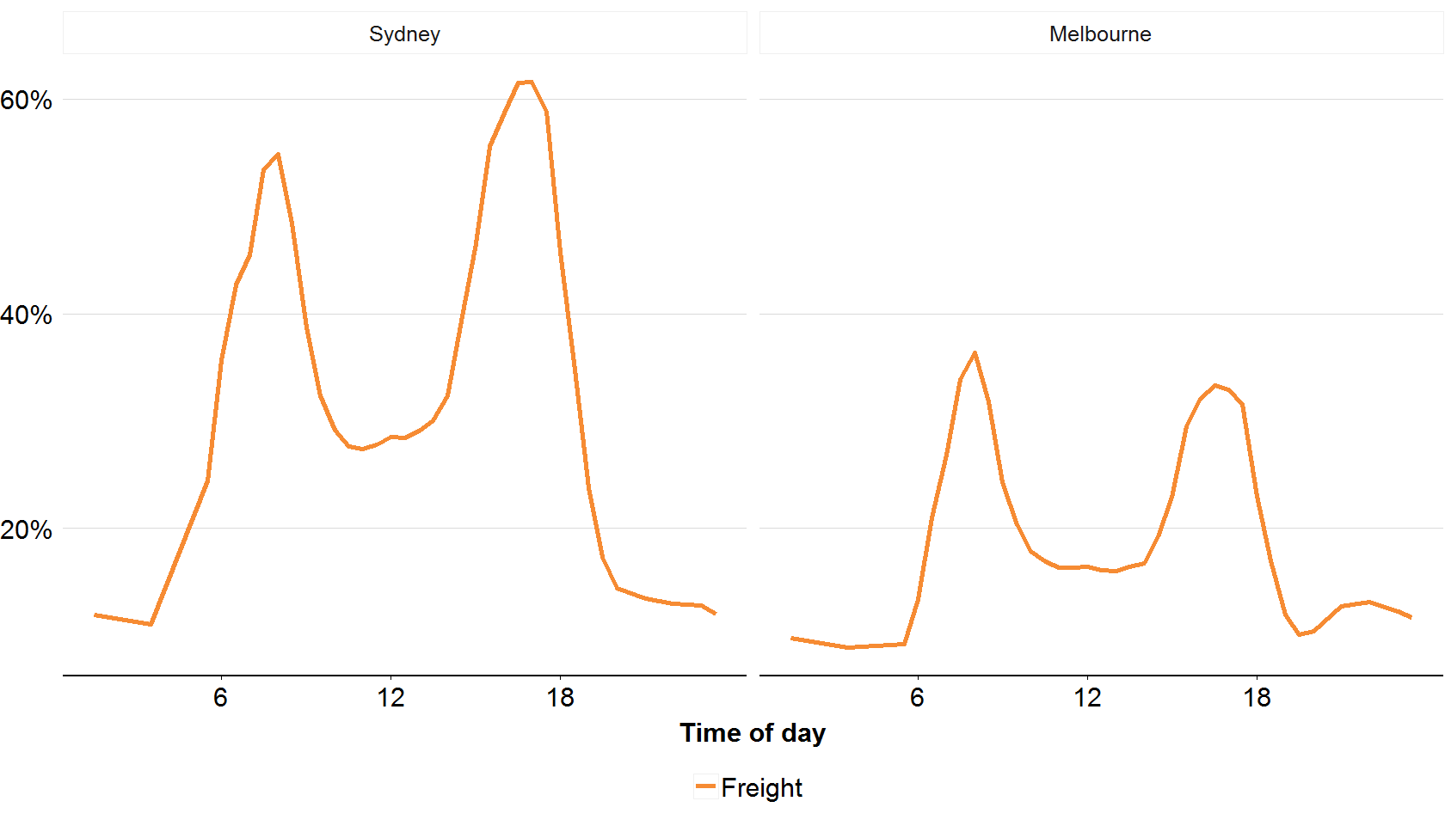

Slide 15
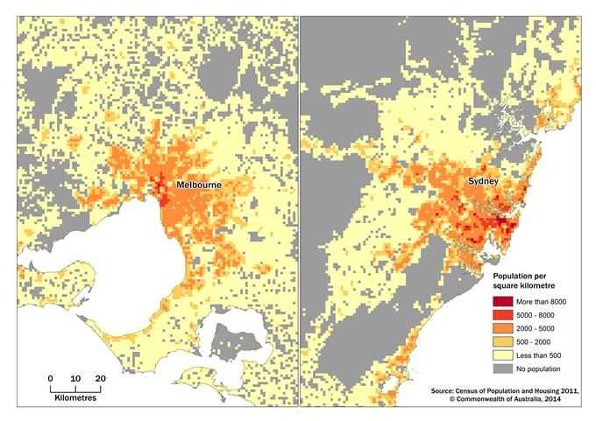

Slide 18
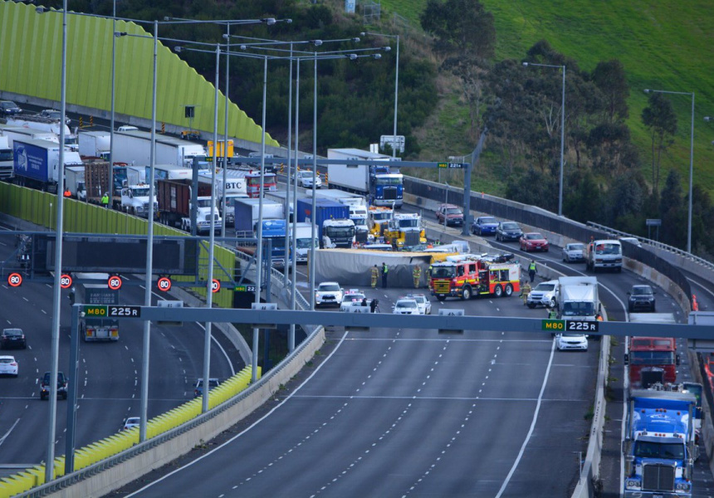

Slide 19
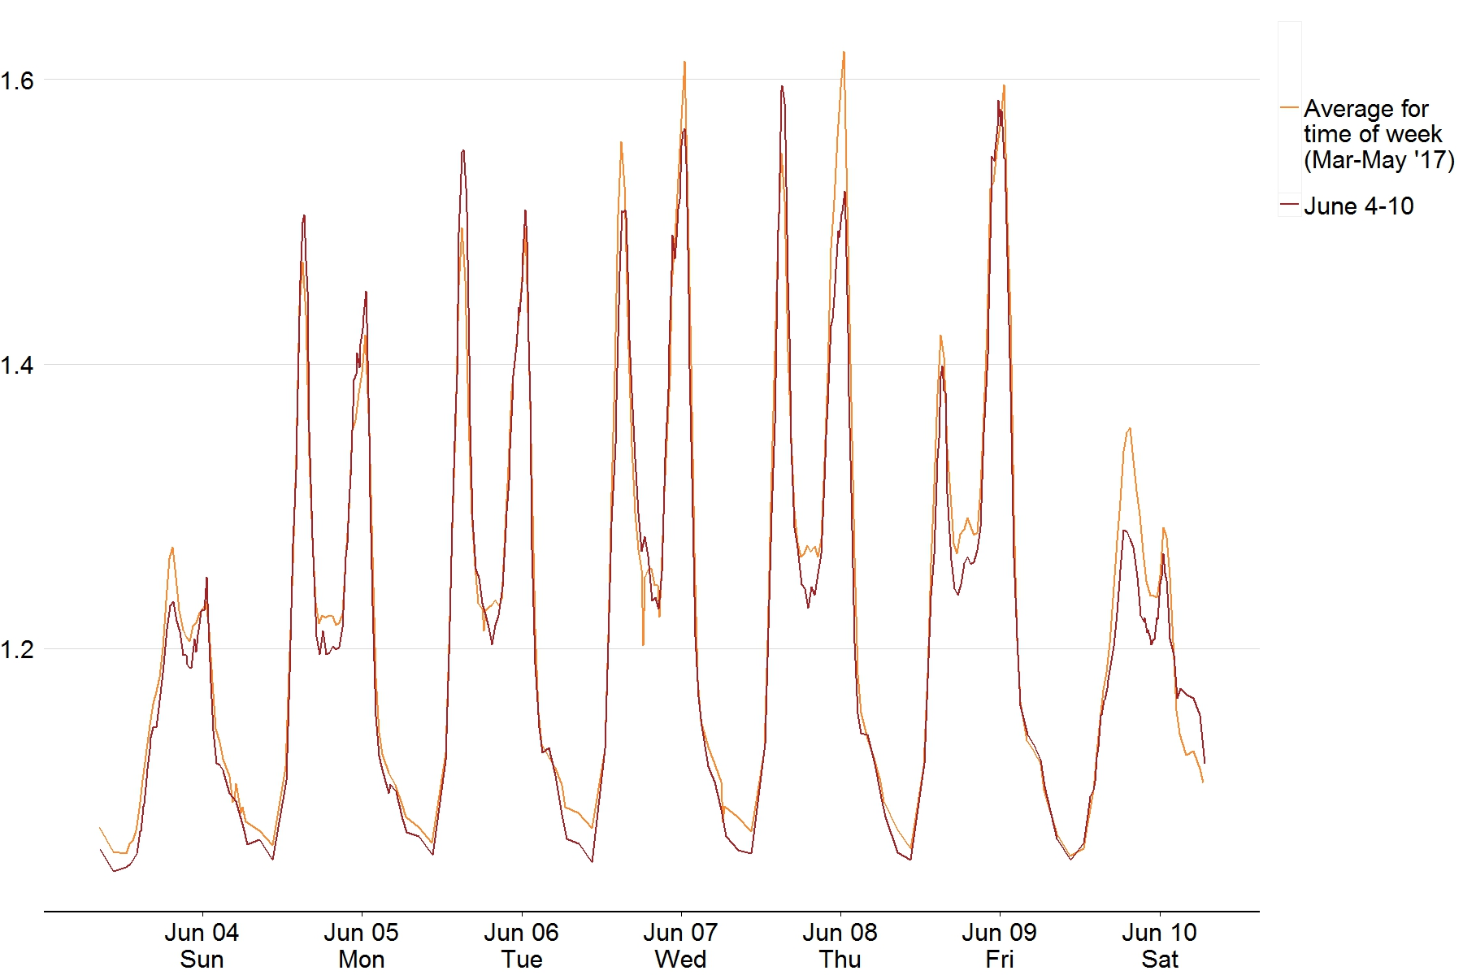
6.2 mm
4.8 mm
0.2 mm
1.8 mm
9.6 mm
50.6 mm between 8PM and 5AM
Long weekend

Slide 22
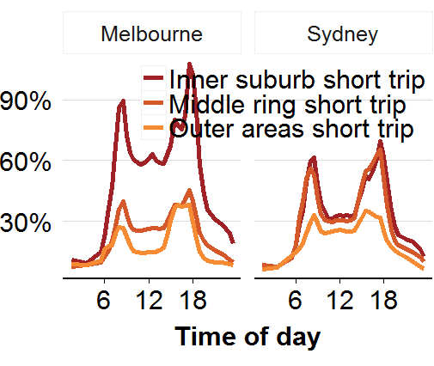

Slide 23
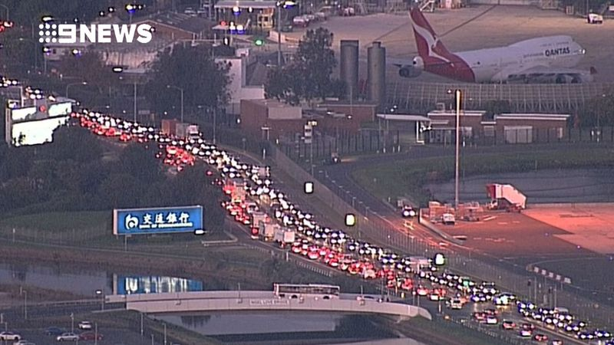

Slide 27
$8.70
$6.70
$7.80
$4.50
$6.00

Slide 28
Tax paid by seniors
Tax paid by working-age Australians
Income ($)

Slide 29
ICSEA
≤ 900
901–
1000
1001–
1100
>1100

Slide 30
Local
State
Commonwealth

Slide 31
Cut due
to fees
Remaining
balance
Fees (per cent)

Slide 32
Real house prices
Real average
full-time earnings

Slide 33
Projects with first cost
announced prior to a
budget commitment
Projects with first cost
announced as a budget commitment,
prior to construction commencing
Projects with first cost
announced during construction
First public
cost announcement
Formal budget
commitment
Commencement
of construction
Completed

Slide 34
Business
as usual
Over 2 billion
tonnes
2020 target
2030 target

Slide 35
Rents fell or flattened
Rents rose
Melbourne
Perth
Adelaide
Sydney
Brisbane

Slide 36
Forecast made in
2012
2013
2014
2015
2016
Actual
2009
2014
2019
Notes:
Budget surplus/deficit as a percentage of GDP.
Purpose of chart: to show that treasury forecasts have been too optimistic.
Dotted lines are another way of distinguishing forecasts, particularly when displaying multiple forecasts.

Slide 38
Half of the over-
funding goes to
just 28 schools
Per cent of SRS

Slide 39
Benefits
Costs

Slide 40
89% attributable to other causes
11% directly attributable to scope changes

Slide 41
Solar exported to grid
Solar output consumed
Electricity consumption
Notes:
Typical pattern of daily consumption and solar PV output (kW), north-facing.
Consumption is calculated as average Victorian, and solar PV is output for a 3kW system (30 degree tilt) on 30th December, 2013, close to a perfectly sunny day.

Slide 42
Average
benefits
for age
Seniors
paying less
than benefits
Younger people paying
more than benefits
Premium paid
20–24
30–34
40–44
50–54
60–64
70–74
80+

Slide 45
Solar households
Under-contributing
Non-solar households
Under-contributing
Over-contributing
Over-contributing
Household
yearly consumption
Megawatt-hours
Household max. demand:
average of top five periods
Kilowatts
Notes:
Contribution to peak demand against consumption and maximum demand.
Note: some households with higher consumption and maximum demand not shown. Scatter plot is a random sample of 100 households, while regression lines use more than 900 solar and 900 non-solar households.

Slide 46
1990–1994
Agriculture
2012–2016
Capital-
intensive
services
Manufacturing
Capital-light
services
Construction
0
20
40
60
80
100
Share of non-mining market output (percentage)

Slide 47
Predicted increase
Low gas user
Medium gas user
High gas user

Slide 48
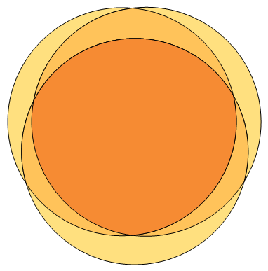
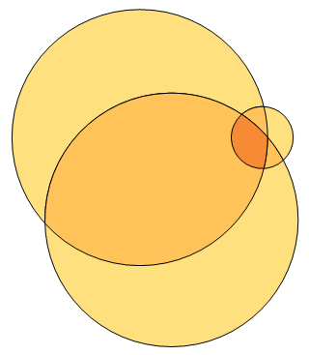
Melbourne
Brisbane
Hot water
(84)
Heating
(84)
Hot water
(70)
14
30
1
Heating
(4)
2
2
1
1
59
38
1
9
9
28
5
Cooking
(82)
Cooking
(68)
Notes:
Percentage of gas households connected to each appliance
Purpose of chart: to show that Melbourne households typically use gas for multiple appliances, while Brisbane households typically use gas for only one or two appliances.
Created using venn diagram plotter, with text and circle outlines added in PowerPoint.

Slide 49
(forecast)
Gas
Brown coal
(historical)
Black coal
Carbon price ($/t)
Notes:
Total cost per MWh by fuel source and carbon price
S:\Programs\Energy\1. Reports\1402 Too good to burn\Analysis\Carbon pricing analysis.xlsx

Slide 50
NAPLAN scale score
Equivalent year levels
Percentiles
90th
80th
50th
20th
10th
Year 3
Year 5
Year 7
Year 9
Year 3
Year 5
Year 7
Year 9

Slide 51
Low Year 3 score
Medium Year 3 score
High Year 3 score
2y
5m
High advantage
Medium advantage
Low advantage
2y
0m
1y
7m
Year 3
Year 9
Year 3
Year 9
Year 3
Year 9
Notes:
CYL estimate by ICSEA, numeracy

Slide 52
Occupational
skill level:
1
3
4
5
Growth (per cent)

Slide 53
Australian Government
10-year bond rate
Interest subsidy
CPI

Slide 54
Education
IT
Nursing
Agriculture
Engineering
Science
Commerce
Maximum
Law
Architecture
Arts
Average
CSP
Minimum

Slide 55
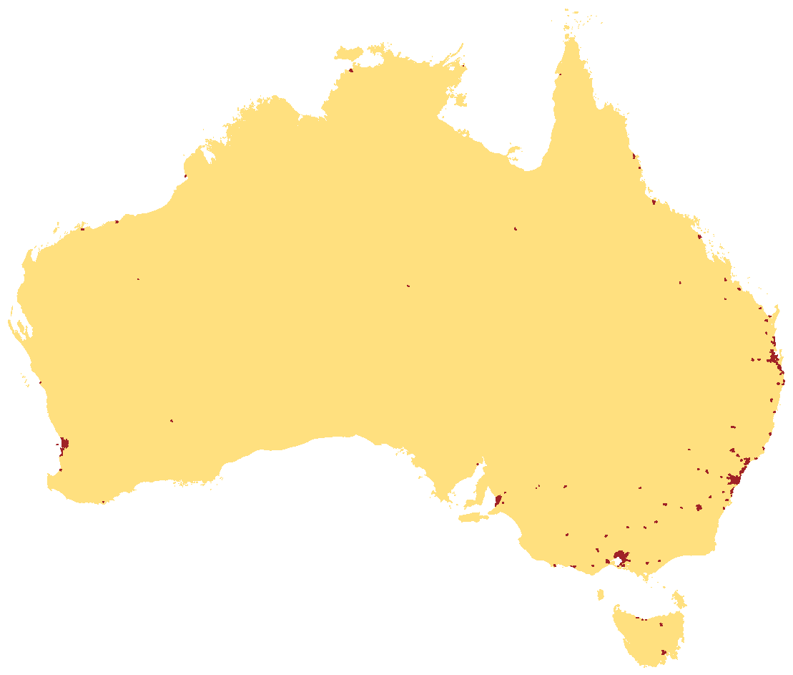
80%
20%

Slide 56
−10
0
10
20
30
Estimated percentage change in FDI

Slide 57
100
Full time
Part time
No
children
Not
working
80
Not
working
60
With
children
40
20
Part time
Full time

Slide 58
Victoria
New South Wales
Queensland
Western Australia

