Slide 1
Aus capitals density

Slide 2
Melbourne (4.7m)
Berlin (3.7m)
People per hectare
Sydney (5.0m)
Toronto (6.4m)
Rome (3.7m)
Notes:
Charting transport

Slide 3
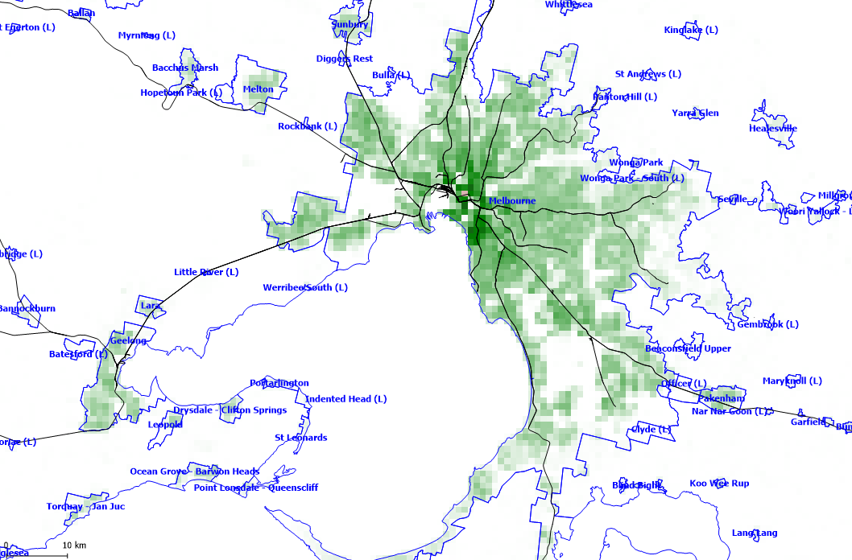
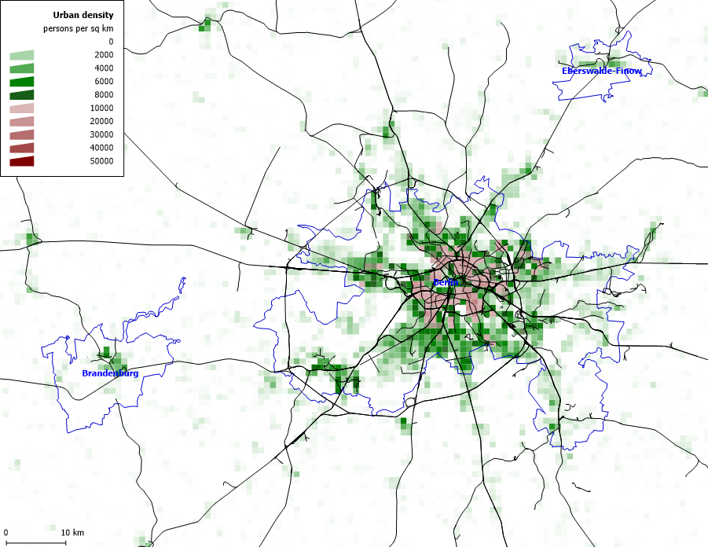
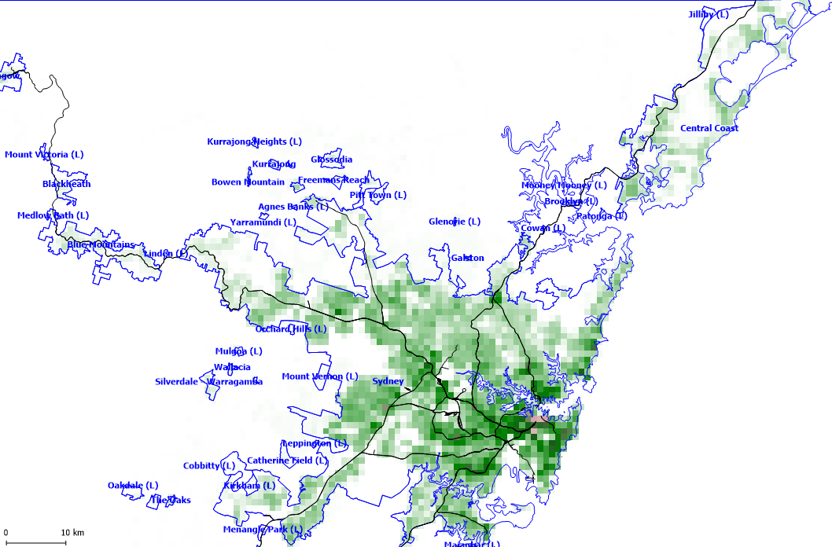
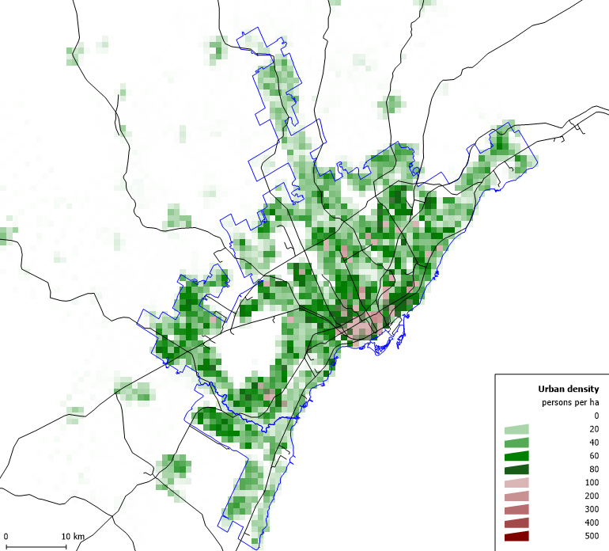
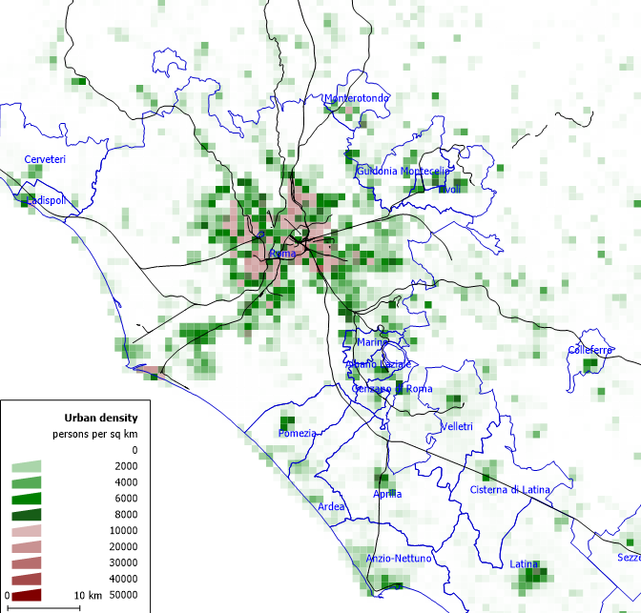
Melbourne (4.7m)
People per hectare
Berlin (3.7m)
Do a new one with these figures
0
20
40
60
80
100
200
300
400
500
Sydney (5.0m)
Toronto (6.4m)
Rome (2.7m)
Notes:
Charting transport

