Slide 2
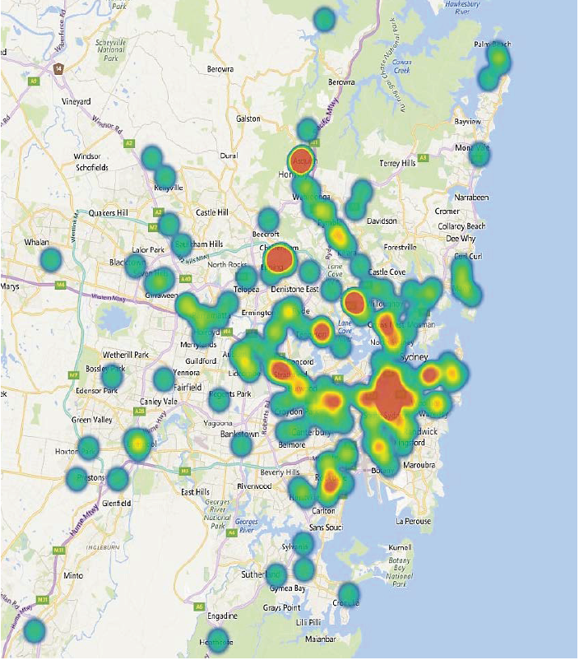
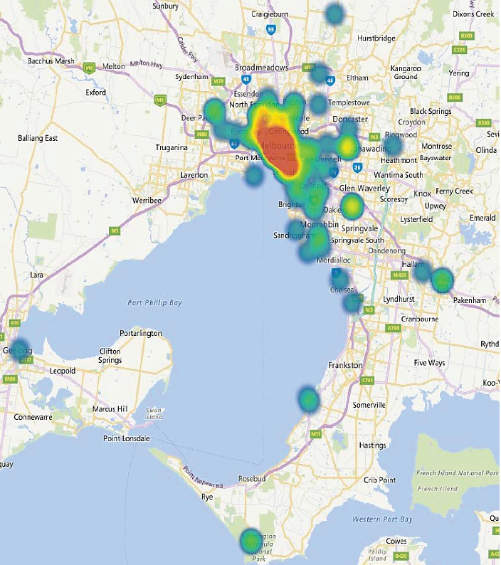
Sydney
Melbourne

Slide 3
Sydney
Melbourne

