Slide 2
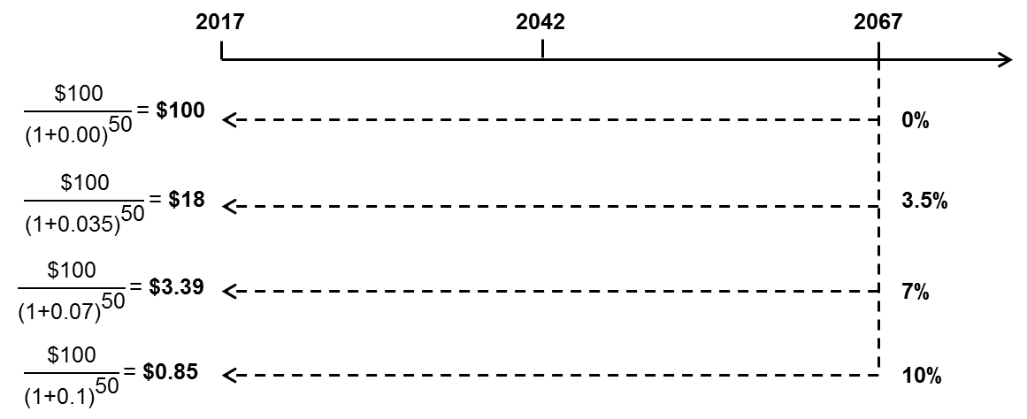

Slide 4
Canberra Light Rail
Murray Basin Rail
Melbourne Metro
Inland Rail Freight
Discount rate

Slide 5
Transport and Infrastructure Council
State and territory guidelines
State and territory governments
Infrastructure Australia; Mark Harrison; New Zealand Treasury; United Kingdom Treasury
Formal sources of advice and economic expertise
Sources that each authority cites in support of its choice of discount rate
Infrastructure Australia
State and territory guidelines; Office of Best Practice Regulation, Mark Harrison
Prime Minister & Cabinet
Department of Finance, Mark Harrison, United States Office of Management and Budget, Department of Finance Handbook of Cost-Benefit Analysis
Productivity Commission
No formal guidance issued, but its Public Infrastructure Inquiry (2014) refers to state and territory guidelines as the relevant sources of authority

Slide 6
10 year average
20 year average
27 year average

Slide 12
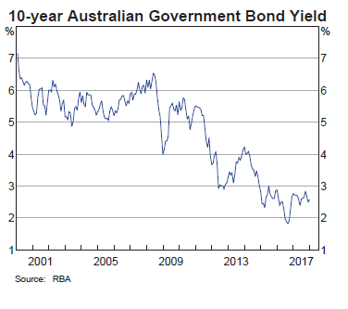

Slide 17
n/a

Slide 18
n/a

Slide 19
n/a

Slide 20
Transport Ministers (national and state)
State and territory guidelines; Infrastructure Australia; Department of Infrastructure and Regional Development
State and territory governments
Infrastructure Australia; Harrison (2010); IPART
Formal sources of discount rate advice and economic expertise
Sources that each authority cites in support of its choice of discount rate
Infrastructure Australia
State and territory guidelines; Office of Best Practice Regulation; Harrison (2010)

Slide 21
State and territory governments
Infrastructure Australia; Harrison (2010); New Zealand Treasury; UK Treasury
Formal sources of discount-rate advice and economic expertise
Sources that each authority cites in support of its choice of discount rate
Infrastructure Australia
State and territory guidelines; Office of Best Practice Regulation; Harrison (2010)

Slide 24
Upper discount rate bound
Constant discount rate of 7%
Lower discount rate bound
2017

