Slide 1

 | Risk minimisation |  | Risk measurement | Ongoing risk monitoring
 | Mitigate avoidable risks | Reduce estimation error | Measure the remaining risk | Account for risk in investment decisions | Manage risk throughout construction
C’wlth
NSW
VIC
QLD
WA
SA

Slide 2
 | Commonwealth |  | NSW | VIC | QLD | WA | SA
Expected value
Sensitivity analysis
Probability pricing
Reference class forecasting

Slide 3
Unavoidable risks
Avoidable and unavoidable risks
Underrun
1
Overrun

Slide 4
Unavoidable risks
Reduction in estimation error
Underrun
1
Overrun

Slide 5


Assumed distribution
Observed distribution
50%
50%
34%
$≤$ 25%
Underrun
1
Overrun
Notes:
Chart 8
Title: Cost outcomes are less extreme across a portfolio of projects than on any individual project
Subtitle: Average probability distribution of final project costs as a proportion of initial project costs for individual projects and the aggregate probability distribution of Australia’s final transport infrastructure expenditure over 2000 – 2015 as a proportion of initial investment intentions, per cent
Notes: This figure is a graphical representation of the Linberg-Levy Central Limit Theorem as it relates to the management of cost overruns. As the sample of infrastructure projects increases, the variance of cost outcomes that could be observed, on average, across the portfolio of projects decreases, and the average cost outcome across the portfolio converges to the expected value of cost overruns for any individual project. For this reason, the individual project and portfolio level probability distributions share the same expected value, but the latter distribution has a smaller spread and is symmetrical. Both distributions share the same expected value.
This diagram is a stylized representation of the differences between project and portfolio level risks. Figure XX in appendix XX presents the raw data underpinning this comparison.
Source:

Slide 6
Association for the Advancement of Cost Engineering
QLD Department of Transport and Main Roads
South Australian Department of Planning, Transport and Infrastructure
National Guidelines for Transport System Management

Slide 7
Investment Monitor dataset
Grattan dataset

Slide 8
Investment monitor dataset
Grattan dataset
Notes:
This chart has been reviewed on 21/10/2016.
Title: A third of cost overruns occur prior to budget commitments
Subtitle: Cost overruns by project stage, per cent
Notes: Australian transport projects, completed between 2001 and 2015.
Source: Deloitte Investment Monitor dataset; Grattan analysis.
Analysis in C:\Users\ldanks\Dropbox (Grattan Institute)\Transport Program\Project - Project-level Study\Analysis\Spreadsheets\IM Results\Overall cost overruns

Slide 9



Full distribution
Median = P50
Expected value
P90
50%
Variance
50%
40%
10%
Underrun
1
Overrun
Notes:
This chart has been reviewed on 21/10/2016.
Title: Key risk measurement and management concepts
Subtitle: Illustrative probability distribution of cost outcomes on individual projects, per cent
Notes: The distribution of cost risks depicted is a stylized representation of the distribution of cost overruns observed in the Investment Monitor; see appendix xx for details. This graph’s illustrative purpose is to graphically present the relative distances between the median, 90th quantile and expected value of cost overruns.
Sources: Deloitte Investment Monitor, Grattan analysis

Slide 10
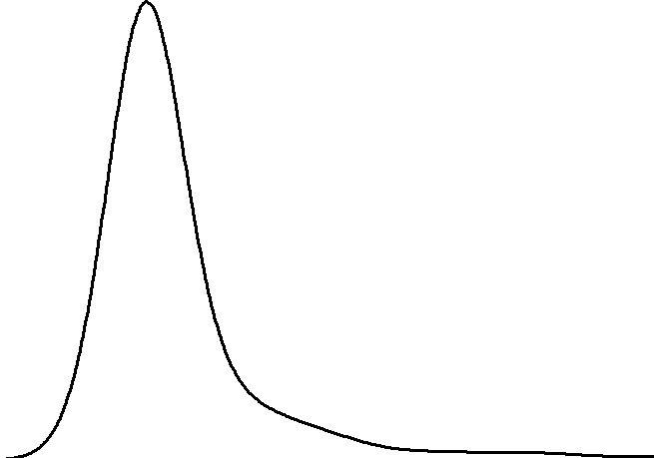
50%
Underrun
1
Overrun
Notes:
This chart has been reviewed on 21/10/2016.
Title: Key risk measurement and management concepts
Subtitle: Illustrative probability distribution of cost outcomes on individual projects, per cent
Notes: The distribution of cost risks depicted is a stylized representation of the distribution of cost overruns observed in the Investment Monitor; see appendix xx for details. This graph’s illustrative purpose is to graphically present the relative distances between the median, 90th quantile and expected value of cost overruns.
Sources: Deloitte Investment Monitor, Grattan analysis

