Slide 1

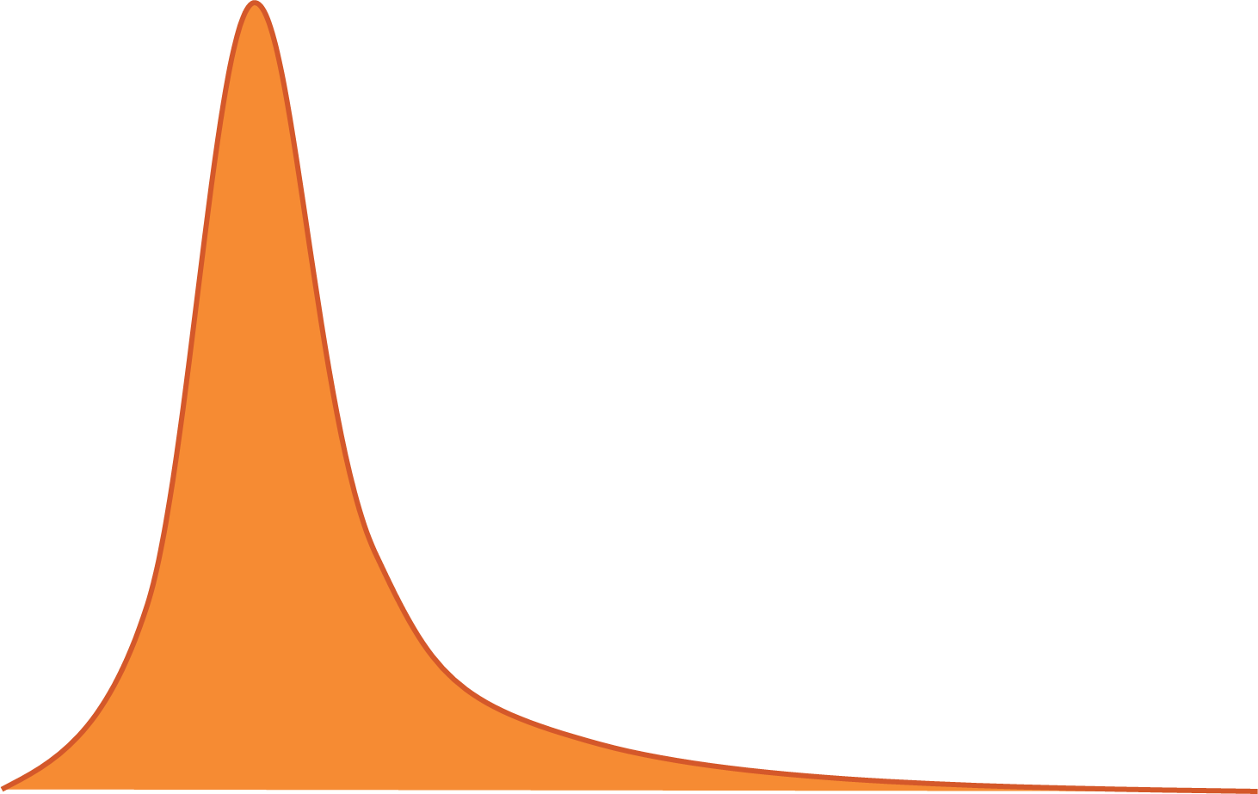

Full distribution
Median = P50
Expected value
P90
Variance
50%
40%
10%
Underrun
1
Overrun
Notes:
This chart has been reviewed on 21/10/2016.
Title: Key risk measurement and management concepts
Subtitle: Illustrative probability distribution of cost outcomes on individual projects, per cent
Notes: The distribution of cost risks depicted is a stylized representation of the distribution of cost overruns observed in the Investment Monitor; see appendix xx for details. This graph’s illustrative purpose is to graphically present the relative distances between the median, 90th quantile and expected value of cost overruns.
Sources: Deloitte Investment Monitor, Grattan analysis

