Slide 1
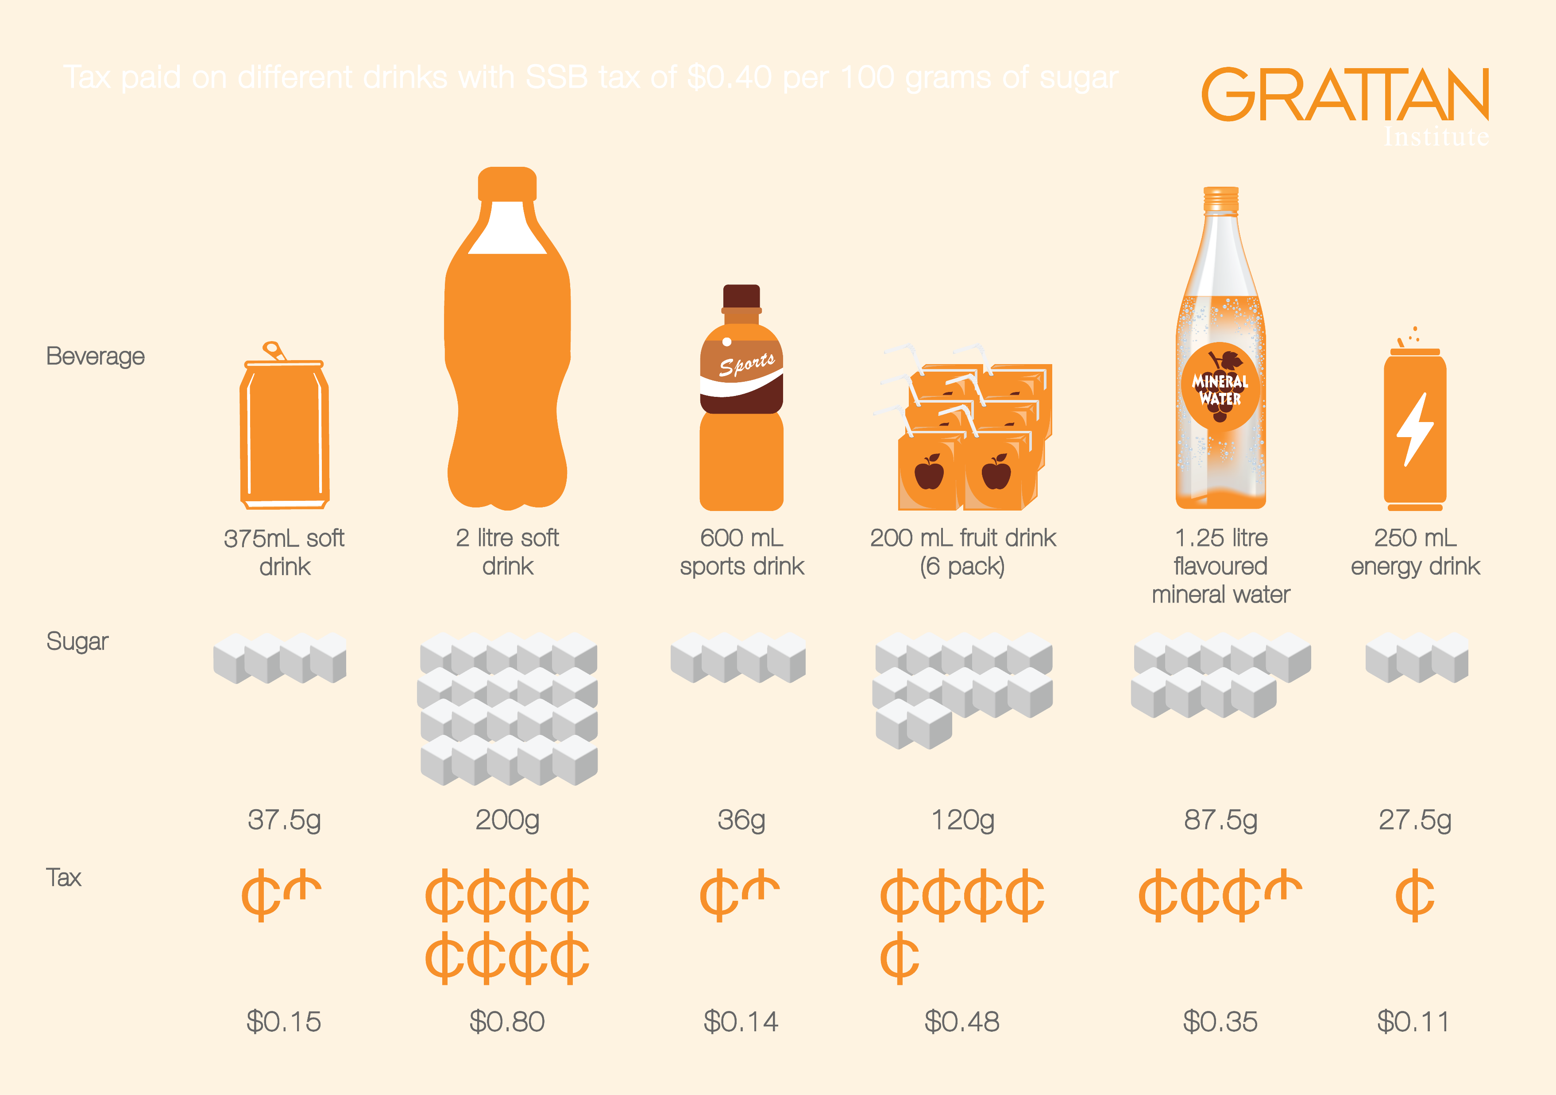
Beverage
375mL soft
drink
2 litre soft
drink
600 mL
sports drink
200 mL fruit drink
(6 pack)
1.25 litre
flavoured
mineral water
250 mL
energy drink
Sugar
37.5g
200g
36g
120g
87.5g
27.5g
Tax
$0.15
$0.80
$0.14
$0.48
$0.35
$0.11

