Slide 1
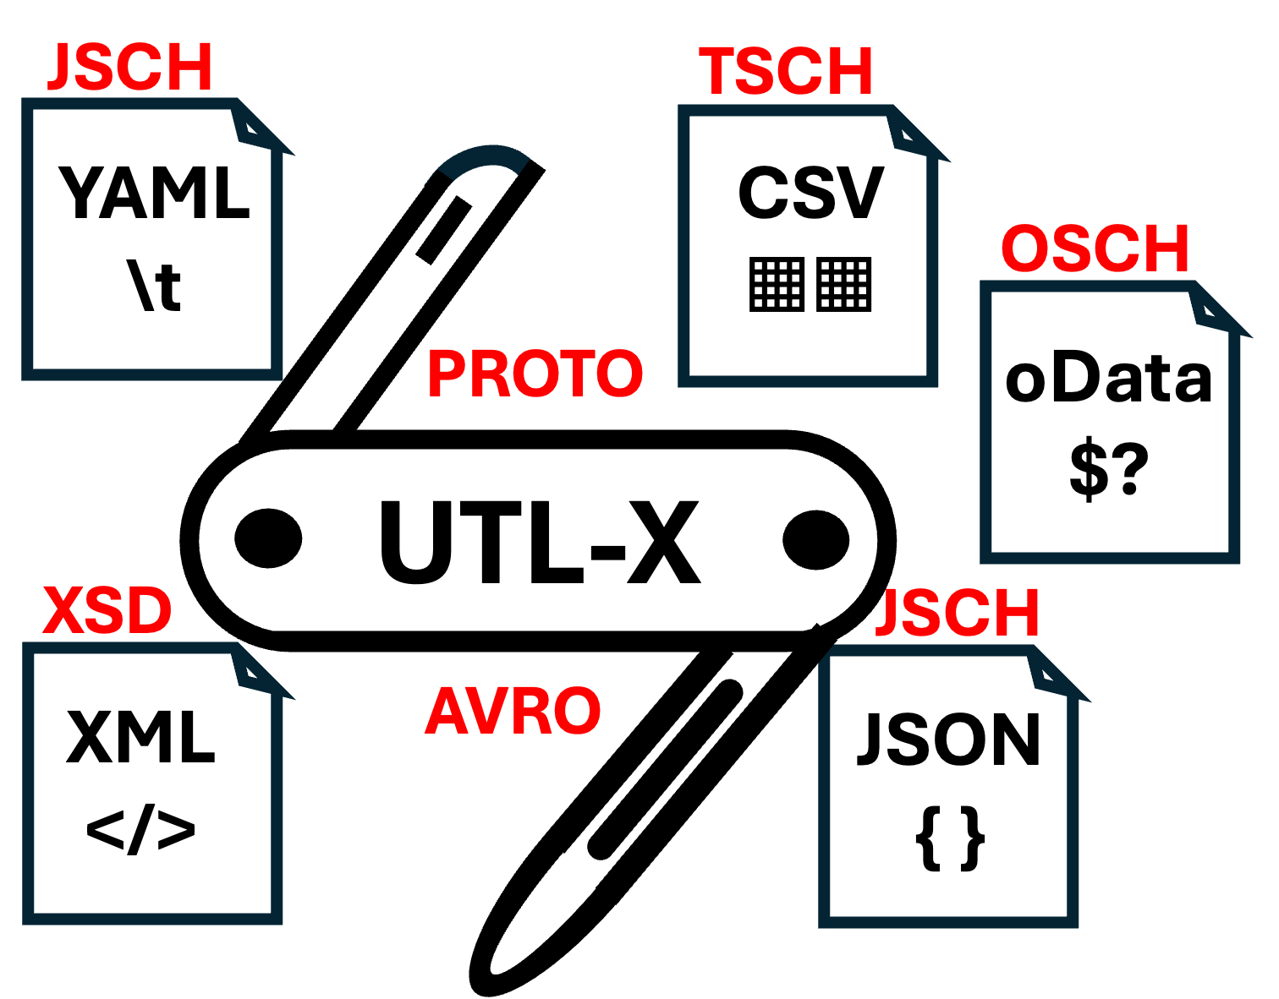


API DAYS AMSTERDAM · 2026
Day 2 · Conference Talk
https://www.linkedin.com/in/marcelgrauwen/
UTL·X
One language. All formats.
The open-source, format-agnostic transformation language — and the alternative to DataWeave.
XML
JSON
CSV
YAML
OData
Ir Marcel Grauwen github.com/grauwen/utl-x
Notes:
Welcome. I'm Marcel Grauwen, creator of UTL-X. In the next ~20 minutes I'll show you one language that transforms XML, JSON, CSV, YAML and OData - and even the schemas behind them - with a live demo of our Theia-based IDE. Think of it as the open alternative to DataWeave.

Slide 2
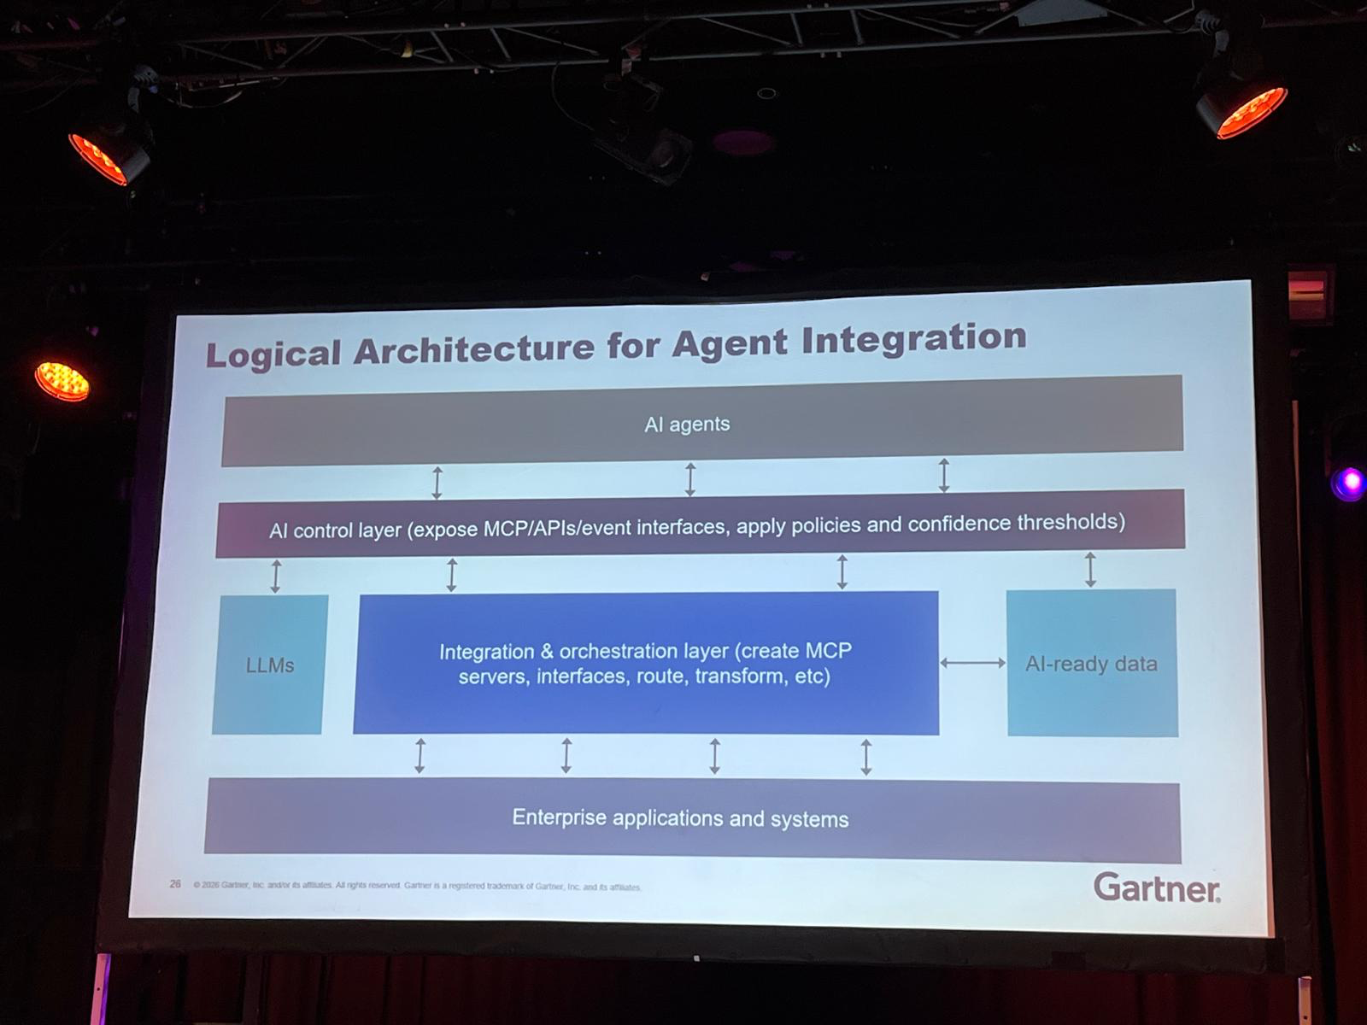
Setting the scene
One photo from this morning’s very interesting Gartner session by
Keith Guttridge
UTL·X
…. transform, ….

Slide 3
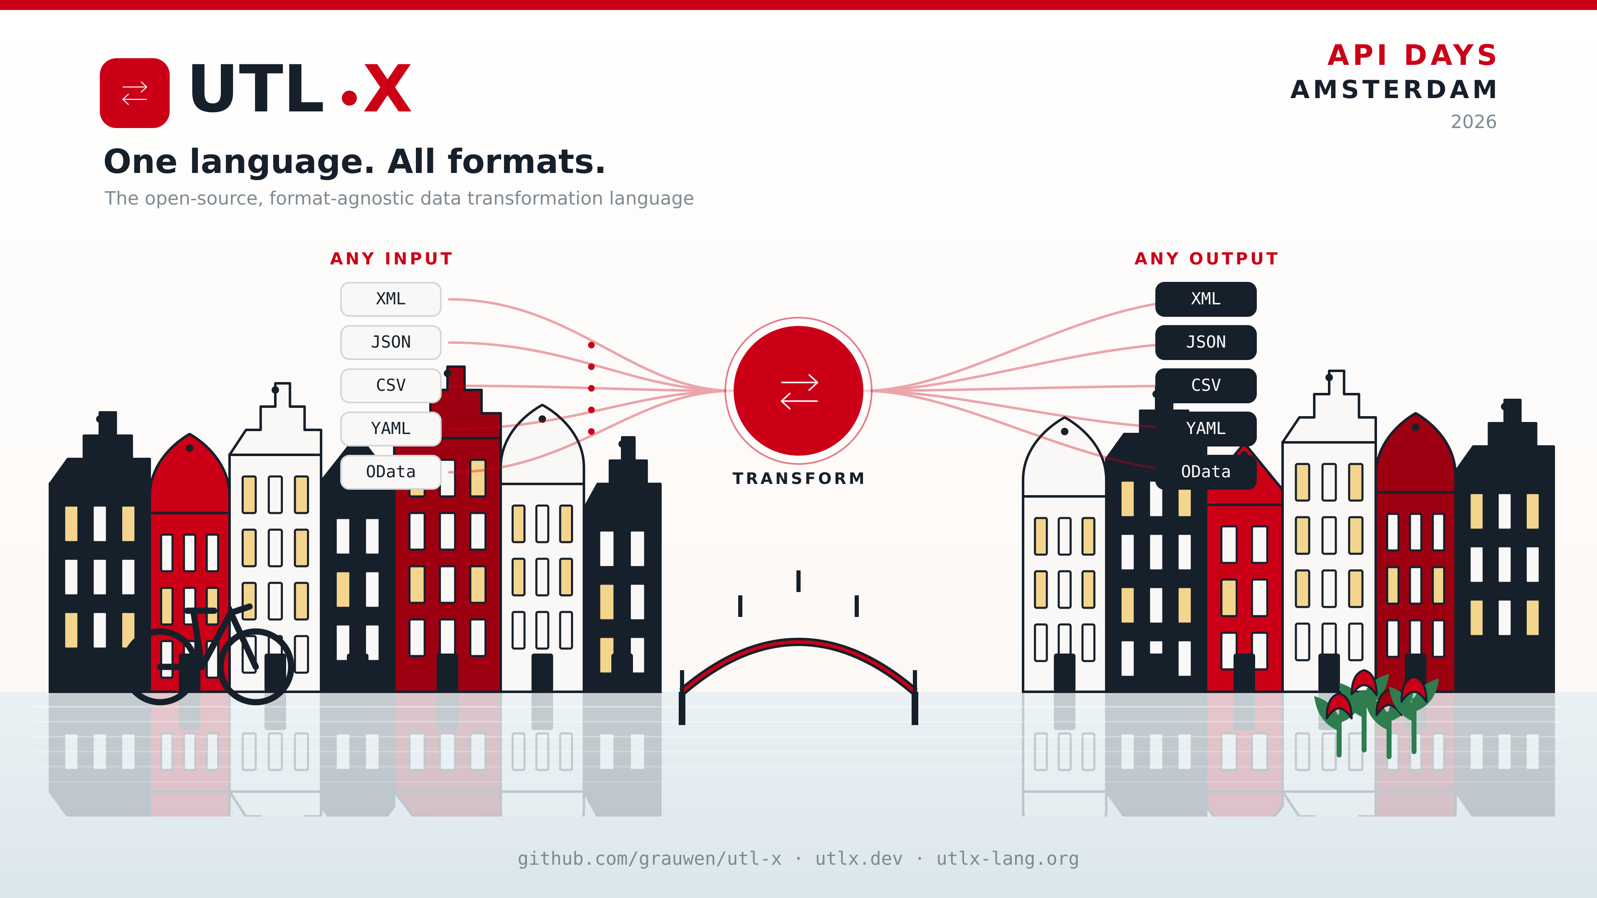


Slide 4

THE PROBLEM
2
Every system speaks a different dialect
Integration teams spend their lives translating — between data formats, and between the schemas that describe them. The logic is the same every time; only the syntax changes.
DATA FORMATS (T1)
SCHEMA FORMATS (T2)
XML
verbose, namespaced
XSD (XML Schema)
contracts for XML
JSON
everywhere, untyped
JSCH (JSON Schema)
contracts for JSON & YAML
CSV
TSCH (Table Schema)
contracts for CSV
flat, ambiguous
OSCH (EDMX)
contracts for oData
YAML
config-friendly
Avro
streaming records
oData
open, fixed datamodel
Proto buf
wire-level RPC
And the usual answer? Brittle glue code, per-pair. It doesn't scale.
UTL·X
© 2026 Glomidco B.V.
Notes:
Show of hands - who has written code to turn an XML order into a JSON payload? Now who's done the reverse? Every integration is the same map-rename-aggregate logic, rewritten because the syntax differs. And it's not just the data - the SCHEMAS need translating too: XSD to JSON Schema, Avro to Protobuf. Most teams solve this with brittle one-off glue code.

Slide 5
THE GAP
3
Today's tools each cover one slice
XSLT
jq
DataWeave
Powerful templates — but XML only, and 1999-era syntax.
Loved on the command line — but JSON only.
All formats, great DX — but locked to MuleSoft and paid.
The gap: no open, format-agnostic option that also transforms schemas — until now.
UTL·X
© 2026 Glomidco B.V.
Notes:
There are great tools, but each owns one slice. XSLT is powerful but XML-only and dated. jq is a joy but JSON-only. DataWeave does everything UTL-X does for data - but it's tied to MuleSoft and it's commercial. Nobody offers an open, format-agnostic option that ALSO handles schema transformation. That's the gap UTL-X fills.

Slide 6
THE ANSWER
4
Meet UTL-X
Write your transformation once. Run it on any format. Open source, AGPL-3.0.
650+
5
7
3
stdlib functions
data formats (T1)
schema formats (T2)
runtimes
Format-agnostic · functional · strongly typed · JVM, Binary compiled CLI, UTLX engine SDKs (C#, python, Kotlin, Java, GO)
UTL·X
© 2026 Glomidco B.V.
Notes:
So here it is. UTL-X: one functional, strongly-typed language. The numbers: over 650 standard-library functions, five data formats, seven schema formats, three runtimes. Write once, run on any of them. And it's fully open source under AGPL-3.0 - no vendor lock-in.

Slide 7

HOW IT WORKS
5
One model in the middle: the UDM
ANY INPUT
ANY OUTPUT
XML
XML
JSON
UDM
UDM
JSON
parse
serialize
CSV
Universal Data Model
CSV
Universal Data Model
YAML
YAML
OData
OData
Parse any format into one model, transform the model, serialize to any format. Your script never mentions XML or JSON — only the shape of the data.
UTL·X
© 2026 Glomidco B.V.
Notes:
The trick is a single internal representation - the Universal Data Model. Every parser turns its format into the UDM; every serializer turns the UDM back out. Your transformation works on the UDM, so it never mentions XML or JSON. That's why the SAME script runs against all five formats. Change one line - the input declaration - and you're done.

Slide 8
THE LANGUAGE
6
One script, any format
%utlx 1.0
input xml
output json
---
{
invoice: {
id: "INV-" + $input.Order.@id,
items: $input.Order.Items.Item
|> map(i => {
sku: i.@sku,
total: i.@qty * i.@price
})
}
}
Change one line.
input xml → input json
The transformation body doesn't change. Same logic runs over XML, JSON, CSV, YAML or OData.
map · filter · reduce · groupBy · pattern matching · safe navigation
UTL·X
© 2026 Glomidco B.V.
Notes:
Here's what it looks like. The header declares input and output formats, then the body describes the OUTPUT shape declaratively - pipelines, map, filter. This turns an XML order into a JSON invoice. The key point is on the right: to run the exact same transformation over JSON input, I change ONE word - xml becomes json. The body is untouched. Functional features you'd expect are all there.

Slide 9

THE SECOND DIMENSION
7
Transform the contracts, not just the messages
USDL extends UTL-X from data to schemas. Convert the contracts that govern your data — in any direction.
XSD
JSON Schema
Avro
Protobuf
%usdl 1.0 — the same write-once model, applied to schema definitions.
Why it matters: keep an Avro stream, an XSD service and a Protobuf API in sync from a single source of truth.
UTL·X
© 2026 Glomidco B.V.
Notes:
This is what makes UTL-X different from everything else. It's not just data - it's a second dimension: SCHEMAS. With USDL you transform XSD, JSON Schema, Avro and Protobuf into each other, in any direction. So if your event stream is Avro, your legacy service is XSD, and your new API is Protobuf, you can keep all three contracts in sync from one source. DataWeave only does this partially; XSLT and jq, not at all.

Slide 10
THE TOOLKIT
8
Three products, one language
01
02
03
utlx
utlxd
utlxe
CLI TOOL
IDE & EDITOR
PRODUCTION ENGINE
Native binary. Pipe any format from your terminal.
Theia-based. Write, map and run transformations live.
Enterprise scale. Kafka, Dapr, Azure Marketplace.
From a one-liner in your terminal to a pipeline handling millions of messages — the same language scales with you.
UTL·X
© 2026 Glomidco B.V.
Notes:
The language ships as three products that share one engine. utlx, the command-line tool for quick conversions and CI/CD. utlxd, the IDE - which I'll demo in a moment. And utlxe, the production engine for running transformations at scale. You start in the terminal and grow into production without changing your transformation language.

Slide 11


01 · utlx
9
The command-line workhorse
Native binary (Windows, Mac, Linux)
INSTALL
<100ms startup, ~15MB — no JVM required
# macOS
brew tap grauwen/utlx
brew install utlx
# Windows
choco install utlx
# Linux
curl -L https://github.com/grauwen/utl-x/releases/latest/download/utlx-linux-x64.bin -o utlx
jq-style inline
utlx -e '.customer.name' -r
Instant conversion
cat data.xml | utlx --output json
CI/CD friendly
stateless, scriptable, exit-code aware
UTL·X
© 2026 Glomidco B.V.
Notes:
utlx is the everyday tool. It's a native binary - sub-100-millisecond startup, about 15 megabytes, no JVM. You get jq-style inline expressions, instant piping between formats, and it drops cleanly into CI/CD. Install is one line on Mac, Windows or Linux.

Slide 12
02 · utlxd
10
A full IDE for transformations
Theia-based
VS Code-compatible — Electron or hosted in the browser
Execution mode
Three panels: input(s) · UTLX transformation editor · (live) output, side by side
Message Contract mode
Schema-driven mapping with a UDM tree browser
LSP + built-in MCP server
Language intelligence — and AI tools can drive it
AI Contract Coverage
Instantly shows if a mapping is possible, and pinpoints gaps
UTL·X
© 2026 Glomidco B.V.
Notes:
utlxd is where you actually build transformations. It's built on Theia, so it feels like VS Code. The execution mode gives you three live panels - input, script, output - so you see results as you type. Message Contract mode lets you design mappings from schemas with a visual UDM tree. There's a language server AND a built-in MCP server, so AI assistants can drive it - and the Contract Coverage Analysis instantly tells you whether a mapping is even possible and where the gaps are. Let me show you.

Slide 13

LIVE DEMO
utlx CLI & IDE in action
Input(s) → UTLX transformation → live output — and AI-assisted contract coverage, end to end.
github.com/grauwen/utl-x · utlx.dev
Notes:
DEMO (~5-6 min). Switch to the recorded utlxd session. Suggested flow: 1) open an XML order in the input panel; 2) write a short transform, show live JSON output; 3) flip input to JSON - output unchanged; 4) open Message Contract mode, load an XSD and a target schema, run Contract Coverage to show a gap, fix it. Keep narration tight - let the live output do the talking. If running long, skip step 4.

Slide 14
WHY UTL-X
13
The open alternative to DataWeave
 | UTL-X | DataWeave | XSLT | jq
Format-agnostic (XML/JSON/CSV/YAML/OData) | ✓ | ✓ | XML only | JSON only
Open source | ✓ AGPL-3.0 | — | ✓ | ✓
Native binary (<100ms startup) | ✓ | — | ~ | ✓
Schema transformation (XSD↔Avro↔Protobuf) | ✓ | partial | — | —
No vendor lock-in | ✓ | MuleSoft | ✓ | ✓
Everything DataWeave does for data — plus schemas, plus open source. Everything jq does — for every format.
UTL·X
© 2026 Glomidco B.V.
Notes:
Let's place it. Against DataWeave: we match the format-agnostic, functional, typed experience - but we're open source, we add schema transformation, and there's no MuleSoft contract. Against XSLT and jq: they're open and fast, but single-format. UTL-X is the only one that's open, format-agnostic, native, AND transforms schemas. That's the one-sentence pitch.

Slide 15
STATUS
14
Shipping today — v1.2.2
The language and all formats are stable. Runtimes are filling in.
STABLE
Sidecar UTLXe Container
In Development
→
More SDK’s (KOTLIN/JAVA, GO, Python)
UTLX 1.0 language
Azure Market Place
→
Theia based IDE
USDL 1.0 (schemas)
UTLXe engine
→
Theia online Cloude IDE offering (subscription)
Universal Data Model (UDM)
DAPR compliant
→
Tree based mapping canvas
High throughput
T1: XML · JSON · CSV · YAML · ODATA
→
Webapp IDE (Electron) Windows, Mac, Linux
T2: XSD · JSCH · TSCH · OSCH
→
Improved AI support for IDE
Back pressure
→
AWS cloud store
+ Avro · + Proto(buf)
Piped I/O multiple SDK
→
GCP cloud store
utlx CLI (JAR)
C# SDK + BizTalk solution
→
Open-M(iddleware) – UTLXe as workhorse
Binary CLI (GRAAL compiled)
DTAP bundle support
v1.2.2 · 650+ stdlib functions · free & open source under AGPL-3.0
UTL·X
© 2026 Glomidco B.V.
Notes:
Where are we? Version 1.2.2 is out now. The language itself, USDL, the data model, all the data and schema formats, and the CLI are stable and shipping. The IDE and engine are real and usable today. The remaining runtimes - JS, Native, WASM - and the VS Code plugin are actively in development. It's free and open under AGPL-3.0.

Slide 16




03 · utlxe (engine)
12
Built for production scale
Sidecar utlxe container offering
UTL-X Transformation Engine
Streaming-native
Kafka & Pulsar via a Dapr sidecar
Built to run hot
Thread pools, back-pressure, hot reload, KEDA auto-scaling
ON AZURE MARKETPLACE
One-click deploy
Observable
Prometheus metrics and health probes out of the box
Provision the UTL-X engine as a managed offer in your own Azure tenant — or pull the container image and run it anywhere.
Any language
Talks Protobuf over piped I/O — C#, Python, Go, Java, Node…
UTL·X
© 2026 Glomidco B.V.
Notes:
When you go to production, utlxe takes over. It's streaming-native - Kafka and Pulsar through a Dapr sidecar - with thread pools, back-pressure, hot reload and KEDA auto-scaling. Full Prometheus metrics and health probes. And because it speaks Protobuf over piped I/O, ANY language integrates - C#, Python, Go, Java, Node. Best of all, it's a one-click offer on the Azure Marketplace: deploy a managed UTL-X engine straight into your own tenant, or just pull the container.

Slide 17






03 · utlxe — ON AZURE
1
What the Marketplace provisions
PROVISIONED AUTOMATICALLY — THE ENGINE
AZURE RESOURCES CREATED
UTLXe engine
Dapr sidecar
▪
Container App Environment
optional VNet integration
the transformation runtime
Service Bus / Event Hub — no custom networking
▪
Container App
engine + Web UI + Dapr
Admin Web UI
Persistent storage
Azure Files
persistent rules (if enabled)
▪
upload · test · monitor (optional)
Azure Files mount (optional)
▪
Log Analytics
logs & metrics
Health & metrics
Distributed tracing
▪
Managed Identity
secretless auth to Azure
Prometheus → Grafana / Azure Monitor
OpenTelemetry → App Insights (optional)
≈ 5 minutes from Marketplace to a running engine. Items marked (optional) are simple toggles in the deploy wizard.
UTL·X
© 2026 Glomidco B.V.
Notes:
When you deploy UTLXe from the Azure Marketplace, you don't assemble anything. The engine container, the Dapr sidecar for Service Bus and Event Hub, an optional admin web UI, optional Azure Files persistence, Prometheus metrics, and optional OpenTelemetry tracing are all provisioned for you. Under the hood the Marketplace also creates the Container App Environment, the Container App with the Dapr sidecar, Azure Files, Log Analytics, and a Managed Identity for secretless auth. About five minutes and you have a running engine. Your only job: create your queues, deploy your .utlx rules, and point Dapr at your messaging.

Slide 18




03 · utlxe — ON AZURE
2
Production-ready on day one
MANAGE — ADMIN WEB UI
OBSERVE
Dashboard: status, throughput, error rate
Upload: paste .utlx, .zip / .utlar, validate
Schemas: XSD · JSON Schema · Avro
Per-transformation Dapr sync
Prometheus metrics + health endpoints
OpenTelemetry → end-to-end traces
Lands in Azure Application Insights
One env var to switch tracing on
SECURE & ISOLATE
SCALE & PAY
Data plane (8085) vs Admin (8081) ports
Admin stays internal to your VNet
Managed Identity — secretless access
Both ports live; no mode switch
Pay per container (CPU+RAM), not per message
Scale out horizontally — no shared state
Scale to zero when idle
No license fees · no per-message charges
UTL·X
© 2026 Glomidco B.V.
Notes:
Day one, before you write any ops tooling, you already have four things. MANAGE: a web UI with a dashboard, upload with validation, schema management, and Dapr sync. OBSERVE: Prometheus metrics plus OpenTelemetry tracing that lands end-to-end in Application Insights with a single env var. SECURE: the data plane and admin API run on separate ports so admin stays inside your VNet, and a Managed Identity means no secrets to manage. SCALE & PAY: it's an Azure Container App, so you pay for CPU and RAM, not per message, scale out horizontally, and scale to zero when idle - no license or per-message fees.

Slide 19



TAKE THE BOOKS WITH YOU
Read the full story
Two companion guides — free PDFs, no sign-up. Scan and keep them.
THE LANGUAGE
ON AZURE
UTL-X: One Language, All Formats
UTLXe on Azure
The complete language spec, standard library and multi-format system.
Deploy & operate the engine on Azure Container Apps — first deploy to production.
Scan to read
Scan to read
UTL·X
© 2026 Glomidco B.V.
Notes:
If you want the full story, both books are free PDFs on GitHub - no sign-up. The first, 'One Language, All Formats', is the complete language reference. The second, 'UTLXe on Azure', is the hands-on deploy-and-operate guide for the production engine on Azure Container Apps. Scan either one now, or grab them later from the books folder in the repo.

Slide 20
GET STARTED
15
Find UTL-X online
01
02
03
MAIN WEBSITE
LANGUAGE REFERENCE
SOURCE CODE
utlx.dev
utlx-lang.org
github.com/grauwen/utl-x
Downloads, products & install guide
CLI · IDE · Engine
Complete language specification
650+ stdlib functions
Open source · AGPL-3.0
Releases · Issues · Discussions
https://utlx.dev
https://utlx-lang.org
https://github.com/grauwen/utl-x
UTL·X
© 2026 Glomidco B.V.
Notes:
Three places to remember. utlx.dev for downloads and the product overview. utlx-lang.org is the full language reference - the whole standard library is documented there. And the source lives on GitHub under grauwen/utl-x - open source, AGPL-3.0. Stars and issues very welcome.

Slide 21
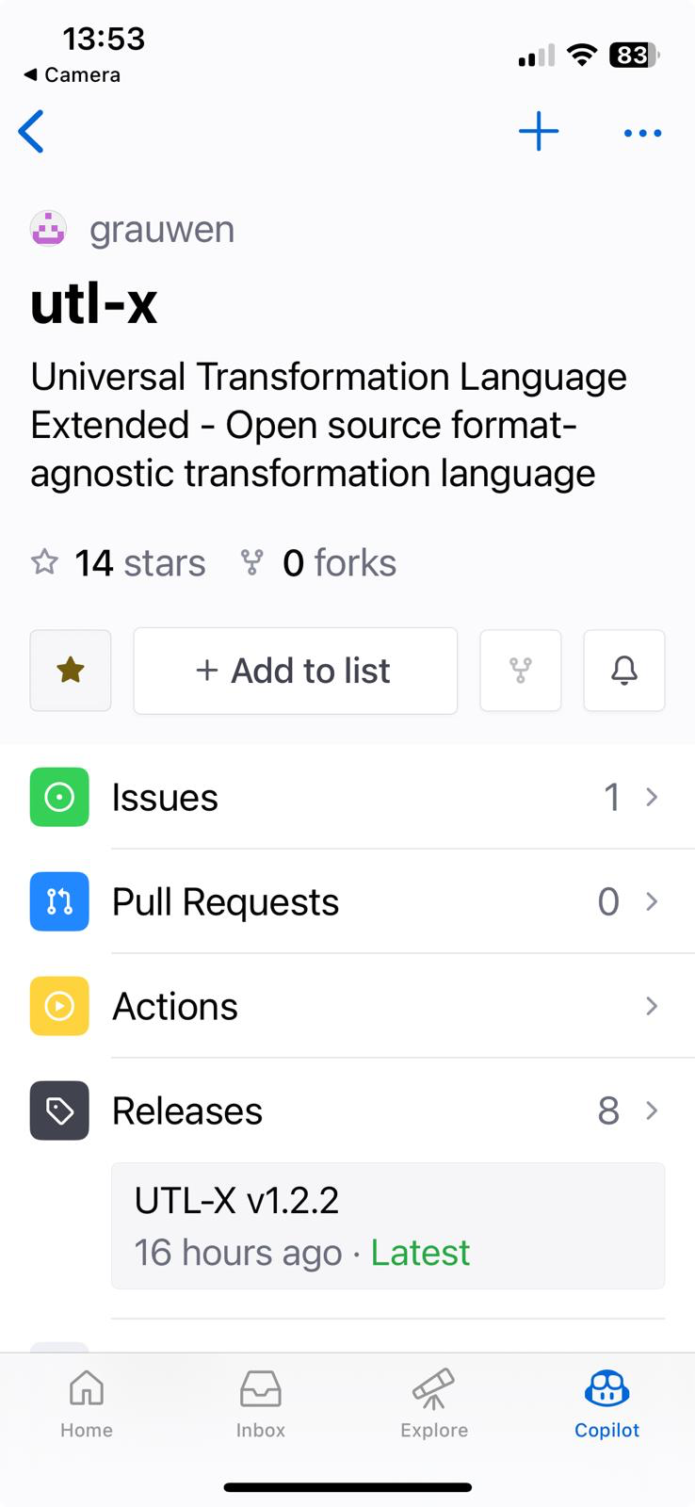

BEFORE YOU GO —
Give UTL-X a star.
Make a maintainer's whole week.
STAR UTL-X ★
It's open source and powered almost entirely by caffeine and GitHub stars.
★ Yours would genuinely make my day.
Scan · Sign in · Tap ★
On your phone and not logged in? Bookmark it now — star me from your laptop later. It still counts.
github.com/grauwen/utl-x
UTL·X Dank je wel!
© 2026 Glomidco B.V.
Notes:
Hold slide for Q&A. Pitch line: 'UTL-X is free and open source - the one thing that genuinely helps is a GitHub star. Scan, sign in, tap the star. If you're not logged in on your phone, bookmark it and star me from your laptop later.'

Slide 22


API DAYS AMSTERDAM · 2026
One language. All formats.
Please fill in
the above
feedback form
Thank you — questions?
Ir. Marcel A. Grauwen
github.com/grauwen/utl-x · utlx.dev · utlx-lang.org
Connect me on LinkedIn
Notes:
That's UTL-X: one open language for every data format - and their schemas. The alternative to DataWeave, free and open. Try it from utlx.dev, read the book at utlx-lang.org, star it on GitHub. Thank you - happy to take questions.

