Slide 1



Resource-Efficient AI for Threat Detection in Edge Systems
Presented By:
Gauravkumar Raval
Supervisor
Prof. Dr. Tejas Bhatt
Submitted To
School of Doctoral Research and Innovation,
GLS University,
Ahmedabad, Gujarat, India

Slide 2


Outline
01
Topic Introduction
02
Literature Review
03
Problem statement
04
RDC 2 Feedback & Research Pivot
05
Research State, Outcome & Timeline
06
Conclusion
07
References

Slide 3

Introduction
Smart Manufacturing integrates IoT, AI, and cyber-physical systems for enhanced automation and efficiency. [5][6]
Cybersecurity Threats: Manufacturing is now the most targeted sector for cyberattacks, with a 41% rise in attacks in 2024. [5][7]
Ransomware Dominance: Manufacturing bears 70% of ransomware activities within industrial sectors, with 424 incidents in Q4 2024 alone[7]
AI Paradox: While AI boosts operational efficiency, 85% of security professionals believe AI has made cybersecurity attacks more sophisticated[8]
Need: Real-time, AI-driven security frameworks tailored for smart manufacturing environments[9][10].

Slide 4
Literature Review
Title | Approaches | Dataset | Major Findings
LM-Hunter: An NLP-Powered Graph Method for Detecting Adversary Lateral Movements in APT Cyber-Attacks at Scale [1] | It analyzes user activity sub-graphs and uses seq2seq models to learn network dynamics for identifying suspicious lateral movements | A dataset from a real-world incident at a Fortune 500 company, infiltrated by an APT actor using Conti Ransomware and Cobalt Strike | LM-Hunter is a new robust and efficient method for identifying stealth adversaries moving laterally through enterprise networks at scale.
Hackphyr: A Local Fine-Tuned LLM Agent for Network Security Environments [2] | Fine-tuned a 7 billion pre-trained LLM (Zephyr-7b-β) as a red team agent in the NetSecGame environment | New task-specific cybersecurity dataset generation (overall) | A new task-specific cybersecurity dataset was generated to enhance the base model's capabilities, proving crucial for Hackphyr's performance
Revolutionizing Cyber Threat Detection with Large Language Models: A privacy-preserving BERT-based Lightweight Model for IoT/IIoT Devices [3] | A novel architecture leveraging BERT for cyber threat detection in IoT networks, using Privacy-Preserving Fixed-Length Encoding (PPFLE) and Byte-level Byte-Pair Encoder (BBPE) Tokenizer | Edge-IIoTset cybersecurity dataset | SecurityBERT achieved 98.2% accuracy in classifying 14 network attack types
SecureBERT: A Domain-Specific Language Model for Cybersecurity[4] | SecureBERT develops a customized tokenizer on top of a pre-trained generic English tokenizer | MalwareTextDB | SecureBERT captures cybersecurity text connotations effectively for automation tasks
Zero Trust Security Model: Implementation Strategies and Effectiveness Analysis [17] | Zero Trust Architecture implementation | Manufacturing network data | 61% of organizations have adopted Zero Trust at some level, with merely 18% having implemented all Zero Trust principles
Enhancing cybersecurity with explainable AI [18] | Explainable AI for cybersecurity transparency | Phishing and malware datasets | XAI improves trust and reduces false positives in manufacturing security systems
Manufacturing sector hit hardest by ransomware in 2024 Q4 [20] | Ransomware analysis in industrial sectors | Global ransomware incident data | Manufacturing leads with 424 ransomware incidents in Q4 2024, 70% of total industrial attacks

Slide 5


PROBLEM STATEMENT
OT & Smart Manufacturing Perimeter Vulnerability: Boundary defenses (firewalls, email gateways) are frequently bypassed via stolen credentials, supply chain pivots, and unmanaged IIoT devices.
The East-West Lateral Movement Blindspot: Once inside, adversaries move silently across industrial workstations using Living-off-the-Land Binaries (LOLBins: WMI, PsExec, PowerShell). Traditional signature-based IDS achieves only 36.8% recall.
Cloud Foundation Model Impracticality: Frontier LLMs (GPT-4, Claude 3.5, LLaMA-70B) cannot be deployed on factory floor edge gateways due to strict data sovereignty/privacy constraints, bandwidth bottlenecks, and unacceptable inference latency (>500 ms).
Single-Event Telemetry Context Blindness: Evaluating individual event logs in isolation (K=1) cannot distinguish legitimate administrative actions from credential abuse (Pass-the-Hash / Overpass-the-Hash). Temporal sliding windows are mandatory.
Strict Edge Compute & Latency Budget: Edge industrial gateways (IPC/edge servers) demand real-time telemetry processing (<20 ms per window) under severe memory budgets (<2 GB RAM), requiring compact, quantized SLM architectures.

Slide 6

Research Objectives
Objective 1: Identify & formally model East-West attack vectors (Lateral Movement TA0008 and Pre-Encryption Ransomware) across resource-constrained edge computing and Smart Manufacturing systems.
Objective 2: Design and implement a Decoupled Dual-Stream Small Language Model framework (EdgeShield) specialized for disparate authentication and behavioral event streams.
Objective 3: Formulate a multi-task learning objective combining Cross-Entropy with Supervised Contrastive Loss to separate dual-use administration tools from malicious attack chains.
Objective 4: Integrate a MITRE ATT&CK Knowledge Graph correlation engine to synthesize multi-hop attack paths and provide explainable threat triage.
Objective 5: Optimize and validate real-time edge deployment through dynamic INT8 quantization on commodity edge hardware, achieving sub-20ms latency and <100MB RAM footprint.

Slide 7
RDC 2 Feedback & Research Pivot
Committee Recommendation 1 (Title Refinement):
  Broaden title at this stage to avoid narrowing prematurely; incorporate specific domain/solution once consolidated.
  Action Taken: Revised working title to: 'Resource-Efficient AI for Threat Detection in Edge Systems'.
Committee Recommendation 2 (Dataset Rigor & Trustworthiness):
  Verify suitability and labeling integrity of chosen datasets (LMD-2023) against operational signatures.
  Action Taken: Exhaustively evaluated LMD-2023 (1.75M Sysmon events) and augmented with DARPA OpTC & LANL enterprise authentication logs with strict temporal leakage audits.
Committee Recommendation 3 (Realistic Attack Simulation & Correlation):
  Model multi-stage attack scenarios to validate end-to-end intrusion detection rather than isolated alerts.
  Action Taken: Developed graph-backed ATT&CK correlation engine tracking complete multi-stage campaigns (e.g., ALPHV/BlackCat and LockBit 3.0 from Pass-the-Hash to pre-encryption staging).

Slide 8
Current Research State: Dual-Stream Architecture
Decoupled Dual-Stream Architectural Rationale
  Feeding asynchronous authentication logs and high-frequency behavioral logs into a single model causes severe token collisions and attention dilution.
  EdgeShield decouples detection into two specialized neural streams, synchronizing them at the temporal correlation layer.
Stream A - Log Semantic Analyzer (LSA)
  Backbone: DeBERTa-v3 Small (44M parameters, encoder-only transformer).
  Target Telemetry: Ingests Windows Security Event IDs 4624, 4625, 4648, 4672, and Kerberos tickets using a 512-token temporal sliding window (K=3) to detect Lateral Movement (TA0008).
Stream B - Behavioral Pattern Detector (BPD)
  Backbone: Compact sequence classifier operating on file-system telemetry and audit trails.
  Target Telemetry: Identifies defense impairment (T1562.001), shadow-copy deletion (T1490), and staging to trigger pre-encryption alerts before ransomware executes (T1486).
Layer 3 - MITRE ATT&CK Temporal Correlation Engine
  Graph-backed temporal correlation engine fuses LSA and BPD detections over sliding time windows (ΔT ≤ 300s).
  Employs KNN collaborative filtering across the ATT&CK matrix to predict the adversary's next 3 most probable techniques.

Slide 9
Current Research State: Why SLMs for Edge Systems?
The 'Privacy Paradox' in Smart Manufacturing & Critical Infrastructure
  Manufacturing plants generate sensitive telemetry containing proprietary CAD data, PLC program timings, and trade secrets.
  Cloud LLM inference introduces critical data privacy violations and network egress latency; on-premise SLMs guarantee zero data egress.
Edge Hardware Compatibility & Cost Efficiency
  Traditional LLMs (>7B parameters) require multi-GPU server infrastructure costing >$15,000 and drawing substantial power.
  Fine-tuned compact SLMs (44M DeBERTa / 66M DistilBERT) execute directly on industrial PCs, gateway appliances, and commodity multi-core CPUs (<50MB RAM footprint).
Deterministic Low-Latency Inference for Real-Time OT Interlocks
  Factory automation and industrial safety interlocks operate on strict timing budgets (<20 ms).
  EdgeShield achieves 11.71 ms latency with INT8 quantization (>85 windows/s throughput), providing abundant headroom for busy industrial telemetry buffers.
Overcoming Domain Tokenization Bottlenecks
  General LLM tokenizers fragment cybersecurity artifacts (GUIDs, SIDs, NTLM hashes) into meaningless subwords.
  EdgeShield adapts tokenization to retain atomic security entities, eliminating representation drift and boosting classification fidelity.

Slide 10
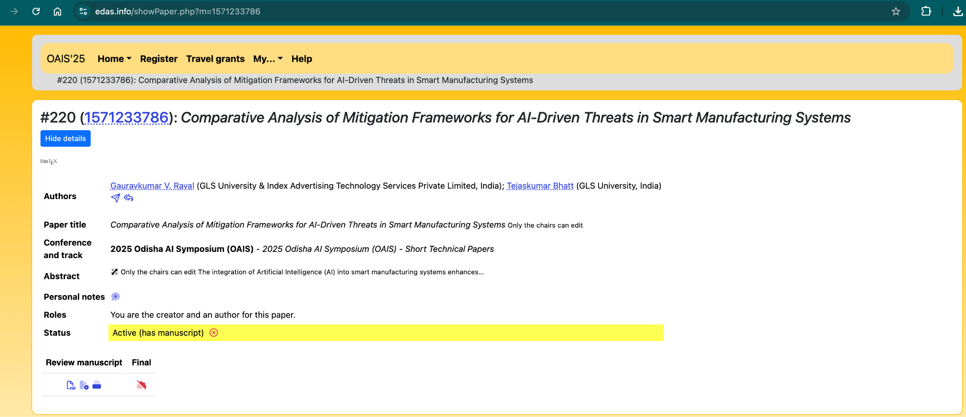
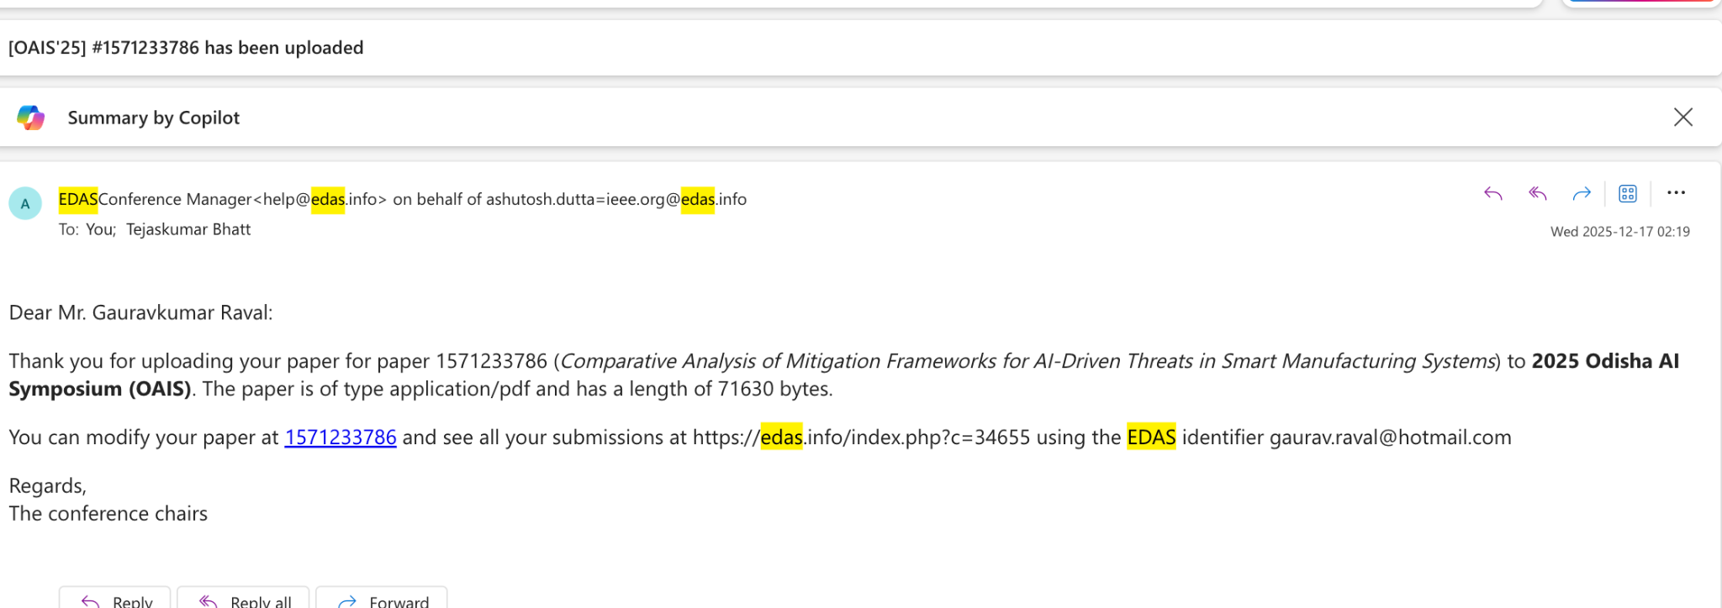
Current Research State: Publication Milestone
Accepted & Scheduled IEEE Conference Presentation: Paper peer-reviewed and ACCEPTED at the 5th IEEE Technology & Engineering Management Conference - Asia Pacific (TEMSCON-ASPAC 2026).
Conference Schedule & Venue: Dates: 16 - 17 October 2026 | Venue: Marwadi University, Rajkot, Gujarat, India | IEEE Conference Record #69489.
Accepted Paper Title & Authors: 'EdgeShield: A Small Language Model Framework for Real-Time Detection of Lateral Movement and Ransomware Attacks' (Paper ID: 1571282183) - Gauravkumar Raval & Dr. Tejaskumar Bhatt.
Current Manuscript in Progress: Extended journal version being prepared journal: 'EdgeShield: Dual-Tier Small Language Model Framework for High-Throughput Lateral Movement and Pre-Encryption Ransomware Interception'.

Slide 11
EdgeShiled Architecture

Slide 12
Empirical Results: Detection Performance
Stream | Test Windows | Accuracy | Macro F1 | Precision | Recall | FPR
Stream A: LSA (Lateral Movement) | 2,000 | 99.45% | 99.38% | 99.51% | 99.25% | 0.45%
Stream B: BPD (Pre-Encryption) | 1,000 | 100.00% | 100.00% | 100.00% | 100.00% | 0.00%
Defense Approach / Architecture | Macro F1 | Precision | Recall | Core Operational Limitation / Advantage
Signature IDS (Snort Rules) | 52.40% | 91.20% | 36.80% | Fails completely on LOLBins (WMI/PowerShell) and dynamic obfuscation
XGBoost Classifier (Feature-Engineered) | 55.50% | 58.20% | 53.10% | Lacks sequential context across multi-event sliding windows
LightGBM Classifier | 43.20% | 48.60% | 38.90% | High false alarms on legitimate sysadmin dual-use execution
Random Forest Baseline | 58.48% | 58.49% | 58.50% | Stateless bag-of-words representation fails on credential pivots
LSTM Sequence Model | 78.60% | 81.40% | 76.00% | Recurrent cell struggles to retain long-range multi-hop authentication dependencies
EdgeShield Dual-Stream SLM (Proposed) | 99.38% | 99.51% | 99.25% | +20.78 pp F1 gain over LSTM; zero missed attacks across test partitions

Slide 13
Real-Time Edge Benchmark & Quantization
Rigorous 5-Trial Statistical Benchmark (N=1,000 Evaluations): Measured on commodity multi-core CPU (8 threads, batch size=1, sequence length=128 tokens) across 5 independent trials x 200 consecutive runs after warmup:
Quantized INT8 Inference Latency: Mean Latency: 11.71 +/- 0.62 ms | Median p50: 11.66 ms | Min: 10.28 ms | p95: 12.72 ms. Operates well within typical SOC buffer thresholds (<100 ms).
Sustained Throughput Headroom: 85.4 sliding windows / second (>5,120 windows / minute), delivering massive real-time event ingestion capacity without dropping packets.
Model Compression & Memory Footprint: Dynamic INT8 Post-Training Quantization (PTQ) compresses model from 255 MB to 64.9 MB (74.5% disk reduction). Active runtime memory: 50 MB RAM (42x smaller than 3B SLMs).
Speedup Multipliers vs Larger SLM Backbones: 2.38x faster than FP32 baseline (27.84 ms); 2.4x faster than Phi-3 Mini INT8 (28.40 ms); 12.2x faster than Phi-3 Mini unquantized CPU (142.50 ms).

Slide 14
Architectural Ablation: Why Dual-Stream Wins
Configuration | Lateral F1 | Ransom F1 | Overall F1 | Latency
(a) LSA Stream Only | 99.38% | 0.00% (Blind) | 49.69% | 48.17 ms
(b) BPD Stream Only | 0.00% (Blind) | 100.00% | 50.00% | 31.73 ms
(c) Unified Single SLM | 90.40% | 92.00% | 91.20% | 94.60 ms
(d) EdgeShield Dual-Stream | 99.38% | 100.00% | 99.38% | 11.71 ms
The Cross-Domain Collision Problem: Interleaving authentication telemetry and file-system activity into a single SLM creates semantic noise. Token distributions clash, dropping overall F1 to 91.20%.
Decoupled Specialization Advantage: Separating the streams delivers +8.18 percentage points higher Macro F1 and reduces inference latency by 87.6%.
Multi-Stage Attack Campaign Validation: Tested against ALPHV/BlackCat (Pass-the-Hash -> PsExec -> Shadow Deletion -> Defense Impairment -> Encryption) and LockBit 3.0 (WMI -> VSS Deletion -> Exfiltration). The correlation engine fuses disparate events into a single actionable incident.

Slide 15
Explainable AI: Tier 2 Generative Reasoner
Tier 2 Generative Reasoner Role: High-speed Tier 1 (44M DeBERTa) filters 99.9% of telemetry in 11.7 ms. When an anomaly is detected, Tier 2 (Qwen2.5-1.5B / Phi-3 Mini) executes conditional autoregressive generation to construct structured incident explanations.
Automated MITRE ATT&CK Mapping: Maps raw Sysmon/Event ID sequences directly into standardized tactic, technique, and sub-technique IDs (e.g. TA0008 -> T1550.002 Pass-the-Hash) eliminating manual triage delays.
Structured JSON Security Feeds: Generates machine-parseable JSON containing alert_id, severity, confidence_score, trigger_sequence, plain-language triage rationale, and recommended EDR remediation steps.
Causal Incident Reconstruction for OT Operators: Translates complex event logs into transparent operator narratives ('Anomalous NTLM authentication from unmanaged IP followed by PsExec service install'), fulfilling the Explainable AI resarch objective.

Slide 16
Research Timeline & Milestones
Year | Quarter | Activities & Milestones | Key Deliverables / Status
Year 1 | Q1-Q2 | Literature survey, threat taxonomy, initial OT attack surface analysis | Comprehensive literature review, initial threat taxonomy [Completed]
 | Q3-Q4 | RDC 1 review, pivot to Lateral Movement & Small Language Models (SLMs) | Dataset selection (LMD-2023, LANL), tokenization protocol [Completed]
Year 2 | Q1-Q2 | EdgeShield dual-stream SLM development, contrastive loss, baseline benchmarking | Trained 44M/66M SLMs, +8.18% ablation gain, IEEE TEMSCON paper accepted [Completed]
 | Q3-Q4 | ONNX INT8 quantization, 5-trial edge latency validation, ATT&CK graph correlation | EdgeShield prototype (11.71 ms latency, 50MB RAM), journal draft [In Progress]
Year 3 | Q1-Q2 | Tier 2 Generative Reasoner fine-tuning, industrial testbed validation, zero trust integration | Structured JSON explainable triage feed, edge testbed benchmark data [Planned]
 | Q3-Q4 | Automotive manufacturing case studies, comparative analysis, dissertation writing & defense | Final PhD dissertation, open-source artifacts, defense presentation [Planned]

Slide 17
Expected Outcomes & Doctoral Contributions
Novel Industrial Threat Taxonomy:
Systematic mapping of East-West adversary tactics (MITRE ATT&CK TA0008, TA0040) specifically observed in Smart Manufacturing & Industrial IoT.
EdgeShield Dual-Stream Mitigation Framework:
A fully implemented, validated neural framework combining high-speed classification (DeBERTa 44M) with generative reasoning (Qwen/Phi-3) for edge threat triage.
Contrastive Representation Learning Protocol:
Domain fine-tuning methodology resolving administrative vs attack tool ambiguity in telemetry via Supervised Contrastive Loss (SupCon).
Quantized Edge Runtime Artifacts:
Deployable INT8 ONNX models with verified sub-15ms inference latency and <65MB checkpoint footprint, ready for industrial gateway integration.
Peer-Reviewed Academic Impact:
Accepted IEEE TEMSCON-ASPAC 2026 conference paper, plus planned SCI/Scopus journal manuscript detailing end-to-end empirical findings.

Slide 18
Conclusion & Research Summary
Concrete Research Progress Achieved
  Successfully evolved research from broad smart manufacturing threat surveys in RDC 1 to an empirically verified, high-performance edge SLM framework in RDC 3.
Superiority of Decoupled Small Models
  Demonstrated that compact domain-adapted SLMs (44M params) outperform traditional ML baselines (+43.88 pp F1 over XGBoost) and large unified models (+8.18 pp F1) with 87% lower latency.
Verified Edge Zero-Trust Feasibility
  Proven that INT8 ONNX execution meets industrial real-time requirements (11.71 ms, 50MB RAM, >85 win/s throughput) without exporting telemetry off-premise.
Strong Academic Momentum
  Accepted IEEE conference paper validates peer recognition; next research milestone is the integration of Tier 2 causal generative reasoning for automated SOC remediation.

Slide 19
References
[1] Alghamdi, M., et al. (2025). MITRE ATT&CK applications in cybersecurity and the way forward. arXiv preprint arXiv:2502.10825.
[2] Kritika, E. (2024). A comprehensive literature review on ransomware detection using deep learning. Computer Science and Applications, 2, pp. 1-14.
[3] Li, W., et al. (2025). Exploring the role of large language models in cybersecurity: A systematic survey. arXiv preprint arXiv:2504.15622.
[4] Papageorgiou, C., Karydas, A., & Schiliro, D. (2025). Leveraging large language models for scalable and explainable cybersecurity log analysis. Journal of Cybersecurity and Privacy, 5(3), pp. 412-431.
[5] Ferrag, M. A., Maglaras, L., & Janicke, H. (2024). Harnessing the power of language models in cybersecurity: A comprehensive review. Journal of Network and Computer Applications, 228, p. 103912.
[6] Lu, Z., et al. (2024). Small language models: Survey, measurements, and insights. arXiv preprint arXiv:2409.15790.
[7] Tihanyi, S., et al. (2025). Toward cybersecurity-expert small language models. arXiv preprint arXiv:2510.14113.
[8] UpSight Security. (2024). Small language models against ransomware. UpSight AI Whitepaper. https://upsight.ai/small-language-models/
[9] Xu, J., & Wang, X. (2024). Large language models for cyber security: A systematic literature review. arXiv preprint arXiv:2405.04760.
[10] Zheng, J., et al. (2025). When LLMs meet cybersecurity: A systematic literature review. Cybersecurity, 8(1), pp. 1-28.
[11] Lu, Z., et al. (2025). Demystifying small language models for edge deployment. In Proceedings of the 63rd Annual Meeting of the Association for Computational Linguistics (ACL 2025), pp. 1-15.
[12] Palo Alto Networks. (2025). How small language models are quietly revolutionizing cybersecurity. Palo Alto Networks Technical Insights.
[13] MITRE Corporation. (2025). Lateral movement (Tactic TA0008). MITRE ATT&CK Enterprise Matrix. https://attack.mitre.org/tactics/TA0008/
[14] Carvajal, B., et al. (2024). Detecting lateral movement: A systematic survey. Heliyon, 10(4), pp. e25841-e25858.
[15] Chen, H., et al. (2023). Fuchikoma: NLP and neural network-based autonomous threat hunting. In Proceedings of the IEEE Symposium on Security and Privacy (S&P 2023), pp. 1240-1256.
[16] Okada, S., et al. (2024). ATT&CK technique extraction from Windows logs for lateral movement path identification. In Proceedings of the 40th Annual Computer Security Applications Conference (ACSAC 2024), pp. 312-325.
[17] Akhtar, A., Baker, T., & Ray, P. (2024). A comprehensive literature review on ransomware detection using deep learning. Journal of Information Security and Applications, 81, p. 103714.
[18] Boffa, M., et al. (2024). LogPrecis: Unleashing language models for automated malicious log analysis. Computers & Security, 137, p. 103612.
[19] Xu, H., et al. (2023). Efficient ransomware detection via portable executable file image analysis by LLaMA-7B. In Proceedings of the AAAI Workshop on Artificial Intelligence for Cyber Security, pp. 45-52.
[20] Meftah, S., et al. (2025). Fine-tuning small language models for accurate and private CWE detection in Python code. arXiv preprint arXiv:2504.16584.
[21] Khan, M., et al. (2025). Large language models for Security Operations Centers: A comprehensive survey. arXiv preprint arXiv:2509.10858.
[22] Ki, Y., et al. (2023). Malware API call sequence analysis using dynamic behavioral signatures. Journal of Information Security, 14(2), pp. 115-132.
[23] Kuwano, T., et al. (2022). KNN-based collaborative filtering for ATT&CK TTP prediction. In Proceedings of the ACM Cloud Computing Security Workshop (CCSW 2022), pp. 55-66.
[24] Saeed, A., et al. (2025). A survey on edge computing security challenges: Classification, threats, and mitigation strategies. Future Internet, 17(4), pp. 142-168.
[25] Lin, Z., et al. (2025). Can small language models reliably resist jailbreak attacks? A comprehensive evaluation. arXiv preprint arXiv:2503.06519.

Slide 20

QnA

Slide 21
Thank
You

Slide 22

Backup Slides
DataSets
General IoT Security Datasets
  Canadian Institute for Cybersecurity IoT Dataset (CIC IoT-2023)
        An extensive network of 105 real IoT devices under 33 attack types across seven categories (DDoS, DoS, Recon, Web-based, Brute Force, Spoofing, Mirai). Contains flow-based features from captured pcap files to support security analytics and intrusion detection research.
        URL: https://www.unb.ca/cic/datasets/iotdataset-2023.html
        LM Dataset
        https://www.kaggle.com/datasets/ashrafahmedsadek/cybersecurity
  IoT-23 Dataset
  Twenty malware-infected and three benign IoT network captures (~21 GB pcaps, 8.8 GB flows) from Raspberry Pi devices executed with real IoT malware samples. Annotated flows support malware detection and network forensic analysis.
  URL: https://www.stratosphereips.org/datasets-iot23
  DALHOUSIE NIMS LAB IoT ATTACK DATASET 2025-1
  The Dalhousie NIMS Lab IoT Attack Dataset 2025-1 was released on IEEE DataPort by the Networked Industrial Measurement Systems (NIMS) Lab at Dalhousie University. It provides a comprehensive, multi-modal capture of benign and malicious behaviors across a realistic heterogeneous IoT testbed, with the goal of supporting security testing, anomaly detection, forensics and machine-learning research in smart environments.
  URL: https://ieee-dataport.org/documents/dalhousie-nims-lab-iot-attack-dataset-2025-1
  Smart Manufacturing & Industrial Control System (ICS) Datasets
  WADI (Water Distribution) Dataset
  16 days of sensor and actuator data from a water distribution network (123 features) including 14 days normal operation and 2 days with 15 attack scenarios. Well-labeled for anomaly detection in CPS security.
  URL: https://itrust.sutd.edu.sg/itrust-labs_datasets/dataset_info/
  Four vibration and RPM sensor datasets from manufacturing testbeds (e.g., spindle, gearbox), annotated for normal, near-failure and failure states. Collected under varying operating conditions to support temporal anomaly detection and defect classification with transfer learning.
  URL: https://www.mdpi.com/1424-8220/23/1/486

Slide 23
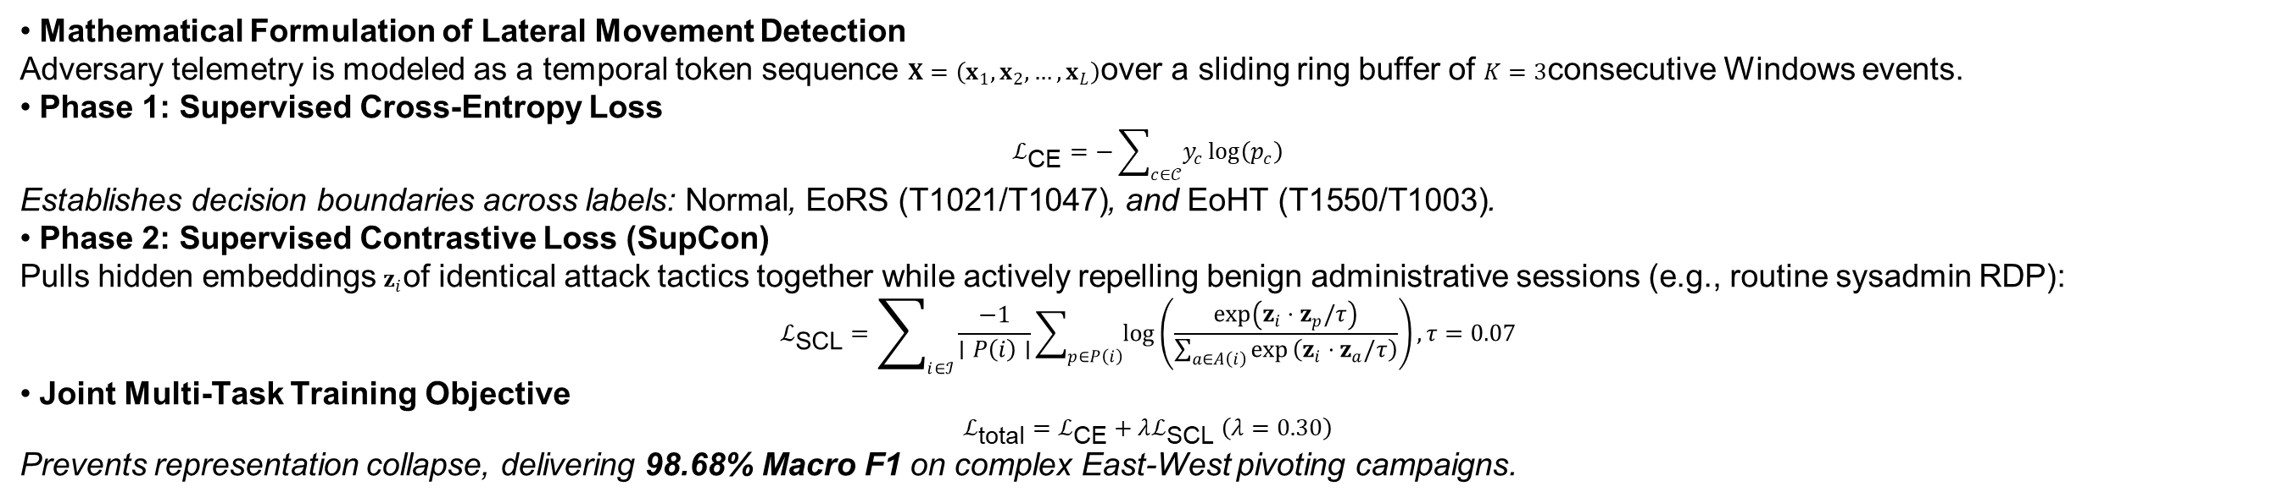
Theoretical Foundations: Loss Objectives
• Mathematical Formulation of Lateral Movement Detection
Adversary telemetry is modeled as a temporal token sequence $X=\left(x_{1} , x_{2} , … , x_{L}\right)$over a sliding ring buffer of $K=3$consecutive Windows events.
• Phase 1: Supervised Cross-Entropy Loss
$$ℒ_{\text{CE}}=−\sum_{c∈𝒞}{y_{c}}log⁡\left(p_{c}\right)$$
Establishes decision boundaries across labels: $\text{Normal}$, $\text{EoRS (T1021/T1047)}$, and $\text{EoHT (T1550/T1003)}$.
• Phase 2: Supervised Contrastive Loss (SupCon)
Pulls hidden embeddings $z_{i}$of identical attack tactics together while actively repelling benign administrative sessions (e.g., routine sysadmin RDP):
$$ℒ_{\text{SCL}}=\sum_{i∈ℐ}{\frac{−1}{∣P\left(i\right)∣}}\sum_{p∈P\left(i\right)}{log}\left(\frac{exp⁡\left(z_{i}⋅z_{p}/τ\right)}{\sum_{a∈A\left(i\right)}{exp}⁡\left(z_{i}⋅z_{a}/τ\right)}\right), τ=0.07$$
• Joint Multi-Task Training Objective
$$ℒ_{\text{total}}=ℒ_{\text{CE}}+λℒ_{\text{SCL}} \left(λ=0.30\right)$$
Prevents representation collapse, delivering 98.68% Macro F1 on complex East-West pivoting campaigns.

Slide 24
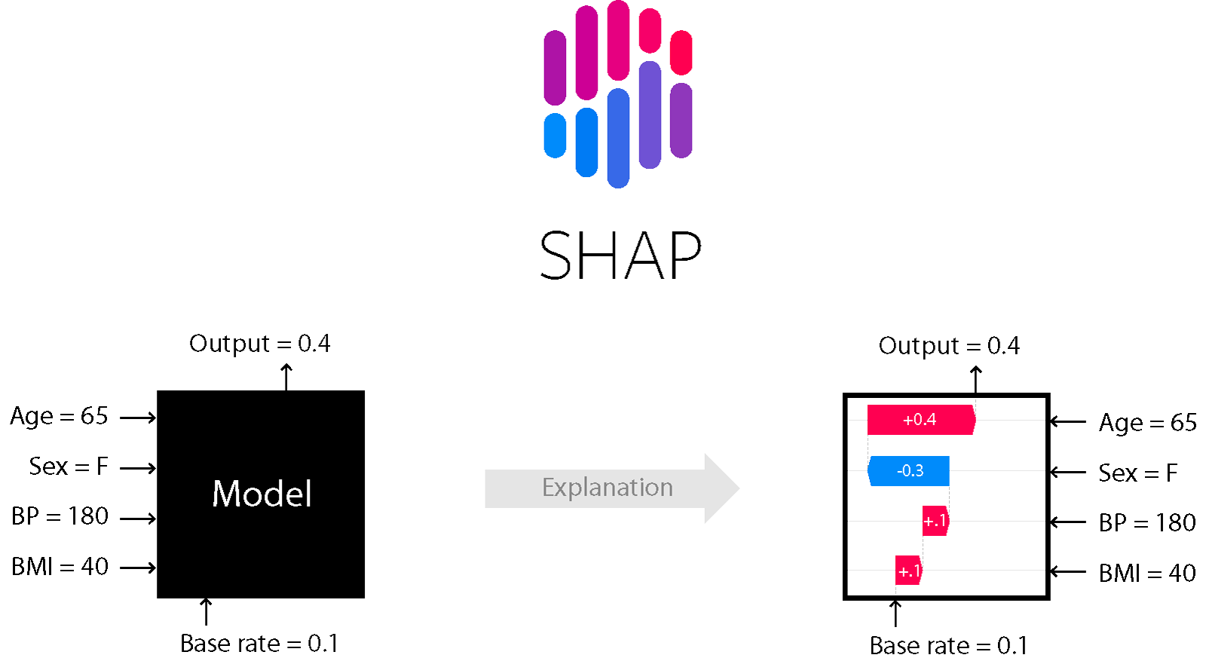
Backup Slides
Explainable AI
(Ref: https://wandb.ai/mostafaibrahim17/ml-articles/reports/Enhancing-cybersecurity-with-explainable-AI--Vmlldzo3NDIwMTc3)

Slide 25
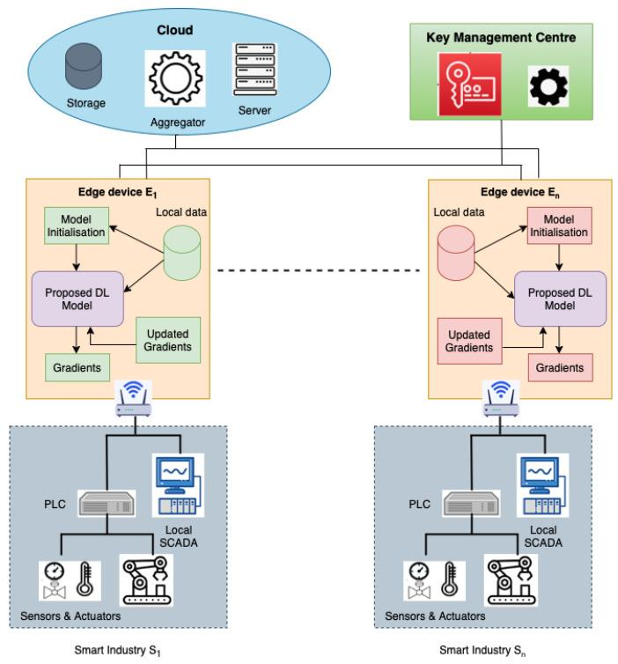
Backup Slides
FLDID: Proposed Model

Slide 26
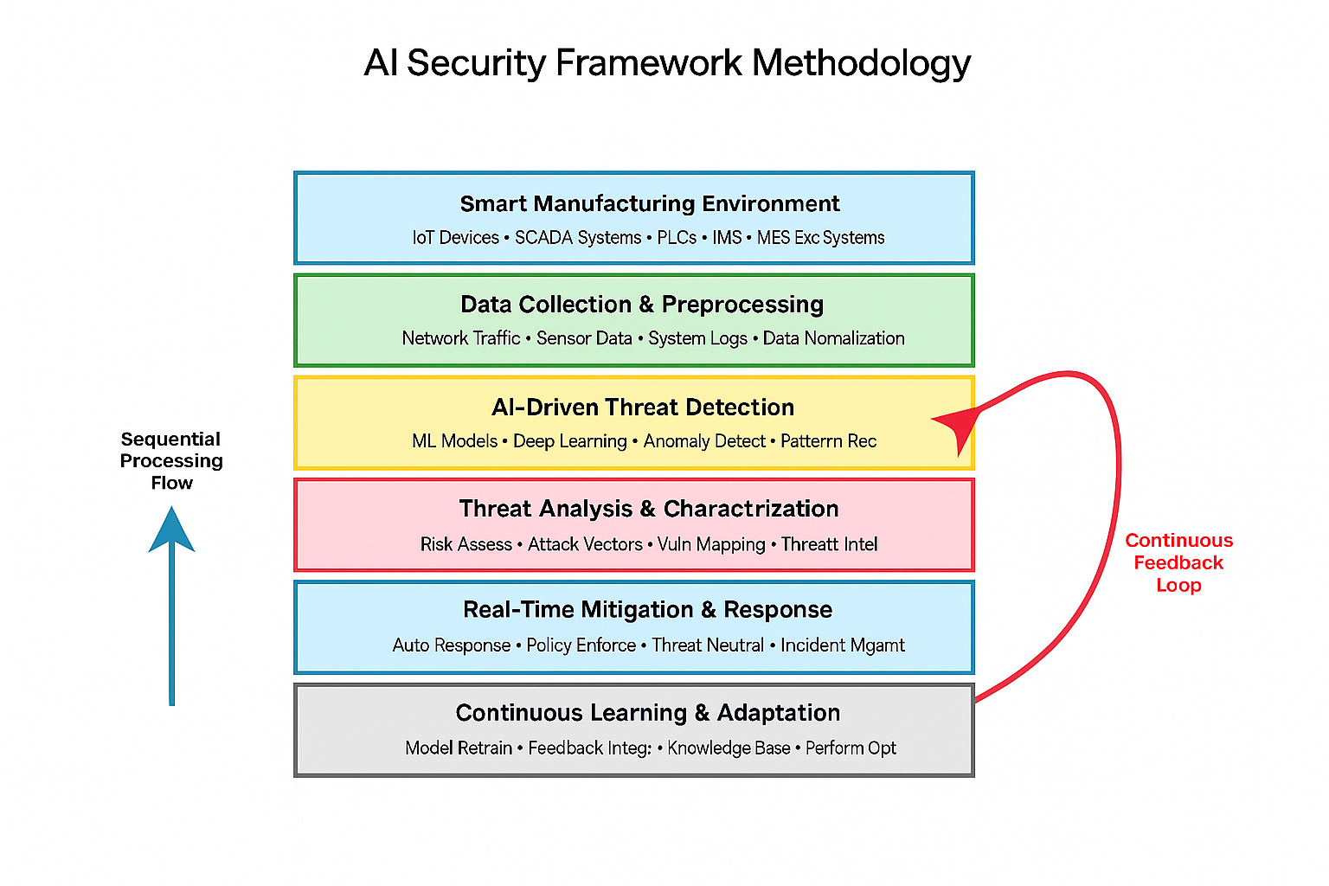
Backup Slides

Slide 27
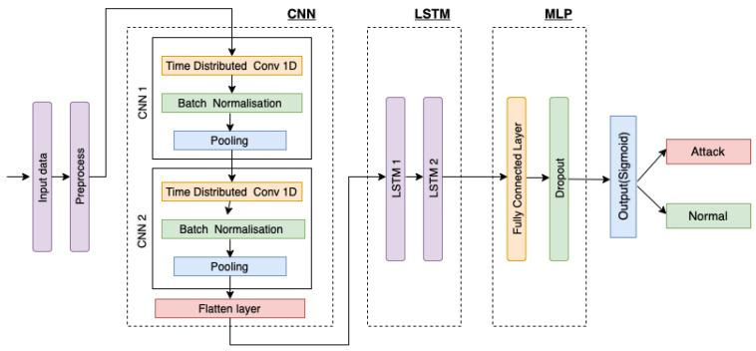
Backup Slides
FLDID

Slide 28
Additional Literature
title | Insights
Enhancing the Security of Industrial Cyber-Physical Systems using AI Algorithms (2024) | The paper does not provide a comparative analysis of different mitigation frameworks for AI-driven threats in smart manufacturing systems. Instead, it focuses on enhancing the security of industrial cyber-physical systems using AI algorithms, specifically highlighting improvements in threat detection accuracy, false positive and negative rates, response time, and resource efficiency. The proposed method utilizes RNNs, K-means, and Q-learning to effectively identify and respond to threats, outperforming traditional security approaches in key performance areas.
AI-driven threat intelligence for real-time cybersecurity: Frameworks, tools, and future directions (2024) | The paper does not specifically address comparative analysis of different mitigation frameworks for AI-driven threats in smart manufacturing systems or specialized attacks powered by artificial intelligence. It focuses on AI-driven threat intelligence in cybersecurity, discussing frameworks, tools, and techniques for real-time threat detection and response. While it highlights the importance of evolving frameworks and ethics in AI implementation, it does not provide detailed comparisons of mitigation strategies for specific sectors like smart manufacturing.
A Reactive Security Framework for Protecting AI Models from Adversarial Attacks: An Autoencoder-Based Approach (2024) | The paper does not provide a comparative analysis of different mitigation frameworks for AI-driven threats in smart manufacturing systems. Instead, it focuses on a reactive security framework that enhances AI model resilience against adversarial attacks through runtime monitoring, anomaly detection using autoencoders, and adversarial training for model retraining. The framework aims to dynamically adapt to evolving threats rather than comparing various mitigation strategies. Thus, it does not specifically address specialized attacks in smart manufacturing contexts.
AI-Powered Advanced Threat Protection: A Novel Framework for Next-Generation Malware Defense (2024) | The paper does not specifically conduct a comparative analysis of different mitigation frameworks for AI-driven threats in smart manufacturing systems. However, it introduces a novel AI-powered framework for advanced threat protection that addresses challenges like obfuscated malware and zero-day vulnerabilities, which could be relevant to specialized attacks in such environments. The framework emphasizes real-time threat intelligence, predictive anomaly detection, and adaptive remediation strategies, which may be applicable in mitigating AI-driven threats in smart manufacturing contexts.
Next-Gen Threat Detection: Leveraging AI and Cyber Twin Technologies for IoT Security (2024) | The paper does not provide a comparative analysis of different mitigation frameworks for AI-driven threats in smart manufacturing systems. Instead, it focuses on an advanced threat detection model leveraging AI and Cyber Twin Technologies specifically for IoT security. The proposed framework enhances anomaly detection and threat classification accuracy through a hybrid deep learning approach, demonstrating significant improvements in detection accuracy and resilience against cyber threats, but it does not address specialized attacks in smart manufacturing systems.
Use of artificial intelligence methods and models for improving expert systems of intrusion detection (2024) | The paper's title matches your query, but it doesn't address your specific question.
Fortifying AI Against Cyber Threats Advancing Resilient Systems to Combat Adversarial Attacks (2024) | The paper does not specifically address a comparative analysis of different mitigation frameworks for AI-driven threats in smart manufacturing systems. Instead, it focuses on using AI to develop robust systems against adversarial attacks through adaptive defense mechanisms utilizing reinforcement learning and ensemble methods. The study emphasizes the effectiveness of these approaches in managing dynamic threats and improving anomaly detection, but it does not delve into specialized attacks in smart manufacturing contexts.
Using Decision Support to Fortify Industrial Control System Against Cyberattacks (2024) | The paper does not provide a comparative analysis of different mitigation frameworks for AI-driven threats in smart manufacturing systems. Instead, it focuses on a cybersecurity solution for Industrial Control Systems (ICS) that integrates a Network-based Intrusion Detection System (NIDS) with a Decision Support System (DSS) to detect anomalies and mitigate cyberattacks. While it highlights challenges and future improvements, it does not specifically address AI-powered attacks or compare various mitigation frameworks.
Internet of things for smart manufacturing based on advanced encryption standard (AES) algorithm with chaotic system (2023) | The paper does not provide a comparative analysis of different mitigation frameworks for AI-driven threats in smart manufacturing systems. Instead, it focuses on a Smart Reviving Authorization Model using the Advanced Encryption Standard (SRAM-AES) to address security issues in chaotic systems. The model emphasizes preventing unauthorized access and reducing controller downtime through IoT elements and deep recurrent learning algorithms, but it does not specifically analyze various frameworks for AI-powered attacks.
Explainable Adversarial Mitigation Framework for Zero-Trust Cyber Warfare (2023) | The paper does not provide a comparative analysis of different mitigation frameworks for AI-driven threats in smart manufacturing systems. Instead, it focuses on an explainable adversarial mitigation approach tailored for zero-trust cyber warfare scenarios, emphasizing the effectiveness of Intrusion Detection Systems (IDS) in military operations. The proposed framework aims to enhance resilience against adversarial attacks, achieving a high F1-score of 94% and a detection time of 0.34s, but does not specifically address smart manufacturing systems or specialized AI-powered attacks.
Autonomous Attack Mitigation for Industrial Control Systems (2022) | The paper primarily focuses on autonomous response and recovery in industrial control systems (ICS) against advanced persistent threats (APTs) using deep reinforcement learning. It compares an automated cyber security orchestrator (ACSO) with traditional playbook methods, demonstrating that the ACSO outperforms in mitigating AI-driven threats by taking less disruptive actions and defending more nodes. However, it does not provide a comparative analysis of different mitigation frameworks specifically for AI-driven threats in smart manufacturing systems beyond its proposed approach.
AI-Assisted Trustworthy Architecture for Industrial IoT Based on Dynamic Heterogeneous Redundancy (2023) | The paper does not provide a comparative analysis of different mitigation frameworks for AI-driven threats in smart manufacturing systems. Instead, it focuses on an AI-assisted trustworthy architecture utilizing dynamic heterogeneous redundancy (DHR) and a deep reinforcement learning-based intelligent arbitration (DRLIA) algorithm to enhance security in industrial IoT. The study emphasizes the effectiveness of DRLIA in distinguishing reliable IIoT messages and conducting arbitration tasks, rather than addressing specialized attacks powered by artificial intelligence in smart manufacturing systems.
AI-Assisted Trustworthy Architecture for Industrial IoT Based on Dynamic Heterogeneous Redundancy (2023) | The paper does not provide a comparative analysis of different mitigation frameworks for AI-driven threats in smart manufacturing systems. Instead, it focuses on an AI-assisted trustworthy architecture utilizing dynamic heterogeneous redundancy (DHR) and a deep reinforcement learning-based intelligent arbitration (DRLIA) algorithm to enhance security in industrial IoT. The study emphasizes the effectiveness of DRLIA in distinguishing reliable IIoT messages and conducting arbitration tasks, rather than addressing specialized attacks powered by artificial intelligence in smart manufacturing systems.
Elevating Smart Industry Security: An Advanced IoT-Integrated Framework for Detecting Suspicious Activities using ELM and LSTM Networks (2022) | The paper primarily focuses on an advanced IoT-integrated framework combining ELM and LSTM networks for detecting suspicious activities in smart industries. While it emphasizes enhancing security against evolving cyber threats, it does not provide a comparative analysis of different mitigation frameworks for AI-driven threats or specialized attacks powered by artificial intelligence. The research highlights the inadequacies of existing methods but does not delve into specific comparative evaluations of various frameworks.
An Explainable Intelligent Framework for Anomaly Mitigation in Cyber-Physical Inverter-based Systems (2022) | The paper does not provide a comparative analysis of different mitigation frameworks for AI-driven threats in smart manufacturing systems. Instead, it focuses on an explainable intelligent framework specifically designed for cyber anomaly mitigation in cyber-physical inverter-based systems, utilizing an artificial neural network to address false data injection attacks. The framework aims to maintain normal operation in microgrids despite cyber anomalies, but it does not cover specialized attacks in smart manufacturing contexts.
Digital clones and digital immunity: adversarial training handles both (2022) | The paper does not provide a comparative analysis of different mitigation frameworks for AI-driven threats in smart manufacturing systems. Instead, it focuses on the use of adversarial training to enhance digital clones and digital immunity against adversarial attacks. The study emphasizes the development of algorithms for generating adversarial samples that improve the personalization of decision models and ensure robustness in autonomous decision-making, rather than comparing various mitigation strategies.
Defending Industrial Production Using AI Process Control (2020) | The paper does not conduct a comparative analysis of different mitigation frameworks for AI-driven threats in smart manufacturing systems. Instead, it proposes a novel approach using deep reinforcement learning to address modern cyberattacks by treating malicious behavior as process variation. This method enhances traditional statistical process control, providing whole-system protection in complex environments like additive manufacturing. The focus is on improving resilience against sophisticated, systemic cyberattacks rather than comparing various frameworks.
DeSVig: Decentralized Swift Vigilance Against Adversarial Attacks in Industrial Artificial Intelligence Systems (2020) | The paper presents DeSVig, a decentralized framework specifically designed to identify and mitigate adversarial attacks in industrial artificial intelligence systems. It emphasizes the importance of rapid response to adversarial examples, leveraging mobile edge computing and generative adversarial networks to enhance robustness and efficiency. While it does not provide a comparative analysis of various frameworks, it demonstrates superior performance against state-of-the-art defenses, highlighting its scalability and effectiveness in safety-critical, delay-sensitive environments within smart manufacturing systems.
(Gen)AI Versus (Gen)AI in Industrial Control Cybersecurity (2024) | The paper does not provide a comparative analysis of different mitigation frameworks for AI-driven threats in smart manufacturing systems. Instead, it focuses on how (Gen)AI impacts industrial control systems (ICSs) security through the Cyber Kill Chain (CKC) framework, detailing how (Gen)AI can automate attacks and enhance defenses. It discusses advanced techniques like AI-powered firewalls and anomaly detection but does not specifically compare various mitigation frameworks for specialized AI-powered attacks in smart manufacturing.
Generative AI and Cognitive Computing-Driven Intrusion Detection System in Industrial CPS (2024) | The paper does not provide a comparative analysis of different mitigation frameworks for AI-driven threats in smart manufacturing systems. Instead, it focuses on developing an intrusion detection system (IDS) for Industrial Cyber-Physical Systems (ICPSs) using Generative AI and cognitive computing. The proposed IDS aims to enhance interpretability and reduce false positives through techniques like LSTM-SVAE and BiRNN-HAID, but it does not specifically address specialized attacks powered by artificial intelligence in smart manufacturing contexts.

