Slide 1



Small Language Model based Lateral Movement Detection approach for Smart Manufacturing Systems
Presented By:
Gauravkumar Raval
Supervisor
Prof. Dr. Tejas Bhatt
Submitted To
School of Doctoral Research and Innovation,
GLS University,
Ahmedabad, Gujarat, India

Slide 2
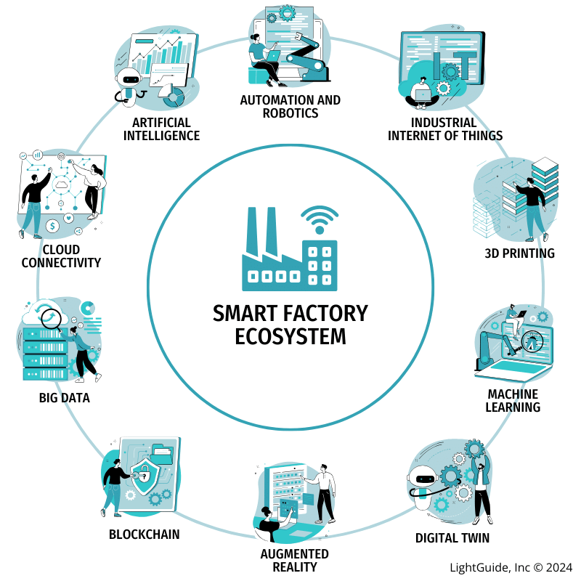

Outline
01
Topic Introduction
02
Literature Review
03
Problem statement
04
RDC 1 Feedback & Research Pivot
05
Research State, Outcome & Timeline
06
Conclusion
07
References

Slide 3

Introduction
Smart Manufacturing integrates IoT, AI, and cyber-physical systems for enhanced automation and efficiency. [5][6]
Cybersecurity Threats: Manufacturing is now the most targeted sector for cyberattacks, with a 41% rise in attacks in 2024. [5][7]
Ransomware Dominance: Manufacturing bears 70% of ransomware activities within industrial sectors, with 424 incidents in Q4 2024 alone[7]
AI Paradox: While AI boosts operational efficiency, 85% of security professionals believe AI has made cybersecurity attacks more sophisticated[8]
Need: Real-time, AI-driven security frameworks tailored for smart manufacturing environments[9][10].

Slide 4
Literature Review
Title | Approaches | Dataset | Major Findings
LM-Hunter: An NLP-Powered Graph Method for Detecting Adversary Lateral Movements in APT Cyber-Attacks at Scale [1] | It analyzes user activity sub-graphs and uses seq2seq models to learn network dynamics for identifying suspicious lateral movements | A dataset from a real-world incident at a Fortune 500 company, infiltrated by an APT actor using Conti Ransomware and Cobalt Strike | LM-Hunter is a new robust and efficient method for identifying stealth adversaries moving laterally through enterprise networks at scale.
Hackphyr: A Local Fine-Tuned LLM Agent for Network Security Environments [2] | Fine-tuned a 7 billion pre-trained LLM (Zephyr-7b-β) as a red team agent in the NetSecGame environment | New task-specific cybersecurity dataset generation (overall) | A new task-specific cybersecurity dataset was generated to enhance the base model's capabilities, proving crucial for Hackphyr's performance
Revolutionizing Cyber Threat Detection with Large Language Models: A privacy-preserving BERT-based Lightweight Model for IoT/IIoT Devices [3] | A novel architecture leveraging BERT for cyber threat detection in IoT networks, using Privacy-Preserving Fixed-Length Encoding (PPFLE) and Byte-level Byte-Pair Encoder (BBPE) Tokenizer | Edge-IIoTset cybersecurity dataset | SecurityBERT achieved 98.2% accuracy in classifying 14 network attack types
SecureBERT: A Domain-Specific Language Model for Cybersecurity[4] | SecureBERT develops a customized tokenizer on top of a pre-trained generic English tokenizer | MalwareTextDB | SecureBERT captures cybersecurity text connotations effectively for automation tasks
Zero Trust Security Model: Implementation Strategies and Effectiveness Analysis [17] | Zero Trust Architecture implementation | Manufacturing network data | 61% of organizations have adopted Zero Trust at some level, with merely 18% having implemented all Zero Trust principles
Enhancing cybersecurity with explainable AI [18] | Explainable AI for cybersecurity transparency | Phishing and malware datasets | XAI improves trust and reduces false positives in manufacturing security systems
Manufacturing sector hit hardest by ransomware in 2024 Q4 [20] | Ransomware analysis in industrial sectors | Global ransomware incident data | Manufacturing leads with 424 ransomware incidents in Q4 2024, 70% of total industrial attacks

Slide 5


PROBLEM STATEMENT
Critical Security Gaps: Traditional IT security tools are ineffective in smart manufacturing due to unique operational and real-time requirements. [9][10]
AI-Driven Threats: Attackers leverage AI to automate attacks. For example, with gen AI reducing phishing email creation time by 99.5% [8]
Operational Constraints: High false positives or slow response can cause costly downtime or safety risks[16]
Limited Attack Data: Individual manufacturing facilities lack sufficient attack examples to build robust detection models [11]
Privacy Concerns: Organizations are reluctant to share cybersecurity data, hindering collaborative defense efforts [11]
Lack of Robust Frameworks: No comprehensive, real-time, AI-based mitigation framework exists that addresses adversarial ML attacks in manufacturing [18][19]

Slide 6

Research Objectives
Identify threats in smart manufacturing environments.
Develop real-time mitigation framework using SLM techniques for selected attack(s).
Enhance robustness of SLM against identified attack(s) in industrial control system environments.
Identify impact of emerging technologies including digital twins, zero trust architecture, and post-quantum cryptography
Evaluate the proposed framework using explainable AI principles for transparency and trust

Slide 7
RDC 1 Feedback & Research Pivot
Committee Feedback (June 2025): Narrow the scope to a single attack vector for higher research depth.
  Identify specialized datasets for the chosen manufacturing sector.
Action Taken (H2 2025): Primary Focus: Lateral Movement (LM) Detection. LM is the critical phase where attackers maneuver through the internal network (East-West traffic) after the initial breach.
  Secondary/Backup Focus: Ransomware Detection
  Strategic Industry Choice: Automotive Smart Manufacturing. This sector features high-value Intellectual Property (IP) and complex assembly-line IoT devices making LM detection vital.

Slide 8
Current Research State
Following an exhaustive 6-month review, the research has transitioned from general threat modeling to data-driven SLM training.
Selected Datasets:
  LMD-2023 (1.8M Sysmon logs): High-fidelity dataset focusing on Process Tree Labeling, allowing the Small Language Model (SLM) to learn the "origin" of malicious commands within host logs.
  LANL (Los Alamos National Laboratory): Comprehensive authentication logs that capture realistic administrative tool abuse e.g. LOLBins like PowerShell/Windows Management Instrumentation (WMI), which are primary Lateral Movement (LM) techniques.
Preliminary Work: Initial approach of tokenization strategies for mapping Windows Event Logs and Sysmon data into a format suitable for Small Language Models (SLMs).

Slide 9
Current Research State
Why Small Language Model (SLM)? Traditional LLMs are too resource-heavy for "at the edge" industrial deployment. (e.g. GPT4 - 1 Trillion vs DistilBERT - 66 Million)
Model Parameters: Utilizing LLM models with under 8B parameters (e.g., DistilBERT - 66 M or similar) to ensure low-latency inference on industrial gateways.
Privacy-First: SLMs allow for on-premises deployment, ensuring sensitive manufacturing telemetry never leaves the facility, addressing the "Privacy Paradox" identified in RDC 1.

Slide 10
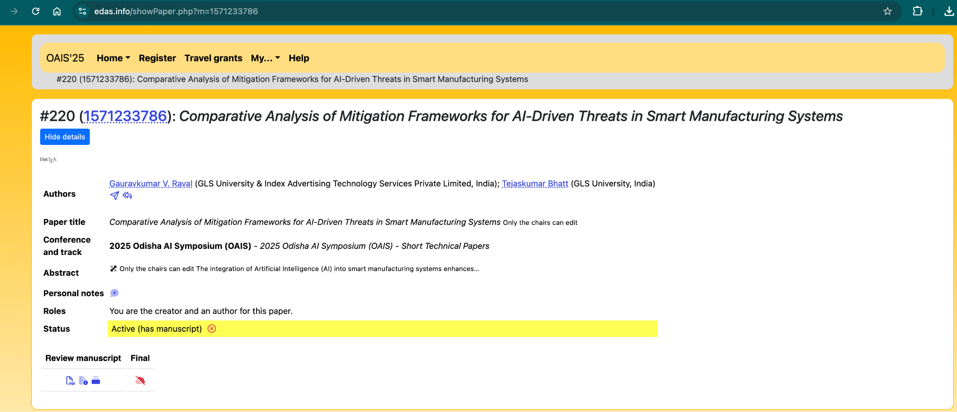
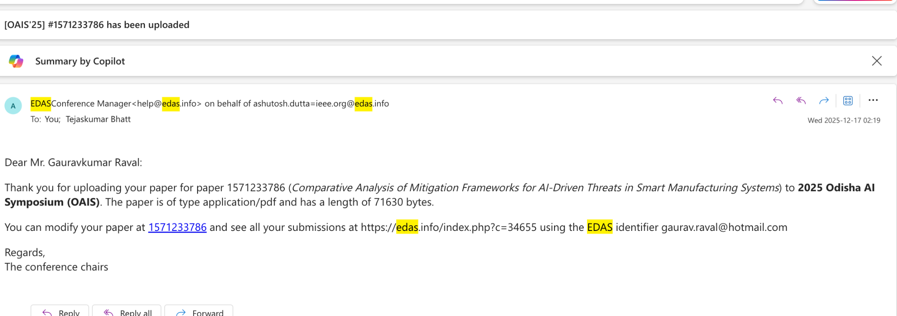
Current Research State
Publication under review for IEEE Tech Focus Conference - Odisha AI Symposium:
Comparative Analysis of Mitigation Frameworks for AI-Driven Threats in Smart Manufacturing Systems

Slide 11
Research Timeline
Year | Quarter | Activities & Milestones | Key Deliverables
Year 1 | Q1-Q2 | Literature review, federated learning framework design , digital twin architecture planning | Comprehensive literature survey, initial framework design
 | Q3-Q4 | Analysis of attack(s), dataset collection, experimental training for LM | Threat taxonomy, Training dataset(s) & validation for approach - SLM to detect LM attack
Year 2 | Q1-Q2 | SLM training for LM attacks with multiple dataset(s) & robustness testing | Functional LLM model(s), robustness evaluation framework
 | Q3-Q4 | Validation & optimisation for SLM in test environment | Detection accuracy & performance measurement on edge devices
Year 3 | Q1-Q2 | Formulate ways to train & improve, run real-world validation, performance benchmarking | Improvement framework, real-world benchmarking data
 | Q3-Q4 | Industrial case studies, comparative analysis, dissertation writing and defense preparation | Final dissertation, defense presentation

Slide 12
Expected Outcome
Threat Taxonomy: Classification of AI-driven threats for Industrial Control Systems
Identification of threat(s) & mitigation framework: SLM based lateral movement attack detection framework using SLM
Training with dataset : Trained SLM with LM dataset
Digital Twin Integration: Real-time edge compute monitoring without operational performance impact
Future-Ready: Potential impact of post-quantum cryptographic & future threats.

Slide 13
Conclusion
The research has successfully moved from broad "AI Security" to a targeted, data-backed approach for Lateral Movement.
The selection of Automotive Manufacturing provides a realistic, high-stakes testbed.
The next milestone is the Trained SLM prototype by next review.

Slide 14
References
Pérez-Gomariz, M., et al. (2025). LM-Hunter: An NLP-Powered Graph Method for Detecting Adversary Lateral Movements in APT Cyber-Attacks at Scale. Computer Networks, 262, pp. 104521-104535.
Rigaki, M., et al. (2025). Building Adaptive and Transparent Cyber Agents with Local Language Models. Expert Systems with Applications, 262, pp. 125123-125140.
Ferrag, M. A., et al. (2023). Revolutionizing Cyber Threat Detection with Large Language Models: A Privacy-Preserving BERT-Based Lightweight Model for IoT/IIoT Devices. arXiv preprint, 2306.14263, pp. 1-15.
Ameri, K., et al. (2022). SecureBERT: A Domain-Specific Language Model for Cybersecurity. arXiv preprint, 2204.02685, pp. 1-13
SotaTek. (2024). The Cybersecurity Imperative in Smart Manufacturing 2024.
IIoT World. (2024). How can AI be used to improve cybersecurity in manufacturing? Manufacturing cybersecurity insights.
Utthunga. (2025). AI-Driven Threat Detection: The Future of OT Cybersecurity Solutions. Operational technology security research.
Lumen Technologies. (2025). Manufacturing security trends and the impact of artificial intelligence. Security trends report.
PureCyber. (2024). Rising Cyber Risks in Manufacturing: AI's Impact and Mitigation Strategies. Cybersecurity analysis.
Sezgin, A., et al. (2023). AID4I: An Intrusion Detection Framework for Industrial Internet of Things Using Automated Machine Learning. Computers, Materials & Continua, 76(2), pp. 2121-2143.
BytePlus. (2025). What adversarial attacks means for the future of manufacturing? Manufacturing security analysis.
IJPREMS. (2024). Enhancing Cybersecurity in Industry 4.0: A Machine Learning Approach. Industrial cybersecurity research.
Kus, D., et al. (2022). A False Sense of Security? Revisiting the State of Machine Learning-Based Industrial Intrusion Detection. COMSYS Research.
IGI Global. (2025). Machine Learning and Federated Learning in Industrial Cybersecurity. Academic research publication.
ArXiv. (2024). Applications of Federated Learning in Manufacturing. Manufacturing technology research.
Verma, P., Breslin, J. G., & O'Shea, D. (2022). FLDID: Federated Learning Enabled Deep Intrusion Detection in Smart Manufacturing Industries. Sensors, 22(22), pp. 8974.
RTInsights. (2023). Digital Twins Offer a Whole New Layer of Security, Study Suggests. Technology security insights.
Illume. (2025). Cybersecurity in Smart Manufacturing: The Next Big Challenge. Industrial cybersecurity analysis.
Trout Software. (2025). Zero Trust for Industrial Networks. Network security architecture.
Fortinet, (2024). 2024 State of Operational Technology and Cybersecurity Report.
Sandeep Reddy Gudimetla. (2024). Zero Trust Security Model: Implementation Strategies And Effectiveness Analysis. International Research Journal of Engineering and Technology. 11 (5), pp. 1186-1194.
Mostafa Ibrahim. (2025). Enhancing cybersecurity with explainable AI. W&B Fully Connected Community Post
Melania Watson. (2025). Manufacturing sector hit hardest by ransomware in 2024 Q4. SecurityBrief Canada
Dragos. (2025). Dragos Industrial Ransomware Analysis: Q4 2024.
West Oahu Hawaii. (2025). The Imperative of Post-Quantum Cryptography in Industrial Control Systems. ICS security research.

Slide 15

QnA

Slide 16
Thank
You

Slide 17

Backup Slides
DataSets
General IoT Security Datasets
  Canadian Institute for Cybersecurity IoT Dataset (CIC IoT-2023)
        An extensive network of 105 real IoT devices under 33 attack types across seven categories (DDoS, DoS, Recon, Web-based, Brute Force, Spoofing, Mirai). Contains flow-based features from captured pcap files to support security analytics and intrusion detection research.
        URL: https://www.unb.ca/cic/datasets/iotdataset-2023.html
        LM Dataset
        https://www.kaggle.com/datasets/ashrafahmedsadek/cybersecurity
  IoT-23 Dataset
  Twenty malware-infected and three benign IoT network captures (~21 GB pcaps, 8.8 GB flows) from Raspberry Pi devices executed with real IoT malware samples. Annotated flows support malware detection and network forensic analysis.
  URL: https://www.stratosphereips.org/datasets-iot23
  DALHOUSIE NIMS LAB IoT ATTACK DATASET 2025-1
  The Dalhousie NIMS Lab IoT Attack Dataset 2025-1 was released on IEEE DataPort by the Networked Industrial Measurement Systems (NIMS) Lab at Dalhousie University. It provides a comprehensive, multi-modal capture of benign and malicious behaviors across a realistic heterogeneous IoT testbed, with the goal of supporting security testing, anomaly detection, forensics and machine-learning research in smart environments.
  URL: https://ieee-dataport.org/documents/dalhousie-nims-lab-iot-attack-dataset-2025-1
  Smart Manufacturing & Industrial Control System (ICS) Datasets
  WADI (Water Distribution) Dataset
  16 days of sensor and actuator data from a water distribution network (123 features) including 14 days normal operation and 2 days with 15 attack scenarios. Well-labeled for anomaly detection in CPS security.
  URL: https://itrust.sutd.edu.sg/itrust-labs_datasets/dataset_info/
  Four vibration and RPM sensor datasets from manufacturing testbeds (e.g., spindle, gearbox), annotated for normal, near-failure and failure states. Collected under varying operating conditions to support temporal anomaly detection and defect classification with transfer learning.
  URL: https://www.mdpi.com/1424-8220/23/1/486

Slide 18
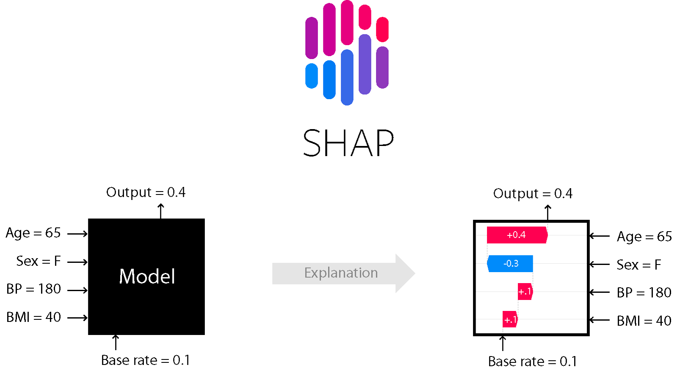
Backup Slides
Explainable AI
(Ref: https://wandb.ai/mostafaibrahim17/ml-articles/reports/Enhancing-cybersecurity-with-explainable-AI--Vmlldzo3NDIwMTc3)

Slide 19
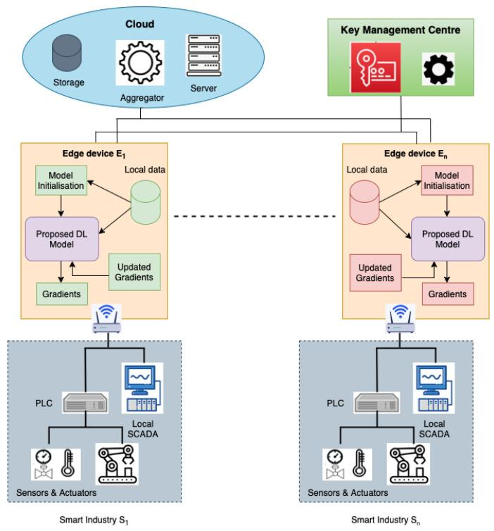
Backup Slides
FLDID: Proposed Model

Slide 20
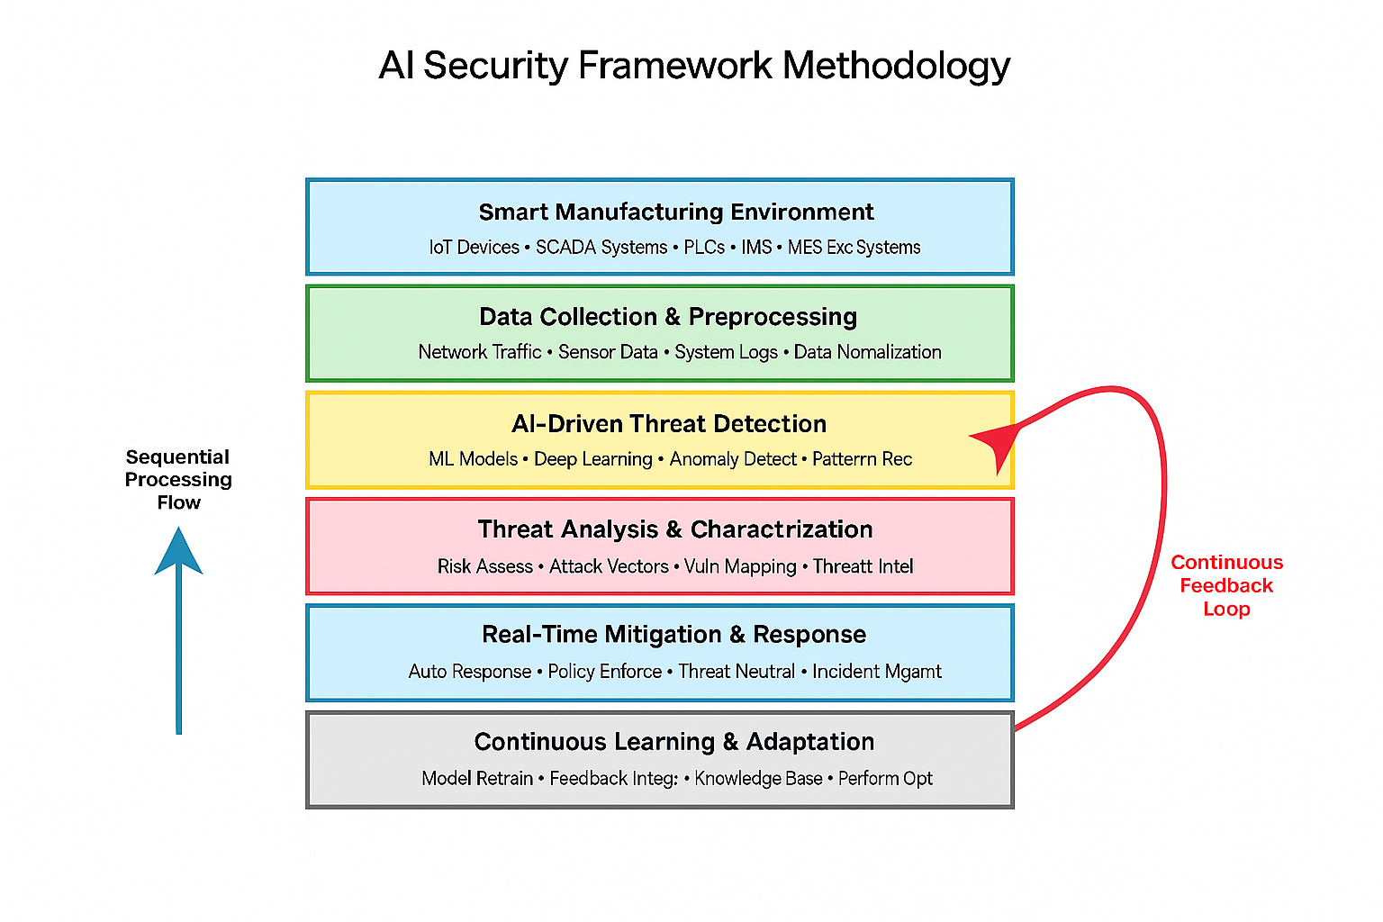
Backup Slides

Slide 21
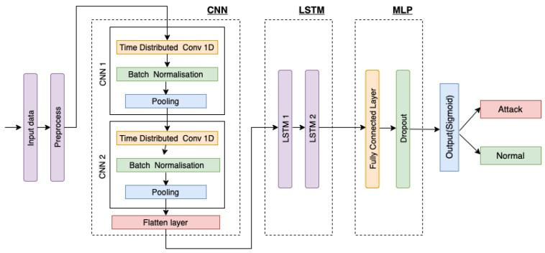
Backup Slides
FLDID

Slide 22
Additional Literature
title | Insights
Enhancing the Security of Industrial Cyber-Physical Systems using AI Algorithms (2024) | The paper does not provide a comparative analysis of different mitigation frameworks for AI-driven threats in smart manufacturing systems. Instead, it focuses on enhancing the security of industrial cyber-physical systems using AI algorithms, specifically highlighting improvements in threat detection accuracy, false positive and negative rates, response time, and resource efficiency. The proposed method utilizes RNNs, K-means, and Q-learning to effectively identify and respond to threats, outperforming traditional security approaches in key performance areas.
AI-driven threat intelligence for real-time cybersecurity: Frameworks, tools, and future directions (2024) | The paper does not specifically address comparative analysis of different mitigation frameworks for AI-driven threats in smart manufacturing systems or specialized attacks powered by artificial intelligence. It focuses on AI-driven threat intelligence in cybersecurity, discussing frameworks, tools, and techniques for real-time threat detection and response. While it highlights the importance of evolving frameworks and ethics in AI implementation, it does not provide detailed comparisons of mitigation strategies for specific sectors like smart manufacturing.
A Reactive Security Framework for Protecting AI Models from Adversarial Attacks: An Autoencoder-Based Approach (2024) | The paper does not provide a comparative analysis of different mitigation frameworks for AI-driven threats in smart manufacturing systems. Instead, it focuses on a reactive security framework that enhances AI model resilience against adversarial attacks through runtime monitoring, anomaly detection using autoencoders, and adversarial training for model retraining. The framework aims to dynamically adapt to evolving threats rather than comparing various mitigation strategies. Thus, it does not specifically address specialized attacks in smart manufacturing contexts.
AI-Powered Advanced Threat Protection: A Novel Framework for Next-Generation Malware Defense (2024) | The paper does not specifically conduct a comparative analysis of different mitigation frameworks for AI-driven threats in smart manufacturing systems. However, it introduces a novel AI-powered framework for advanced threat protection that addresses challenges like obfuscated malware and zero-day vulnerabilities, which could be relevant to specialized attacks in such environments. The framework emphasizes real-time threat intelligence, predictive anomaly detection, and adaptive remediation strategies, which may be applicable in mitigating AI-driven threats in smart manufacturing contexts.
Next-Gen Threat Detection: Leveraging AI and Cyber Twin Technologies for IoT Security (2024) | The paper does not provide a comparative analysis of different mitigation frameworks for AI-driven threats in smart manufacturing systems. Instead, it focuses on an advanced threat detection model leveraging AI and Cyber Twin Technologies specifically for IoT security. The proposed framework enhances anomaly detection and threat classification accuracy through a hybrid deep learning approach, demonstrating significant improvements in detection accuracy and resilience against cyber threats, but it does not address specialized attacks in smart manufacturing systems.
Use of artificial intelligence methods and models for improving expert systems of intrusion detection (2024) | The paper's title matches your query, but it doesn't address your specific question.
Fortifying AI Against Cyber Threats Advancing Resilient Systems to Combat Adversarial Attacks (2024) | The paper does not specifically address a comparative analysis of different mitigation frameworks for AI-driven threats in smart manufacturing systems. Instead, it focuses on using AI to develop robust systems against adversarial attacks through adaptive defense mechanisms utilizing reinforcement learning and ensemble methods. The study emphasizes the effectiveness of these approaches in managing dynamic threats and improving anomaly detection, but it does not delve into specialized attacks in smart manufacturing contexts.
Using Decision Support to Fortify Industrial Control System Against Cyberattacks (2024) | The paper does not provide a comparative analysis of different mitigation frameworks for AI-driven threats in smart manufacturing systems. Instead, it focuses on a cybersecurity solution for Industrial Control Systems (ICS) that integrates a Network-based Intrusion Detection System (NIDS) with a Decision Support System (DSS) to detect anomalies and mitigate cyberattacks. While it highlights challenges and future improvements, it does not specifically address AI-powered attacks or compare various mitigation frameworks.
Internet of things for smart manufacturing based on advanced encryption standard (AES) algorithm with chaotic system (2023) | The paper does not provide a comparative analysis of different mitigation frameworks for AI-driven threats in smart manufacturing systems. Instead, it focuses on a Smart Reviving Authorization Model using the Advanced Encryption Standard (SRAM-AES) to address security issues in chaotic systems. The model emphasizes preventing unauthorized access and reducing controller downtime through IoT elements and deep recurrent learning algorithms, but it does not specifically analyze various frameworks for AI-powered attacks.
Explainable Adversarial Mitigation Framework for Zero-Trust Cyber Warfare (2023) | The paper does not provide a comparative analysis of different mitigation frameworks for AI-driven threats in smart manufacturing systems. Instead, it focuses on an explainable adversarial mitigation approach tailored for zero-trust cyber warfare scenarios, emphasizing the effectiveness of Intrusion Detection Systems (IDS) in military operations. The proposed framework aims to enhance resilience against adversarial attacks, achieving a high F1-score of 94% and a detection time of 0.34s, but does not specifically address smart manufacturing systems or specialized AI-powered attacks.
Autonomous Attack Mitigation for Industrial Control Systems (2022) | The paper primarily focuses on autonomous response and recovery in industrial control systems (ICS) against advanced persistent threats (APTs) using deep reinforcement learning. It compares an automated cyber security orchestrator (ACSO) with traditional playbook methods, demonstrating that the ACSO outperforms in mitigating AI-driven threats by taking less disruptive actions and defending more nodes. However, it does not provide a comparative analysis of different mitigation frameworks specifically for AI-driven threats in smart manufacturing systems beyond its proposed approach.
AI-Assisted Trustworthy Architecture for Industrial IoT Based on Dynamic Heterogeneous Redundancy (2023) | The paper does not provide a comparative analysis of different mitigation frameworks for AI-driven threats in smart manufacturing systems. Instead, it focuses on an AI-assisted trustworthy architecture utilizing dynamic heterogeneous redundancy (DHR) and a deep reinforcement learning-based intelligent arbitration (DRLIA) algorithm to enhance security in industrial IoT. The study emphasizes the effectiveness of DRLIA in distinguishing reliable IIoT messages and conducting arbitration tasks, rather than addressing specialized attacks powered by artificial intelligence in smart manufacturing systems.
AI-Assisted Trustworthy Architecture for Industrial IoT Based on Dynamic Heterogeneous Redundancy (2023) | The paper does not provide a comparative analysis of different mitigation frameworks for AI-driven threats in smart manufacturing systems. Instead, it focuses on an AI-assisted trustworthy architecture utilizing dynamic heterogeneous redundancy (DHR) and a deep reinforcement learning-based intelligent arbitration (DRLIA) algorithm to enhance security in industrial IoT. The study emphasizes the effectiveness of DRLIA in distinguishing reliable IIoT messages and conducting arbitration tasks, rather than addressing specialized attacks powered by artificial intelligence in smart manufacturing systems.
Elevating Smart Industry Security: An Advanced IoT-Integrated Framework for Detecting Suspicious Activities using ELM and LSTM Networks (2022) | The paper primarily focuses on an advanced IoT-integrated framework combining ELM and LSTM networks for detecting suspicious activities in smart industries. While it emphasizes enhancing security against evolving cyber threats, it does not provide a comparative analysis of different mitigation frameworks for AI-driven threats or specialized attacks powered by artificial intelligence. The research highlights the inadequacies of existing methods but does not delve into specific comparative evaluations of various frameworks.
An Explainable Intelligent Framework for Anomaly Mitigation in Cyber-Physical Inverter-based Systems (2022) | The paper does not provide a comparative analysis of different mitigation frameworks for AI-driven threats in smart manufacturing systems. Instead, it focuses on an explainable intelligent framework specifically designed for cyber anomaly mitigation in cyber-physical inverter-based systems, utilizing an artificial neural network to address false data injection attacks. The framework aims to maintain normal operation in microgrids despite cyber anomalies, but it does not cover specialized attacks in smart manufacturing contexts.
Digital clones and digital immunity: adversarial training handles both (2022) | The paper does not provide a comparative analysis of different mitigation frameworks for AI-driven threats in smart manufacturing systems. Instead, it focuses on the use of adversarial training to enhance digital clones and digital immunity against adversarial attacks. The study emphasizes the development of algorithms for generating adversarial samples that improve the personalization of decision models and ensure robustness in autonomous decision-making, rather than comparing various mitigation strategies.
Defending Industrial Production Using AI Process Control (2020) | The paper does not conduct a comparative analysis of different mitigation frameworks for AI-driven threats in smart manufacturing systems. Instead, it proposes a novel approach using deep reinforcement learning to address modern cyberattacks by treating malicious behavior as process variation. This method enhances traditional statistical process control, providing whole-system protection in complex environments like additive manufacturing. The focus is on improving resilience against sophisticated, systemic cyberattacks rather than comparing various frameworks.
DeSVig: Decentralized Swift Vigilance Against Adversarial Attacks in Industrial Artificial Intelligence Systems (2020) | The paper presents DeSVig, a decentralized framework specifically designed to identify and mitigate adversarial attacks in industrial artificial intelligence systems. It emphasizes the importance of rapid response to adversarial examples, leveraging mobile edge computing and generative adversarial networks to enhance robustness and efficiency. While it does not provide a comparative analysis of various frameworks, it demonstrates superior performance against state-of-the-art defenses, highlighting its scalability and effectiveness in safety-critical, delay-sensitive environments within smart manufacturing systems.
(Gen)AI Versus (Gen)AI in Industrial Control Cybersecurity (2024) | The paper does not provide a comparative analysis of different mitigation frameworks for AI-driven threats in smart manufacturing systems. Instead, it focuses on how (Gen)AI impacts industrial control systems (ICSs) security through the Cyber Kill Chain (CKC) framework, detailing how (Gen)AI can automate attacks and enhance defenses. It discusses advanced techniques like AI-powered firewalls and anomaly detection but does not specifically compare various mitigation frameworks for specialized AI-powered attacks in smart manufacturing.
Generative AI and Cognitive Computing-Driven Intrusion Detection System in Industrial CPS (2024) | The paper does not provide a comparative analysis of different mitigation frameworks for AI-driven threats in smart manufacturing systems. Instead, it focuses on developing an intrusion detection system (IDS) for Industrial Cyber-Physical Systems (ICPSs) using Generative AI and cognitive computing. The proposed IDS aims to enhance interpretability and reduce false positives through techniques like LSTM-SVAE and BiRNN-HAID, but it does not specifically address specialized attacks powered by artificial intelligence in smart manufacturing contexts.

