Slide 1


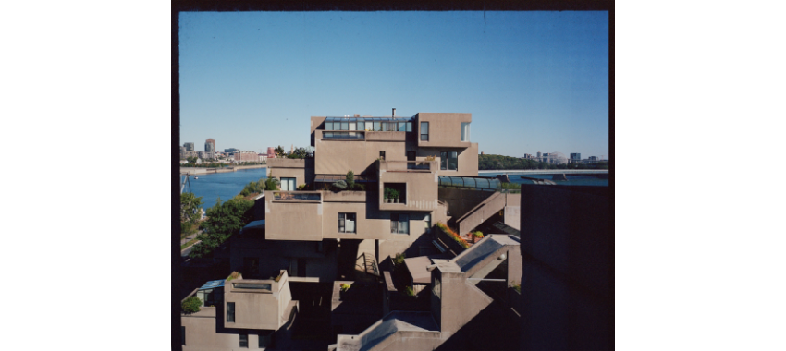
Predictive Modeling of Building Energy Efficiency
Robert Gravatt | DATA 201 | April 30, 2026

Slide 2

1 & 2. Project Scope & Strategy
Bridging Design & Science
Goal: Determine if architectural parameters like height, surface area, and compactness can reliably forecast energy efficiency requirements.
Sustainable architecture requires the ability to predict thermal behavior before construction. We leverage the UCI Energy Efficiency dataset to bridge architectural geometry with energy demand.
Key Target Variable: Heating Load (kWh/m²)

Slide 3
3. Dataset: Variable Overview
Feature Group | Specific Variable | Description
Geometric | Relative Compactness | Measure of building shape efficiency.
Envelope | Surface Area / Roof Area | Total structural exposure measurements (m²).
Massing | Overall Height | Binary split: 3.5m vs 7.0m structures.
Environmental | Orientation / Glazing | Building direction and window distribution.
Target | Heating Load | Energy required for heating (kWh/m²).

Slide 4
Methodology: Data Cleaning
Relabeling: Transformed generic "X1-Y2" indices into descriptive architectural features for interpretability.
CSV Cleanup: Addressed trailing delimiters and ghost columns from spreadsheet exports to ensure matrix alignment.
Validation: Verified 768 complete observations with zero missing values via df.info() check.
Splitting: Identified "Overall Height" as the primary binary predictor for bimodal performance analysis.

Slide 5
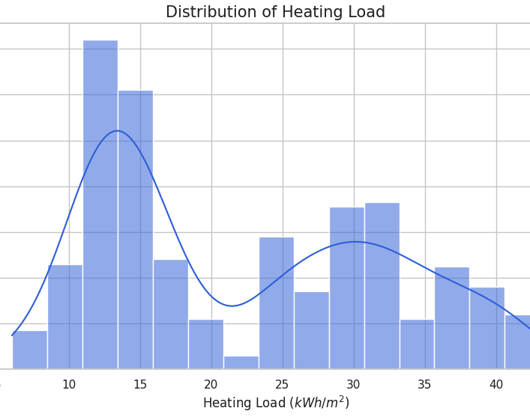
4a. Heating Load Distribution
Bimodal Clusters
The histogram reveals two distinct performance clusters. This suggests a primary design factor creates a "split" in thermal behavior.
•
Efficient Designs: 10–15 kWh/m²
•
High-Demand Designs: 25–35 kWh/m²

Slide 6
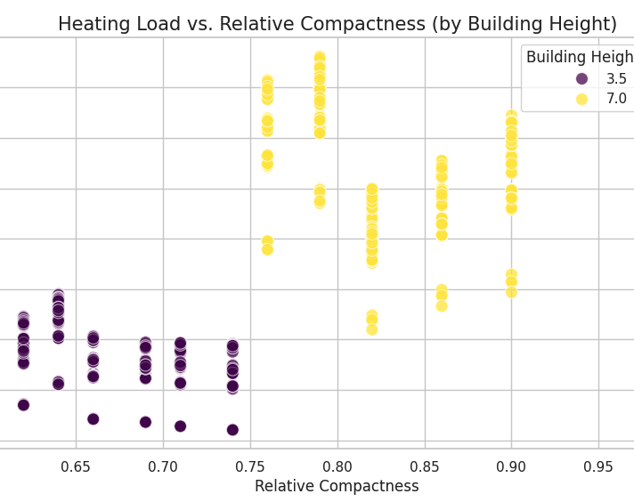
Height: The Primary Driver
Height vs. Compactness
By color-coding the scatter plot by Height, we observe that vertical massing is the primary determinant of demand.
Regardless of compactness, 7.0m buildings consistently require more energy than 3.5m structures.

Slide 7
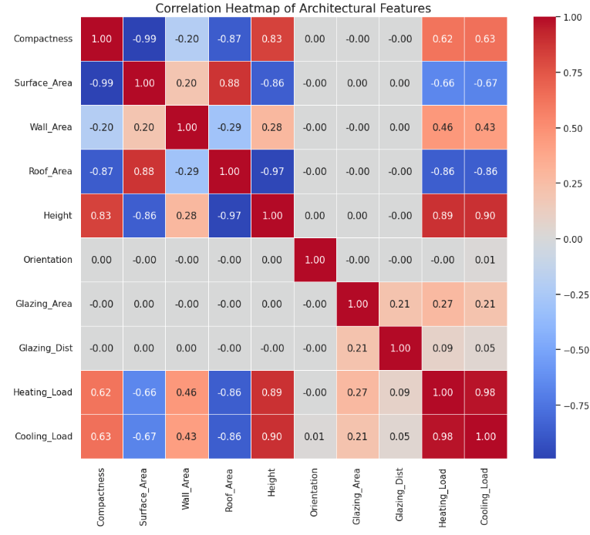
Numerical Evidence: Correlation
Feature Importance
The correlation matrix quantifies the physical drivers of energy efficiency:
0.89 correlation: Overall Height
0.62 correlation: Relative Compactness
0.00 correlation: Orientation (Negligible)

Slide 8






Modeling: Baseline vs. Improved
Baseline
Reasoning
Improved Model
Multiple Linear Regression assuming additive effects. Achieved 91% starting accuracy.
Thermal physics is non-linear. Interactions (e.g., Height x Surface Area) better reflect structural reality.
Polynomial Features (Degree 2) captured non-linear interactions, raising accuracy to 99%.

Slide 9
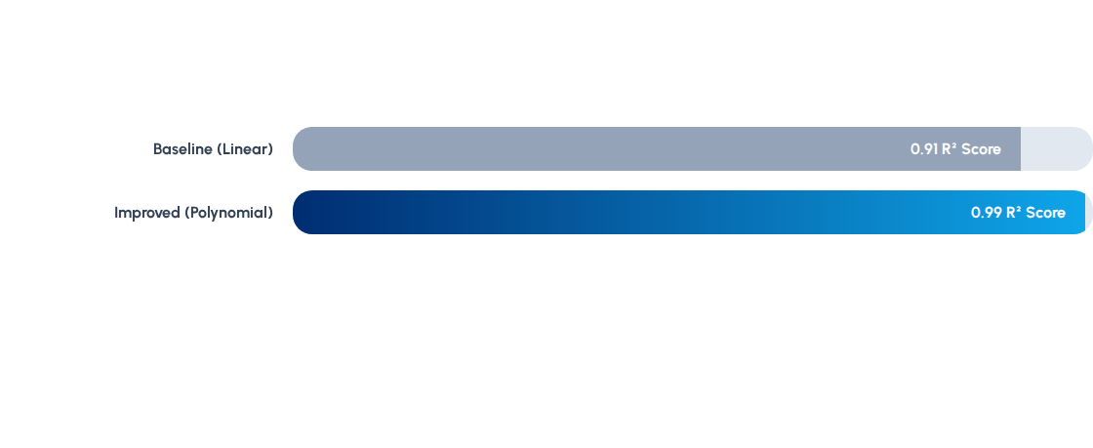
4b-e. Performance Benchmark
By introducing interaction terms, we reduced prediction error (RMSE) from 3.02 to 0.80 kWh/m².

Slide 10
4g. Final Predictive Validation
Testing the model on three unique design scenarios from the test set:
Design Sample | Actual Load | Predicted Load | Model Error
Building Design 1 | 16.47 kWh/m² | 16.56 kWh/m² | 0.09
Building Design 2 | 13.17 kWh/m² | 13.32 kWh/m² | 0.15
Building Design 3 | 32.82 kWh/m² | 32.79 kWh/m² | 0.03

