Slide 1
Hands-on Model Calibration in R
Eva A. Enns & Fernando Alarid-Escudero
41st Annual North American Meeting of
the Society for Medical Decision Making
October 20, 2019

Slide 2
The DARTH Workgroup
Materials for this workshop were developed in part by the Decision Analysis in R for Technologies in Health (DARTH) Workgroup
Goals: To expand knowledge in decision analysis using R and develop educational materials to empower people to construct R-based decision models.
For more information
www.darthworkgroup.com
Tweet: @DARTHworkgroup
Join the DARTH “Dinner with Experts” tonight!

Slide 3
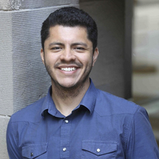
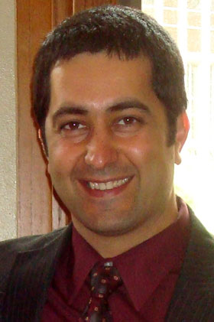




The DARTH Workgroup
F. Alarid-Escudero PhD H. Jalal MD PhD E. Enns PhD
E. Krijkamp PhDc M. Hunink MD P. Pechlivanoglou PhD

Slide 4
Motivation
Mathematical models of disease often involve a subset of parameters whose values are unknown
Common reasons include physical, feasibility, and ethical limitations
Estimate values for these parameters by matching model outputs to observed outcomes
Model calibration

Slide 5
Calibration definition
Process of adjusting model input parameter values to match data on an outcome of interest (e.g., survival, prevalence, or incidence)
Outcome(s) of interest = “calibration targets”

Slide 6
Calibration process
KNOWN PARAMETERS
MODEL
OBSERVABLE HEALTH OUTCOMES
UNKNOWN PARAMETERS
Try different sets of parameter values
Compare against calibration targets
(Calculate “fit”)
Repeat to find “best-fitting”
set of parameter values

Slide 7
Calibration targets
Empirical data to be replicated by the model
Summary statistics (e.g. mean age of cancer diagnosis) or series of observations (e.g. age-specific incidence)
Can calibrate to multiple targets (e.g. survival and prevalence) simultaneously
Model should be able to output the outcomes of interest

Slide 8
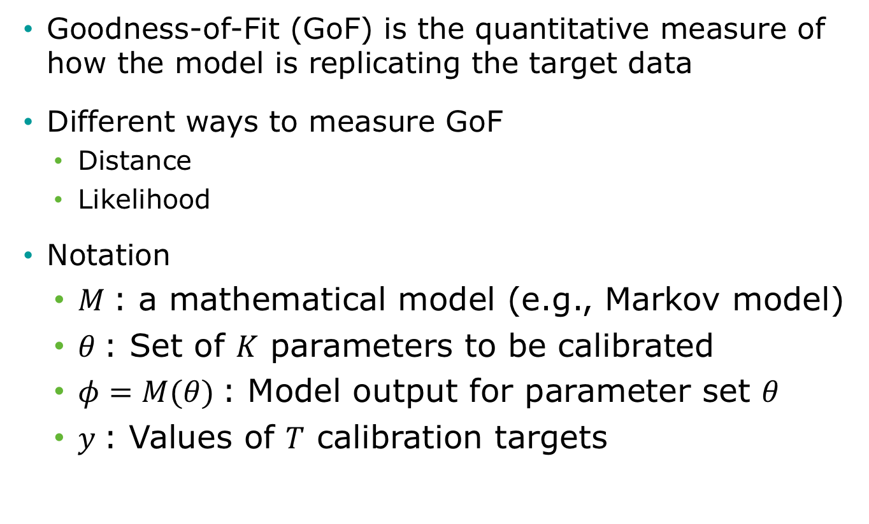
Calculating “fit”
Goodness-of-Fit (GoF) is the quantitative measure of how the model is replicating the target data
Different ways to measure GoF
Distance
Likelihood
Notation
$M$: a mathematical model (e.g., Markov model)
$θ$: Set of $K$ parameters to be calibrated
$φ=M(θ)$: Model output for parameter set $θ$
$y$: Values of $T$ calibration targets

Slide 9
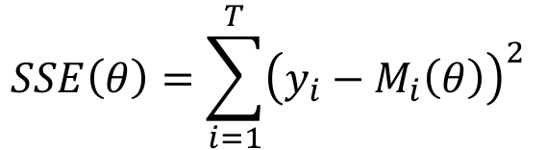

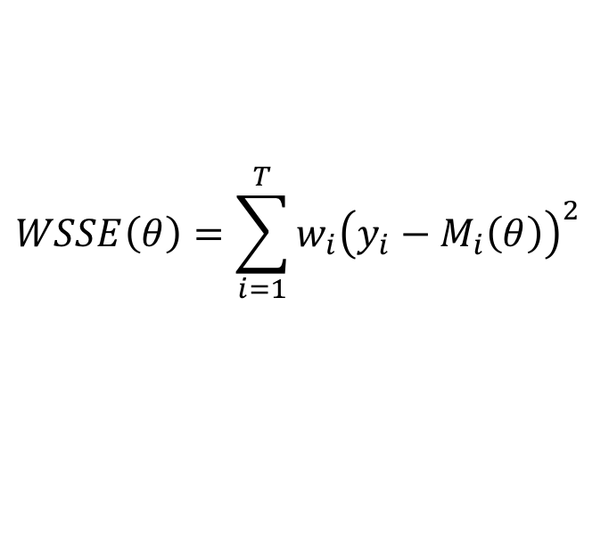
Distance GoF measures
Sum of squared errors
Weighted sum of squared errors
Assign different weight to different targets ($w_{i}$)
Often, $w_{i}=\frac{1}{σ^{2}}$
$$SSE\left(θ\right)=\sum_{i=1}^{T}{{\left(y_{i}−M_{i}\left(θ\right)\right)}^{2} }$$
$$WSSE\left(θ\right)=\sum_{i=1}^{T}{{w_{i}\left(y_{i}−M_{i}\left(θ\right)\right)}^{2} }$$

Slide 10
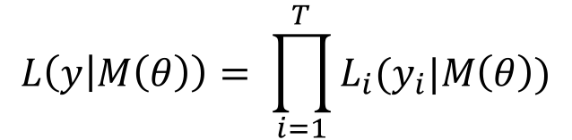
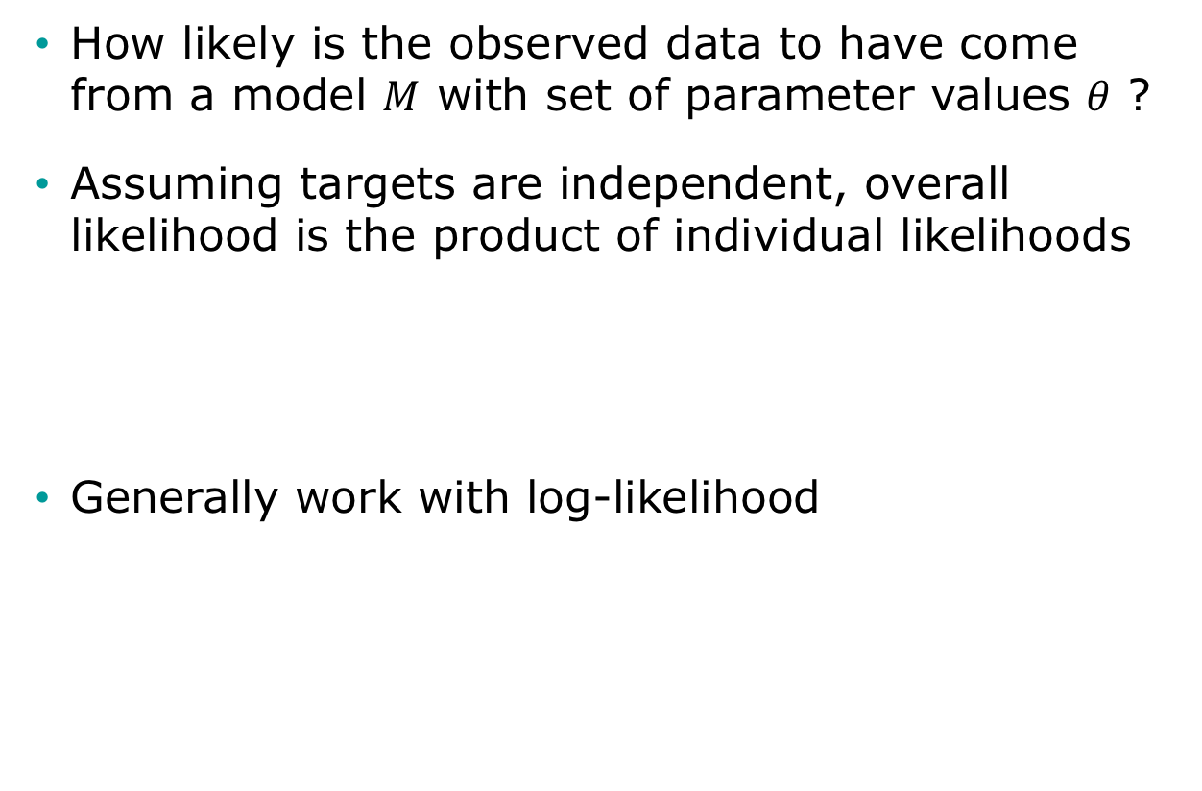
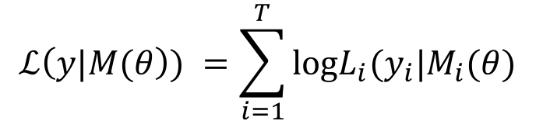
Likelihood as GoF
How likely is the observed data to have come from a model $M$ with set of parameter values $θ$ ?
Assuming targets are independent, overall likelihood is the product of individual likelihoods
Generally work with log-likelihood
$$L\left(y | M\left(θ\right)\right)= \prod_{i=1}^{T}{L_{i}(y_{i}|M\left(θ\right))}$$
$$ℒ\left(y|M(θ\right)) =\sum_{i=1}^{T}{\text{log}L_{i}(y_{i}|M_{i}(θ) }$$

Slide 11
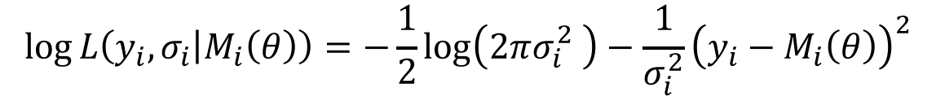
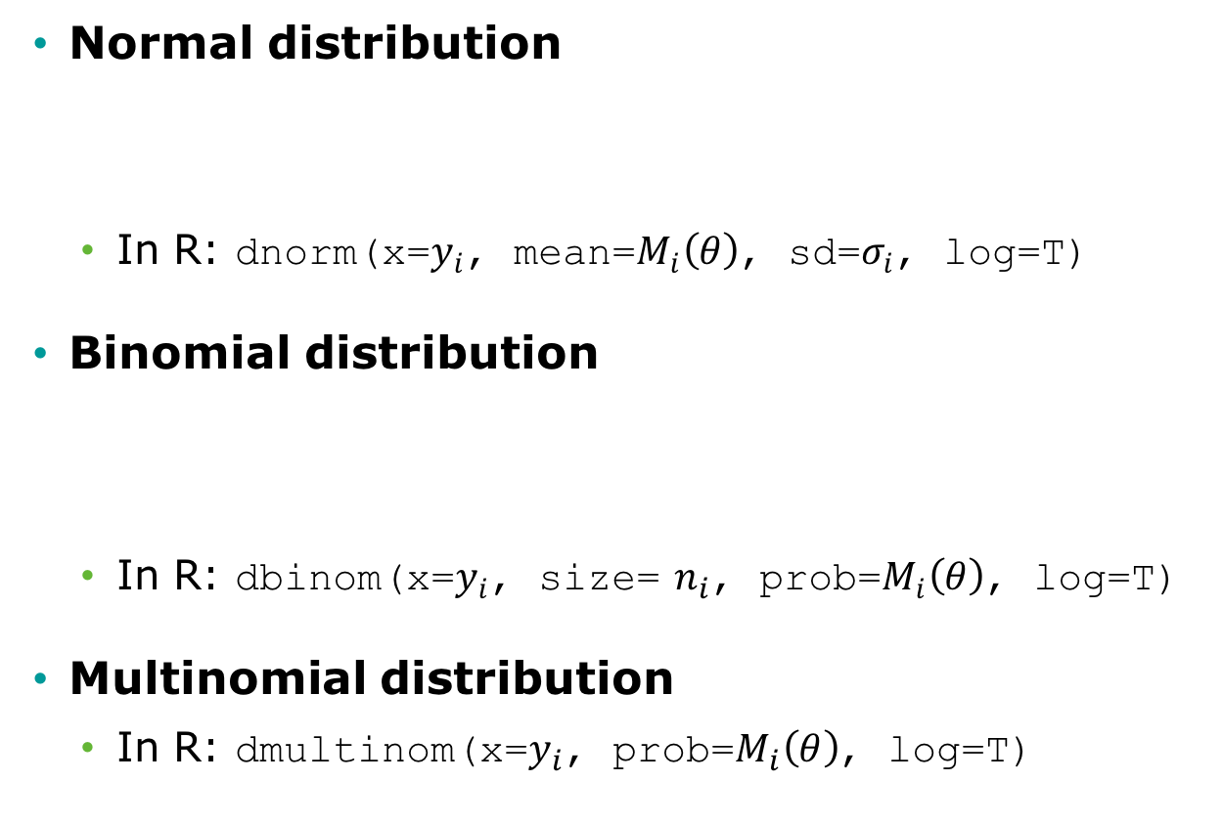
Commonly used likelihoods
Normal distribution
In R: dnorm(x=$y_{i}$, mean=$M_{i}\left(θ\right)$, sd=$σ_{i}$, log=T)
Binomial distribution
In R: dbinom(x=$y_{i}$, size= $n_{i}$, prob=$M_{i}\left(θ\right)$, log=T)
Multinomial distribution
In R: dmultinom(x=$y_{i}$, prob=$M_{i}\left(θ\right)$, log=T)
$$\log{L\left(y_{i},σ_{i} | M_{i}\left(θ\right)\right)}=−\frac{1}{2}\log\left(2πσ_{i}^{2} \right)−\frac{1}{σ_{i}^{2}}{\left(y_{i}−M_{i}\left(θ\right)\right)}^{2}$$
$$\log{L\left(y_{i},n_{i} | M_{i}\left(θ\right)\right)}=log\left(\left(\begin{matrix}n_{i} \\ y_{i}\end{matrix}\right)\right){+{ y}_{i}log\left(M_{i}\left(θ\right)\right)}+(n_{i}−y_{i})log\left(1−M_{i}\left(θ\right)\right)$$

Slide 12
Search Strategy
Define plausible ranges for parameter whose values are unknown
Use a search strategy to “search” through the input parameter space
Run the model for sets of parameter values generated by search strategy
Parameter space

Slide 13
Grid Search
Run model for all possible combinations of parameter values
Often infeasible

Slide 14
Random Search
Randomly sample a large number of parameter value sets from probabilistic distributions
Use "Latin hypercube sampling” (LHS) to ensure sample captures the full parameter space
Random sample

Slide 15
Random Search
Randomly sample a large number of parameter value sets from probabilistic distributions
Use "Latin hypercube sampling” (LHS) to ensure sample captures the full parameter space
LHS sample

Slide 16
Iterative Search
Use fits of past input values to determine which input values to try next
Directed methods
Nelder-Mead (simplex method)
Gradient–descent and others
Meta-heuristic algorithms
Genetic algorithms
Simulated annealing

Slide 17
Nelder-Mead Algorithm
Downhill simplex method
Must be run multiple times for different starting points to avoid local extrema
starting point
final value
search path

Slide 18
Example: Calibrating a 3-state cancer model
Notes:
Part 1 = Showing code 3 state model
Part 2 = Exercise build Sick-Sicker model
Part 3 = Show answers of Sick-Sicker

Slide 19
3-state cancer model
Relative survival as reported by the Surveillance, Epidemiology, and End Results (SEER) Program, represents cancer survival in the absence of other causes of death
Cancer Markov models often have a distant metastasis state, a state not directly observed in SEER, from which cancer deaths are presumed to occur
These models are used to model interventions that affect transitions to and from this state
Alarid-Escudero F, Maclehose RF, Peralta Y, Kuntz KM, & Enns, EA. Non-identifiability in model calibration and implications for medical decision making. Medical Decision Making, 2018;38(7):810–21.

Slide 20
3-state cancer model
Two unknown transition probabilities
p.Mets: Monthly risk of developing distant recurrence, range = [0.04, 0.16]
p.DieMets: Monthly risk of cancer death, range = [0.04, 0.16]

Slide 21
Target: Relative survival
Data frame “CRS_targets$Surv” stored in data file “CRS_CalibTargets.RData”

Slide 22
Calibration R code template
### Load calibration targets ###
### Load model as a function ###
### Specify calibration parameters ###
### Calibrate ###
### Explore best-fitting input sets ###

Slide 23
Calibration specification
Goodness-of-fit measure
Sample size and standard deviation of each target is given in target data frame “Surv”
We will use log-likelihood as the GoF measure
Search strategy
Latin-hypercube random sampling (1,000 samples)
We’ll also demonstrate how to use Nelder-Mead

Slide 24
Calibration Code Structure
Setup Markov model as a function
Inputs: parameter values
Outputs: outcomes to be compared against calibration targets
Write function to compute goodness-of-fit
Inputs: set of values for parameters to be calibrated
Outputs: goodness-of-fit for the resulting model outcomes to the calibration targets
Randomly sample values for parameters to be calibrated and run goodness-of-fit function for each set
Identify the set of parameter values that achieves the best goodness-of-fit
Find best set using a directed search approach

Slide 25
R Session
Notes:
Part 1 = Showing code 3 state model
Part 2 = Exercise build Sick-Sicker model
Part 3 = Show answers of Sick-Sicker

Slide 26
Bayesian Calibration
Notes:
Part 1 = Showing code 3 state model
Part 2 = Exercise build Sick-Sicker model
Part 3 = Show answers of Sick-Sicker

Slide 27
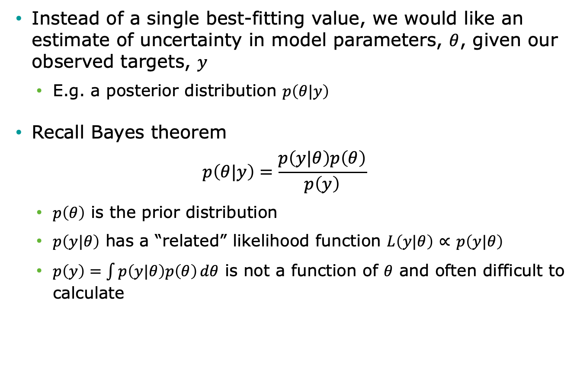
Bayesian setup
Instead of a single best-fitting value, we would like an estimate of uncertainty in model parameters, $θ$, given our observed targets, $y$
E.g. a posterior distribution $p\left(θ|y\right)$
Recall Bayes theorem
$$p\left(θ|y\right)=\frac{p\left(y|θ\right)p\left(θ\right)}{p\left(y\right)}$$
$p\left(θ\right)$ is the prior distribution
$p\left(y|θ\right)$ has a “related” likelihood function $L\left(y|θ\right)$ $∝$ $p\left(y|θ\right)$
$p\left(y\right)=\int{p\left(y|θ\right)p\left(θ\right)}dθ$ is not a function of $θ$ and often difficult to calculate

Slide 28
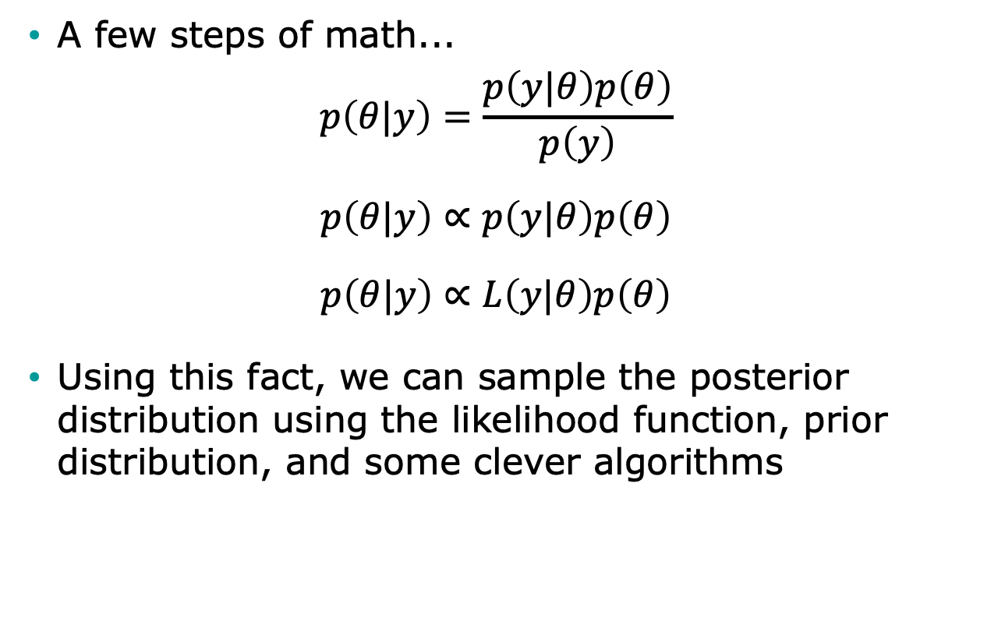
Bayesian setup
A few steps of math...
$$p\left(θ|y\right)=\frac{p\left(y|θ\right)p\left(θ\right)}{p\left(y\right)}$$
$$p\left(θ|y\right)∝p\left(y|θ\right)p\left(θ\right)$$
$$p\left(θ|y\right)∝L\left(y|θ\right)p\left(θ\right)$$
Using this fact, we can sample the posterior distribution using the likelihood function, prior distribution, and some clever algorithms

Slide 29
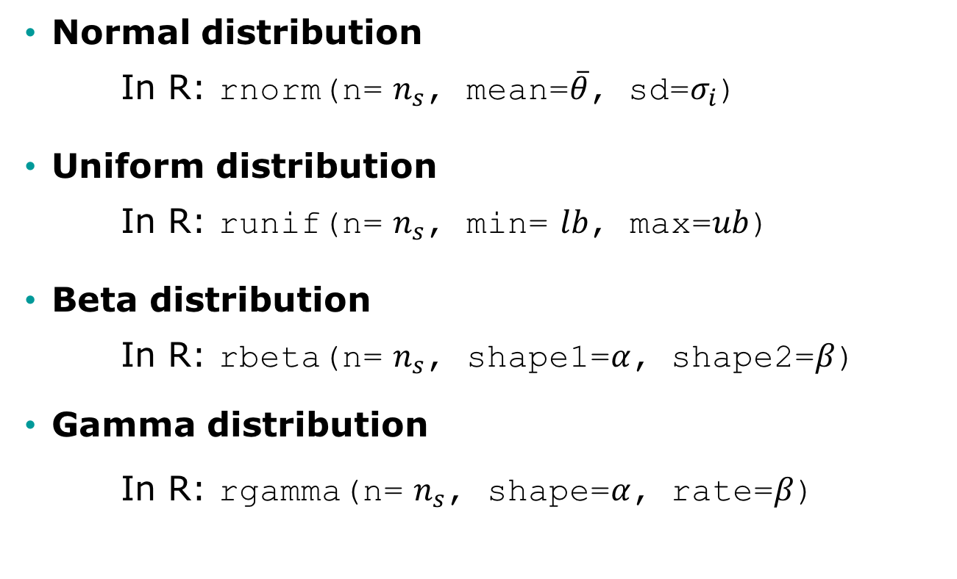

Commonly used prior distributions to sample $n_{s}$ values
Normal distribution
In R: rnorm(n= $n_{s}$, mean=$\overline{θ}$, sd=$σ_{i}$)
Uniform distribution
In R: runif(n= $n_{s}$, min= $lb$, max=$ub$)
Beta distribution
In R: rbeta(n= $n_{s}$, shape1=$α$, shape2=$β$)
Gamma distribution
In R: rgamma(n= $n_{s}$, shape=$α$, rate=$β$)

Slide 30
Pros and cons
Pros: We obtain distributions of parameters rather than only point estimates
Cons: “Harder” to implement than other methods? Mmm not really!

Slide 31
Obtaining a posterior distribution
Analytically
Not feasible for simulation models
Markov chain Monte Carlo (MCMC)
Sampling methods
Sampling Importance Resampling (SIR)
Incremental Mixture Importance Sampling (IMIS)

Slide 32
Markov chain Monte Carlo (MCMC)
Simulates posterior distribution by jumping in the parameter space in a Markovian fashion
The transition matrix of the Markov chain is proposed using a proposal distribution
There are numerous algorithms that implement MCMC, including Metropolis-Hastings (MH)
R has some packages that implement MCMC algorithms
Other R packages interface with external MCMC software, including WinBUGS and JAGS

Slide 33
Markov chain Monte Carlo (MCMC)
Pros:
Theoretically will eventually converge to the “true” posterior distribution
Cons:
Computationally intensive
Autocorrelation is a problem with simulation models and therefore requires a high number of samples
Use of external software (WinBUGS, JAGS), requires implementing the model within that software’s syntax

Slide 34
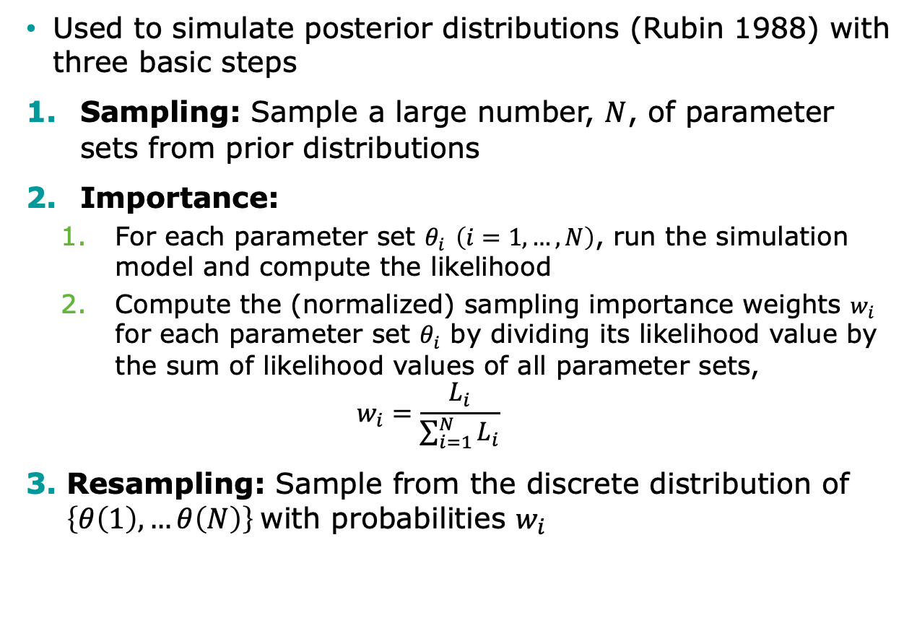
Sampling Importance Resampling (SIR)
Used to simulate posterior distributions (Rubin 1988) with three basic steps
Sampling: Sample a large number, $N$, of parameter sets from prior distributions
Importance:
For each parameter set $θ_{i}$ $\left(i=1,…,N\right)$, run the simulation model and compute the likelihood
Compute the (normalized) sampling importance weights $w_{i}$ for each parameter set $θ_{i}$ by dividing its likelihood value by the sum of likelihood values of all parameter sets,
$$w_{i}=\frac{L_{i}}{\sum_{i=1}^{N}{L_{i}}}$$
Resampling: Sample from the discrete distribution of $\left\{θ\left(1\right), …θ\left(N\right)\right\}$with probabilities $w_{i}$

Slide 35
Incremental Mixture Importance Sampling (IMIS)
SIR can miss areas of high posterior probability as the number of parameter increases
IMIS addresses limitations of SIR and was proposed by Steele at al. (2006)
Starts with a modest-size SIR
But in addition to SIR samples, add in samples from a multivariate normal distribution centered at the point with the highest importance weight
Recalculate importance weights and sample a new sample of input parameter sets
At the end, posterior becomes a mixture of multivariate normal distributions and of the prior distribution

Slide 36
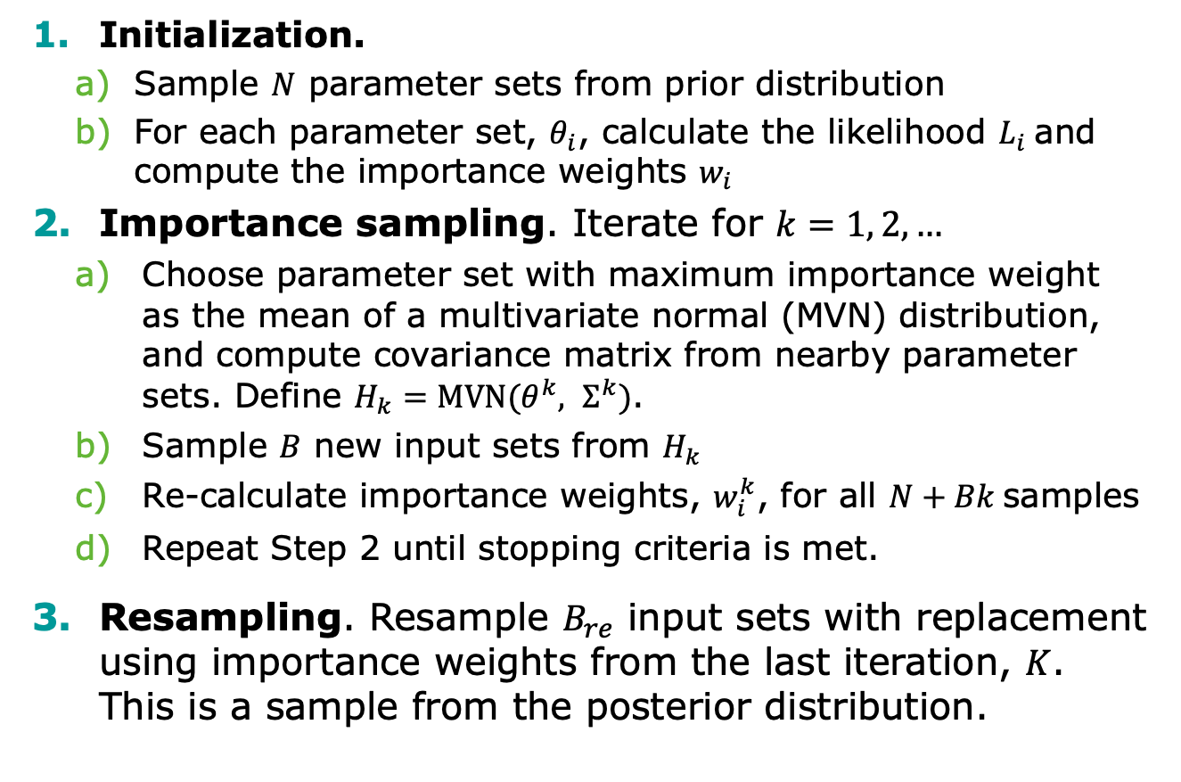
Incremental Mixture Importance Sampling (IMIS)
Initialization.
Sample $N$ parameter sets from prior distribution
For each parameter set, $θ_{i}$, calculate the likelihood $L_{i}$and compute the importance weights $w_{i}$
Importance sampling. Iterate for $k=1, 2, …$
Choose parameter set with maximum importance weight as the mean of a multivariate normal (MVN) distribution, and compute covariance matrix from nearby parameter sets. Define $H_{k}=\text{MVN}(θ^{k}, Σ^{k})$.
Sample $B$ new input sets from $H_{k}$
Re-calculate importance weights, $w_{i}^{k}$, for all $N+Bk$samples
Repeat Step 2 until stopping criteria is met.
Resampling. Resample $B_{re}$ input sets with replacement using importance weights from the last iteration, $K$. This is a sample from the posterior distribution.

Slide 37
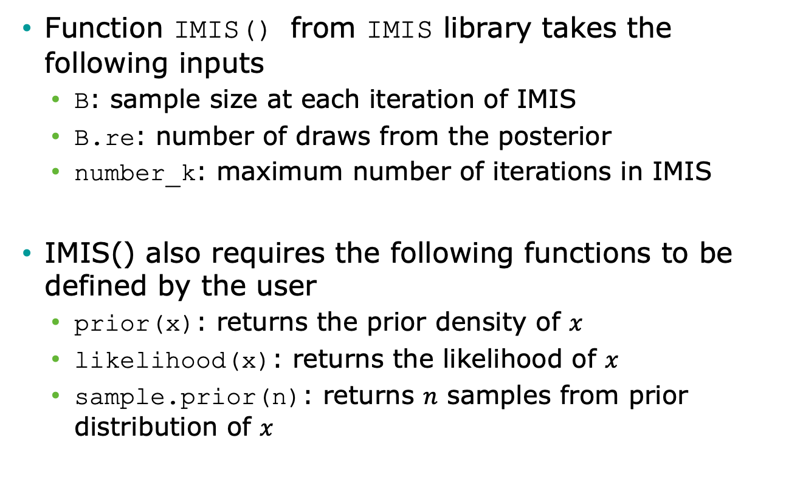
Incremental Mixture Importance Sampling (IMIS) in R
Function IMIS() from IMIS library takes the following inputs
B: sample size at each iteration of IMIS
B.re: number of draws from the posterior
number_k: maximum number of iterations in IMIS
IMIS() also requires the following functions to be defined by the user
prior(x): returns the prior density of $x$
likelihood(x): returns the likelihood of $x$
sample.prior(n): returns $n$ samples from prior distribution of $x$

Slide 38
Incremental Mixture Importance Sampling (IMIS) Outputs
resamples: B.re draws from the posterior distribution
stat: diagnostic statistics at each IMIS iteration
MargLike:
UniquePoint: expected number of unique points among resamples
MaxWeight: maximum importance weight
ESS: effective sample size (the closer to B.re, the better)
center: center of Gaussian components

Slide 39
R Session
Notes:
Part 1 = Showing code 3 state model
Part 2 = Exercise build Sick-Sicker model
Part 3 = Show answers of Sick-Sicker

