Slide 1
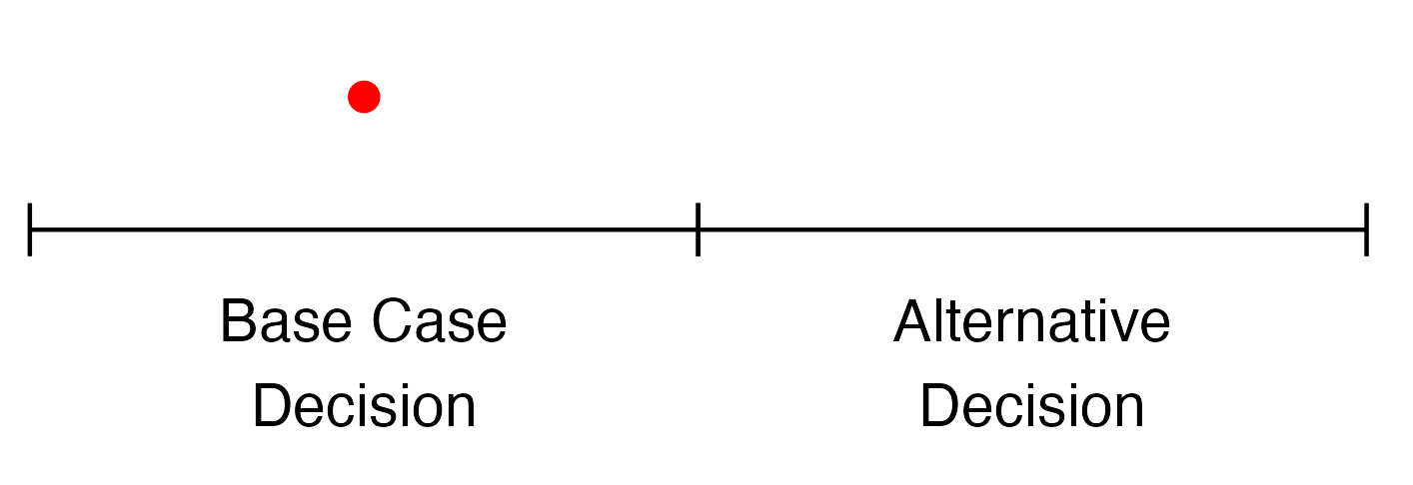
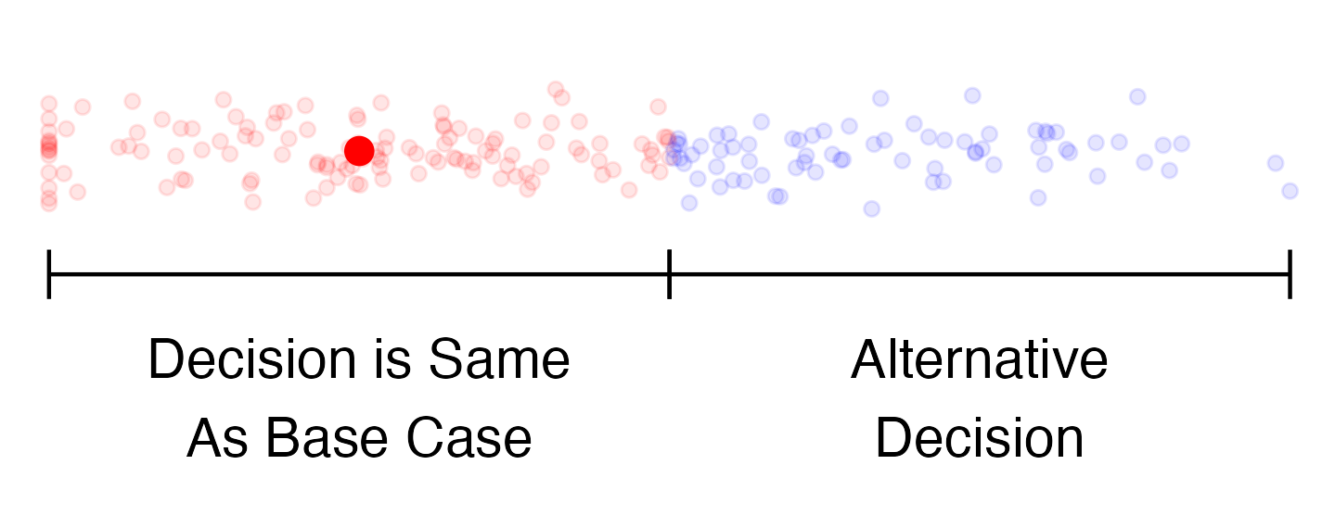
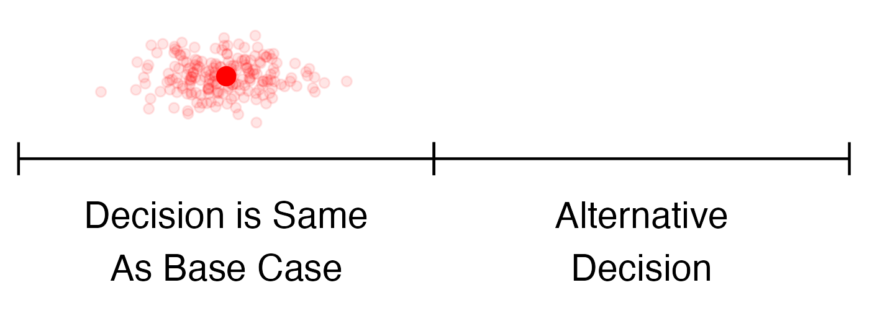
Stochastic (First-Order)
Uncertainty
Parameter (Second-Order)
Uncertainty
vs.
Model Structure Uncertainty
vs.

Slide 2
Stochastic (First-Order)
Uncertainty
Parameter (Second-Order)
Uncertainty
vs.
Model Structure Uncertainty
vs.

