Slide 1
Mobile Wallet
Transaction
Analysis in Indonesia
Analyzing Investment Probability

Slide 2
Outline
01
Background
02
Collect Data
03
Process Data
04
Analyze Data
05
Conclusion

Slide 3
Background

Slide 4
All transactions are connected around the world
3.00
People
can do transactions
Easily
Mobile Money
is used for Payment
Fast process
Easy Registration
No physical cash
Notes:
Fast | Easy Registration
Invest | How to

Slide 5
FOCUS IN INDONESIA
Chance of Investment
A developing country
The largest economy in Southeast Asia

Slide 6
Collect Data

Slide 7



Collect Data
Download Data
Store Data
Source
Tools
https://data360.worldbank.org/en/dataset/IMF_FAS accessed at 17-Jan-2026
Microsoft Excel can used to processing data, including make charts

Slide 8
Clean Data

Slide 9
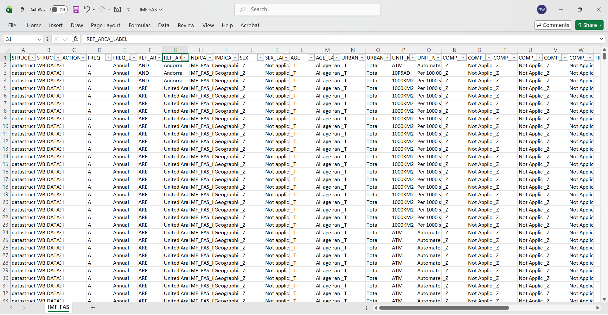
Process Data
Choose the right data
Use excel file named IMF_FAS showing records over years
Filter Indonesia country
Use column REF_AREA_LABEL
Delete unnecessary columns
Delete columns such as:
STRUCTURE
ACTION
FREQ
Etc.
Snapshot of raw data

Slide 10
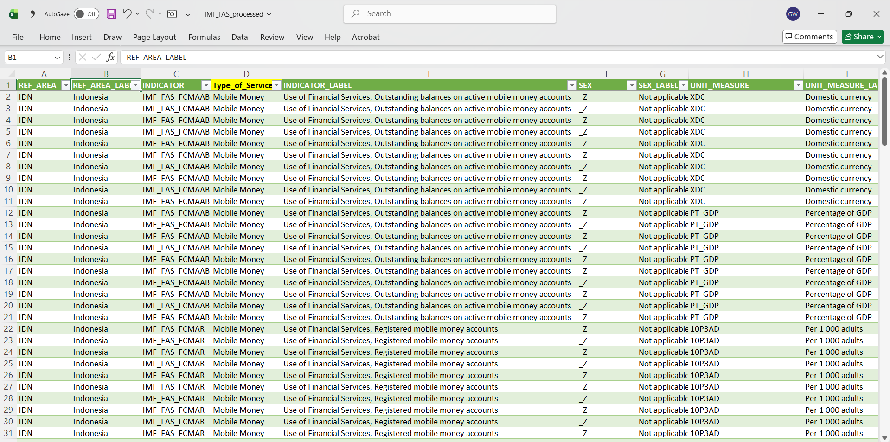
Process Data (cont.)
Filter focused indicators
Understanding what the indicators are based on dictionary file.
Adding new columns
Add ‘Type of Services’ and ‘Real Value’ to make the plot easier
Snapshot of final data

Slide 11
Analyze Data

Slide 12
Comparison Transactions per 1000 Adults
Key points
From 2013 – 2022, the number transactions of mobile money is increased.
The decline in 2020 of mobile money transactions is not lower than banking transactions in 2019

Slide 13
Growth Transactions per 1000 Adults
Key points
The growth of mobile money transactions since 2013 reached almost 45 times.
It shows high potential to be invested.

Slide 14
Registered Mobile Money Accounts
Key points
As the total accounts increased, so do the total accounts per 1000 adults from 2007 – 2022.
It shows the distribution of the owner accounts among adults are distributed well.

Slide 15
Outstanding Balance
Challenge
Throughout 2012 ~ 2022, the outstanding balance increases. It shows the big potential of failed to pay
Solution
Give education about budgeting to avoid over budget
Provide good tracking so users can track the transactions
Limit the maximal debt of user’s capability (around 30% of salary)

Slide 16
Conclusion

Slide 17
Conclusion
Per 1000 Adults, mobile money have shown significantly increasement of transactions compare with banking
Growth Transactions
Registered Accounts
Total registered accounts is increased throughout years, showing good popularity
Manage Challenges
Educate budgeting
Track spending
Limit debt about 30% salary

Slide 18
THANK YOU
Insert the Subtitle of Your Presentation

