Slide 1
Leaned Index Presentation
Jiangneng

Slide 2
Presenting Papers
The Case for Learned Index Structures
Learning Multi-dimensional Indexes
Lifting the Curse of Multidimensional Data with Learned Existence Indexes
The ML-Index: A Multidimensional, Learned Index for Point, Range, and Nearest-Neighbor Queries

Slide 3
The Case for Learned Index Structures
Constructions
Cumulative Distribution Function(CDF)
Range Index: Recursive Model Index(RMI model)
Existence Index: Bloom Filter (Learned Bloom Filter)
Point Index: Learned Hash Function
Kraska T, Beutel A, Chi E H, et al. The case for learned index structures[C]//Proceedings of the 2018 International Conference on Management of Data

Slide 4

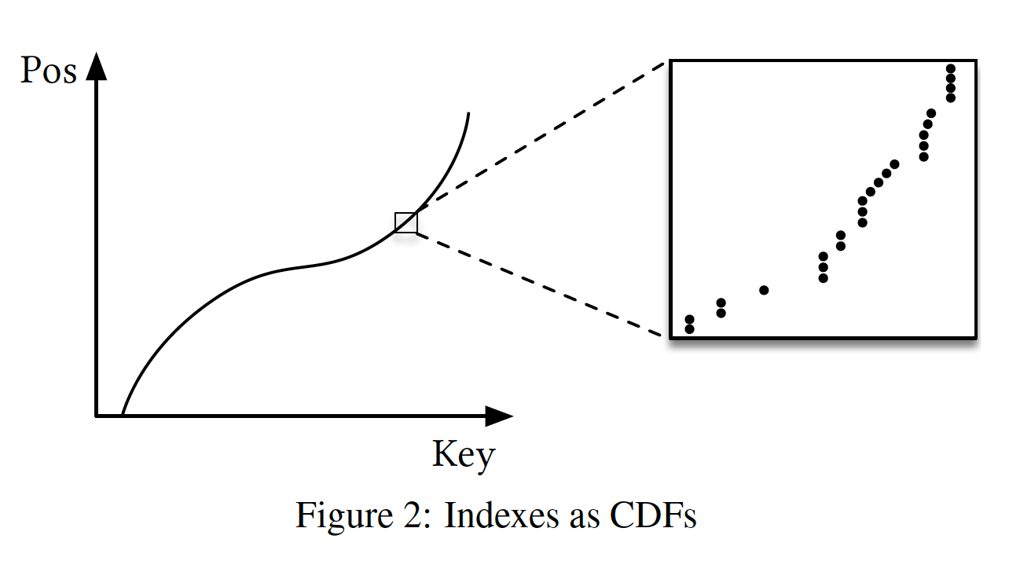
The Case for Learned Index Structures
Cumulative Distribution Function(CDF)

Slide 5
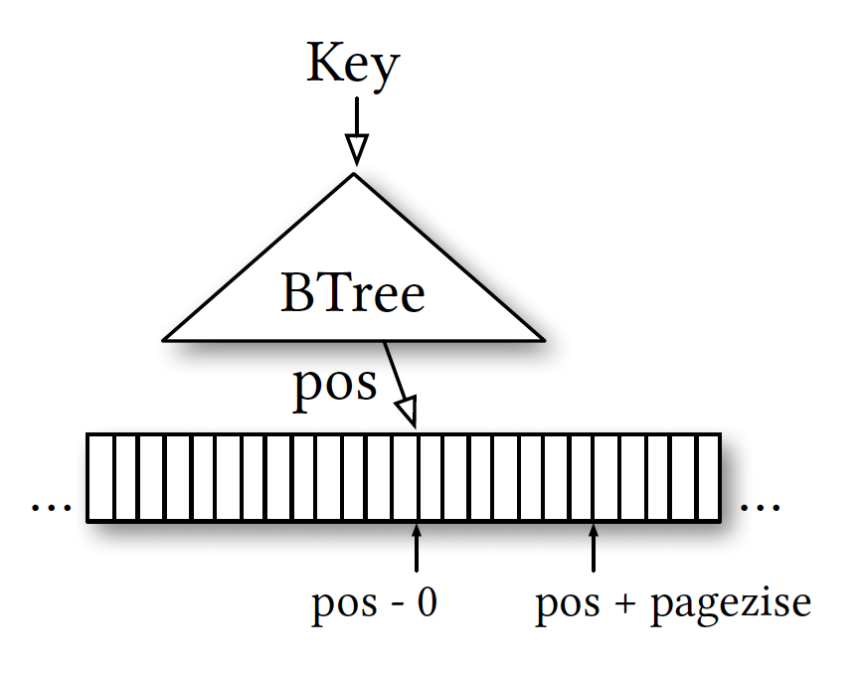
The Case for Learned Index Structures
Problem Definition: Range Index
Record table sorted by keys
Index method project from key to position
Leverage Page size to deduct Index size

Slide 6
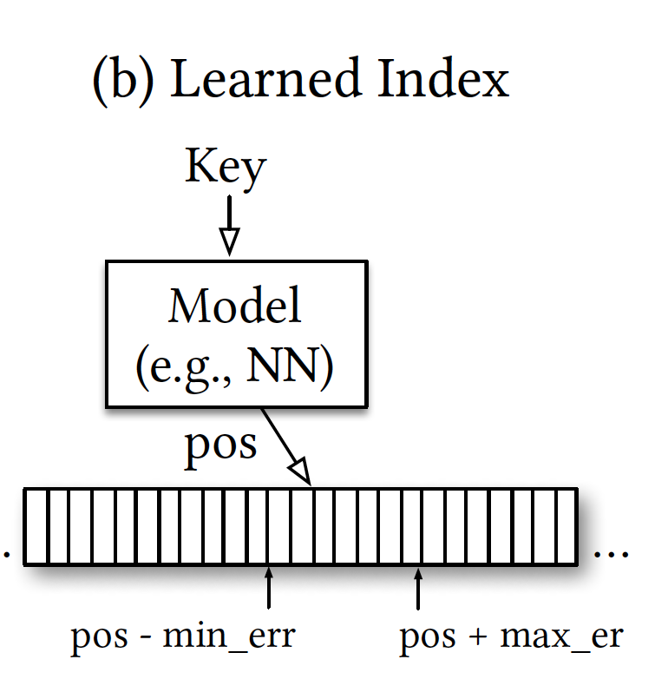
The Case for Learned Index Structures
Index to Machine Learning Method Definition
Model Input&Output
Input : Key of each record, say K
Output: Position in a Physical Memory
Range Index is a regression task
Mimic the CDF curve

Slide 7
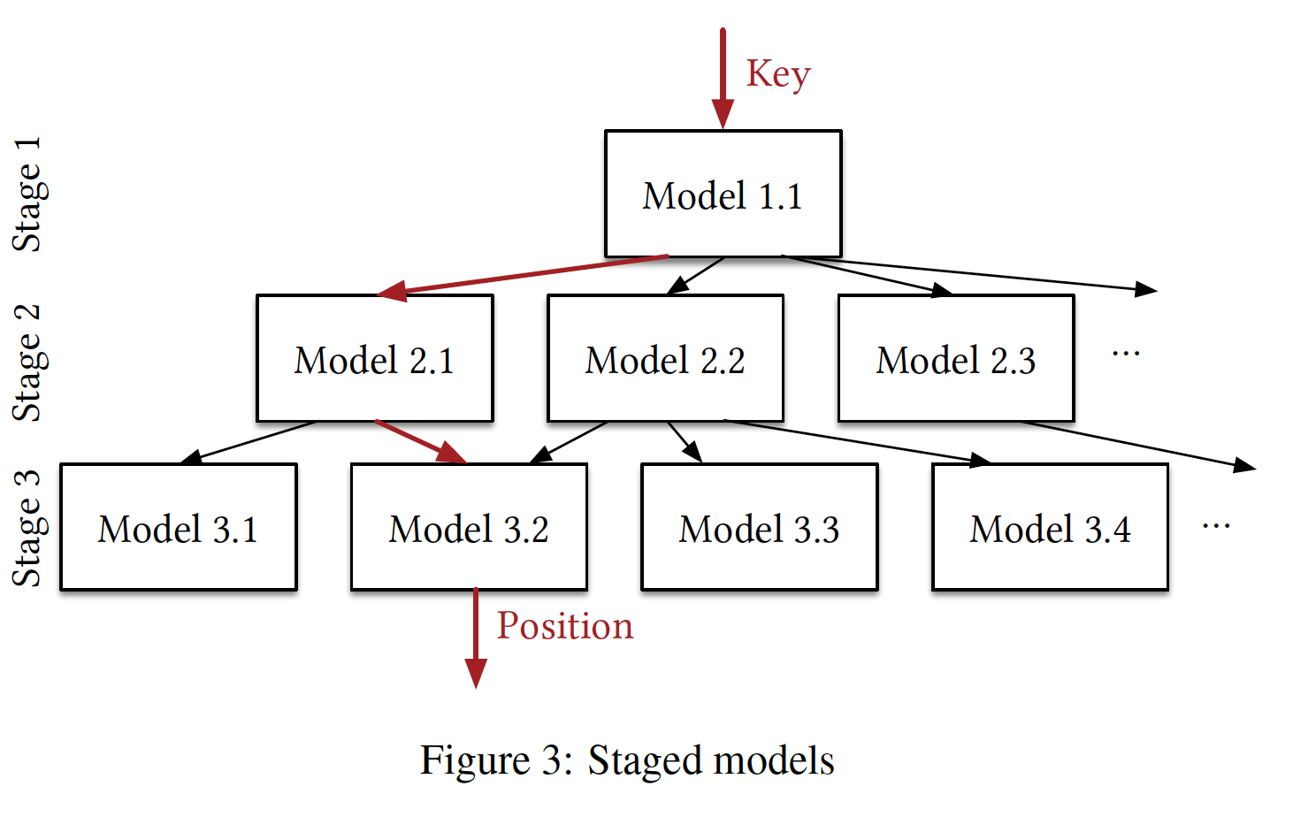
The Case for Learned Index Structures
Range Index: Recursive Model Index(RMI)
Last Mile Problem: good in distribution finding, bad in limited range localization
Single Regression model cause lage error

Slide 8
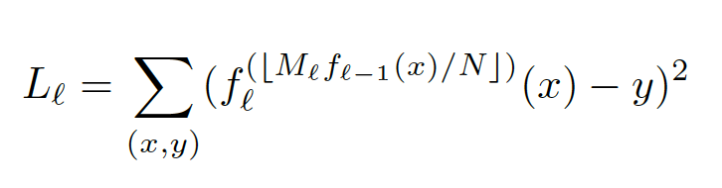
The Case for Learned Index Structures
Training
Hybrid Recursive Model Index
Change Model in last stage to B-tree if error larger than threshold Theta
Theta = [pos – error, pos + error]

Slide 9
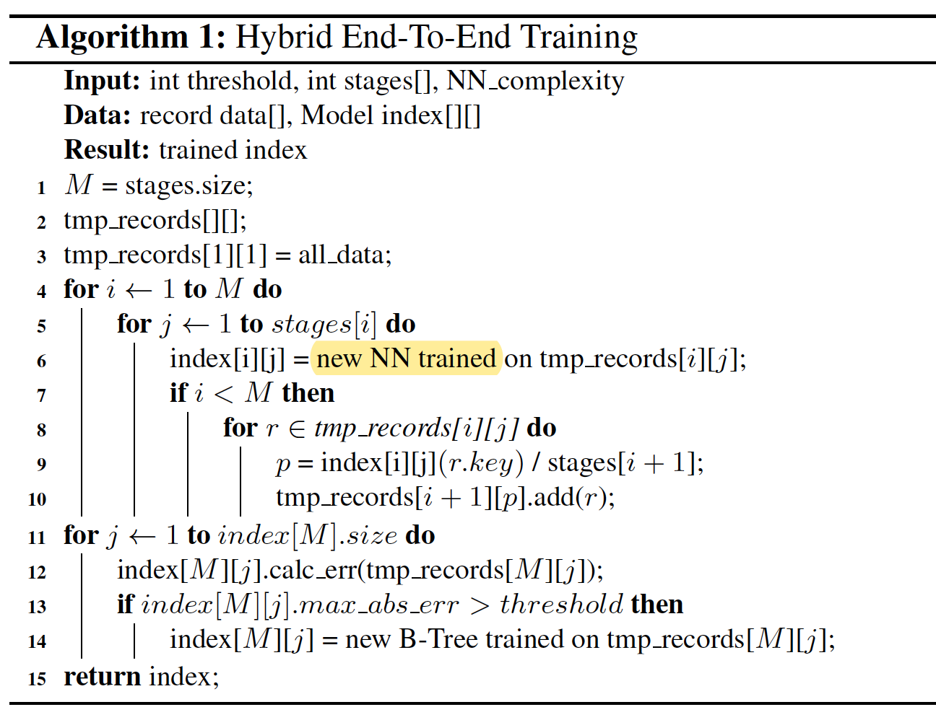

The Case for Learned Index Structures
Pseudo Code

Slide 10
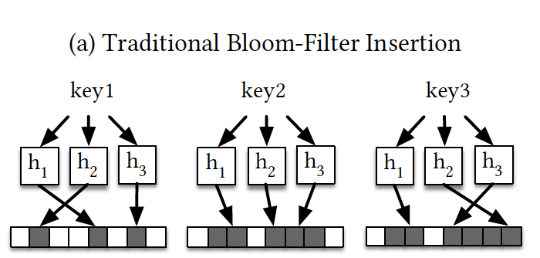
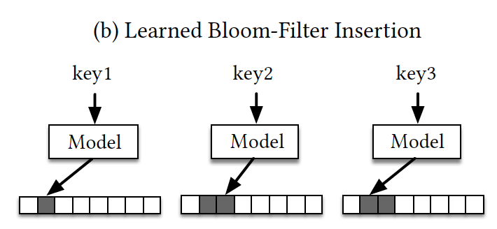
The Case for Learned Index Structures
Exsistence Index
Bloom Filter
Zero False Negative Rate(FNR)
Precise False Positive Rate(FPR)
Exsistence Index is a classification task
Is or is not a key
Two solutions:
Learned Hash Function
Classification Model

Slide 11
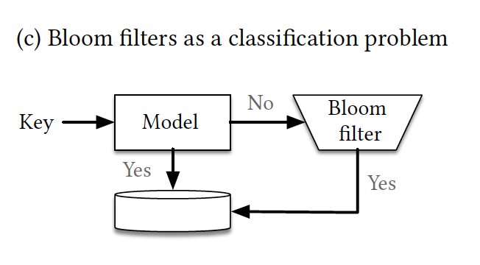
The Case for Learned Index Structures
Classification Bind with Traditional Bloom filter
How to garuantee a zero FNR?
Add a Bloom filter to re-predict value which Learned model say no.
Model’s FPR rate
FPR__{all} = FPR__{model} + (1 – FPR__{model})*FPR__{bloom}

Slide 12
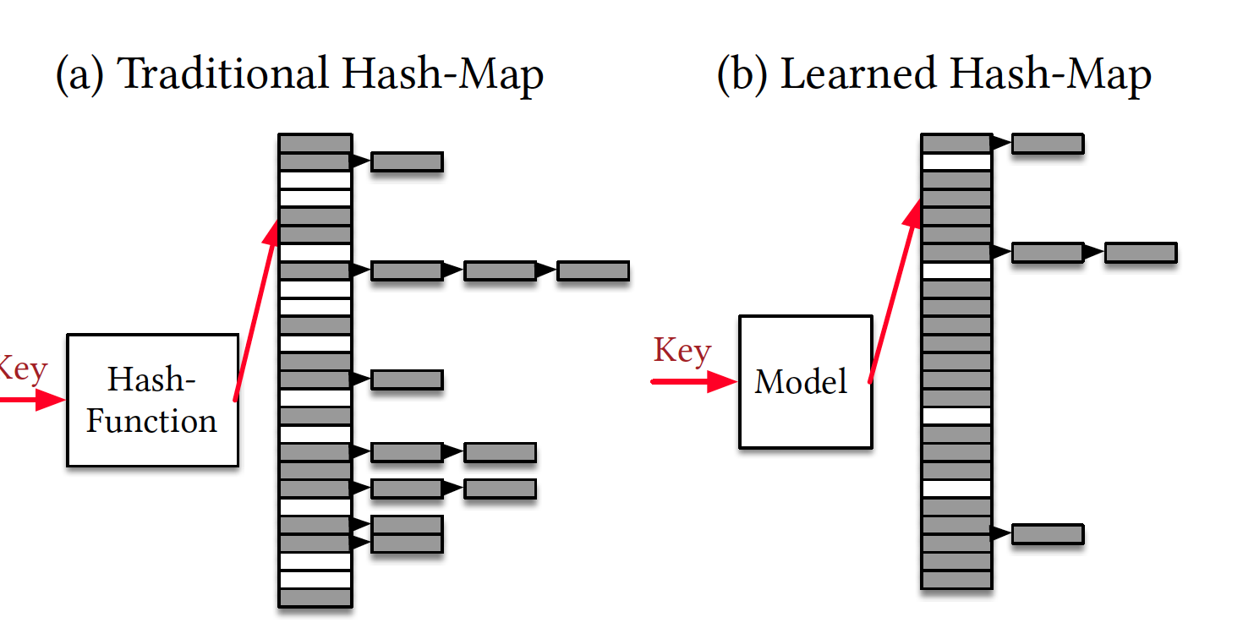
The Case for Learned Index Structures
Hash Function and CDF

Slide 13
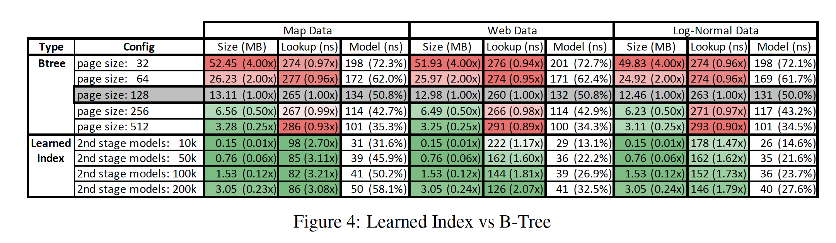
The Case for Learned Index Structures
Experimental result

Slide 14
The Case for Learned Index Structures

Slide 15
Learning Multi-dimensional Indexes
Constructions
What’s the special Feature of Multi-dimensional index
Grid Structure for multi-dimenssion
Flood’s operation flow
Optimize Layout and refinement

Slide 16
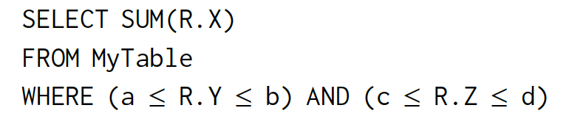
Learning Multi-dimensional Indexes
Multi-dimensional Index
Filter predicate could include multiple feature dimensions
Hard to find a natural sort-order when store data
Traditional Ways:
e.g. k-d trees, R-Trees, or octrees
Tuning is hard

Slide 17
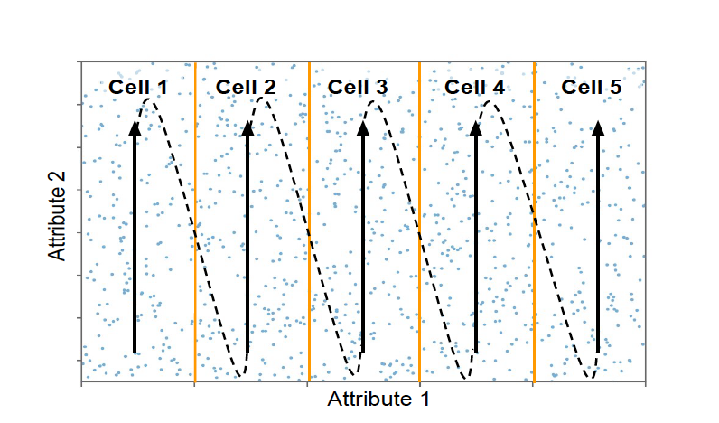
Learning Multi-dimensional Indexes
Data Layout (Order)
Say dataset with d feature dimension
Build Grid:
(d - 1) dimension serve as grid dimension, each dimension i divide space into m_{i} partitions by value.
d th dimension serves as sort dimension
Save data grid by grid

Slide 18
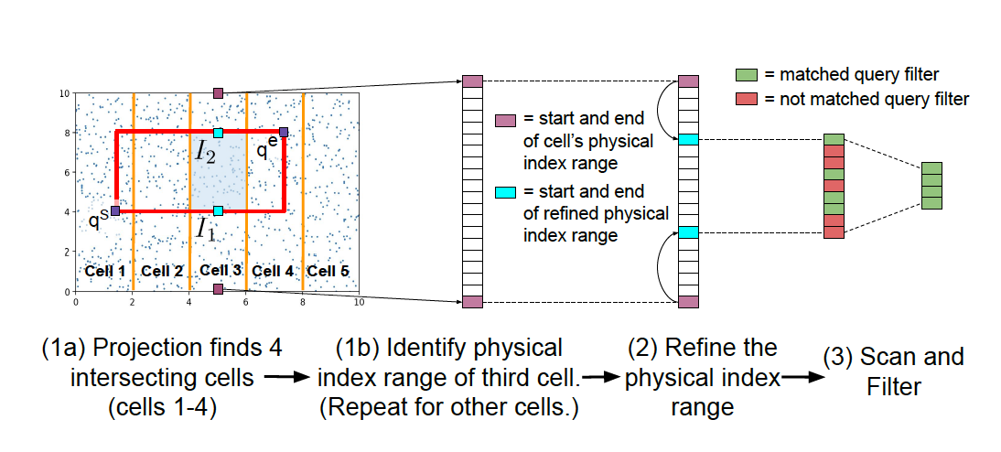
Learning Multi-dimensional Indexes
Flood Operation
Projection -> Refinement -> Scan
Concept1: Hype-Rectangle
Concept2: Scan dth dimention shrink the problem into a one-dimension task

Slide 19
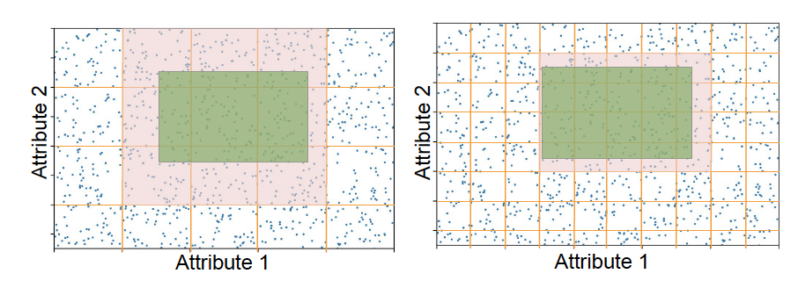
Learning Multi-dimensional Indexes
Relations between grid-number and performance
For d dimensional dataset, the layout present like: (c₁, c₂,.., c_{n-1})
Pick which dimension as dth dimension

Slide 20

Learning Multi-dimensional Indexes
Cost Model
Learn the Cost function by random forest regression
When New Dataset coming:
Generate dataset sample together with query workload
Build different layout and run the query workload
Get result: Query time, Scan cells number -> get query weights
Use the Query result(i.e. computed weight) and input(i.e. Layout and query-workload) as train example of random forest regression model
Use Layout, Query result as input to predict Different equation weight,

Slide 21
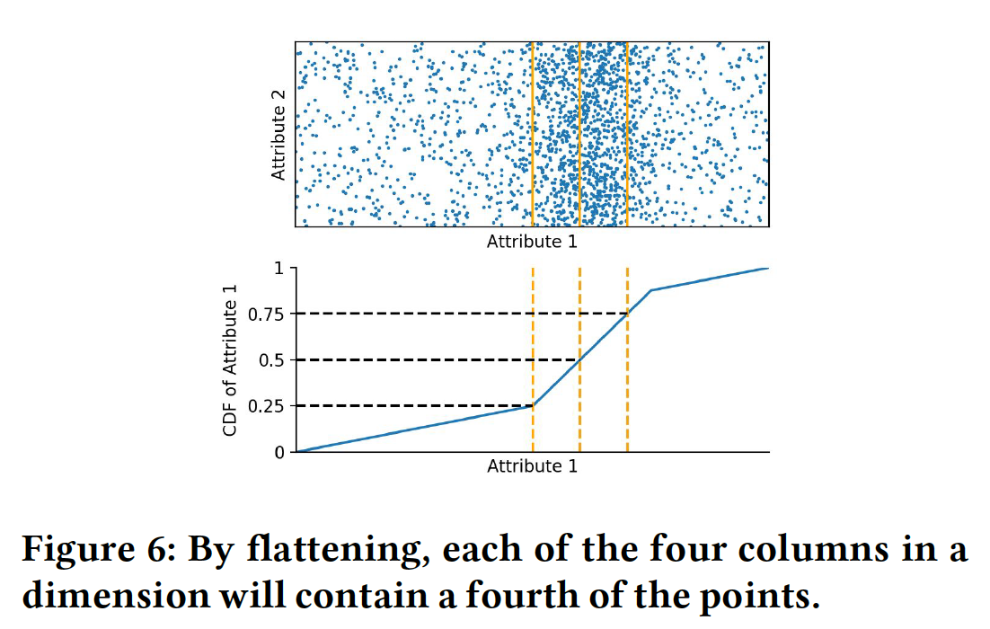
Learning Multi-dimensional Indexes
Two optimize method
Flattening
Each column should have similar point number.
Using a CDF(RMI) model to learn distribution

Slide 22
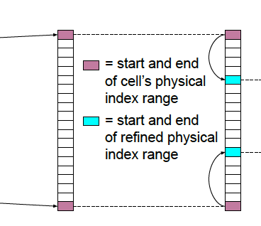
Learning Multi-dimensional Indexes
Two optimize method
Flattening
Fast Refinement
Using RMI for range indexing
Piecewise Linear Modeling(PLM)
Last stage use simple linear segment, say F1(key) from the begining
From the start, increase number of key predicted by F1(),
until average error distance > threshold, generate a new linear segment, say F2(key)

Slide 23
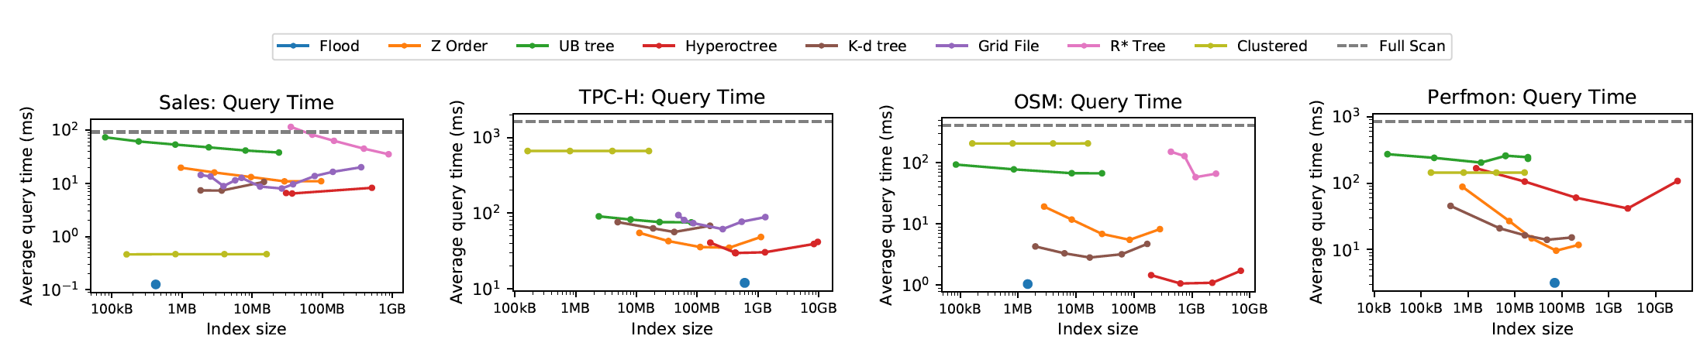
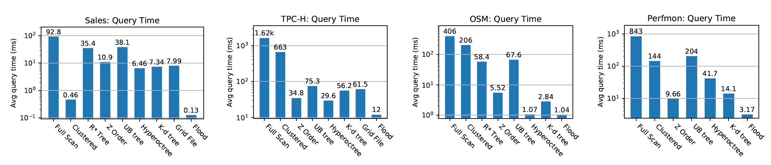
Learning Multi-dimensional Indexes
Experimental result

Slide 24
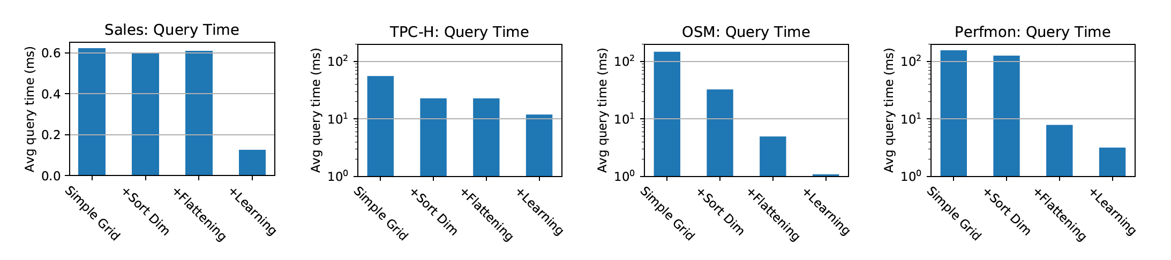
Learning Multi-dimensional Indexes
Experimental result

Slide 25
Lifting the Curse of Multidimensional Data with Learned Existence Indexes
Construction
Learned Bloom Filter for multi-dimension index
Optimization: Low False Positive Rate

Slide 26
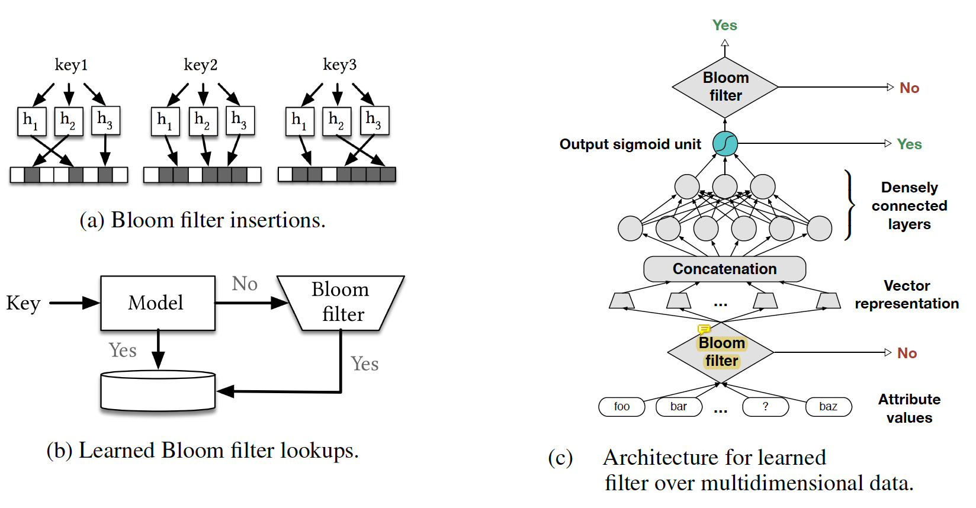
Lifting the Curse of Multidimensional Data with Learned Existence Indexes
Multi-dimensional Learned Bloom Filter

Slide 27
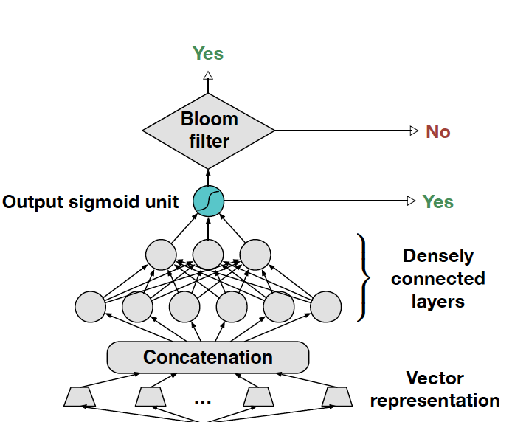

Lifting the Curse of Multidimensional Data with Learned Existence Indexes
Multi-dimensional Learned Bloom Filter
Support wildcard queries
Robust query: allow some attribute remain unknown
Generate Vector representation
Unknown Attribute has specific vec-pre(e.g. zeros)
Paper leave representation method beyond discuss
Concat as a whole vector
As input of NNs
Add a Postfilter(Traditional Bloom)
Guarantee zero FNR

Slide 28
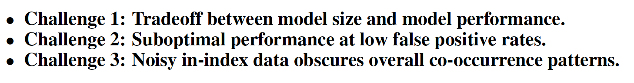
Lifting the Curse of Multidimensional Data with Learned Existence Indexes
Three challenges

Slide 29
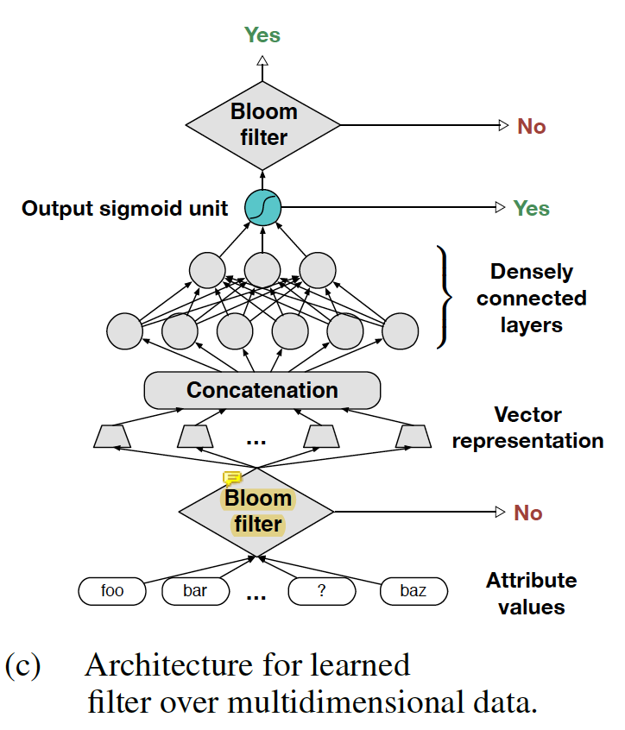
Lifting the Curse of Multidimensional Data with Learned Existence Indexes
Three challenges
Pre-filter(Sandwiching optimization)
Bloom->learned model->Bloom
Treat High/Low cardinality differently
High cardinality: use RNNs generate vector
Word by word representation
Low cardinality: Directly transform value
Transform value into vector(e.g. One hot)

Slide 30
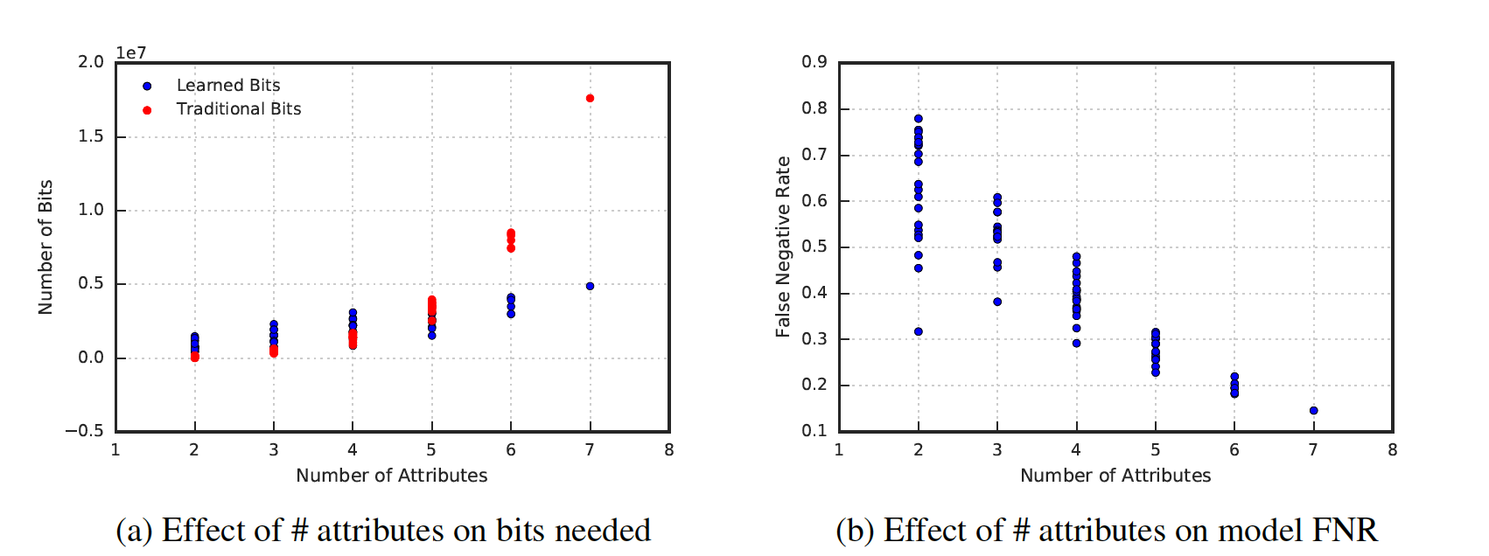
Lifting the Curse of Multidimensional Data with Learned Existence Indexes
Experiment Result

Slide 31
The ML-Index
Construction
Transform multi-dimention into one dimension
Scaling Method

Slide 32


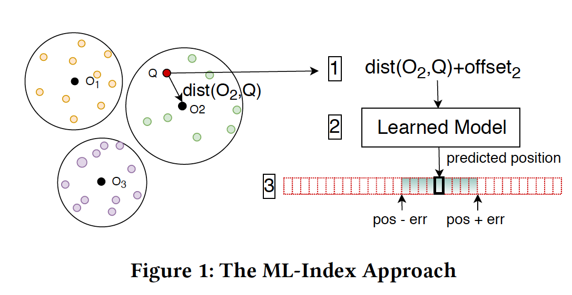
The ML-Index
Transform Structure
Multi-dimention feature:
Reference Point O_{i}.
Use key as one-dimentional search key

Slide 33
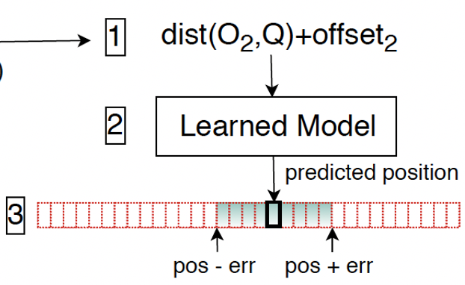
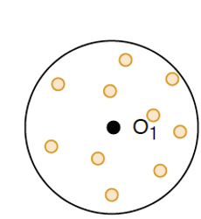
The ML-Index
Scaling Method
Single Reference Point
Strong backward:
by mapping multidimensional points that are far from each other to the same value

Slide 34

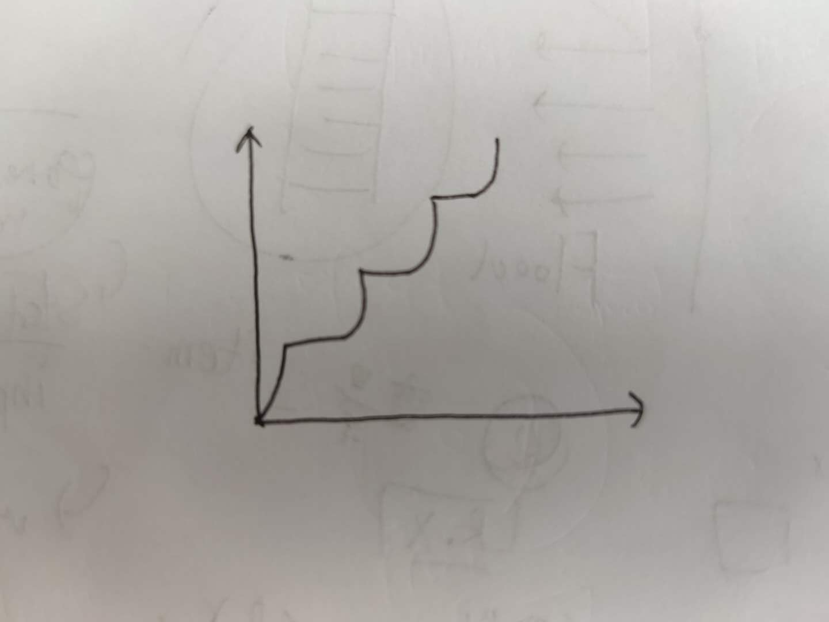
The ML-Index
Scaling Method
Single Reference Point
iDistance
Multiple reference points
Add C: a fix offset to each reference point when compute key:
Cons:
c is small: Cause Overlap when store data
C is large: Cause CDF un-smooth

Slide 35
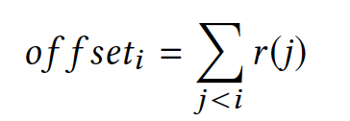
The ML-Index
Scaling Method
Single Reference Point
iDistance
Offset for each reference
Key = offset_{i} + dist(O_{i}, d)
Pros:
No overlap will occur when store data
CDF also smoth

Slide 36
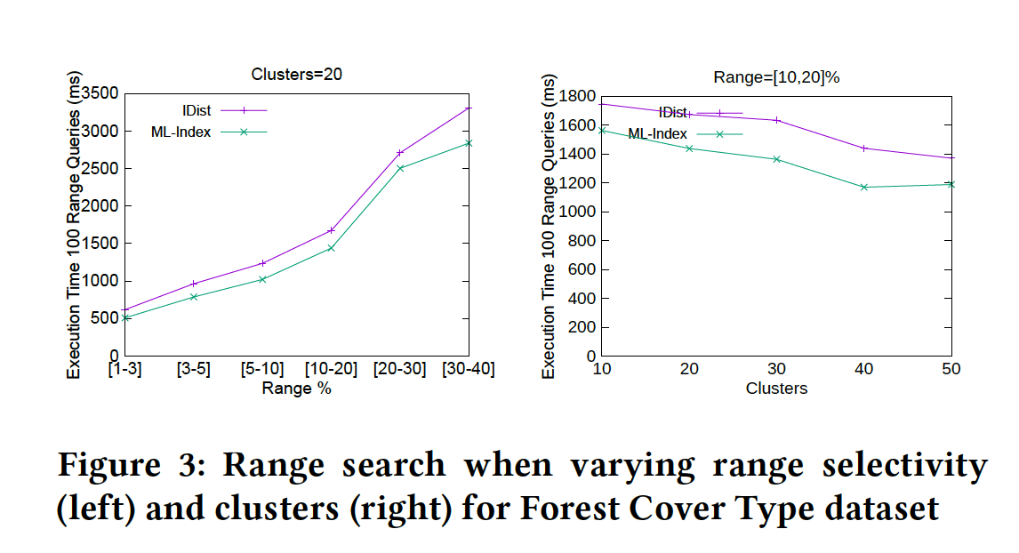
The ML-Index
Experimental Result

