Slide 1
COWLS strong-lens modelling — status
COSJ100018+022138 (J18) · COSJ100024+021749 (J24) · COSJ095921+020638 (J0959)
12 November 2026

Slide 2
Goal and the three problems
Goal: smooth mass models stable enough that a subhalo search can run on the residuals.
Problem 1 — the mass model wants a large quadrupole:
  all three lenses fit large external shear (|γ| ≈ 0.1–0.2) under a power-law model
  real external shear (groups), or the power law absorbing internal structure (stars+dark split)?
Problem 2 — source reconstruction pathologies:
  J18's source is tiny (~0.05″) and highly magnified → pixelized reconstruction fragments into fake clumps
  J0959 has compact (AGN-like) knots some meshes fail to reconstruct at all
Problem 3 — nuisance systematics: PSF mismatch in lens cores, noise maps, nearby galaxies, practical run failures

Slide 3
What we have ruled out
Group environment alone ≠ the shear: J18 and J24 sit in spectroscopically confirmed groups, but
  group shear is only ~1/3–1/2 of the fitted value (|γ| ≈ 0.05–0.09, roughly the right direction)
  J0959 has NO detected group — its quadrupole cannot be environmental
The data are not broken: PSFs, noise maps, masks, positions all audited
  PSF-error noise floor fixed J24's core residuals; shear unchanged
  J18's shear orientation repeats in a second band (F277W) — not a single-band artefact
The old 13-day non-convergence is fixed (discontinuous regularization bookkeeping + GPU sparse path)
ConstantSplit regularization is ruled out for compact sources (irons the source flat; ±10σ knot residuals)
Lens light stealing arc flux is fixed (single-component MGE light model)

Slide 4
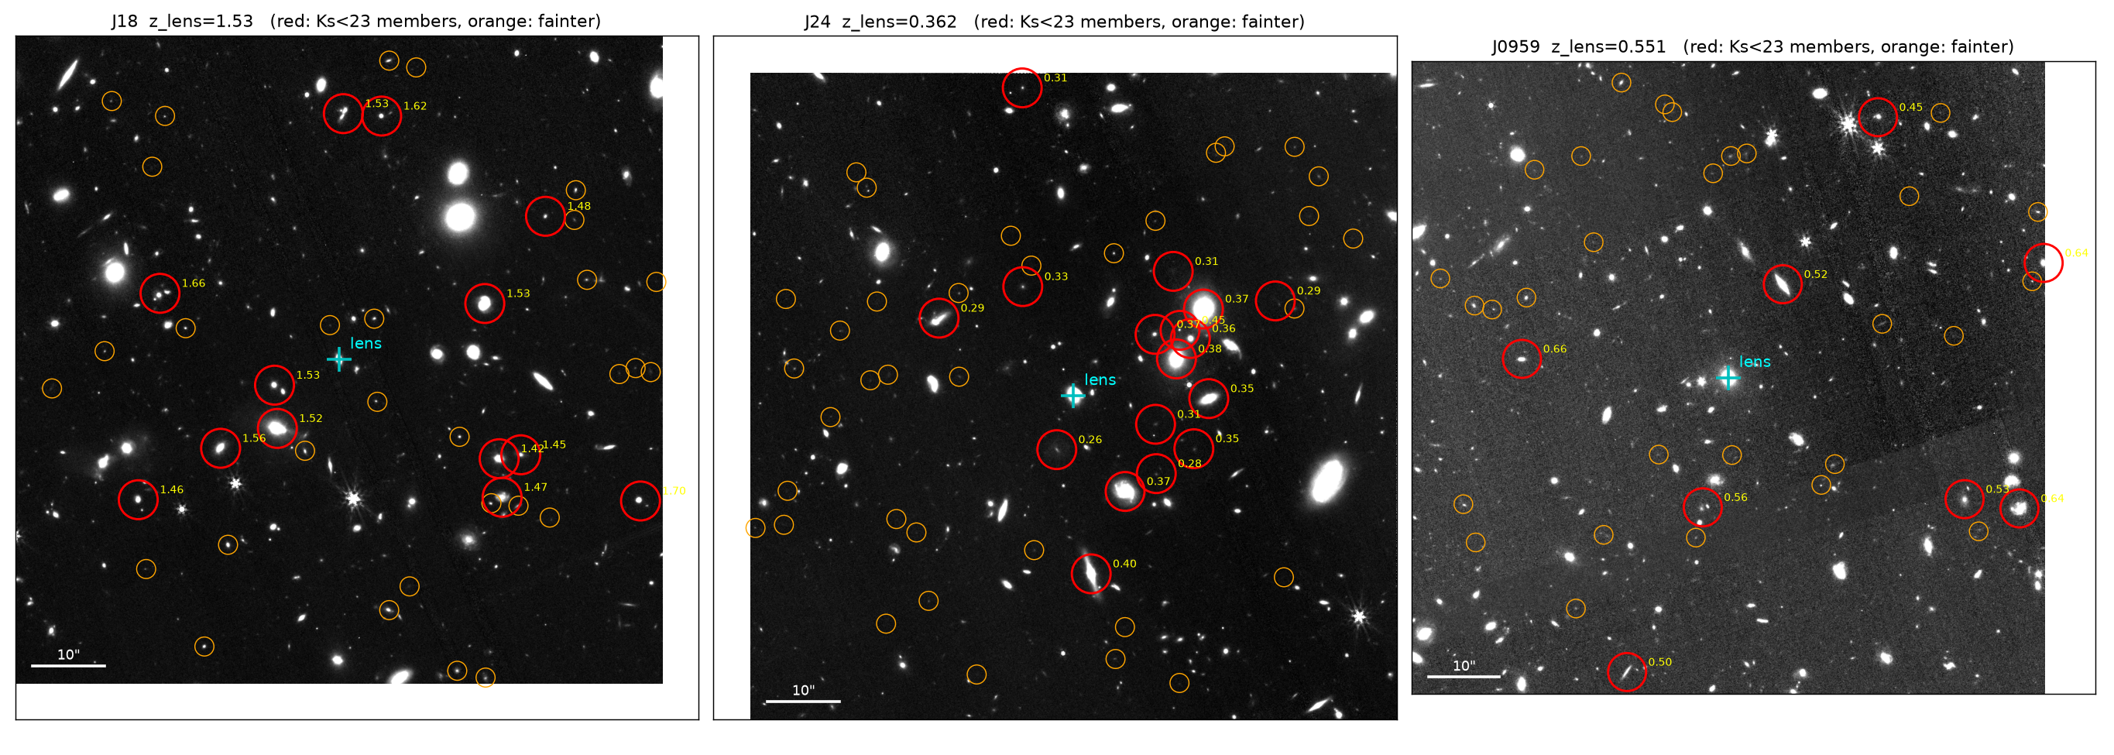
The group environment
90″ F444W mosaics with spectroscopically confirmed group members marked: J18 (z=1.53, 11 members) and J24 (z=0.36, 8 members).
Group shear |γ| ≈ 0.05–0.09 in roughly the fitted direction for both; J0959: no group found.

Slide 5
Where does the quadrupole live? External shear |γ|
Lens | Power-law (EPL) | Stars + dark halo | Group supplies
J18 | 0.20 | 0.04 (collapsed) | ≈ 0.06–0.09
J24 | 0.17 | 0.15–0.18 (survives) | ≈ 0.05
J0959 | 0.14 | 0.09 (partly absorbed) | ≈ 0 (no group)
Stars+dark test: stellar component fixed to the lens light, NFW halo with near-spherical prior, small centre freedom.
J18: shear collapses to the group level → the power law was faking it (internal quadrupole).
J24: shear survives in every variant → genuine external (group) + elliptical halo (e ≈ 0.2).
J0959: halved but not eliminated; nothing environmental to supply it — open question.

Slide 6
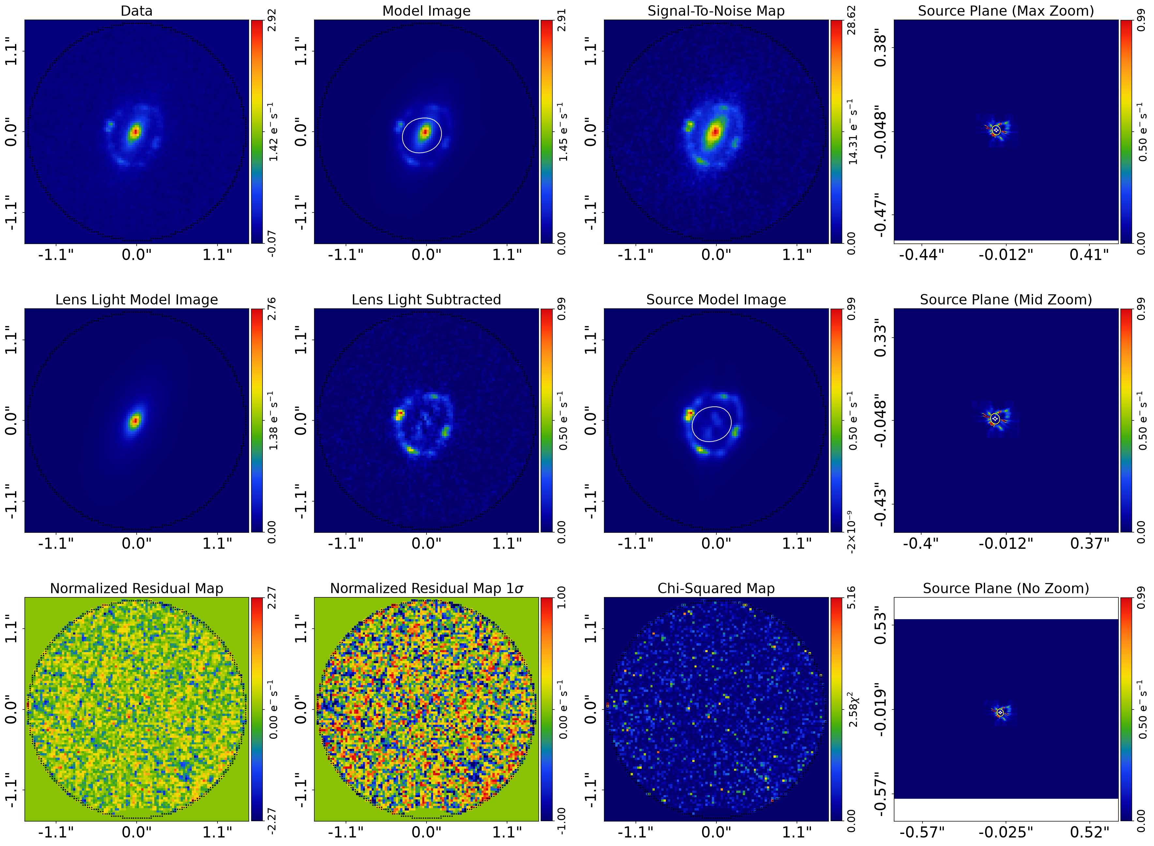
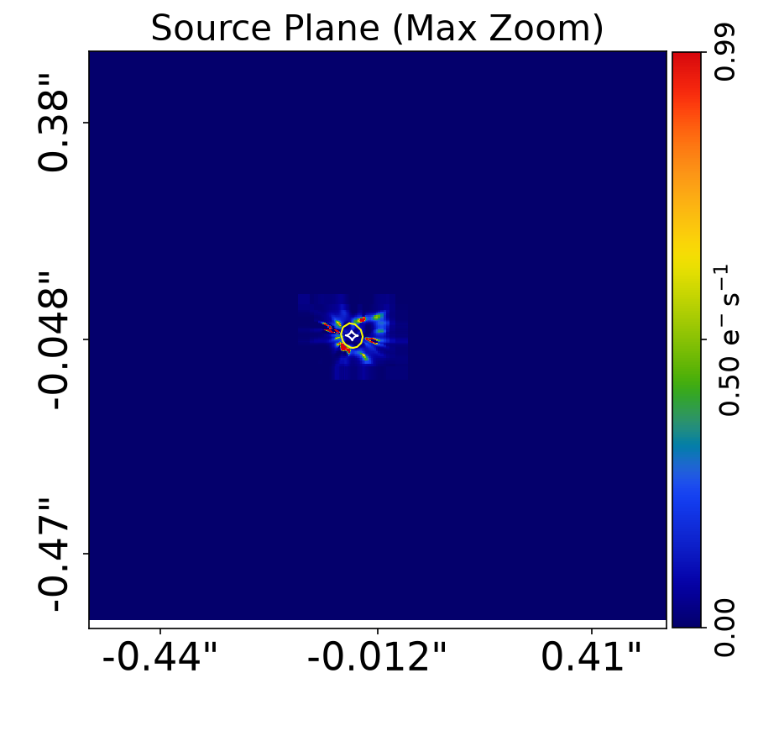
J18 (z=1.53) — stars+dark fit: shear collapses
γ = (−0.02, +0.04), |γ| ≈ 0.04 (EPL wanted 0.20)
Halo near-round (e ≈ 0.04), centre offset 0.06″
M₂₀₀ ≈ 3.9×10¹³ M⊙
Image-plane residuals at noise level
BUT zoomed in the source is multi-clump over ~1″ (next slide),
and the mass model moves 10–20% between source variants

Slide 7
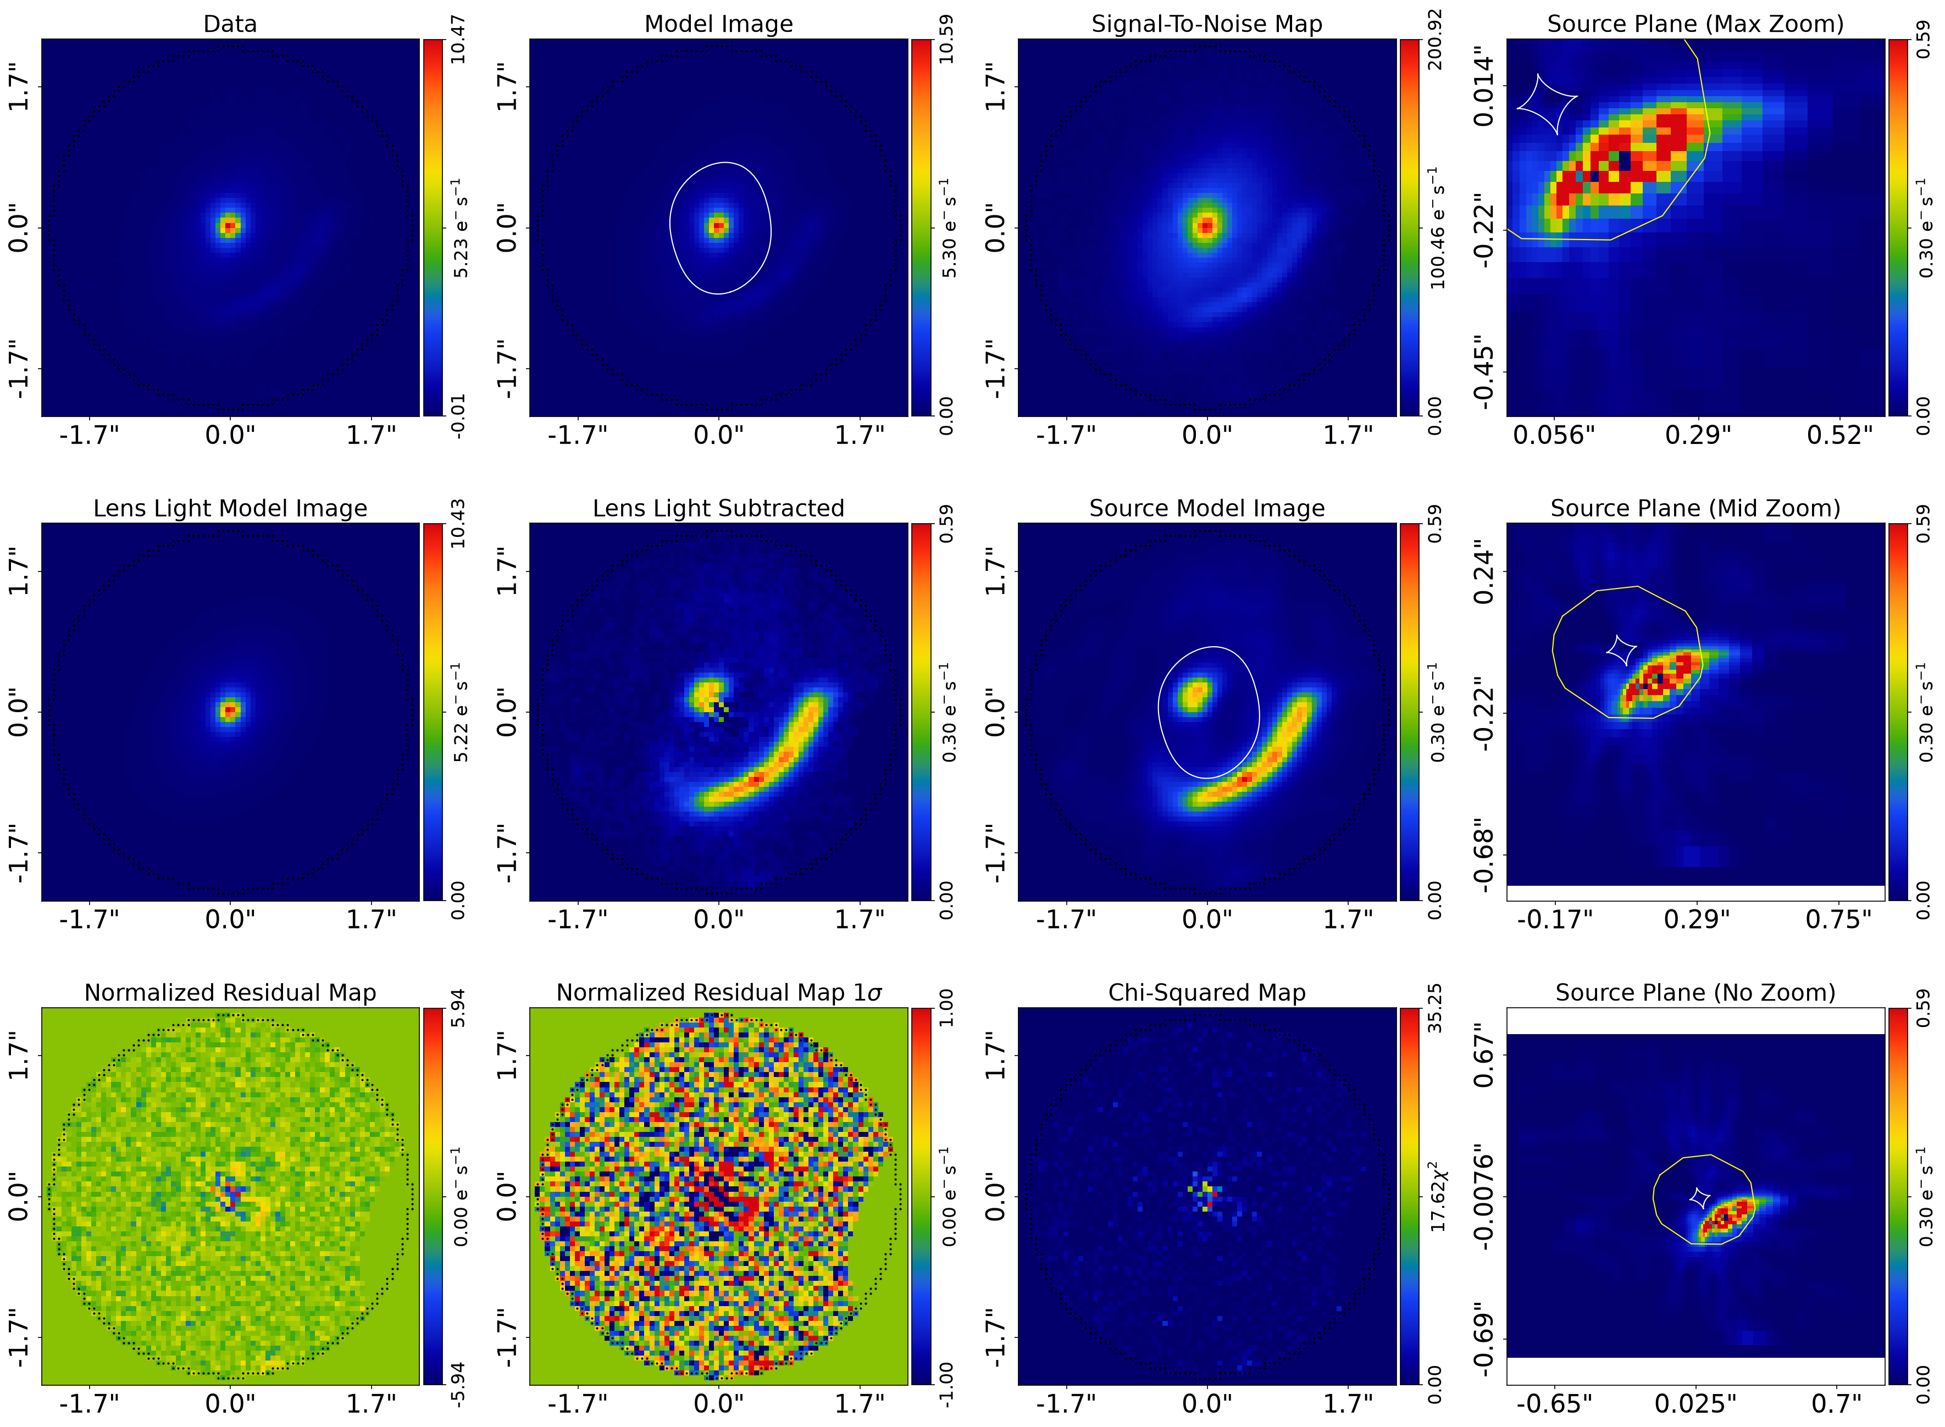
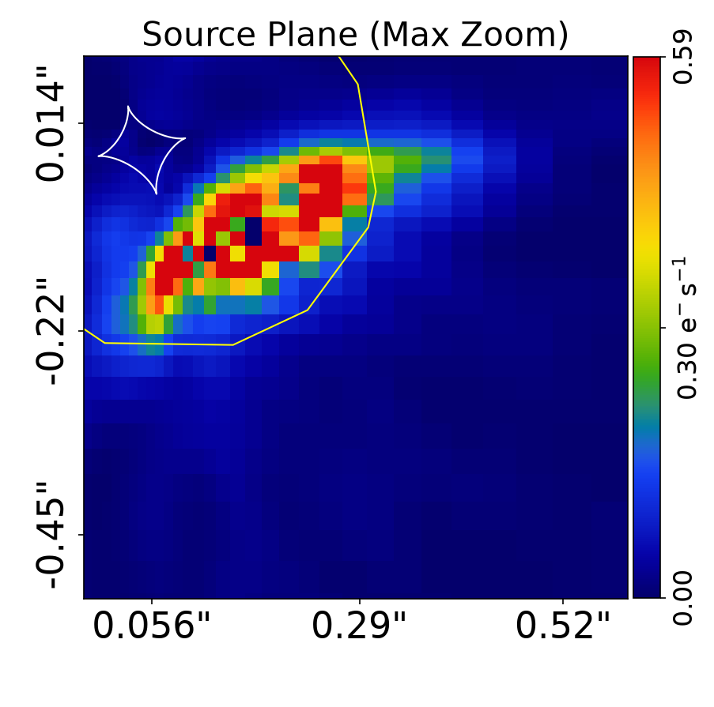
J24 (z=0.36) — stars+dark fit: shear survives
γ = (−0.10, +0.11), |γ| ≈ 0.15 (two mesh families agree)
Halo elliptical (e ≈ 0.2)
Group supplies ≈ 0.05 in the right direction — needs more
Good fit on every variant; closest to done

Slide 8
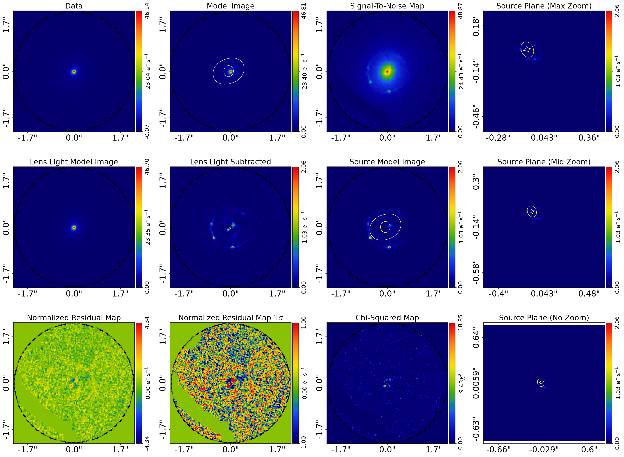
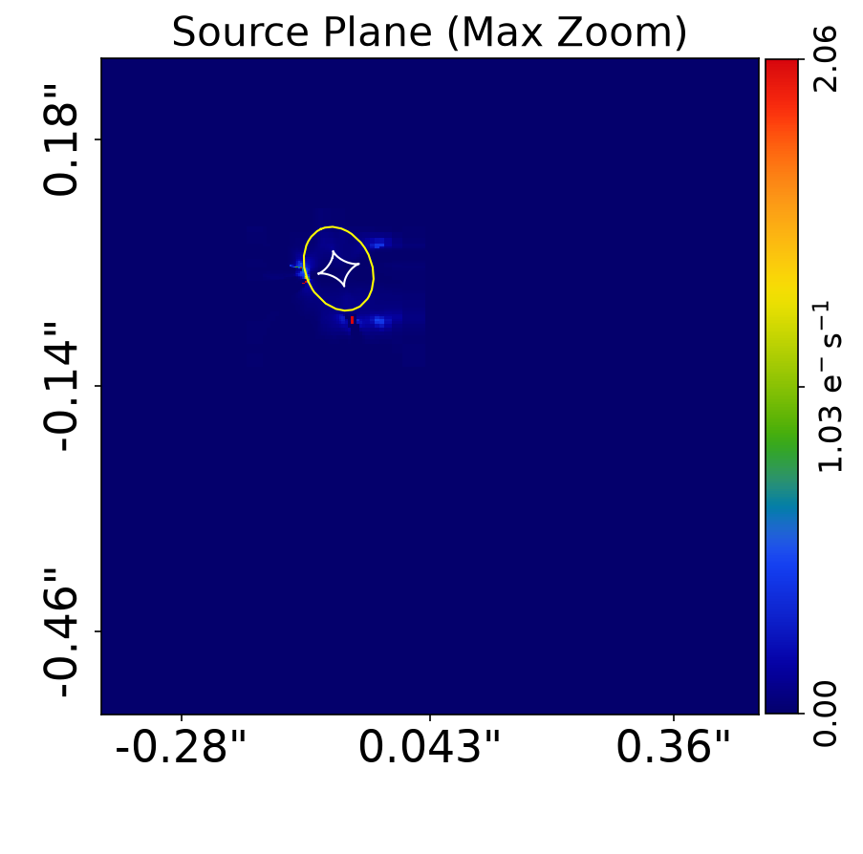
J0959 (spec-z, no group) — stars+dark fit
γ = (−0.005, +0.089), |γ| ≈ 0.09 (EPL wanted 0.14)
Compact knots mostly reconstructed now
M₂₀₀ ≈ 4.9×10¹³ M⊙
Einstein radius 0.86″ vs 0.71″ in Anguita+09 — unresolved
Compact residual spots remain (lensed AGN?)

Slide 9
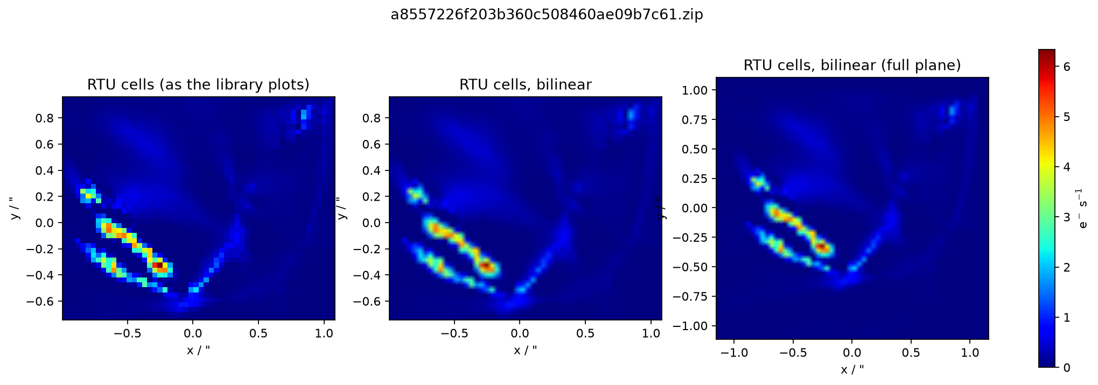
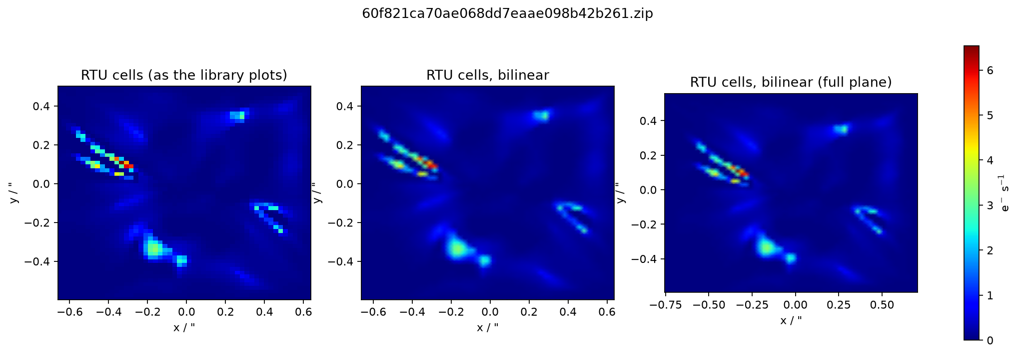
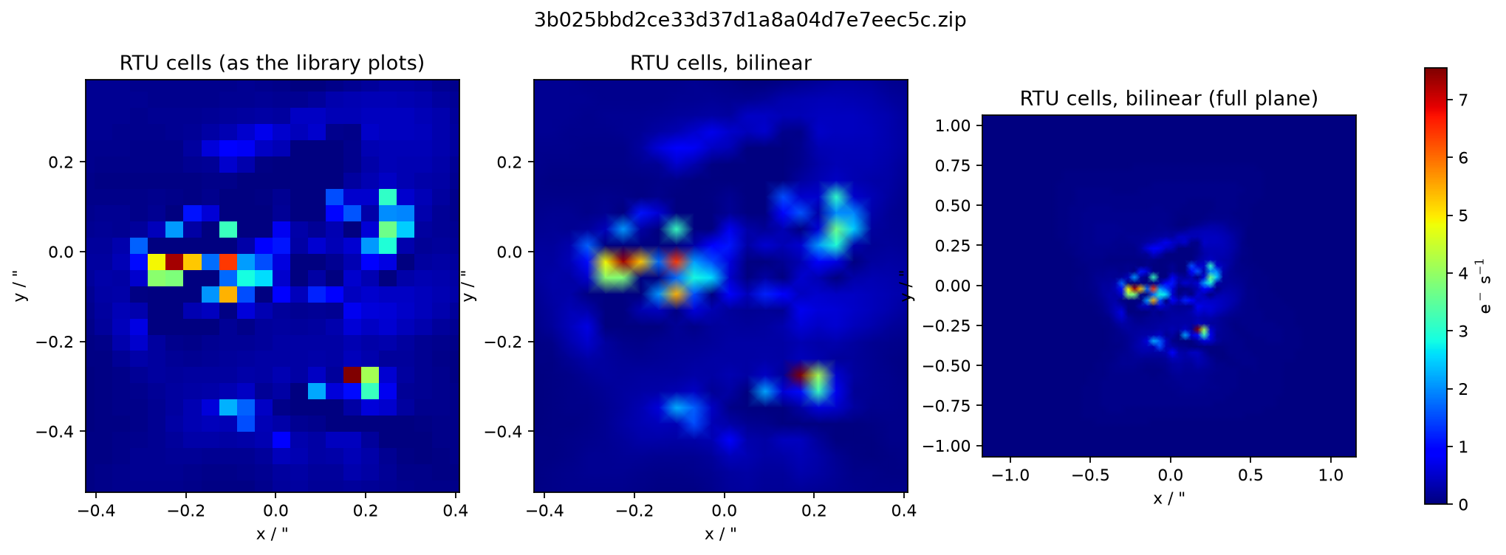
J18's source, zoomed: fragmented or genuinely clumpy?
F150W, source_pix[2] (RTU): clumpy chains over ~1.2″ along the caustic path, isolated bright cells.
F150W, stars+dark (RTU): four clump groups — a DIFFERENT arrangement (mass-model dependent).
F277W (independent band + fit): also multi-clump, different arrangement again.
All meshes and both bands agree the source is multiple clumps (consistent with two marked position sets; z≈3.1 star-formers are clumpy). But clump positions are unstable across mass models and bands — the (mass, source) pair is under-constrained. This is the 10–20% slope/shear systematic.

Slide 10
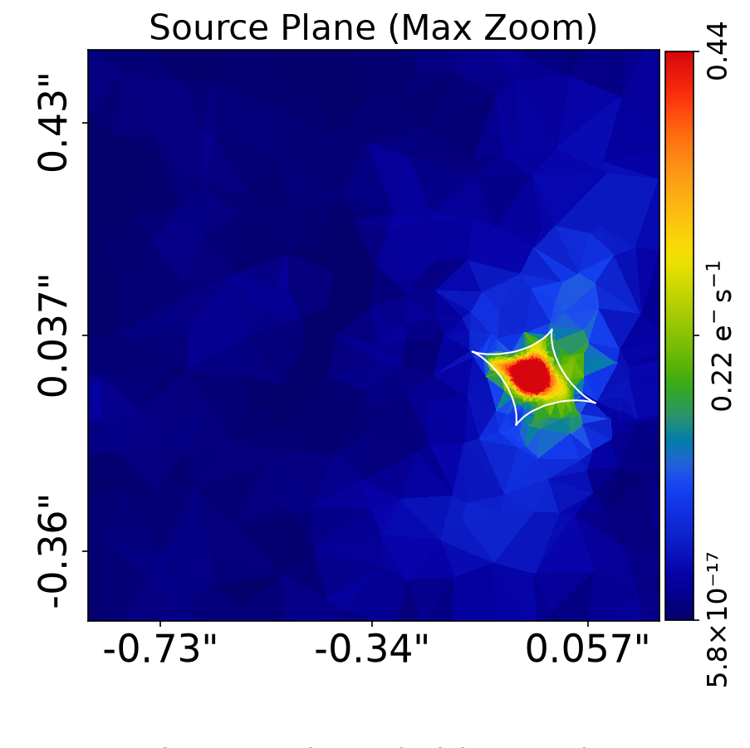
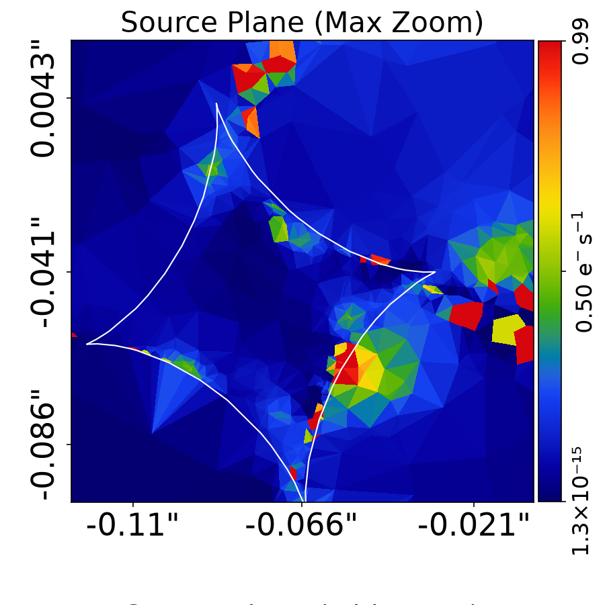
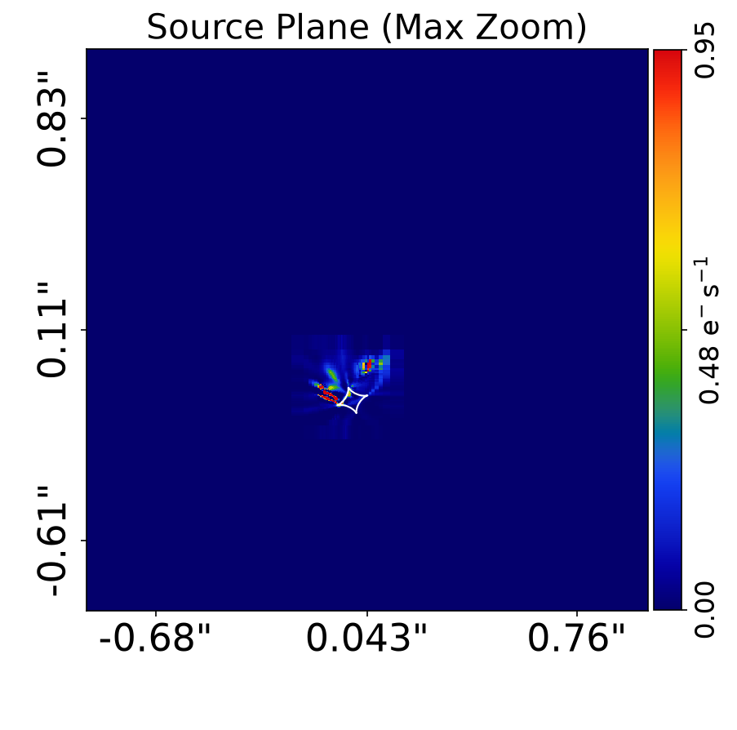
The source reconstruction is the systematic (J18)
ConstantSplit: over-smoothed to one blob → ±10σ knot residuals. Ruled out.
AdaptSplit: clean image fit, but clumps scattered on the caustics — fragmentation.
RTU (production): looked compact at panel zoom, but zoomed view shows clumpy chains too.
The inferred mass model moves 10–20% (slope, γ₂) purely from source-reconstruction freedom. Setup is now chosen by source-plane behaviour, not image-plane residuals.

Slide 11
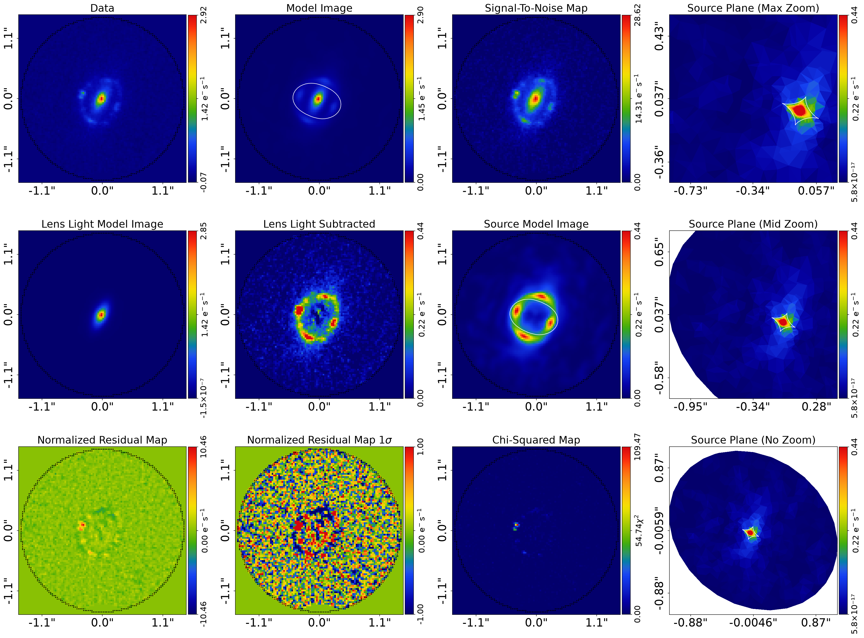
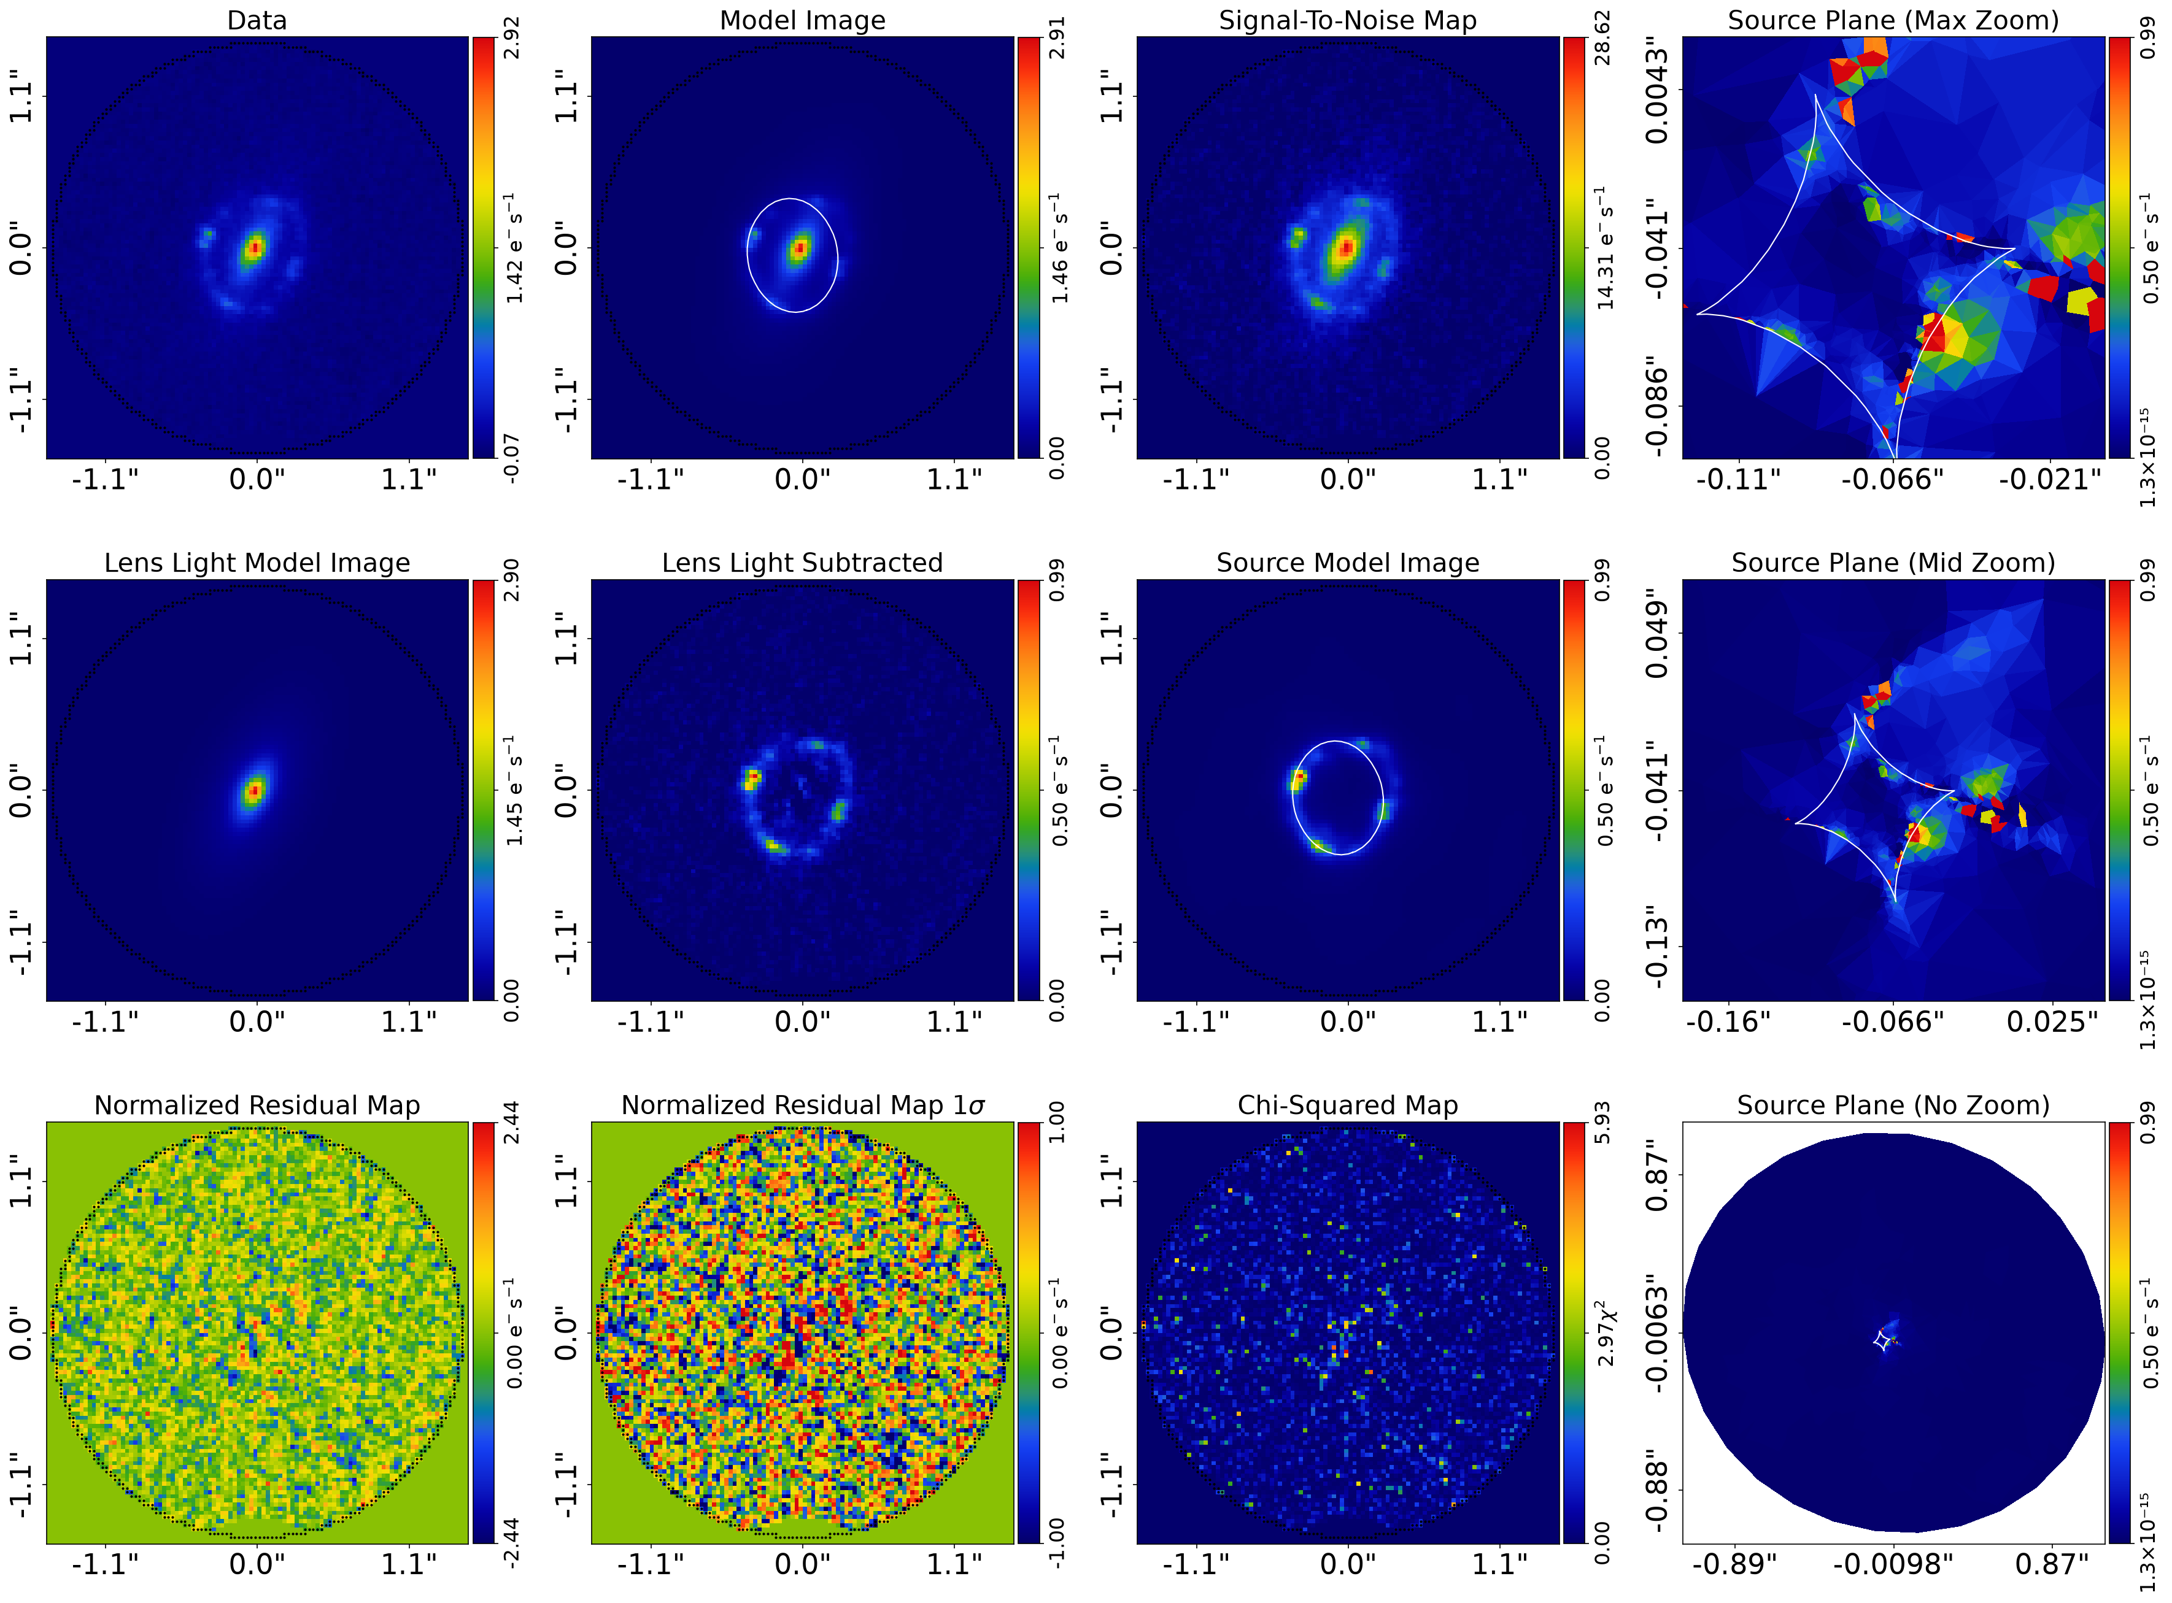
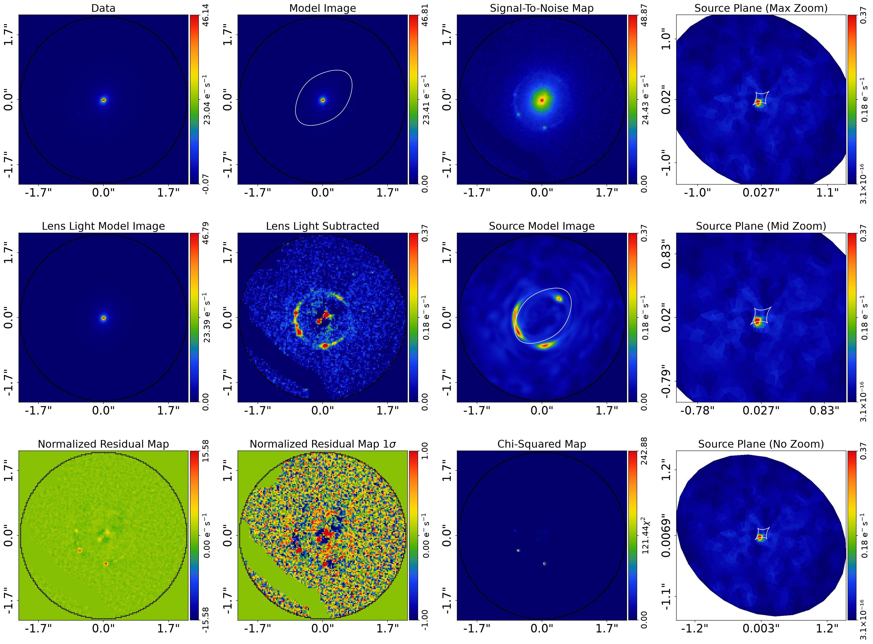
Fit gallery — failures vs working fits
J18 Delaunay+ConstantSplit: smooth model ring, knot residuals ±10σ — all downstream mass results discarded.
J18 Delaunay+AdaptSplit: image plane clean (±2.4σ) — but source plane still fragments (previous slides).
J0959 CS: misses the compact knots entirely (χ² ~ 243). The RTU chain reconstructs them (χ² ~ 17).
Lesson: image-plane residuals alone cannot adjudicate — the source plane must be inspected.

Slide 12
Next steps
J18 (critical path): joint MULTI-BAND fit wired and running (F150W+F444W+F277W+F115W):
  ONE shared mass+shear model across all bands — the strongest lever against the mass/source degeneracy
  plus: AdaptSplitPower test, mesh-independence of the shear collapse, CS wide-shear (completeness)
Multi-band plan for all three lenses once J18's chain is proven; J0959 next (F277W strongest there)
  J24 caveat: its F444W arc S/N measures negative with a contaminant flag — band selection needs care
J0959: finish wide-shear chains; r_E offset vs Anguita+09; AGN point-source component if knots persist
J24: essentially done single-band — write down the group + elliptical-halo shear story
Then: freeze the production chain per lens → merge to master → HTCondor subhalo tiling
Icebox: model the confirmed group members explicitly; multipoles on the stars+dark model

Slide 13
Reference (1/2) — output folders
Path layout: <folder>/<model_setup_free_source|mass_models>/<lens>/<stage>/<identifier>.zip
output_sam_v4 — production on data/cowls_sam (J18, J24): RTU + Delaunay(AS/CS) chains, wide-shear, mld
output_sam_v4_f277 — J18 in F277W (RTU chain)
output_sam_v5 — psffloor noise: J24 full chain; J0959 all chains; J18 partial (to source_pix[1])
output_test_as — J18 AdaptSplit + weight_floor 0.1 + adapt_floor 0.02
output_test_as_sp1 — same, with run_2 adapting to the PIX 1 reconstruction
output_sam_v3 and older — superseded archives (local only)
Stages: source_lp[1] → source_pix[1] → source_pix[2] → light[1] → mass_EPL → mass_multipole
  or mass_light_dark[1] (stars+dark variant). 'wide shear' = ±0.2 shear prior; baseline = ±0.1.
Full annotated list of every zip: docs/update_2026-11-12/run_inventory.txt

Slide 14
Reference (2/2) — key result zips (first 8–16 chars of the identifier)
Lens | Run | Zips
J18 | RTU production chain (v4) | source_lp 0f67864c3c55 · sp1 f06b21c95524 · sp2 a8557226f203 · light b299bcdfa166 · mass_EPL 201756ac/50088962 · mass_multipole 25e03b37/c860c378
J18 | RTU wide-shear (v4) | mass_EPL ff53dc005fa3 · mass_multipole 9d7cf843cb6f
J18 | stars+dark RTU — shear collapse | mass_light_dark[1]/60f821ca70ae
J18 | stars+dark CS — failed fit, discard | mass_light_dark[1]/88451090ddb0
J18 | Delaunay AdaptSplit chain (v4) | sp1 7402fbacf766 · sp2 94d0ac6d09d0 · light a5524e3ddb87 · mass_EPL(wide) 0c8b3b8de5dc
J18 | F277W chain (output_sam_v4_f277) | mass_EPL e19cbea5f203 · mass_multipole f8562ab7971e
J18 | taming tests | output_test_as: sp2 89e6ae51966c, mass_EPL 32f986325298 · output_test_as_sp1: sp2 5a3514cb9124, mass_EPL 9af8d7bf2fe6
J24 | RTU production chain (v4) | source_lp 756be2753561 · sp1 b3963ce057a0 · sp2 1de83b715ec3 · light cb6d13c71d70 · mass_multipole a5876a95/a9ceefa4
J24 | RTU wide-shear (v4) | mass_EPL 0e102780016a · mass_multipole a9ded3195f56
J24 | stars+dark RTU / CS (v4) | mass_light_dark[1]/b2e19554a1ea · …/4de601086dd7
J24 | psffloor chain (v5) | mass_EPL 0eb7711ac38e · mass_multipole 513ebb3bf5d5
J0959 | RTU + CS chains (v5, psffloor) | source_lp 81040185a4c3 · RTU sp2 b22a5cbd558c, light 7d8fb139046c · CS sp2 465d2db5fed7
J0959 | stars+dark RTU / CS (v5, wide) | mass_light_dark[1]/c77480187e03 · …/a49b50c96e11
J0959 | mass_multipole CS (v5) | wide 0302932ad741 · baseline 272f598e3afa

