Slide 1
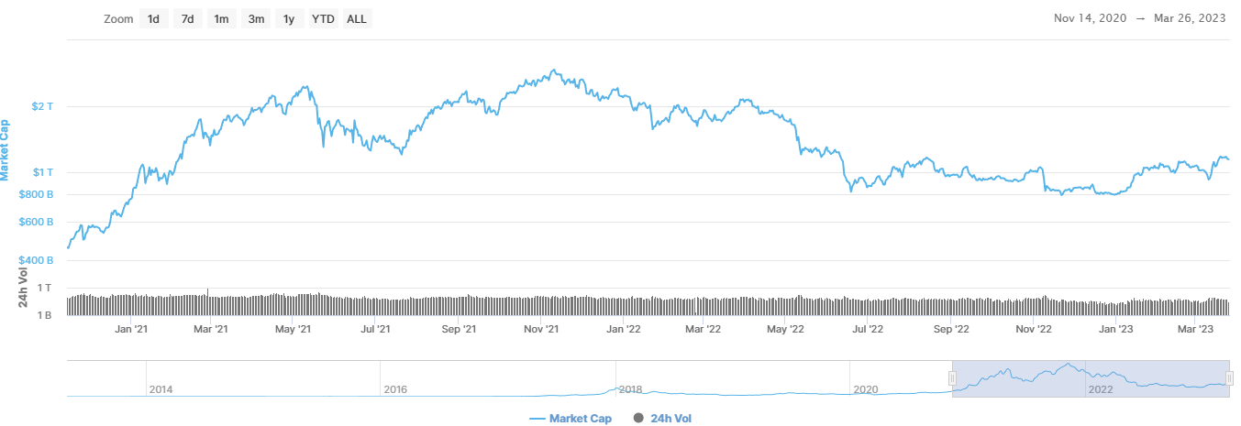
coinmarketcap.com

Slide 2
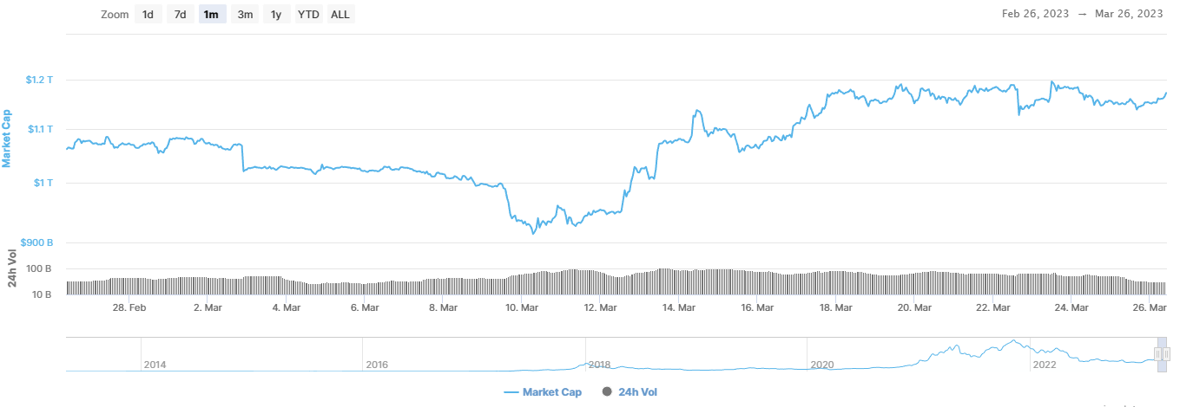
coinmarketcap.com

Slide 3
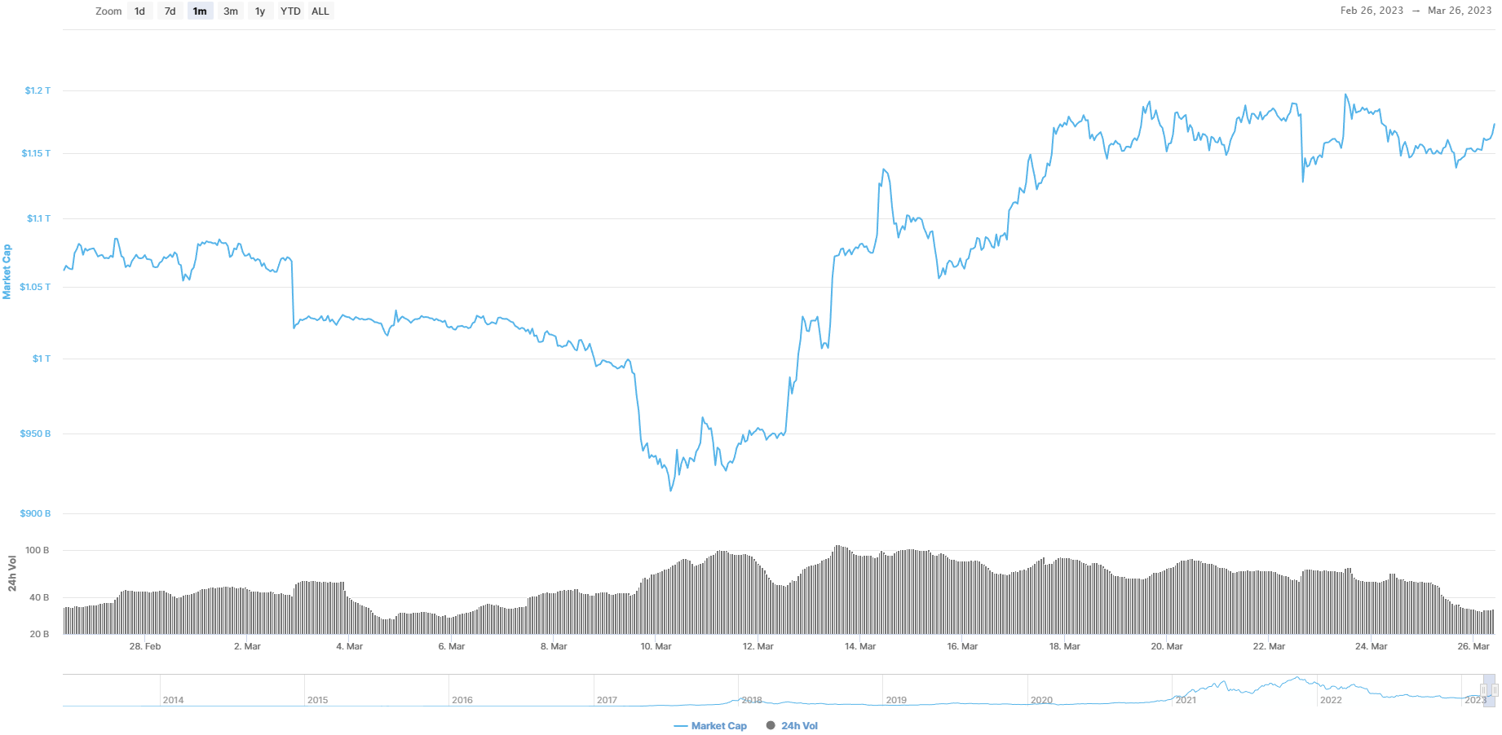
coinmarketcap.com

Slide 4
