Slide 1
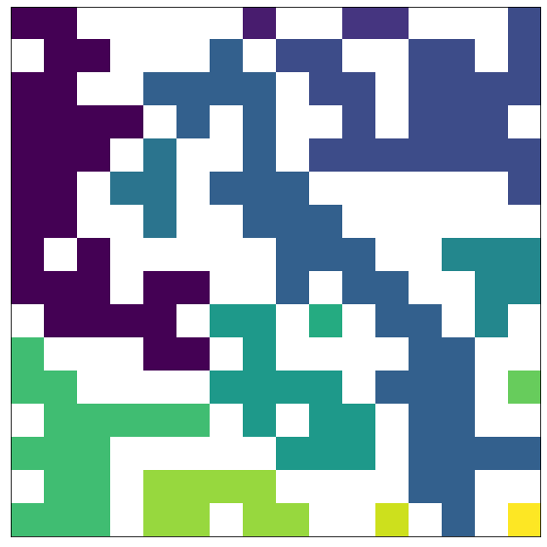
1
2
Sample 0, 16x16 lattice, P =P_c
24
30
4
{'1s0': 5,
'2s0': 1,
'4s0': 1,
'6s0': 1,
'8s0’: 1,
'13s0': 1,
'16s0': 1,
'24s0': 1,
'30s0': 1,
'36s0': 1,}
6
1
13
36
1
16
8
1
1

Slide 2
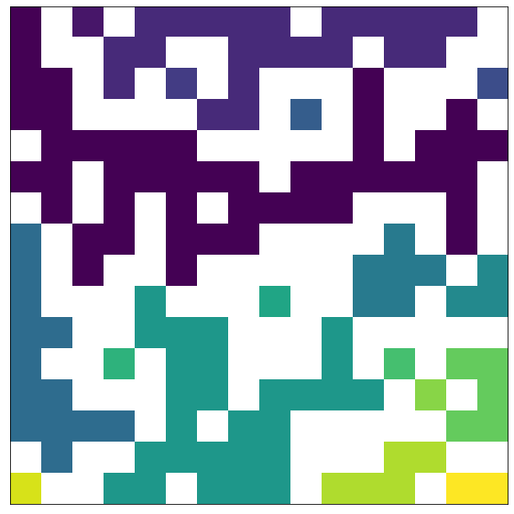
1
22
1
1
Sample 47, 16x16 lattice, P =P_c
1
47s1
{'1s0’: 9,
'2s0': 1,
‘3s0': 1,
‘5s0’: 2,
‘6s0’: 1,
'13s0': 1,
‘22s0': 1,
‘27s0': 1,
‘47s1': 1, }
6
1
3
13
1
1
1
5
27
1
5
2

Slide 3
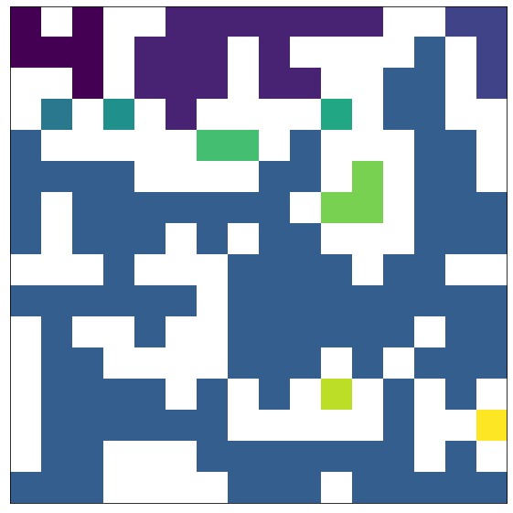
6
4
17
Sample 7, 16x16 lattice, P =P_c
1
1
1
{'1s0': 5,
'2s0': 1,
'3s0': 1
'4s0': 1,
'6s0': 1,
'17s0': 1,
'115s1': 1,}
2
3
115 S1
1
1

Slide 4
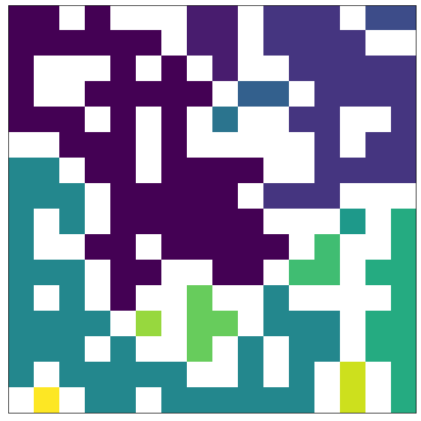
2
5
2
29
Sample 24, 16x16 lattice, P =P_c
{'1s0': 4,
'2s0': 3,
'3s0': 1,
'4s0’: 1,
'5s0': 1,
'11s0': 1,
'29s0': 1,
'44s0': 1,
'56s0': 1}
1
56
1
3
1
4
11
44
2
1

