Slide 1

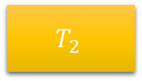


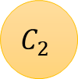



$$T_{2}$$
$$Q_{2}$$
$$Q_{2}$$
$$T_{s}$$
$$C_{2}$$
$$W_{2}$$
$$Q_{0,2}$$
$$T_{0}$$

