Slide 1




$$P_{b}$$
$P_{0}$ $ρ_{0}$ $T_{0}$
$$P_{e}$$
$$L$$

Slide 2
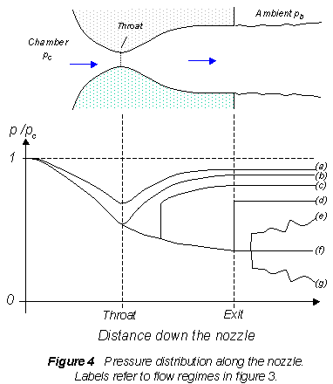













$$P_{e}>P_{b}$$
$$P_{e}=P_{b}$$
Flow speed
$$1$$
$$shock inside$$
$$P_{e}<P_{b}$$
$$shock at exit$$
$$choked flow$$
$$subsonic flow$$
$$0$$
$$no flow$$
$$0$$
$$throat$$
$$L$$
distance down nozzle

Slide 3





$$5$$
$$0$$
$$L$$
$$0$$
$$10$$

Slide 4
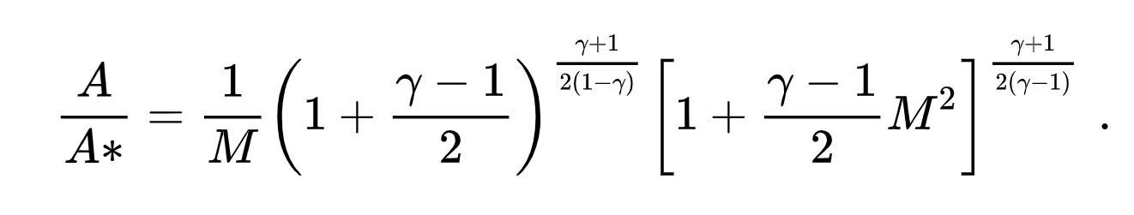
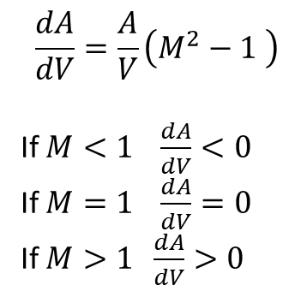
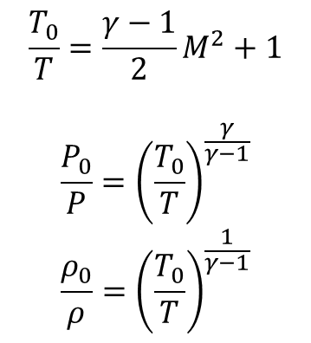
$$\frac{T_{0}}{T}=\frac{γ−1}{2}M^{2}+1$$
$$\frac{P_{0}}{P}={\left(\frac{T_{0}}{T}\right)}^{\frac{γ}{γ−1}}$$
$$\frac{ρ_{0}}{ρ}={\left(\frac{T_{0}}{T}\right)}^{\frac{1}{γ−1}}$$
$$\frac{dA}{dV}=\frac{A}{V}\left(M^{2}−1 \right)$$
If $M<1 \frac{dA}{dV}<0$
If $M=1 \frac{dA}{dV}=0$
If $M>1 \frac{dA}{dV}>0$

