Slide 1
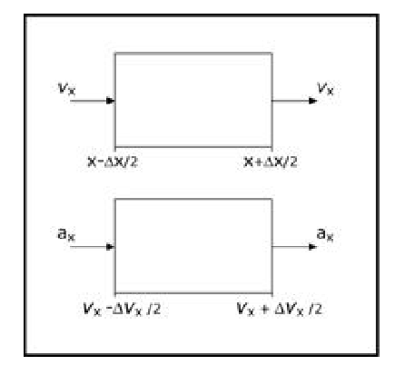










$$a_{x}$$
$$v_{x}$$
$${dv}_{x}$$
$$v_{x}$$
$$(x,v_{x})$$
$$Γ$$
$$v_{x}$$
$$dx$$
$$a_{x}$$
$$x$$

