Slide 1




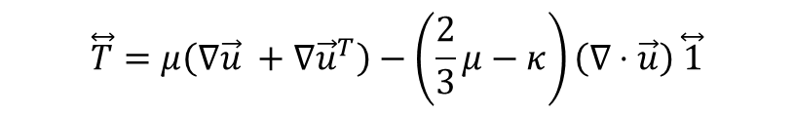

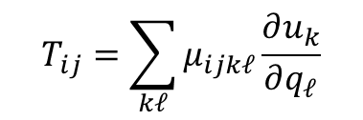



$$y$$
$$\vec{u}(y)$$
shear-thickening
$$\frac{∂\vec{u}}{∂y}$$
Shear Strain Rate $\dot{ε}$
shear-constant
$$T_{ij}=\sum_{kℓ}{μ_{ijkℓ}\frac{∂u_{k}}{∂q_{ℓ}}}$$
$$\overset{⃡}{T}=μ ∇\vec{u}$$
$$\overset{⃡}{T}=μ\left(∇\vec{u} +∇{\vec{u}}^{T}\right)−\left(\frac{2}{3}μ−κ\right)\left(∇⋅\vec{u}\right) \overset{⃡}{1}$$
shear-thinning
$$\vec{J}=−D \vec{∇}ρ$$
$$\vec{q}=−k \vec{∇}T$$
Shear Stress $T$

Slide 2
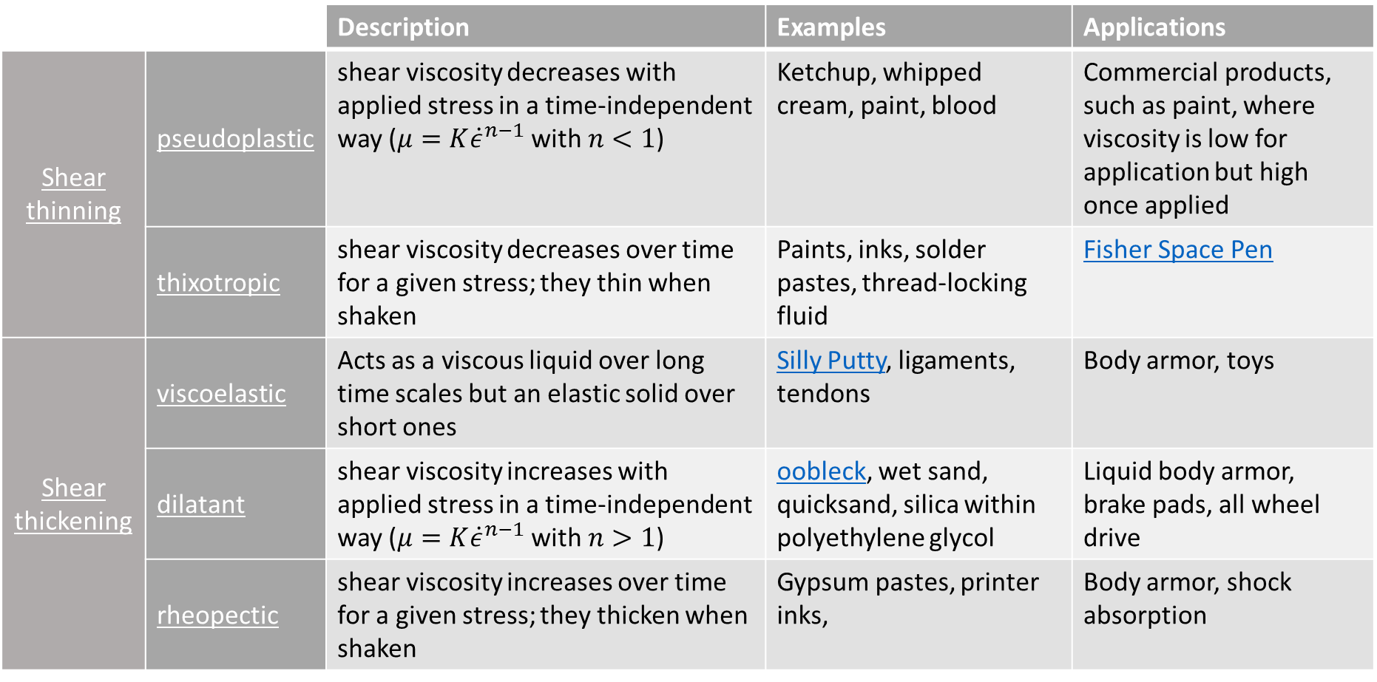
 |  | Description | Examples | Applications
Shear thinning | pseudoplastic | shear viscosity decreases with applied stress in a time-independent way ($μ=K{\dot{ε}}^{n−1}$ with $n<1$) | Ketchup, whipped cream, paint, blood | Commercial products, such as paint, where viscosity is low for application but high once applied
 | thixotropic | shear viscosity decreases over time for a given stress; they thin when shaken | Paints, inks, solder pastes, thread-locking fluid | Fisher Space Pen
Shear thickening | viscoelastic | Acts as a viscous liquid over long time scales but an elastic solid over short ones | Silly Putty, ligaments, tendons | Body armor, toys
 | dilatant | shear viscosity increases with applied stress in a time-independent way ($μ=K{\dot{ε}}^{n−1}$ with $n>1$) | oobleck, wet sand, quicksand, silica within polyethylene glycol | Liquid body armor, brake pads, all wheel drive
 | rheopectic | shear viscosity increases over time for a given stress; they thicken when shaken | Gypsum pastes, printer inks, | Body armor, shock absorption
Shear thickening (systems crystalize under stress)

