Slide 1
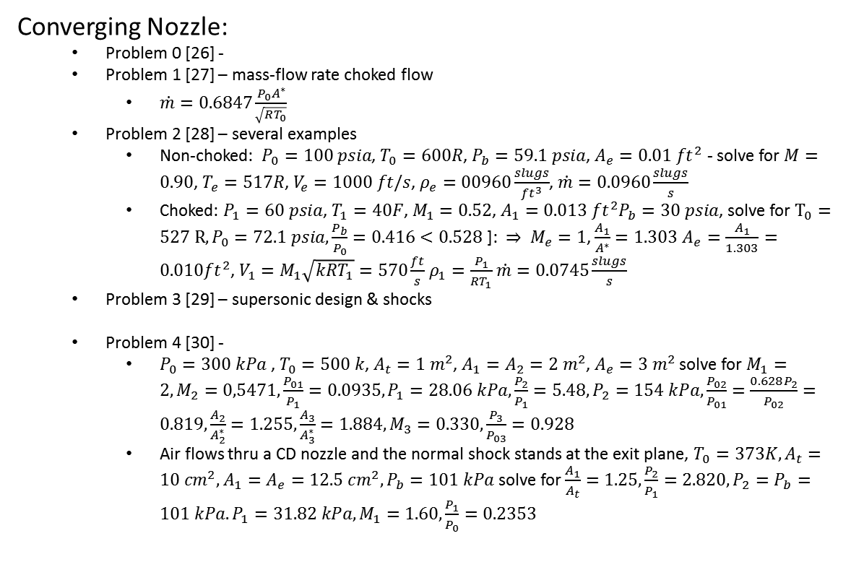



Mach Relations: $\frac{dA}{dV}=\frac{A}{V}(M^{2}−1)$ $Q≡1+\frac{γ−1}{2}M^{2}$ $\frac{T_{0}}{T}=Q; \frac{P_{0}}{p}=Q^{\frac{γ}{γ−1}} ; \frac{ρ_{0}}{ρ}=Q^{\frac{1}{γ−1}}$
1
Converging Nozzle:
Problem 0 [26] -
Problem 1 [27] – mass-flow rate choked flow
$\dot{m}=0.6847\frac{P_{0}A^{∗}}{\sqrt{RT_{0}}}$
Problem 2 [28] – several examples
Non-choked: $P_{0}=100 psia$, $T_{0}=600R$, $P_{b}=59.1 psia$, $A_{e}=0.01 ft^{2}$ - solve for $M=0.90$, $T_{e}=517R$, $V_{e}=1000 ft/s$, $ρ_{e}=00960\frac{slugs}{ft^{3}}$, $\dot{m}=0.0960\frac{slugs}{s}$
Choked: $P_{1}=60 psia$, $T_{1}=40F$, $M_{1}=0.52$, $A_{1}=0.013 ft^{2}P_{b}=30 psia$, solve for $T_{0}=527 R, P_{0}=72.1 psia, \frac{P_{b}}{P_{0}}=0.416<0.528$ ]: $⇒ M_{e}=1$, $\frac{A_{1}}{A^{∗}}=1.303$ $A_{e}=\frac{A_{1}}{1.303}=0.010ft^{2}$, $V_{1}=M_{1}\sqrt{kRT_{1}}=570\frac{ft}{s}$ $ρ_{1}=\frac{P_{1}}{RT_{1}}$ $\dot{m}=0.0745\frac{slugs}{s}$
Problem 3 [29] – supersonic design & shocks
Problem 4 [30] -
$P_{0}=300 kPa$ , $T_{0}=500 k$, $A_{t}=1 m^{2}$, $A_{1}=A_{2}=2 m^{2}$, $A_{e}=3 m^{2}$ solve for $M_{1}=2, M_{2}=0,5471,\frac{P_{01}}{P_{1}}=0.0935, P_{1}=28.06 kPa,\frac{P_{2}}{P_{1}}=5.48, P_{2}=154 kPa,\frac{P_{02}}{P_{01}}=\frac{0.628P_{2}}{P_{02}}=0.819,\frac{A_{2}}{A_{2}^{∗}}=1.255,\frac{A_{3}}{A_{3}^{∗}}=1.884, M_{3}=0.330, \frac{P_{3}}{P_{03}}=0.928$
Air flows thru a CD nozzle and the normal shock stands at the exit plane, $T_{0}=373K, A_{t}=10 cm^{2}, A_{1}=A_{e}=12.5 cm^{2}, P_{b}=101 kPa$ solve for $\frac{A_{1}}{A_{t}}=1.25,\frac{P_{2}}{P_{1}}=2.820, P_{2}=P_{b}=101 kPa. P_{1}=31.82 kPa, M_{1}=1.60,\frac{P_{1}}{P_{0}}=0.2353$
$$\frac{P_{b}}{p_{0}}$$
0.5283
$$x$$
$$L$$
Variable | Change Trans-shock
Mach # | ⇩
Static pressure | ⇧
Stagnation pressure | ⇩
Static temperature | ⇧
Stagnation temperature | ------
Density | ⇧
Velocity | ⇩
Entropy | ⇧
R_{specific} for dry air | Units
287.058 | J⋅kg⁻¹⋅K⁻¹
53.3533 | ft⋅lbf⋅lb⁻¹⋅°R⁻¹
1,716.49 | ft⋅lbf⋅slug⁻¹⋅°R⁻¹
Based on a mean molar mass for dry air of 28.9645 g/mol.
Vibliography: Mechanical Engineering Cal Poly Pomona
[26] – https://youtu.be/ewoUwCVa3QY
[27] – https://youtu.be/PjZqCPSe4zM
[28] – https://youtu.be/luCT9jWUWMM
[29] – https://youtu.be/J-b7YkriJr0
[30] – https://youtu.be/do-XAFKRlAE

