Slide 1






$$I$$
$$HL$$
$$O$$
...
...
...
...
...
...
...
$$10$$
$$10$$
$$784$$

Slide 2
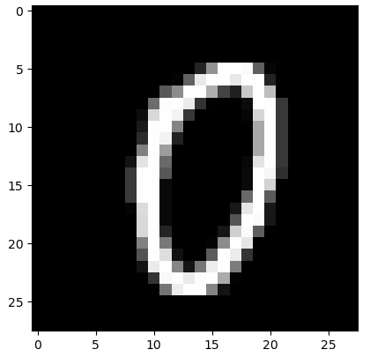






$$I$$
$$HL$$
$$O$$
[0.
0.
...
6.89707059e-01
...
1.07995135e-08
6.49872052e-04
...
...
8.72099318e-04
1.01031184e-02
0.99607843
...
1.86985953e-01
...
...
1.21456247e-03
1.49845572e-06
1.05260674e-01
...
5.20515331e-03
$$10$$
$$10$$
0.]
$$784$$

Slide 3




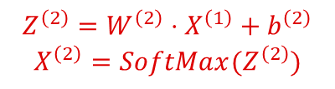

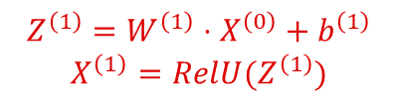
$$I$$
$$HL$$
$$O$$
...
...
...
$$X^{\left(0\right)}$$
$$Z^{\left(1\right)}=W^{\left(1\right)}⋅X^{\left(0\right)}+b^{\left(1\right)}$$
$$X^{\left(1\right)}=RelU(Z^{\left(1\right)})$$
$$Z^{\left(2\right)}=W^{\left(2\right)}⋅X^{\left(1\right)}+b^{\left(2\right)}$$
$$X^{\left(2\right)}=SoftMax(Z^{\left(2\right)})$$
...
...
...
...
$$10$$
$$10$$
$$784$$

