Slide 1



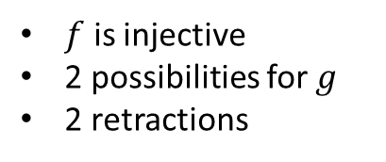

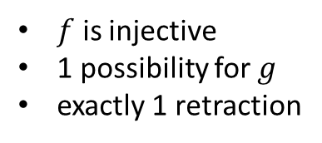
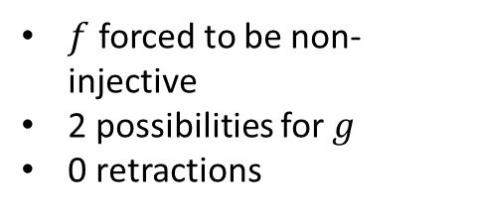
$$b_{1}$$
$$b_{1}$$
$$b_{2}$$
$$b_{1}$$
$$b_{2}$$
$$b_{3}$$
û
ü
ü
$f$ forced to be non-injective
2 possibilities for $g$
0 retractions
$f$ is injective
1 possibility for $g$
exactly 1 retraction
$f$ is injective
2 possibilities for $g$
2 retractions

Slide 2
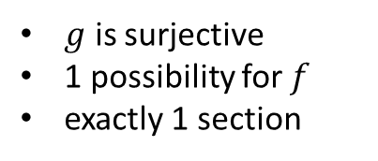
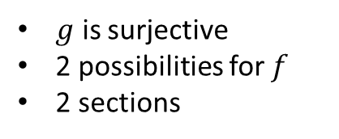
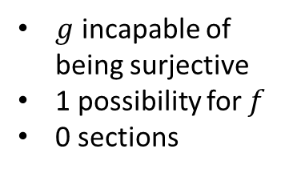
$$b_{1}$$
$$b_{1}$$
$$b_{2}$$
$$b_{1}$$
$$b_{2}$$
$$b_{3}$$
û
ü
ü
2
$g$ incapable of being surjective
1 possibility for $f$
0 sections
$g$ is surjective
1 possibility for $f$
exactly 1 section
$g$ is surjective
2 possibilities for $f$
2 sections

Slide 3

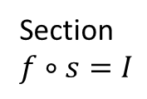



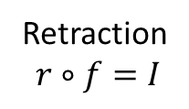




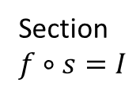



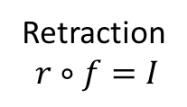

Retraction
$$r∘f=I$$
Section$f∘s=I$
$$f$$
$r$?
$s$?
$f$
$$I$$
$$I$$
determination
choice
Retraction
$$r∘f=I$$
Section$f∘s=I$
$$f$$
$r$?
$s$?
$f$
$$I$$
$$I$$
determination
choice

Slide 4






$$b_{1}$$
$$b_{2}$$
$$b_{3}$$
$$b_{1}$$
$$b_{2}$$
$$b_{3}$$
$$r$$
$$s$$
$$f$$
$$f$$
$r$ is a retraction of $f$ $⇔$ $s$ is a section of $f$

Slide 5

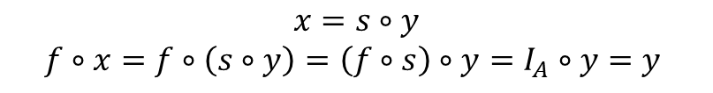
















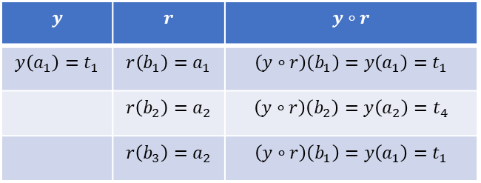




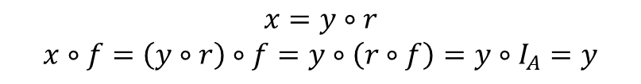

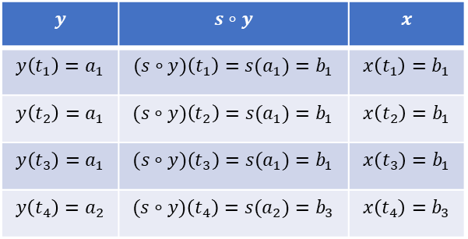










$$b_{1}$$
$$b_{2}$$
$$b_{3}$$
$$B$$
$$f$$
$$x?$$
$$y$$ | $$r$$ | $$y∘r$$
$$y\left(a_{1}\right)=t_{1}$$ | $$r\left(b_{1}\right)=a_{1}$$ | $$\left(y∘r\right)\left(b_{1}\right)=y\left(a_{1}\right)=t_{1}$$
 | $$r\left(b_{2}\right)=a_{2}$$ | $$\left(y∘r\right)\left(b_{2}\right)=y\left(a_{2}\right)=t_{4}$$
 | $$r\left(b_{3}\right)=a_{2}$$ | $$\left(y∘r\right)\left(b_{1}\right)=y\left(a_{1}\right)=t_{1}$$
$$r$$
$$A$$
$$T$$
$$t_{3}$$
$$y$$
$$a_{1}$$
$$t_{1}$$
$$a_{2}$$
$$t_{2}$$
$$t_{4}$$
$$x=y∘r$$
$$x∘f=\left(y∘r\right)∘f=y∘\left(r∘f\right)=y∘I_{A}=y$$
$$b_{1}$$
$$b_{2}$$
$$b_{3}$$
$$y$$ | $$s∘y$$ | $$x$$
$$y\left(t_{1}\right)=a_{1}$$ | $$(s∘y)\left(t_{1}\right)={s(a}_{1})=b_{1}$$ | $$x\left(t_{1}\right)=b_{1}$$
$$y\left(t_{2}\right)=a_{1}$$ | $$(s∘y)\left(t_{2}\right)={s(a}_{1})=b_{1}$$ | $$x\left(t_{2}\right)=b_{1}$$
$$y\left(t_{3}\right)=a_{1}$$ | $$(s∘y)\left(t_{3}\right)={s(a}_{1})=b_{1}$$ | $$x\left(t_{3}\right)=b_{1}$$
$$y\left(t_{4}\right)=a_{2}$$ | $$(s∘y)\left(t_{4}\right)={s(a}_{2})=b_{3}$$ | $$x\left(t_{4}\right)=b_{3}$$
$$B$$
$$f$$
$$x?$$
$$s$$
$$t_{3}$$
$$T$$
$$A$$
$$t_{1}$$
$$a_{1}$$
$$y$$
$$t_{2}$$
$$t_{4}$$
$$a_{2}$$
$$x=s∘y$$
$$f∘x=f∘\left(s∘y\right)=\left(f∘s\right)∘y=I_{A}∘y=y$$

Slide 6
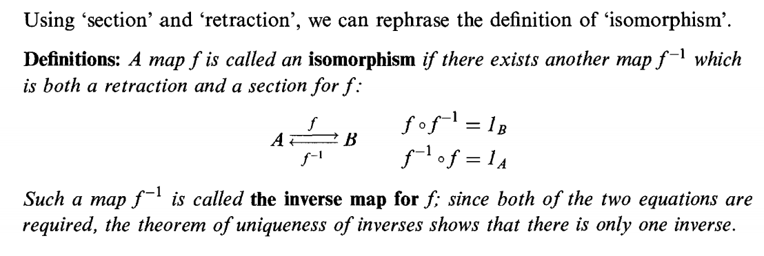

Slide 7
$$b_{1}$$
$$b_{2}$$
$$b_{3}$$
f?
g
h

Slide 8
$$b_{1}$$
$$b_{2}$$
$$b_{3}$$
9 possibilities
û

Slide 9
$$b_{1}$$
$$b_{2}$$
$$b_{3}$$
ü

Slide 10






$$B$$
$$f$$
$$g$$
$$A$$
$$h$$
$$C$$

