Slide 1








$$V$$
$$F$$
$$T$$
$$U$$
$$G$$
$$S$$
$$H$$
$$P$$

Slide 2
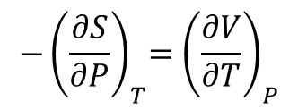
$$V$$
$$F$$
$$T$$
$$U$$
$$G$$
$$S$$
$$H$$
$$P$$
$${−\left(\frac{∂S}{∂P}\right)}_{T}={\left(\frac{∂V}{∂T}\right)}_{P}$$

Slide 3
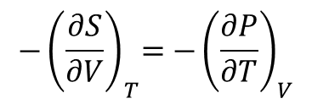
$$V$$
$$F$$
$$T$$
$$U$$
$$G$$
$$S$$
$$H$$
$$P$$
$${−\left(\frac{∂S}{∂V}\right)}_{T}={−\left(\frac{∂P}{∂T}\right)}_{V}$$

Slide 4
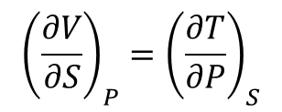
$$V$$
$$F$$
$$T$$
$${\left(\frac{∂V}{∂S}\right)}_{P}={\left(\frac{∂T}{∂P}\right)}_{S}$$
$$U$$
$$G$$
$$S$$
$$H$$
$$P$$

Slide 5
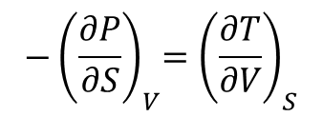
$$V$$
$$F$$
$$T$$
$${−\left(\frac{∂P}{∂S}\right)}_{V}={\left(\frac{∂T}{∂V}\right)}_{S}$$
$$U$$
$$G$$
$$S$$
$$H$$
$$P$$

Slide 6













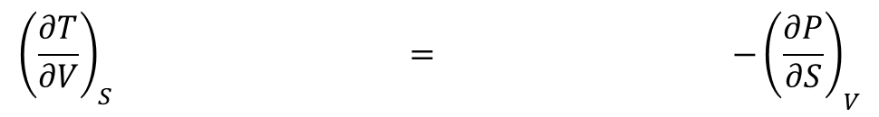



$$V$$
$$F$$
$$T$$
$$V$$
$$F$$
$$T$$
$$U$$
$$G$$
$$U$$
$$G$$
$$S$$
$$H$$
$$P$$
$$S$$
$$H$$
$$P$$
$${{\left(\frac{∂T}{∂V}\right)}_{S} = −\left(\frac{∂P}{∂S}\right)}_{V}$$

