Slide 2
0
1
2
3
4
5
6
0
1
2
3
4
5
6

Slide 3
Strictly Left-Up Scanning
1
2
2
3
1
1
4
3
3
5
4
3
3
6
6
5
5
4
3
3
6
5
3
3
7
8
3
3
7
7
9
8
3

Slide 4
Left-Up with local and global labeling
0
1
2
3
4
5
6
(0,0) : [1,(0,0)]
(0,2) : [2,(0,2)]
(0,3) : [2,(0,2)]
(0,5) : [3,(0,5)]
(1,0) : [1,(0,0)]
(1,1) : [1,(0,0)]
(1,4) : [4,(1,4)]
0
1
2
2
3
1
1
1
4
2
3
4
5
6

Slide 5
Left-Up with local and global labeling
0
1
2
3
4
5
6
(0,0) : [1,(0,0)]
(0,2) : [2,(0,2)]
(0,3) : [2,(0,2)]
(0,5) : [3,(0,5)]
(1,0) : [1,(0,0)]
(1,1) : [1,(0,0)]
(1,4) : [4,(0,5)]
(1,5) : [3,(0,5)]
0
1
2
2
3
1
1
1
4
3
2
3
4
5
6

Slide 6
Left-Up with proper and improper labeling
0
1
2
3
4
5
6
(0,0) : [1,(0,0)]
(0,2) : [2,(0,2)]
(0,3) : [2,(0,2)]
(0,5) : [3,(0,5)]
(1,0) : [1,(0,0)]
(1,1) : [1,(0,0)]
(1,4) : [4,(0,5)]
(1,5) : [3,(0,5)]
(1,6) : [3,(1,5)]
(2,2) : [5,(2,2)]
(2,4) : [4,(0,5)]
(2,5) : [3,(1,5)]
0
1
2
2
3
1
1
1
4
3
3
2
5
4
3
3
3
6
6
5
5
4
3
3
4
6
5
3
3
5
7
8
3
3
6
7
7
9
8
3

Slide 7
Left-Up with proper and improper labeling
0
1
2
3
4
5
6
(0,0) : [1,(0,0)]
(0,2) : [2,(0,2)]
(0,3) : [2,(0,2)]
(0,5) : [3,(0,5)]
(1,0) : [1,(0,0)]
(1,1) : [1,(0,0)]
(1,4) : [4,(0,5)]
(1,5) : [3,(0,5)]
(1,6) : [3,(1,5)]
(2,2) : [5,(2,2)]
(2,4) : [4,(0,5)]
(2,5) : [3,(1,5)]
0
1
2
2
3
1
1
1
4
3
3
2
5
4
3
3
3
6
6
5
5
4
3
3
4
6
5
3
3
5
7
8
3
3
6
7
7
9
8
3

Slide 8
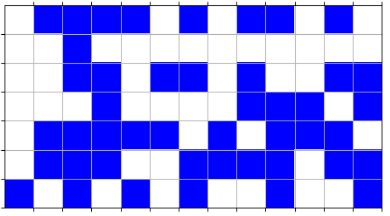
0
1
2
3
4
5
6
7
8
9
10
11
12
{0: -1, 1: 1, 2: 1, 3: 1, 4: 1, 5: -1, 6: 2, 7: -1, 8: 3, 9: 3,
10: -1, 11: 4, 12: -1, 13: -1, 14: -1, 15: 1, 16: -1, 17: -1, 18: -1, 19: -1,
20: -1, 21: -1, 22: -1, 23: -1, 24: -1, 25: -1, 26: -1, 27: -1, 28: 1, 29: 1,
30: -1, 31: 5, 32: 5, 33: -1, 34: 6, 35: -1, 36: -1, 37: 7, 38: 7, 39: -1,
40: -1, 41: -1, 42: 1, 43: -1, 44: -1, 45: -1, 46: -1, 47: 6, 48: 6, 49: 6,
50: -1, 51: 7, 52: -1, 53: 8, 54: 8, 55: 1, 56: 1, 57: 1, 58: -1, 59: 9,
60: -1, 61: 6, 62: 6, 63: 6, 64: -1, 65: -1, 66: 8, 67: 8, 68: 1, 69: -1,
70: -1, 71: 10, 72: 9, 73: 9, 74: 6, 75: -1, 76: 6, 77: 6, 78: 11, 79: -1,
80: 8, 81: -1, 82: 12, 83: -1, 84: 10, 85: -1, 86: -1, 87: 6, 88: -1, 89: -1,
90: 6}
0
1
2
3
4
{-1: 0,
0: 0,
1: 1,
2: 2,
3: 3,
4: 4,
5: 5,
6: 6,
7: 7,
8: 1,
9: 6,
10: 9,
11: 11,
12: 12}
5
6
(5,6) = 71
[[ 0. 1. 1. 1. 1. 0. 2. 0. 3. 3. 0. 4. 0.]
[ 0. 0. 1. 0. 0. 0. 0. 0. 0. 0. 0. 0. 0.]
[ 0. 0. 1. 1. 0. 5. 5. 0. 6. 0. 0. 7. 7.]
[ 0. 0. 0. 1. 0. 0. 0. 0. 6. 6. 6. 0. 7.]
[ 0. 1. 1. 1. 1. 1. 0. 6. 0. 6. 6. 6. 0.]
[ 0. 1. 1. 1. 0. 0. 8. 6. 6. 6. 0. 6. 6.]
[ 9. 0. 1. 0. 10. 0. 8. 0. 0. 6. 0. 0. 6.]]

Slide 9
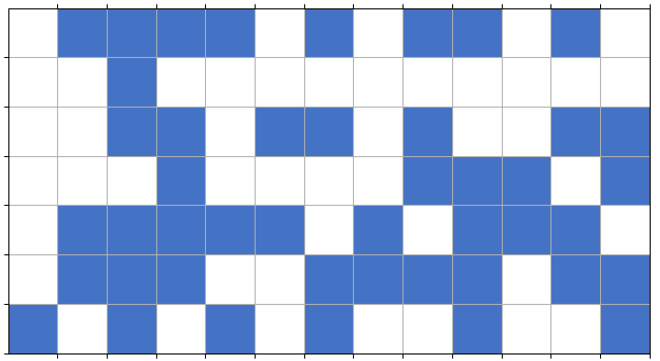
0
1
2
3
4
5
6
7
8
9
10
11
12
0
1
2
3
4
9
6
5
10
9
6

