Slide 1


$$δ{\vec{r}}_{0}$$
$$δ{\vec{r}}_{1}$$

Slide 2



















$$δ{\vec{r}}^{′}$$
$$Q_{1}$$
$$𝒫_{1}$$
$$δ\vec{u}$$
$$δ\vec{r}$$
$$\vec{u}(\vec{r})$$
$$L$$
$$\vec{u}(\vec{r})$$
$$\vec{u}(\vec{r}+δ{\vec{r}}_{0})$$
$$𝒫_{0}$$
$$ΔL′$$
$$δ\vec{r}$$
$$Q_{0}$$
$$ΔL′$$
$$ΔL$$
$$\vec{r}$$
$$𝒪$$
$$δ\vec{x}=\hat{i}$$
$$δ\vec{y}=\left(1+η_{11}\right)\hat{i}+η_{12}\hat{j}$$

Slide 3


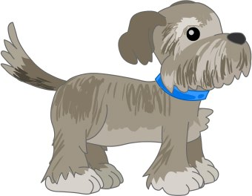
Pretty
Ugly
Pretty Ugly

