Slide 1
Nov 22 Tagup

Slide 2
Poster Outline

Slide 3
Poster Outline
Science Context
Mechanisms of ionospheric escape (Strangeway diagram)
Precipitating Electrons as a mechanism
Ambipolar potential
Instrument Measurements
FPI Sky Map (time, az, el, energy – diagram)
FGM magnetic field
Error sources
Spacecraft Potential
Internally-generated photoelectrons
FGM errors
Results
Closed field lines
Environmental/Solar Wind Conditions
Expect counter-streaming flux
Pitch angle distribution plots
Differential particle flux
Flux asymmetry, northward versus southward
Open Questions/Future Work
Wave-particle interactions

Slide 4
Title & Authors
Aug 04
Oct 26
Mar 02
Open Questions & Future Work
Science Context
Instrument Measurement

Slide 5
Aug 04 - 2015

Slide 6
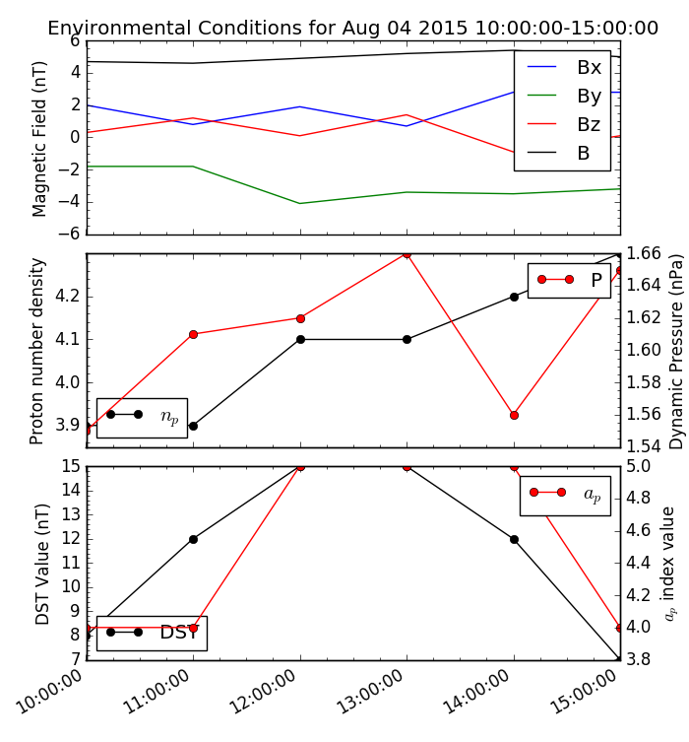
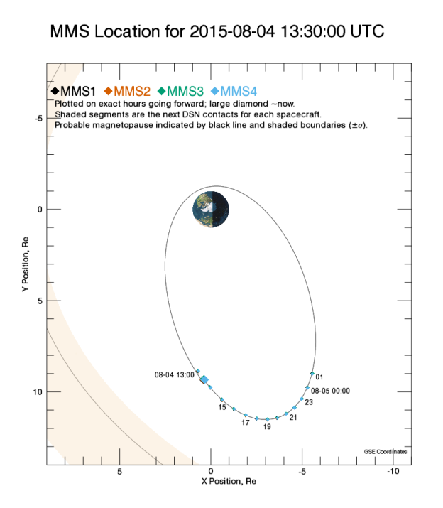
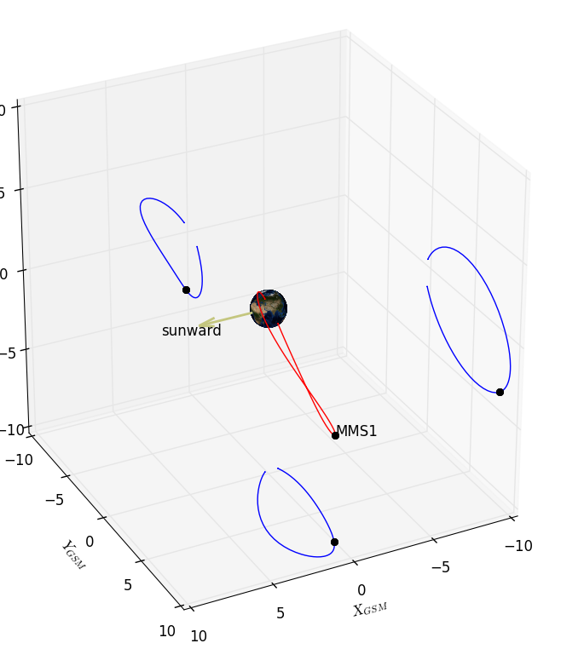
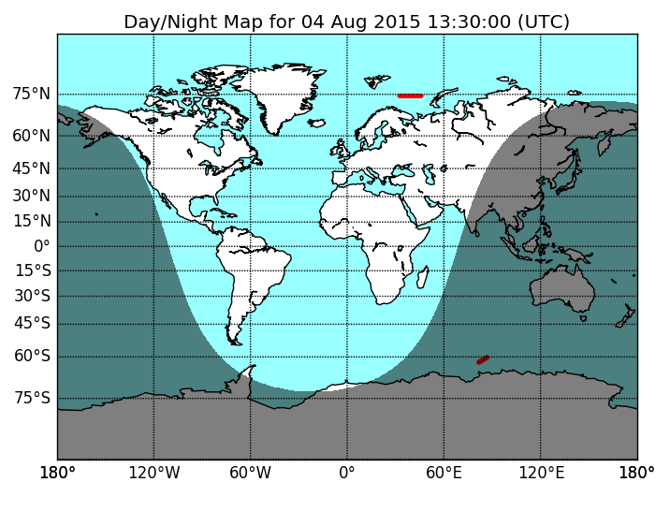
Context

Slide 7
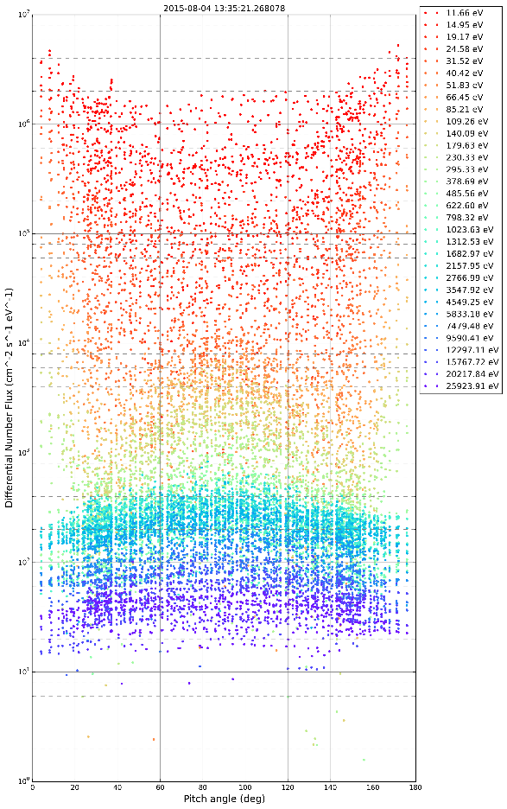
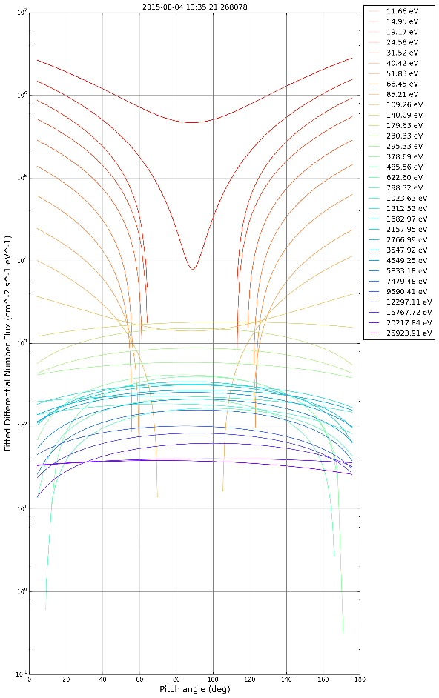
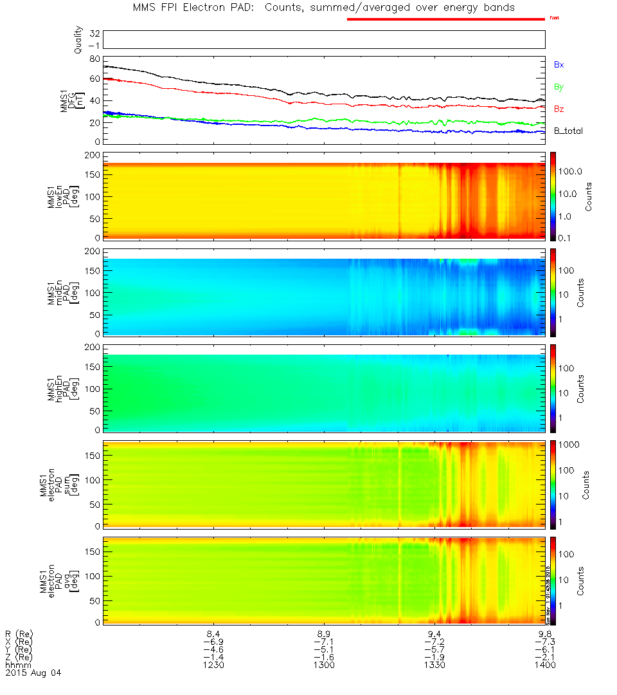
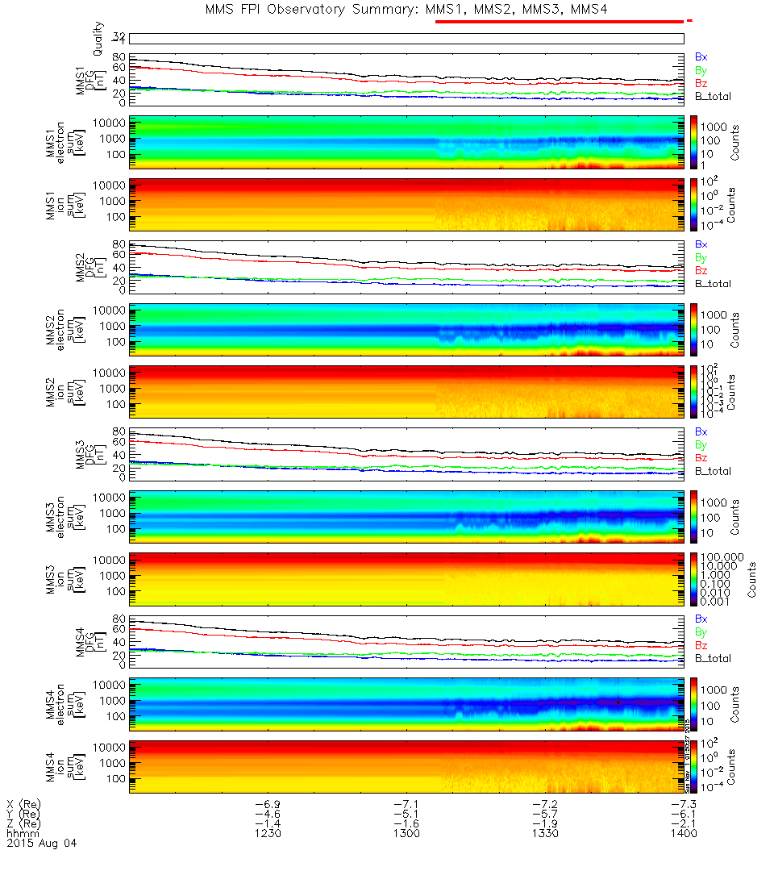
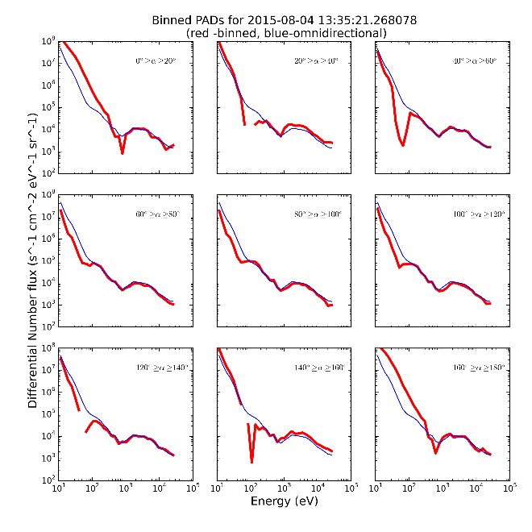
Pitch Angle Distributions

Slide 8
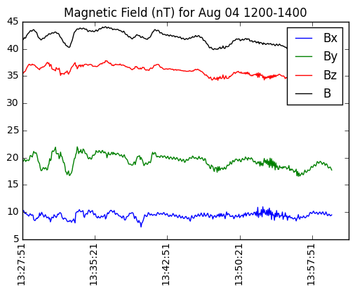
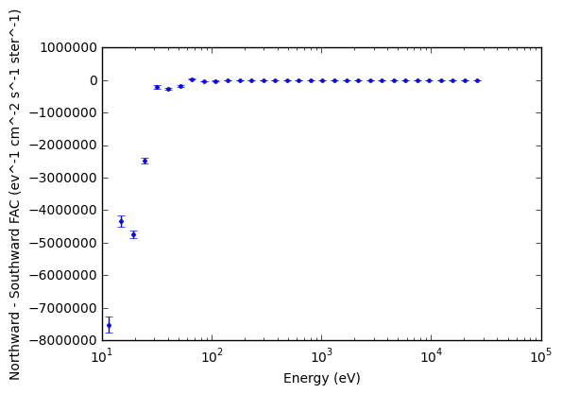
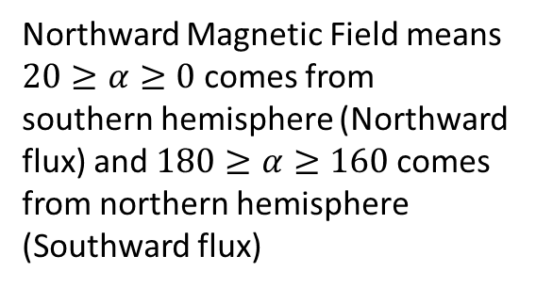
Northward Magnetic Field means $20≥α≥0$ comes from southern hemisphere (Northward flux) and $180≥α≥160$ comes from northern hemisphere (Southward flux)

Slide 9
Oct 26 - 2015

Slide 10
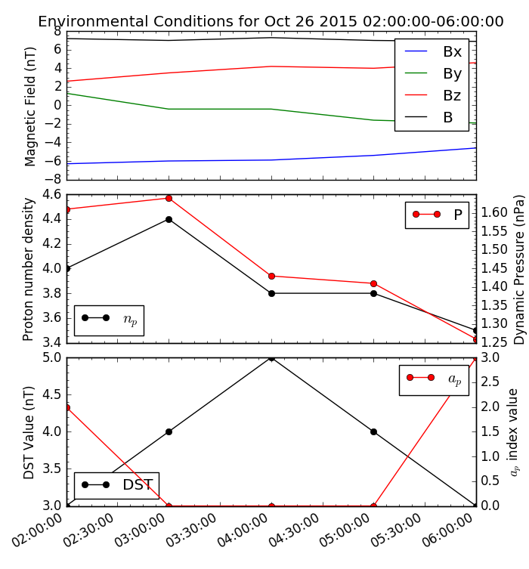
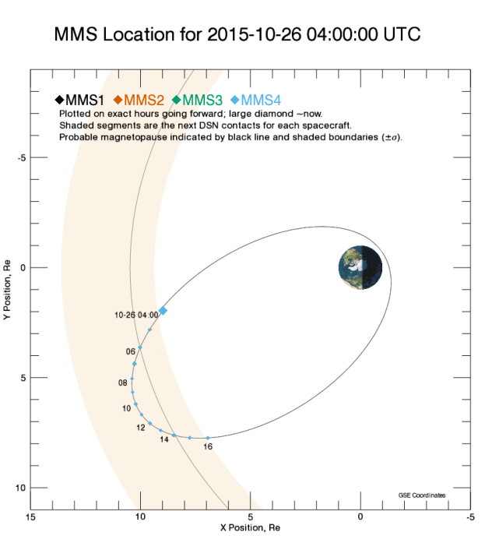
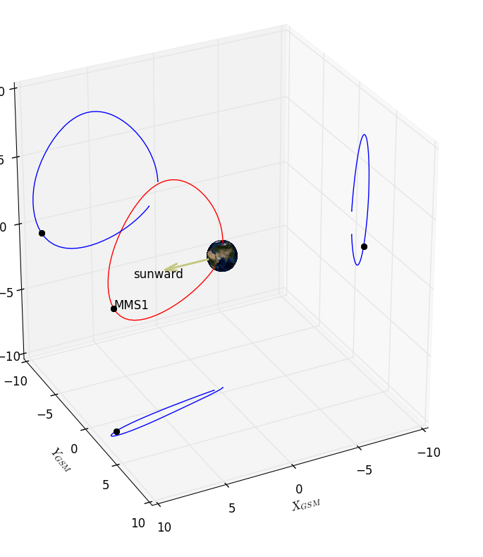
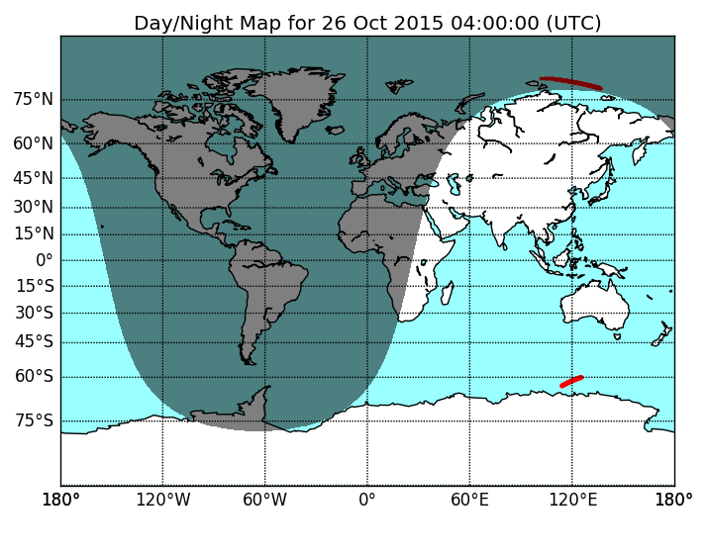
Context

Slide 11
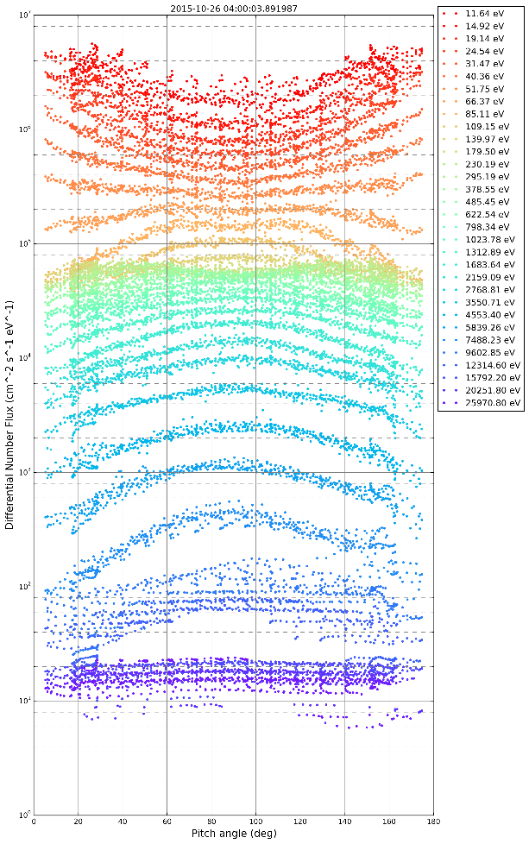
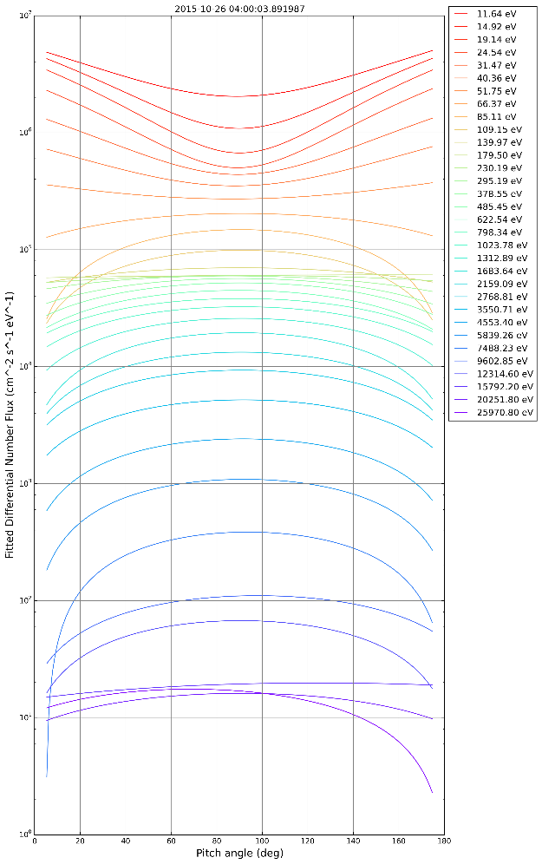
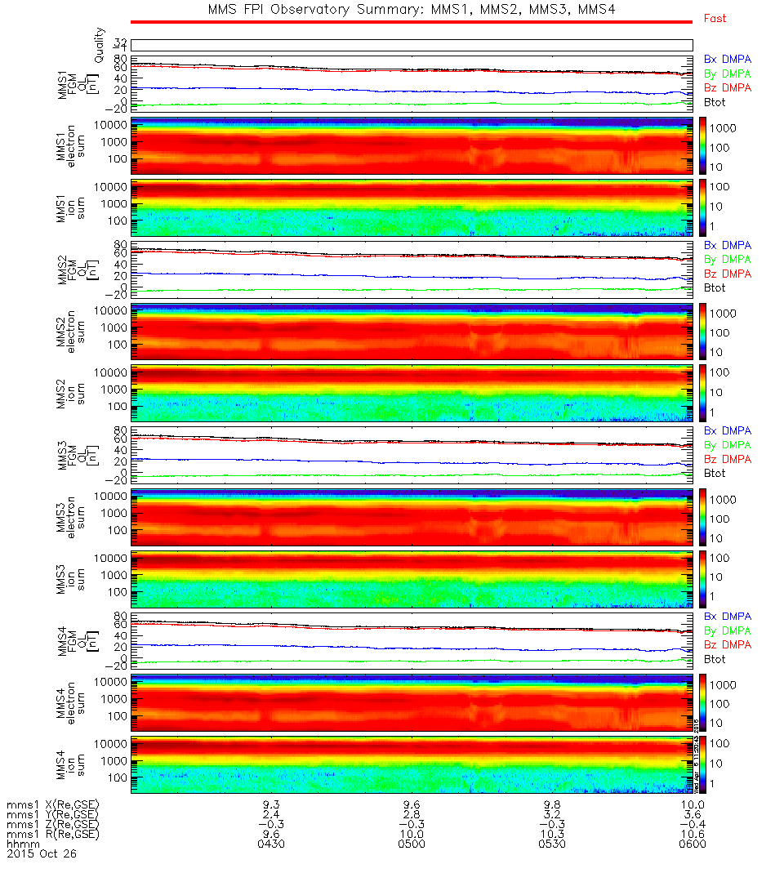
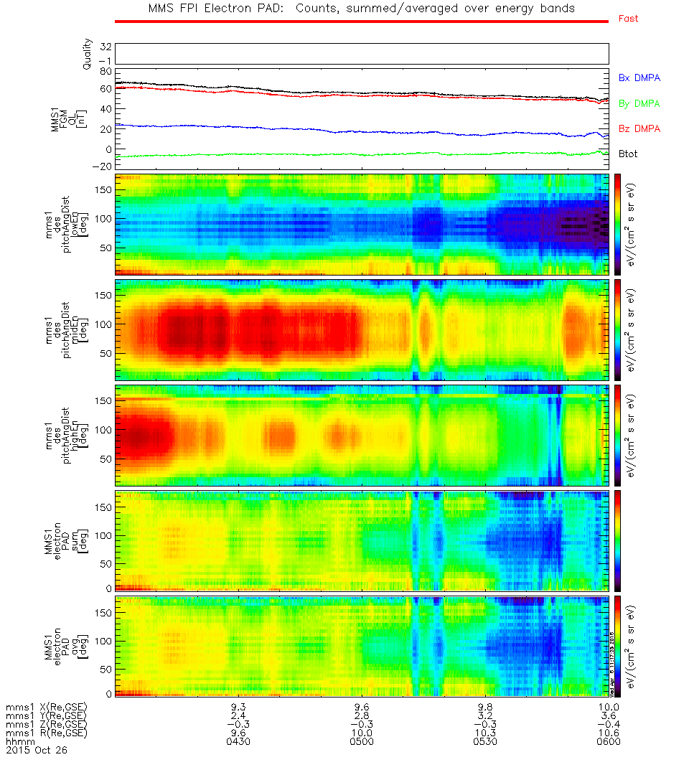
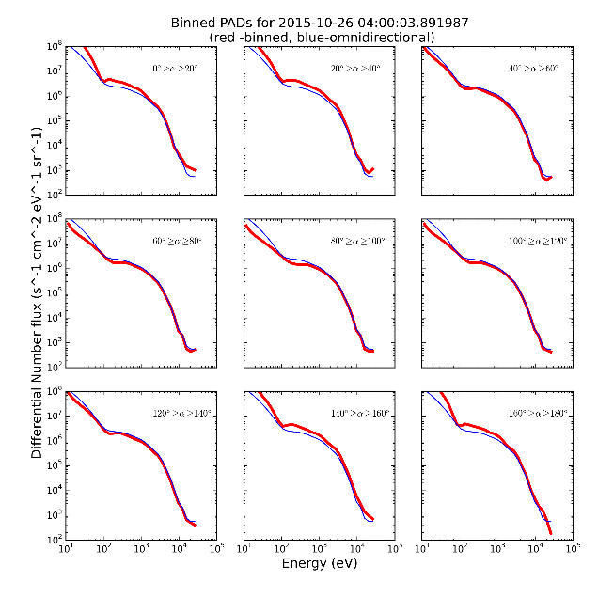
Pitch Angle Distributions

Slide 12
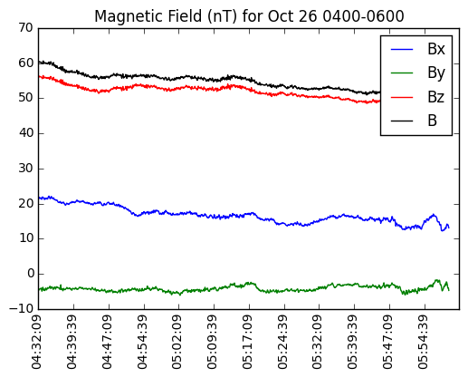
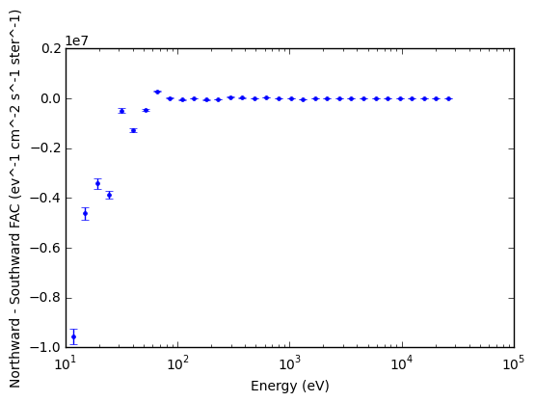
Northward Magnetic Field means $20≥α≥0$ comes from southern hemisphere (Northward flux) and $180≥α≥160$ comes from northern hemisphere (Southward flux)

Slide 13
Mar 02 - 2016

Slide 14
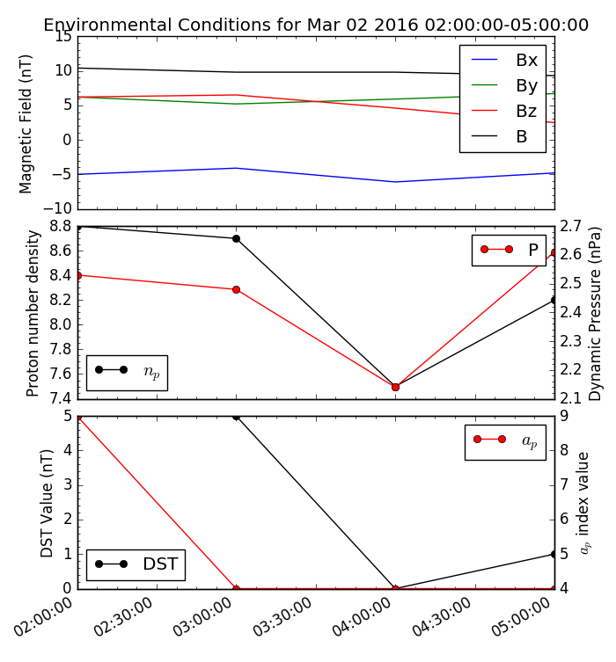
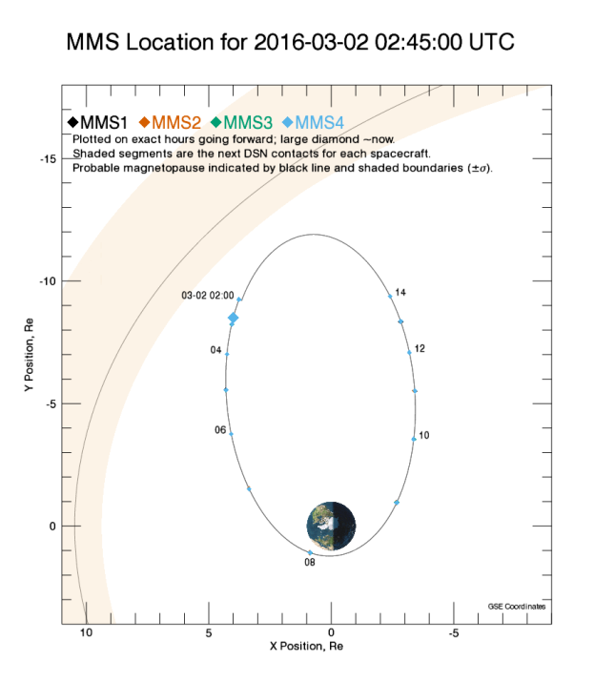
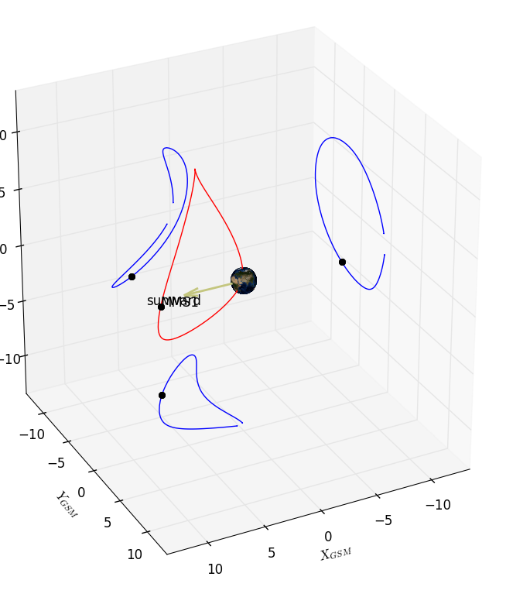
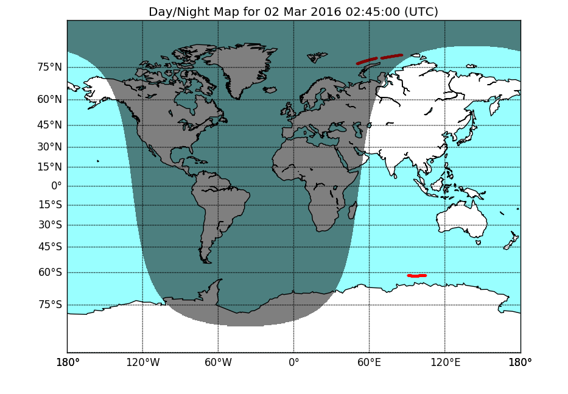
Context

Slide 15
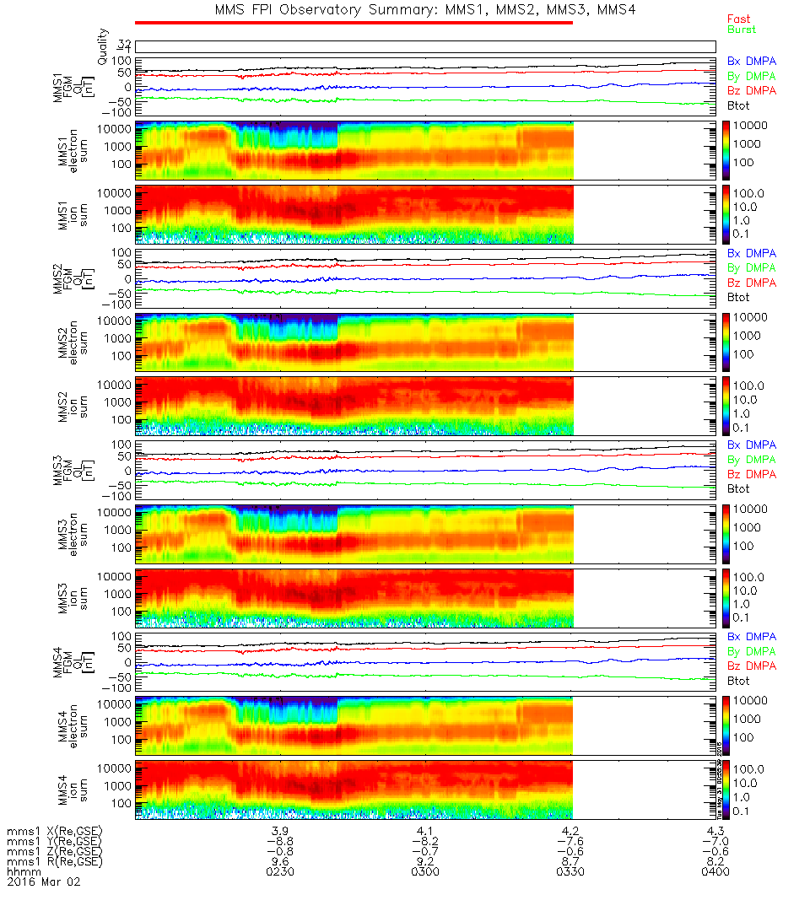
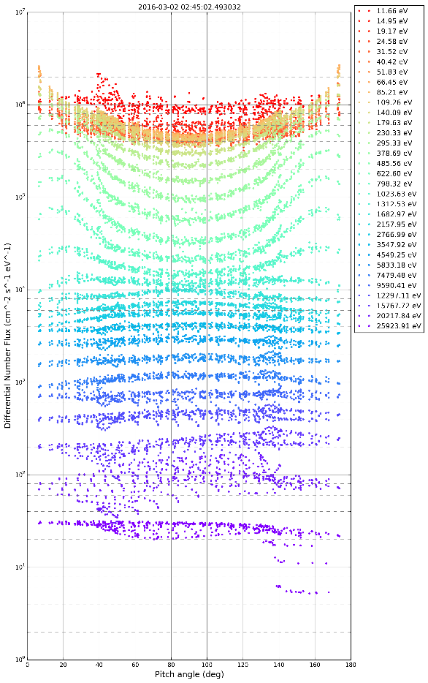
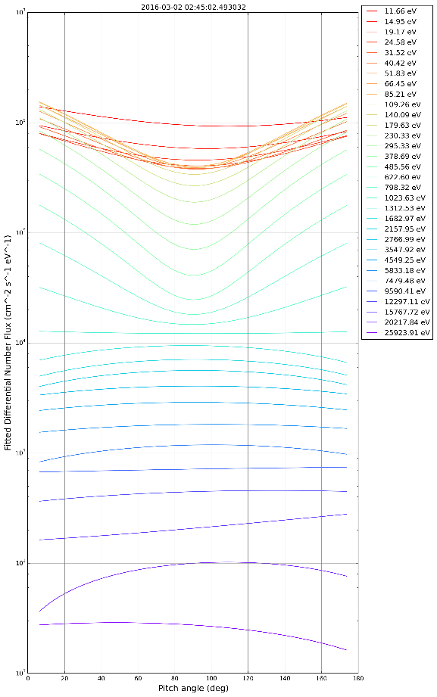
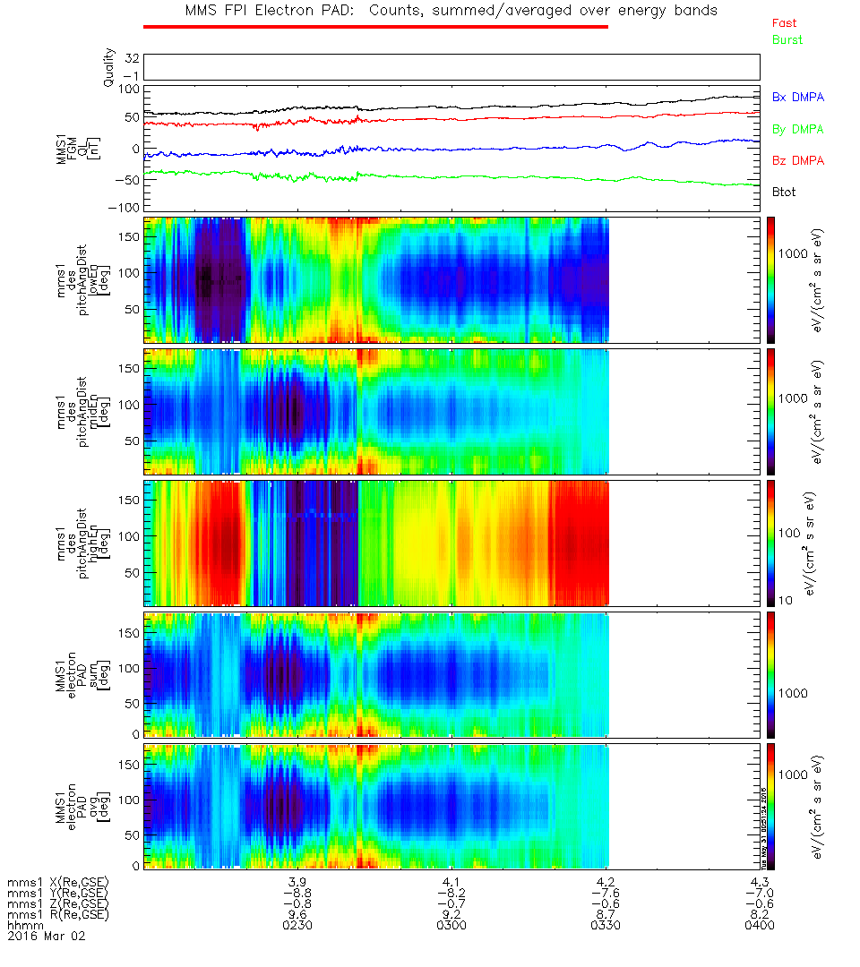
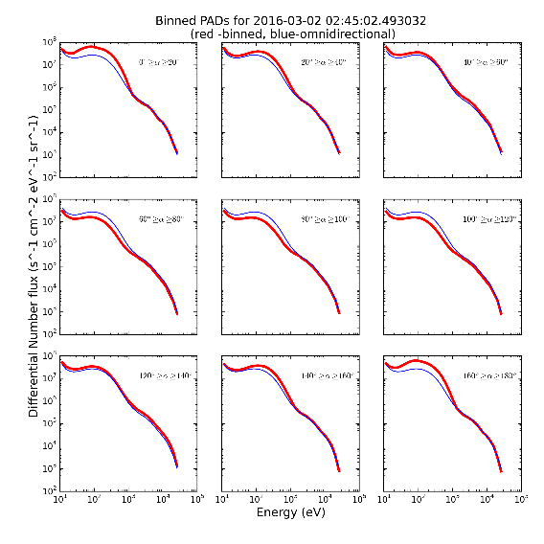
Pitch Angle Distributions

Slide 16
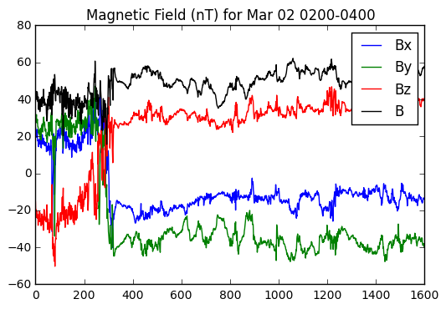
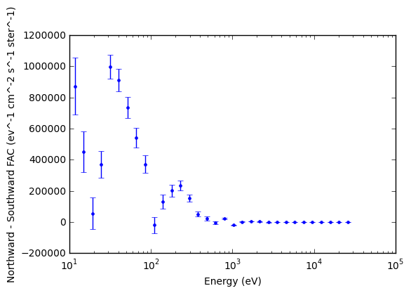
Northward Magnetic Field means $20≥α≥0$ comes from southern hemisphere (Northward flux) and $180≥α≥160$ comes from northern hemisphere (Southward flux)

