Slide 1
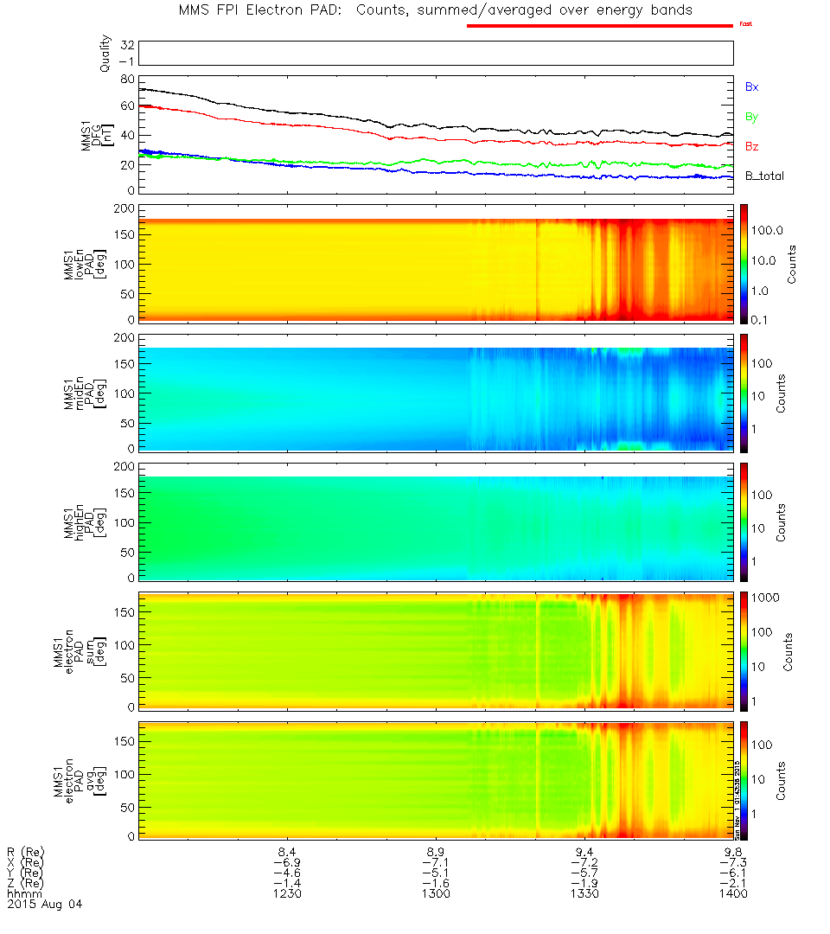
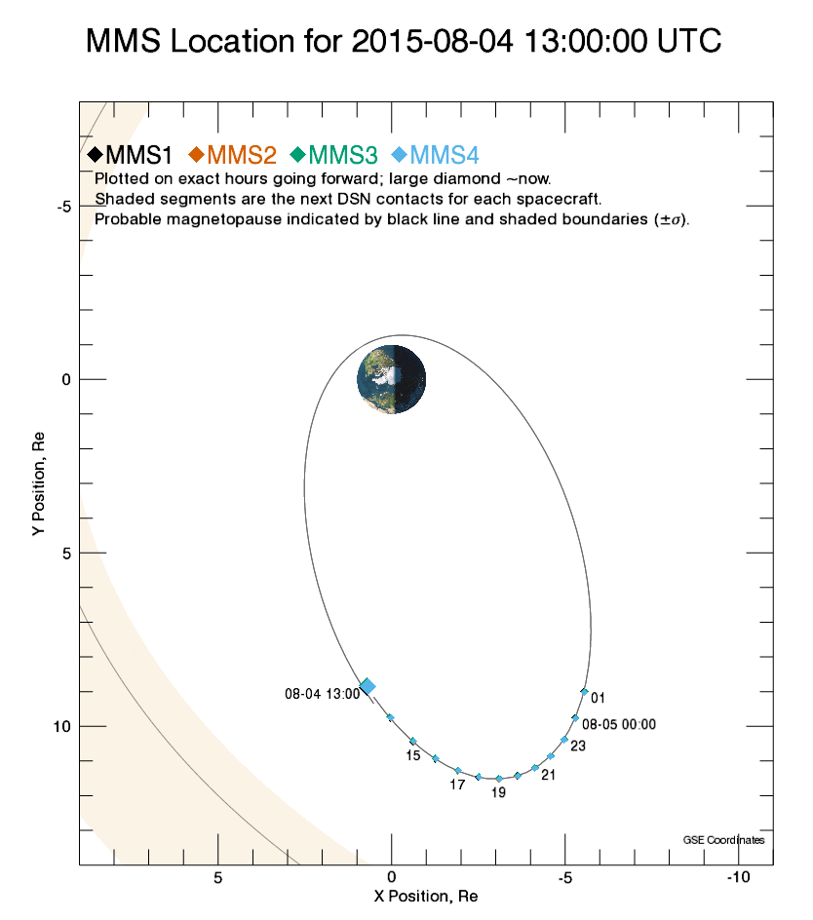
Frame | x | y | z
GCI | -7.22173132 | -5.6468827 | -1.89359624
GSE | 0.3659067 | 9.33990392 | 0.50862687
GSM | 0.3659067 | 8.7181698 | -3.38910342

