Slide 1
An Introduction to the Circular Restricted Three-Body Problem (CRTBP) and Related Applications
Conrad Schiff
CRTBP

Slide 2
Outline
Background and References
Defining the CRTBP
Basic CRTBP Properties
Related Applications
CRTBP

Slide 3
Background and References
The Circular Restricted Three Body Problem is one of the most important problems and results in mathematics, celestial mechanics, and physics
It is applicable to many of the missions; Apollo (free-return), ISEE-3/ICE, WIND, SOHO, ACE, MAP, JWST,GENESIS, GEOTAIL, and others
There is a huge amount of literature on the subject – not all of which uses the same conventions, nomenclature, etc.
I choose to use the convention found in ‘Orbital Motion’ by A.E. Roy
Perhaps the most complete work is ‘Theory of orbits; the restricted problem of three bodies’, by Victor Szebehely.
CRTBP

Slide 4
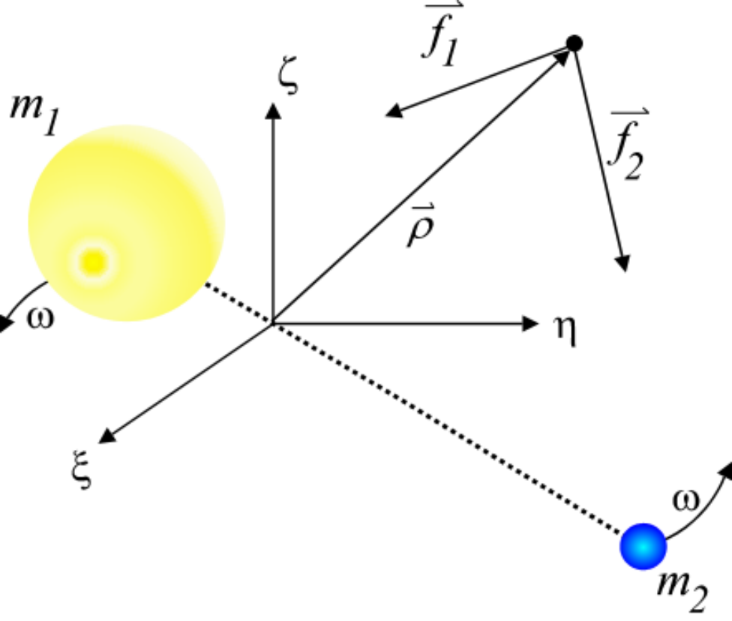
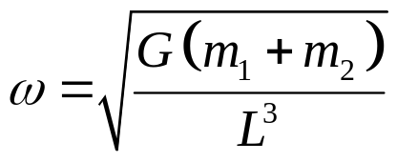
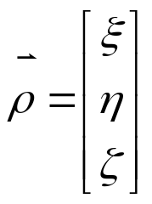
Defining the CRTBP (1/6)
Consider two bodies of mass m₁ and m₂ in circular motion about their center-of mass
The angular rate of their orbital motion is given by
where G is Newton’s gravitational constant and L is their constant separation
Insert a small test mass into the system, calculate the forces on it from the two bodies but ignore the reaction force
  Circular Restricted Three Body Problem
CRTBP

Slide 5


Defining the CRTBP (2/6)
To make the problem generally applicable, the physics will be describe in terms of dimensionless variables
  Unit of mass is picked such that the total mass is set to unity (m₁+m₂=1)
    m₁ = 1 – μ
    m₂ = μ
  Unit of distance is chosen to be the distance between them (L = 1)
  Unit of time is chosen so that G = 1 (ω = 1)
Define inertial coordinates {ξ,η,ζ} with
  The origin at the center-of-mass and
  m₁ and m₂ move in the ξ−η plane
CRTBP

Slide 6
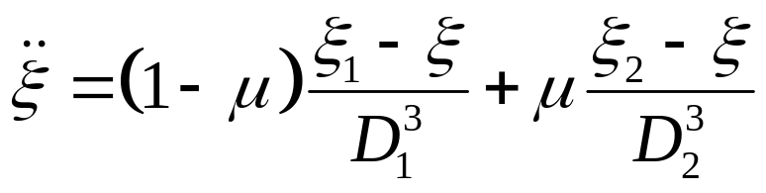
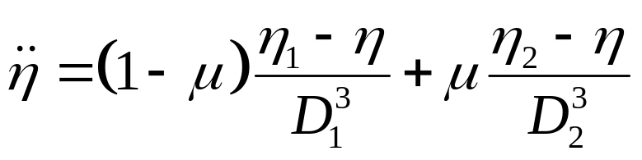
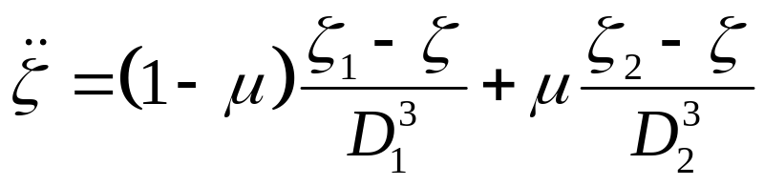
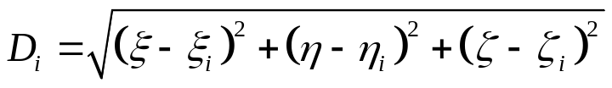
Defining the CRTBP (3/6)
In terms of this coordinate system, the equations of motion (EOMs) for the test mass about the center-of-mass (barycenter) become
where is the distance between the m_{i}
and the test mass
CRTBP

Slide 7




Defining the CRTBP (4/6)
Note that time explicitly appears on the RHS of the equations of motion (e.g., ). Note: this is a consequence of the circular motion of the two bodies in the units and coordinates discussed above.
The fact that the two bodies move in circular orbit suggests that a rotating frame, moving with the bodies may make things easier to handle
The desired transformation is
CRTBP

Slide 8
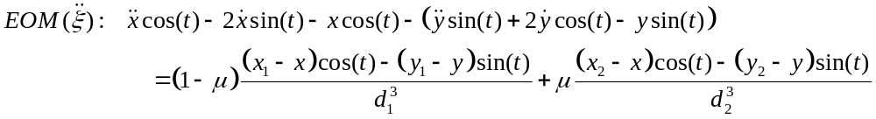
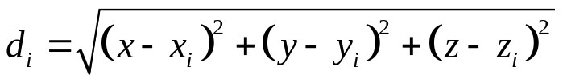


Defining the CRTBP (5/6)
Applying the transformation yields, for example,
Simplification comes by using the linear combinations
CRTBP

Slide 9
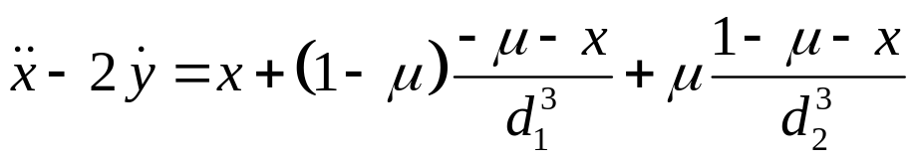
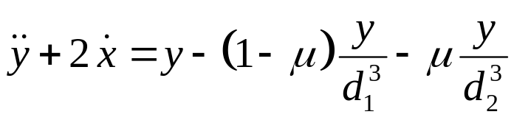
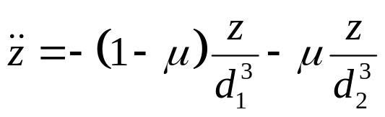
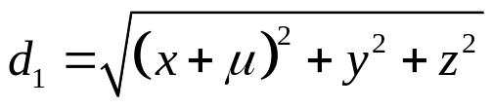
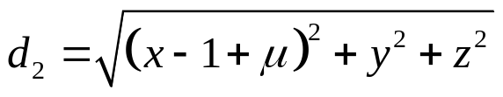
Defining the CRTBP (6/6)
The final set equations (with the x-axis chosen to lie along the line joining the two bodies) is
CRTBP

Slide 10
Basic CRTBP Properties (1/22)
The basic properties that everyone working with the CRTBP should know are:
  P1: The existence of the Jacobi integral and Jacobi constant
  P2: The turning point boundaries (surfaces of zero relative velocity)
  P3: The existence of the 5 Lagrange equilibrium points
  P4: The stability of the 5 Lagrange equilibrium points
  P5: Linearized solutions about L₁ and L₂
  P6: Symmetries in the Equation of Motion
  P7: Tisserand’s criterion
CRTBP

Slide 11
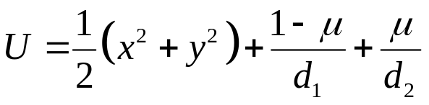
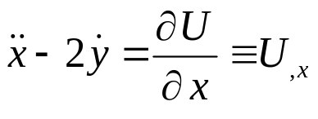
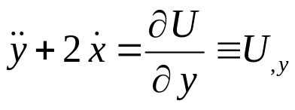
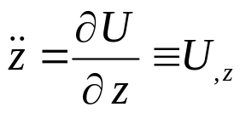
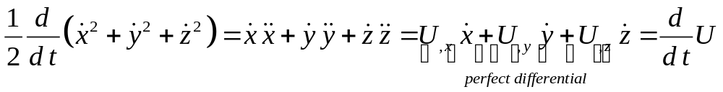
Basic CRTBP Properties (2/22)
Jacobi’s Integral
Define the function:
The CRTBP can now be written as
Take each of the above equations and multiply by the corresponding first derivative and add. The cross terms cancel leaving
CRTBP

Slide 12
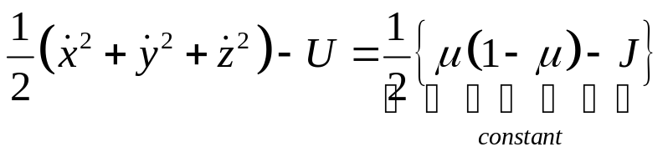
Basic CRTBP Properties (3/22)
Jacobi’s Integral
Since the two total time derivatives are equal to each other, an immediate integration (Jacobi’s integral) can be performed to give
where the constant J is called the Jacobi’s constant
CRTBP

Slide 13
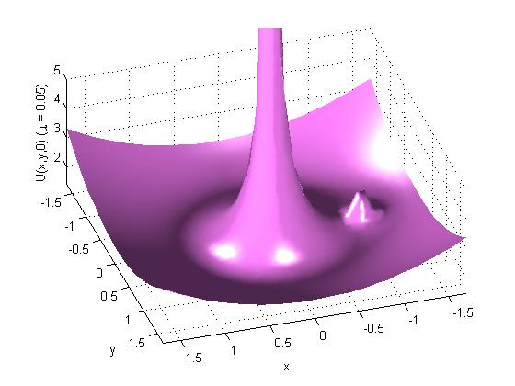
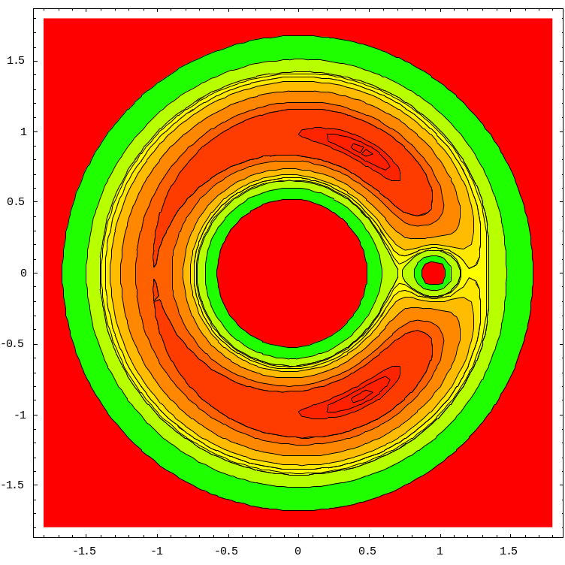
Basic CRTBP Properties (4/22)
Jacobi’s Integral
CRTBP

Slide 14

Basic CRTBP Properties (5/22)
Turning Points (Surface’s of Zero Relative Velocity)
The value of the Jacobi constant gives a basic idea of the regions open to the motion of the test mass
Solving the Jacobi integral for velocity gives
Allowable values of the velocity occur only for U > C
CRTBP

Slide 15
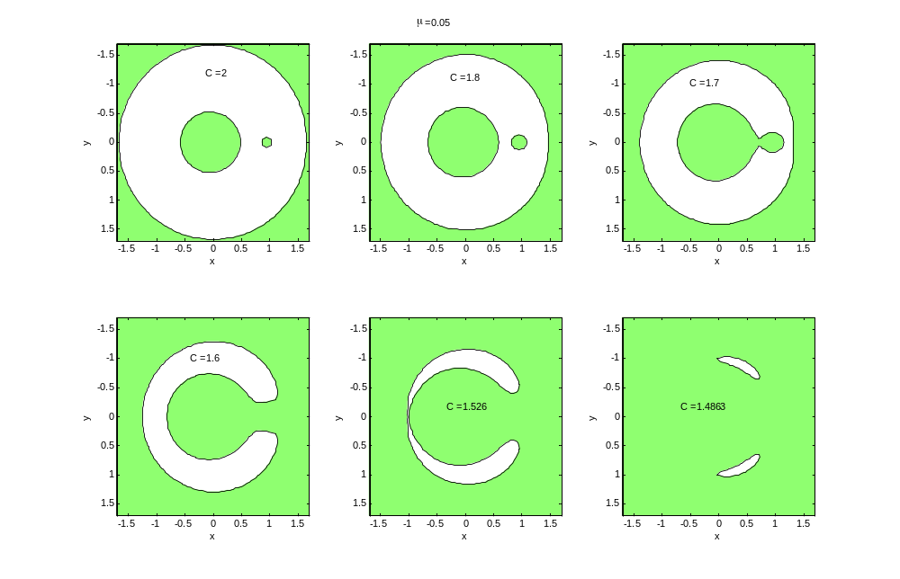
Basic CRTBP Properties (6/22)
Turning Points (Surface’s of Zero Relative Velocity)
CRTBP

Slide 16



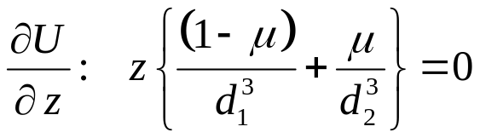
Basic CRTBP Properties (7/22)
Equilibrium Points
Equilibrium implies that if the test mass is placed at a point with zero velocity ( ) it remains there, which requires .
This reduces the solution to the equilibrium time evolution to the equivalent problem of finding critical points of U (dynamics geometry)
To find the critical points, start with the z equation.
since d₁, d₂, μ, and (1-μ) are greater than zero, z = 0
CRTBP

Slide 17
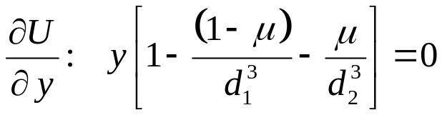

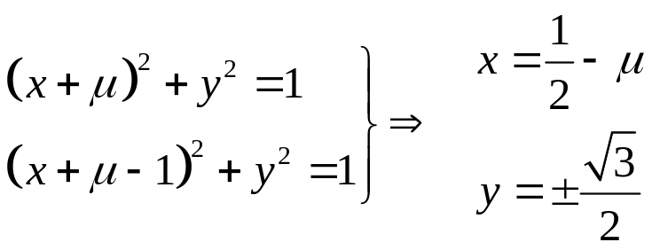
Basic CRTBP Properties (8/22)
Equilibrium Points
Now look at the y equation
The two choices are the term in [ ] = 0 and y = 0.
Taking the former case ([ ] = 0 ) first and combining with the x equation yields , which in turn yields
‘Equilateral Points’ L₄ & L₅
CRTBP

Slide 18
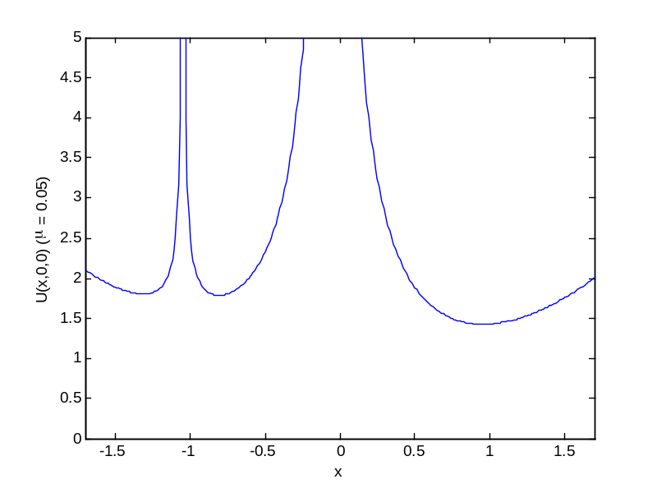
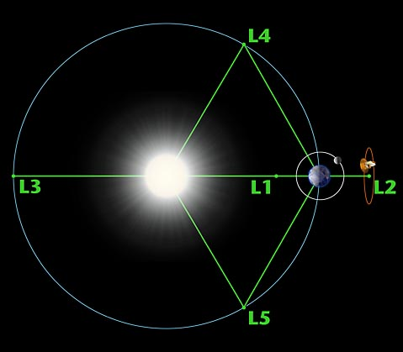
Basic CRTBP Properties (9/22)
Equilibrium Points
Finally the y = 0 case yields a quintic equation (actually three branches) in x for the solution (see Szebehely for details).
While the equation possesses no analytic solutions, a graph shows that there are only three real roots (co-linear points L₁, L₂, and L₃)
CRTBP

Slide 19
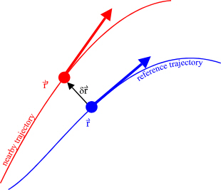




Basic CRTBP Properties (10/22)
Stability
Start with a reference trajectory in the CRTBP
A nearby solution is defined so that the separation at any time is given by
The equation of motion for the separation is then given by
CRTBP

Slide 20



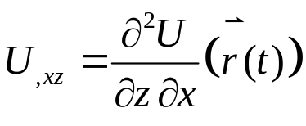
Basic CRTBP Properties (11/22)
Stability
Assuming that the separation is small enough to warrant including only linear terms in a Taylor’s series expansion of the RHS, the equations of motion become
where all the partial derivatives of U are evaluated on the reference trajectory: e.g.,
CRTBP

Slide 21
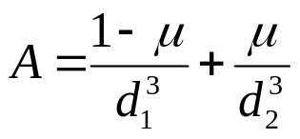

Basic CRTBP Properties (12/22)
Stability
After some long steps, we get for that for the co-linear points
Since A is real the z motion is oscillatory
Further analysis shows that the characteristic polynomial associated with the x-y motion is
Since 1 + A – 2 A² < 0 the roots consist of two real numbers, and two imaginary ones – the motion is unstable
CRTBP

Slide 22
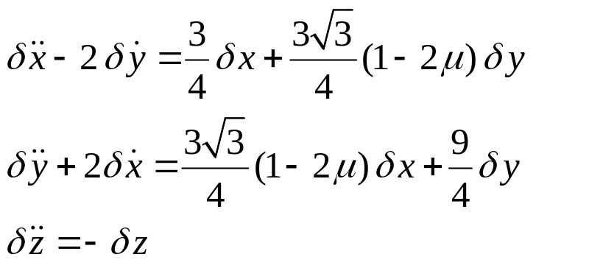
Basic CRTBP Properties (13/22)
Stability
An easier calculation for the L4 equilateral point yields
Again the z motion is oscillatory
The characteristic polynomial for the x-y motion shows that the motion is stable (almost always) for μ < 0.0385
CRTBP

Slide 23


Basic CRTBP Properties (14/22)
Linearized Solution
A convenient linearized solution exists for the co-linear points based on the linearized equations used for the stability analysis
Near L₁/L₂, these equations have a solution of the form
where are freely specified parameters and where
are determined by the dynamics
CRTBP

Slide 24


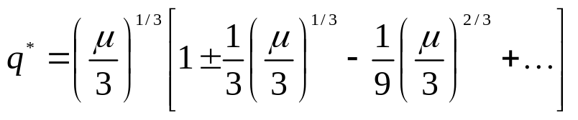

Basic CRTBP Properties (15/22)
Linearized Solution
To get a rough idea of the frequency of the motion, consider the z equation, whose the frequency is
Defining , an iterative solution to the quintic equation exists for the value of q near L₁/L₂ (denoted by q*)
As μ goes to zero, and we see that the motion has a period of half the period of the bodies about their center-of-mass
CRTBP

Slide 25
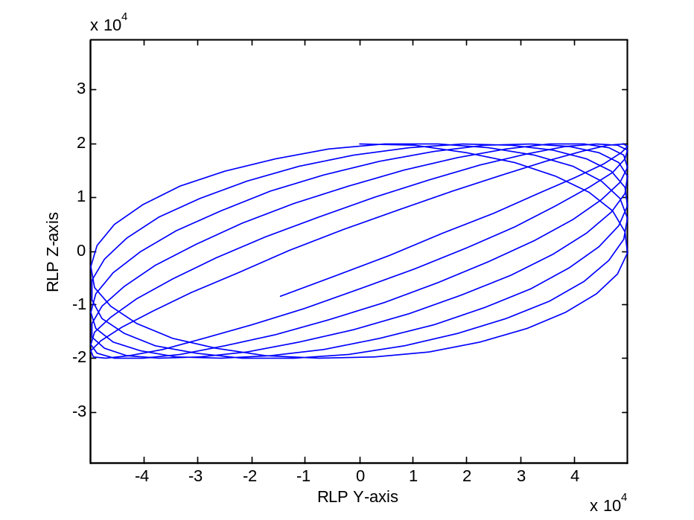
Basic CRTBP Properties (16/22)
Linearized Solution
For the important case of motion about L₂ in the Sun-Earth/Moon system
The in-plane and out-of-plane frequencies are different leading to Lissajous pattern of trajectories
Note that the Lissajous pattern is ‘collapsing’ and has entered the Earth’s shadow (denoted by the black dot)
CRTBP

Slide 26
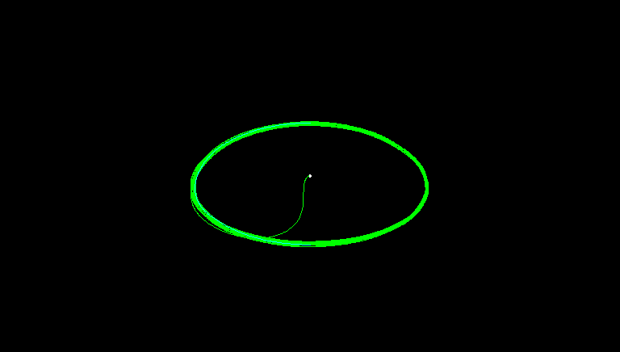
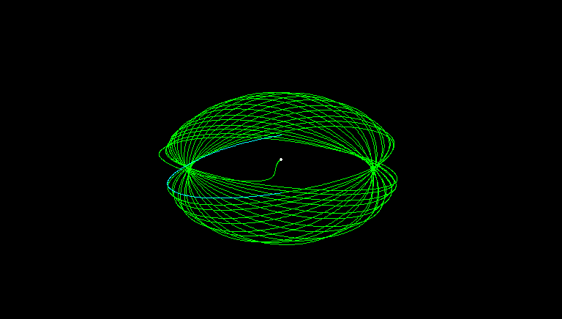
Basic CRTBP Properties (17/22)
Linearized Solution
As the size of the motion about L1 or L2 grows so does the error in the linearized model
At a certain critical size, the nonlinear effects can make the in-plane and out-of-plane frequencies equal leading to ‘Halo’ orbits.
CRTBP

Slide 27




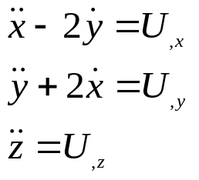
Basic CRTBP Properties (18/22)
EOM Symmetries
Imagine that the flow of time is reversed (like running a movie backwards).
Under this transformation:
  time picks up a minus sign
  positions remain unchanged
  velocities pick up a minus sign
  accelerations remain unchanged
  the EOMs become
CRTBP

Slide 28




Basic CRTBP Properties (19/22)
EOM Symmetries
How do we fix the EOMs so that they have the same form?
One might try making since , , and the first equation would have an overall minus sign that cancels and the in the second equation flips its sign again.
However, the transformation doesn’t work for d₁ due to the term (x+μ-1)→(-x+μ-1) – same for d₂
But y → -y does.
CRTBP

Slide 29
Basic CRTBP Properties (20/22)
EOM Symmetries
In other words, the EOMs are invariant under the transformation
This observation is very important in finding periodic orbits. To quote the geometry center (http://www.geom.uiuc.edu/~megraw/CR3BP_html/cr3bp.html)
  “The time reversal symmetry across the y = 0 plane can be exploited to find certain periodic orbits. If a trajectory pierces the y = 0 plane such that it is perpendicular to the plane we know that it is "attached" to its symmetric counterpart. If the trajectory again intersects the y = 0 plane perpendicularly then it and its symmetric partner form a loop; a periodic orbit.”
CRTBP

Slide 30
Basic CRTBP Properties (21/22)
Tisserand’s Criterion
Tisserand’s criterion was developed to distinguish between many ‘test masses’ (i.e., comets) in the solar system.
Once a comet is found, its orbit can be predicted based on its orbital elements until it has a ‘collision’ with some massive body (e.g., Jupiter)
Start with
  the Jacobi integral expressed in inertial coordinates
  the vis viva equation
  the angular momentum vector in terms of orbital elements
CRTBP

Slide 31
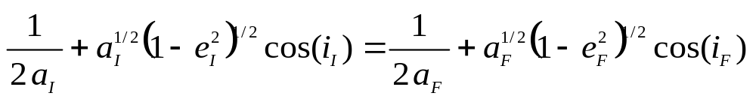
Basic CRTBP Properties (22/22)
Tisserand’s Criterion
In addition, make the approximations that d₁ is equal to the comet’s distance from the Sun and assume that d₂ is large
Putting these ingredients together gives
relating the initial values of the semi-major axis, eccentricity, and inclination to their final values
CRTBP

Slide 32
Applications
CRTBP Properties | Analysis Topic | Reference
Stability Analysis | Optimal stationkeeping and momentum unloads for JWST (pierogi plots) Stationkeeping for SOHO, WIND, ACE, MAP | JWST Momentum Management Analysis, M. Beckman 2004-2006 ‘Stationkeeping Approach for the Microwave Anisotropy Probe (MAP)’, D. Rohrbaugh and C. Schiff (2002)
Linearized Model | ACE prelaunch analysis: SEV predictions, communication constraints Map lunar shadow analysis and SEV analysis | ACE compendium, P. Sharer, C.Schiff, M. Matthews, etc. (1993-1995) MAP Peer reviews, MAP trajectory team (2000 & 2001) ‘Earth Shadows and the SEV Angle of MAP’s Lissajous Orbit at L2’, A. Edery, (2003)
Symmetries in the EOMs | Justification of X-Z plane crossing balancing and targeting | Swingby documentation
Tisserand’s Criterion | Inclination raising (i.e, cranking) for DLS phase of MMS | ‘Analytical Expressions for the Semi-major Axis and Eccentricity after a Lunar Gravity Assist and Tisserand’s Criterion’, A. Edery (2002)
CRTBP

