Slide 1
Monte Carlo Simulations of the Formation Flying Dynamics for the Magnetospheric Multiscale (MMS) Mission
Conrad Schiff
Edwin Dove

Slide 2
Agenda
The Science
  Magnetic Reconnection
  Spacecraft Description
  Flight Dynamics Concept
Operations Concept
  Baseline Orbit
  Formation Flying
  Executing Formation Maneuvers
Performing Monte Carlo
  Verification
  End-to-End Code Design
  Results
Conclusions and Future Work

Slide 3
THE SCIENCE

Slide 4
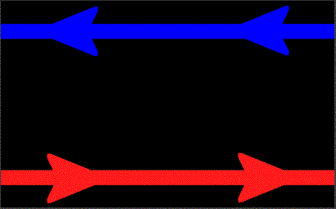
Magnetic Reconnection
Study magnetic reconnection in the Earth's magnetosphere
Magnetic reconnection converts magnetic energy into kinetic energy
  Oppositely directed parallel field lines are pinched
  They join and snap apart like a breaking rubber band
Benefit: understanding of how the Earth lives with the Sun (e.g. Class X Flash 0156 GMT Tuesday, Feb. 15, 2011)‏
  Power grid problems
  Communications disruption
  Aurora formation
Credit: European Space Agency

Slide 5
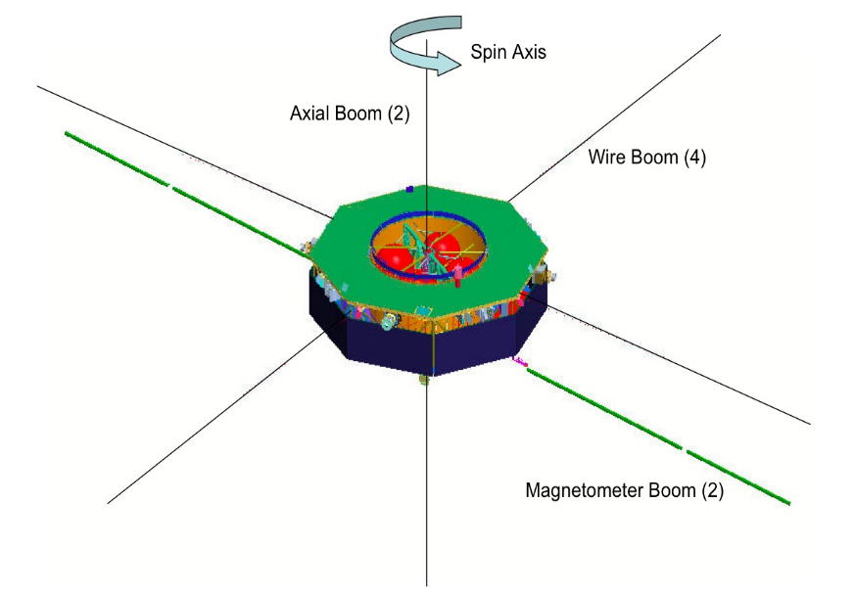
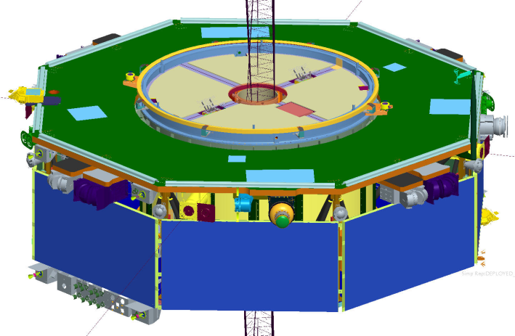
Spacecraft Description
The 4 MMS Spacecraft are
  Equipped with the standard ‘particles and fields’ instrument suit
  Equipped with 8 science booms
    2 Axial (E-field)
    4 Wire (E-field) & 2 Magnetometer Radial
  Spin-stabilized at 3.0 rpm with spin-axis nearly parallel to ecliptic north
  Onboard controllers process GN&C sensor data & fire thrusters to achieve accurate ΔV while keeping the booms safe
    Digital Sun Sensor & Star Camera
    Accelerometer
    Navigator GPS receiver with GEONS navigation s/w
  Equipped with 12 thrusters
    4 Axial 1-lbf (yellow)
    8 Radial 4-lbf (red)
(a)
(b)

Slide 6




Flight Dynamics Concept
Use the formation as a ‘science instrument’ to study the magnetosphere
Night-side science (neutral sheet) bound by power (limits shadow duration)
Need to prevent close approaches (<4 km)
Shadow
30-400 km
Magnetic Field Lines
10-160 km
Maneuvers used to maintain formation against relative drift
Sun
Formation scale matches science scale

Slide 7
THE OPERATIONS CONCEPT

Slide 8

Baseline Orbit Definitions
The trajectory about which the formation flies is defined as the baseline orbit
Because the Sun-Earth interaction is key to the science, the baseline orbit is designed and discussed in the Geocentric Solar Ecliptic (GSE) coordinates
GSE +X-axis is defined as the vector from the center of the Earth to the sun, GSE +Z-axis is defined as the ecliptic normal vector, and GSE +Y-axis completes the right hand coordinate system.
GSE Frame
06:00
12:00
00:00
Sun
18:00
z out of page
ecl

Slide 9
Baseline Orbit
Phase 0
06:00
Perigee Raise
1.04 Re → 1.2±0.1 Re
Phase 1a
GSE Latitude
[-20º, 20º]
when
Apogee GSE
time
[14:00-10:00]
Phase 1x
06:00
06:00
No science
~02:00
12:00
00:00
12:00
00:00
12:00
Allowed
Phase 1a
start range
120-day commissioning
17:00
19:00
19:00
180 days
18:00
17:00
No shadow > 1 hrs
during first 2 weeks after launch
18:00
180 days
18:00
No formation science
Phase 2b
06:00
Phase 2a
Phase 1b
06:00
GSE Latitude
[-25º, 25º]
when
Apogee GSE
time
[14:00-10:00]
Neutral Sheet Dwell
Time >= 100 hrs
10:00
90 days
10:00
12:00
00:00
-10 Re
12:00
00:00
12:00
-10 Re
160 days
Apogee Raise
12 Re → 25 Re
18:00
No formation science
18:00
120 days
18:00

Slide 10







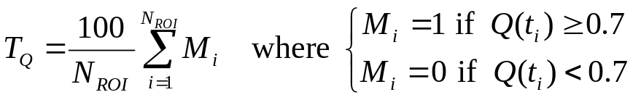
Formation Flying
Target formation has shape of a regular tetrahedron in the science region-of-interest (ROI) (TA ~160-200 deg)
Goodness of the formation is expressed in terms of a quality factor Q(t) ϵ [0,1] which is a product of two terms
  Q_{s}(t) associated with scale size (allows for ‘breathing’)
  Q_{v}(t) measures how close the shape is to a regular tetrahedron
Science requirement is expressed by T_{Q}, the time the formation spends in the ROI with a Q(t) above 0.7
  T_{Q} ϵ [0,100]
  Current science goal to have T_{Q} > 80 for each orbit
2
3
1
4
shape
volume

Slide 11


Executing Formation Maneuvers
Region of Interest (ROI) >9Re
Phase 1 – 1 day period
R/T GEONS
TLM
Maneuver # 2 Planning
IS Safing
Apogee
Maneuver #2
Perigee
Desired
Tetrahedron
HV Keepout
IS Safing
GPS 4 SV
DSN Dumps
HV Keepout
Degraded Tetrahedron
Maneuver #1
GPS available entire orbit

Slide 12
PERFORMING MONTE CARLO

Slide 13
Verification
MMS phases alternate ‘transfer’ and ‘stationkeeping’ opportunities
  Deterministic transfer maneuvers (perigee & apogee raising and formation initialization & resize)
  Random maneuvers (formation maintenance)
Monte Carlo analyses need for fuel budgeting
  Model propulsion and ACS systems with reasonable accuracy
  Handle a variety of error sources: navigation (knowledge) & maneuver execution (control) uncertainties
  Model the operations cycle of deterministic estimation and predictive planning for 2+ years for each trial
Planned change
Realized change
Realized change
Planned change
Truth trajectory
Planning/Desired trajectory
Navigation Update

Slide 14








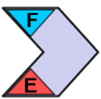


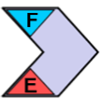








Design of the End-to-End Code
The End-to-End code (ETE) was designed to perform the Monte Carlo verification (closer to test-as-you-fly)
Favors robustness over smarts
  Brute force approach to operations – limited future prediction
    Sometime fires maneuvers sooner than needed (not Deep Blue)
    Can’t account for human-in-the-loop intelligence that will be present in operations
  Results in a conservative estimate of maneuver frequency and fuel usage
FreeFlyer Code Component
GMAT Code Component
F
Finite Burn Capable
E
Maneuver Execution Errors
N
Navigation Errors
Ref. Orbit
HDF5 Data File
Local End-to-End Driver
Phase 0
Phase 1
Phase 2a
Phase 2b
Post-Process
Inputs
Nominal
MC1
MC2
MCN
Outputs
Nominal
MC1
MC2
MCN
160km
Formation
Init.
400km
Formation
Init.

Slide 15
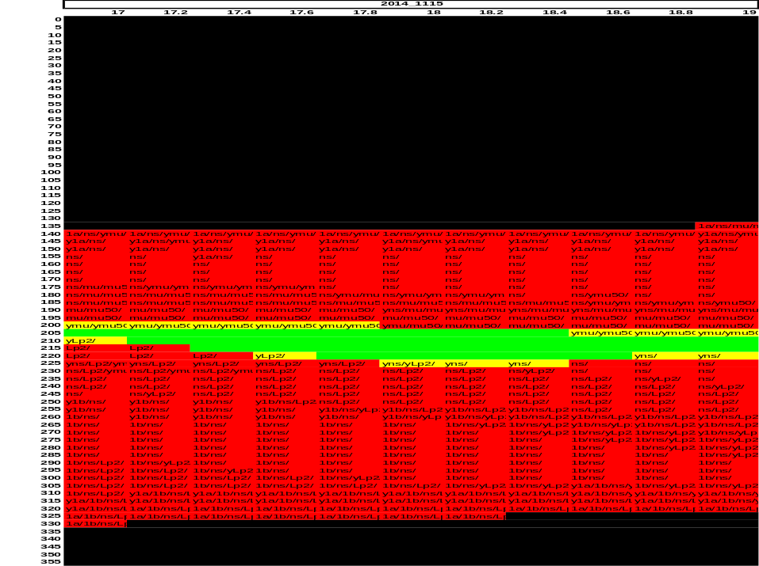
Results: Baseline
102 Monte Carlo trials (~800 hrs)
Reference orbit (first guess with limited modeling) used to seed each trial
Six baseline orbit metrics used to characterize the baseline orbit
ETE code shows excellent agreement – formation follows the desired baseline orbit
Sample reference orbit output
AOP
RAAN
Metric | Requirement | Reference orbit value | ETE orbit value
Phase 1a GSE Latitude, la (deg) | 0 < |la| ≤ 20 | [1.41,3.85] | [3.16,5.28]
Phase 1b GSE Latitude, lb (deg) | 0 < |lb| ≤ 25 | [-5.94,-1.91] | [-4.56,-0.73]
Neutral sheet dwell time, TNS (hours) | TNS ≥ 100 | 232.06 | 287.38
Maximum umbra duration, MU (minutes) | MU ≤ 216 | 174.27 | 189.90
Maximum umbra + 50% penumbra, MUP (minutes) | MUP ≤ 231 | 183.23 | 200.70
Max. shadow in the first 2 weeks, MS (minutes) | MS ≤ 60 | 0 | 0

Slide 16
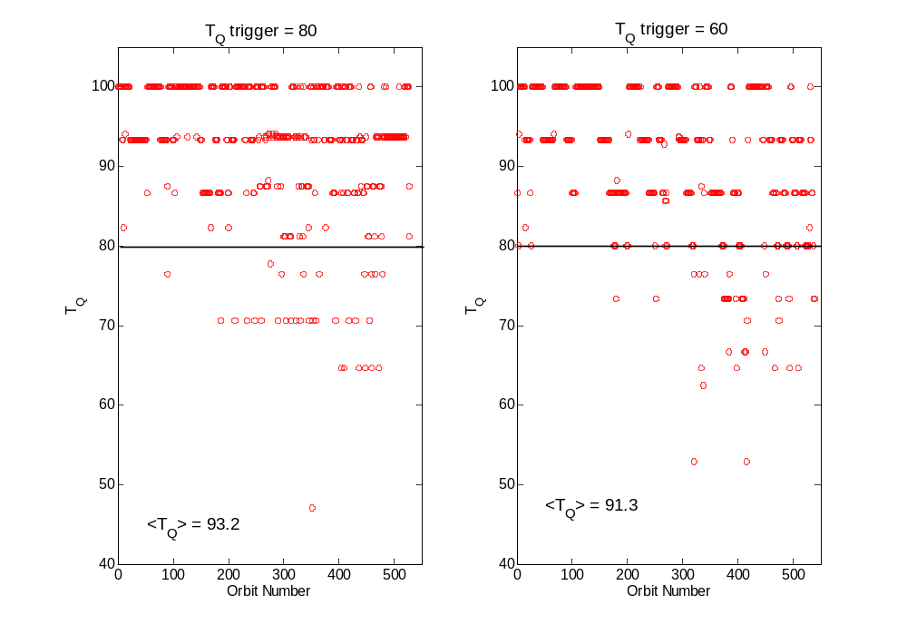
Results: Formation Flying
Intuition for tetrahedron flight much harder to achieve - little in the way of either experience or theory to serve as a guide
a priori approach to formation maneuvers is to trigger before T_{Q} < 80
Due to knowledge and control errors it is impossible to always have T_{Q} > 80
What T_{Q} should be used as a trigger for the formation maintenance?
6.2% of cases violate
8.0% of cases violate
T_{Q} trigger of 60 give <T_{Q}> of ~90 for the entire mission
  Gives better fuel usage ~30 kg savings per spacecraft
  Used for all modeling

Slide 17
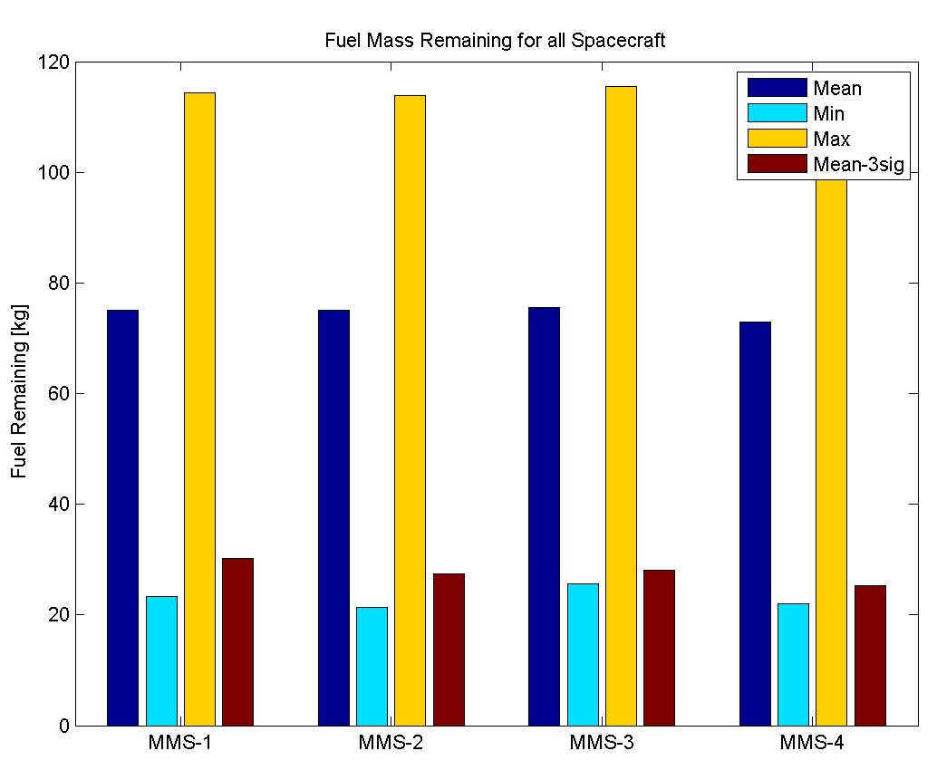
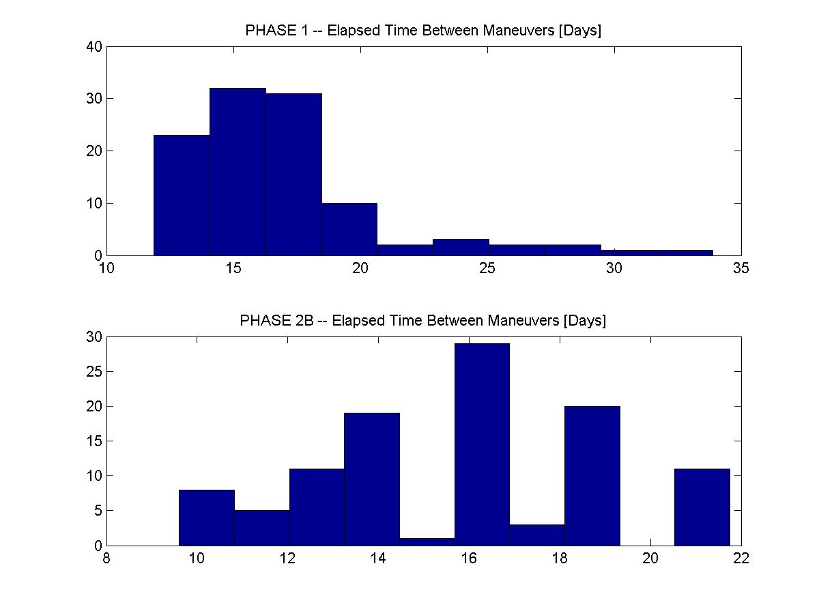
Results: Fuel Usage and Maneuver Frequency
Fuel usage is measured by
  Nominal usage with no errors
  Variations of the usage over the Monte Carlo trials
  100% of Nov. 1, 2014 launch opportunity have fuel remaining – although there is significant variation across the Monte Carlo trials
Maneuver frequency
  Histogram (right) shows the elapsed time between maneuver pairs
  The distribution, while not Gaussian, shows that the required 14-day average is met – reasonable operations tempo
MMS Statistical Fuel Usage – Nov. 1st Launch
Event | Fuel Used (kg)
Phase 0 | 51.9
Formation Initialization 1 | 10.7
Phase 1 | 61.4
Phase 2a | 167.3
Formation Initialization 2 | 9.4
Phase 2b | 14.5
ACS (allocation) | 20.0
Unusable (allocation) | 2.0
Total | 337.2

Slide 18
CONCLUSIONS AND FUTURE WORK

Slide 19
Conclusions and Future Work
The ETE code results have verified
  There is enough fuel to launch on most of the days predicted by the reference orbit code
  The baseline mission design is robust and stable
  The formation flying dynamics are complex and only partially understood
Future work is concentrated in two areas
  Removal of the conservatism and improve the maneuver targeting to get more optimal fuel usage
  Improve the automation techniques
    Better mimic human-in-the-loop intelligence
    Serve as a prototype for the ground system development currently under design
Thanks for your attention!

