Slide 1
Orbital Mechanics
NASA Goddard Space Flight Center
July 10, 2007
Marco Concha
Conrad Schiff

Slide 2
Overview
Definitions
Orbit Mechanics
Picture Glossary
Newton’s Laws of Motion
Orbit Basics
Addition Results
Interlude #1
Kepler’s Laws
Interlude #2
Keplerian Elements
Changing the Orbit
Interlude #3
References
7/5/2007

Slide 3
Orbital Mechanics
Orbital Mechanics is the term used to describe the study of the motion of natural and man-made bodies in space
The description of the motion is in terms of the position and velocity of each body as seen by some observer
Our task is to take some physical observations and to then determine the motion
Our toolkit consists of primarily of Newton’s Laws of Motion (3 of these) and Newton’s Law of Universal Gravitation (1 of these)
These laws helps up to discover, define, and understand
  Mechanical Energy
  Kepler’s Three Laws
  Orbit shape and size
  Etc.
7/5/2007

Slide 4
Picture Glossary
Since we will be drawing a lot of pictures it is worth having a ‘picture glossary’
Each body in question will (almost) always be drawn as a circle or sphere with a number in it
The position of a body is given by where it is placed
The velocity of the body will be drawn as a white arrow
The force on the body will be drawn as a red arrow
The size of any arrow is related to the size of the thing is represents (big velocities are big arrows, small velocities are small arrows)
The body’s motion will be drawn as a bright yellow curve
1
7/5/2007

Slide 5
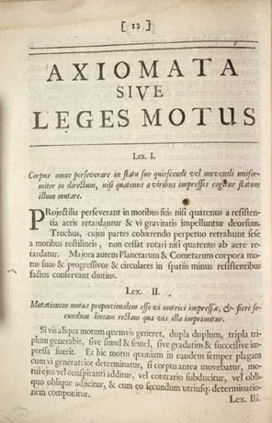
Newton’s Laws of Motion
Isaac Newton (1643-1727) gave his three laws of motion and the universal law of gravitation in his Philosophiae Naturalis Principia Mathematica in 1687 (‘Principia’ for short)
His three laws are:
  An object in motion will remain in motion unless acted upon by a net force.
  Force equals mass multiplied by acceleration.
  To every action there is an equal and opposite reaction.
Using the three laws and his universal law of gravitation, Newton explained why Kepler's laws worked and showed that the same laws at work on Earth worked in the heavens
A page from Newton’s Principia
7/5/2007

Slide 6
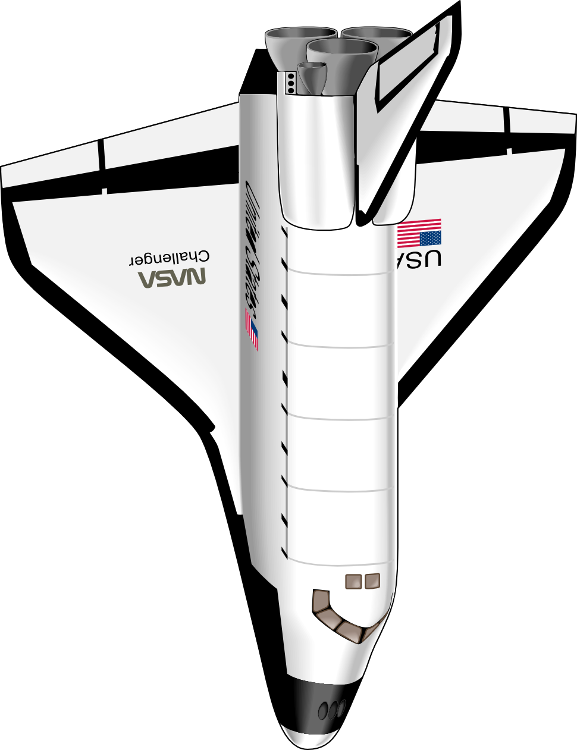
Newton’s 1st Law
An object in motion will remain in motion unless acted upon by a net force.
Original motion
Resulting motion
7/5/2007

Slide 7
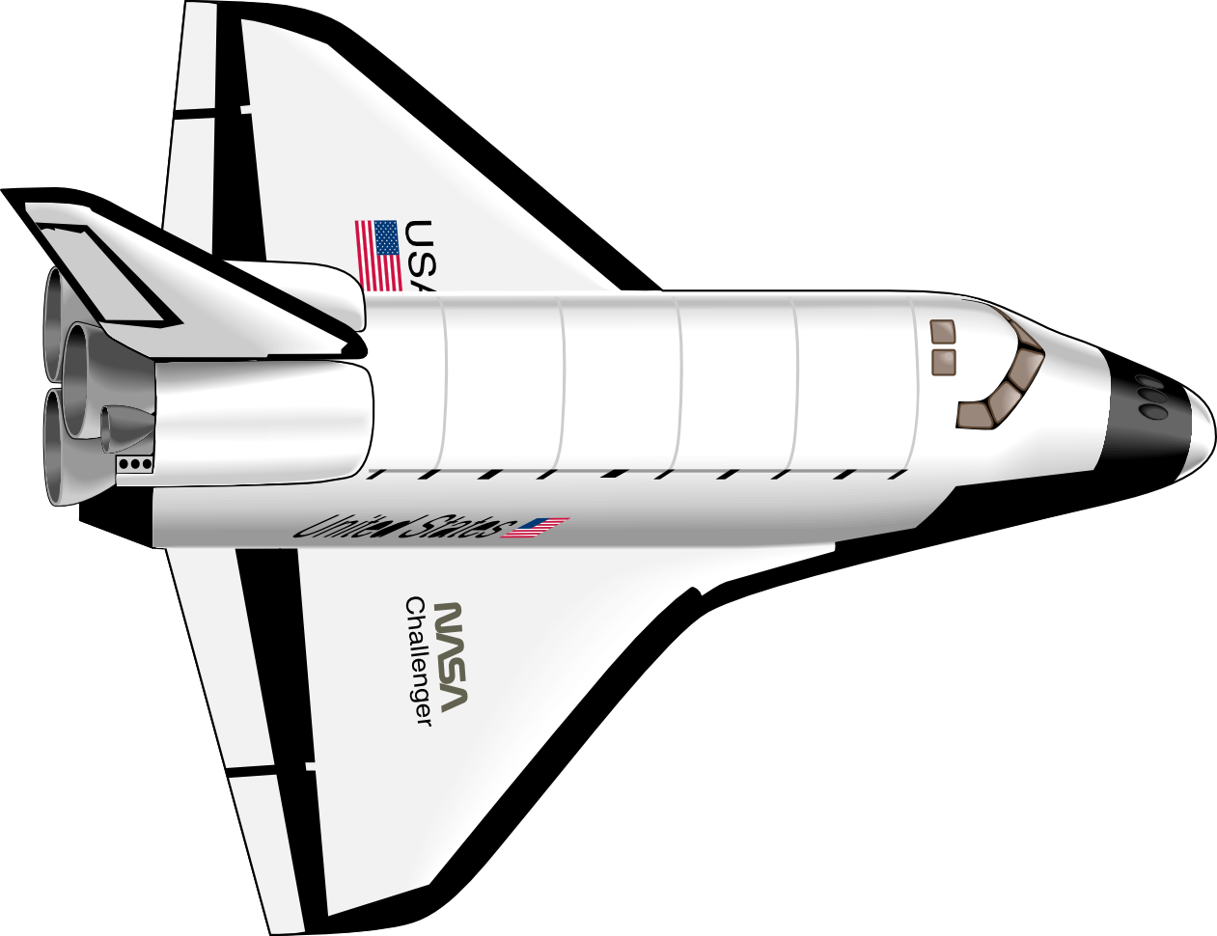
Newton’s 2nd Law
Force equals mass multiplied by acceleration.
  Force = Mass * Acceleration ( F = m a)
  Acceleration = Change in Velocity over time
Increase in velocity is due to the shuttle’s thrusters exerting a force
This law is the workhorse of millions of computations performed at NASA everyday
7/5/2007

Slide 8
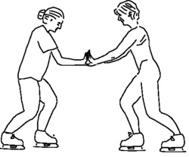
Newton’s 3rd Law
To every action there is an equal and opposite reaction.
If we define the product of a body’s mass and velocity as its momentum (p = mv) then this law tells us that each body’s momentum is conserved
7/5/2007

Slide 9
Orbit Basics
Consider the simplest system - two bodies
The primary force acting between them is gravity
Initially, with no relative motion, the bodies will fall toward each other.
When one body is much more massive than the other, the discussion is idealized as
  one stationary body (Body 1)
  and one moving body (Body 2).
The resulting path of motion is called an orbit.
Body 1 exerts an attractive force on Body 2
1
2
Body 2 exerts an attractive force on Body 1
1
2
Initial Velocity
7/5/2007

Slide 10
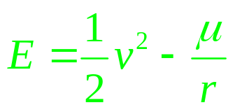
Some Additional Results
After a over a century of work (and occasionally controversy) some additional and very useful concepts came about
The primary ones deal with conservation laws. These laws specify that certain combinations of the position and velocity are constant in certain circumstances. These include:
  Conservation of Energy
  Conservation of Momentum
  Conservation of Angular Momentum
Of these three, the Conservation of Energy is most important
where: v is the speed of the Body 2 relative to Body 1
r is the distance between Body 2 and Body 1
μ is a measure of the mass of Body 1
7/5/2007

Slide 11
Interlude #1
Why are we allowed to say that Body 1 is stationary?
  Doesn’t Body 2 exert a force on Body 1? (Newton’s 3rd law)
  Doesn’t Body 1 move under this force? (Newton’s 1st and 2nd laws)
  Can we accurately think of the Moon moving about the Earth this way?
  What about the Earth moving about the Sun?
7/5/2007

Slide 12
Kepler’s Laws - Describing an Orbit
Since the ‘orbit’ idealization discussed above does make sense, we now need to describe an orbit.
Johannes Kepler (1571-1630) developed the concepts associated with planetary motions by describing the positions and motions of objects in our solar system in terms of orbits.
  Planets move around the Sun in elliptic orbits with the Sun located at one focus of the ellipse
  As the planet moves in its orbit around the Sun, equal areas as measured from the focus are swept out in equal times.
  The square of the period of the orbit is proportional to the cube of the semi-major axis of the ellipse.
7/5/2007

Slide 13
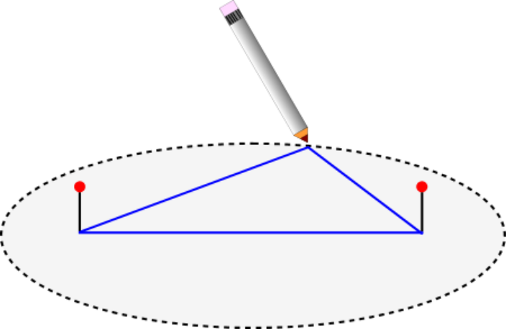
Kepler’s 1st Law
For an ellipse
  Apohelion : Point furthest from the Sun
  Perihelion : Point closest to the Sun
  Semi-major Axis : Half the rectilinear distance between perihelion and apohelion
Constructing an Ellipse
  An ellipse is a set of points in a plane where the sum of the distance from any point on the ellipse to two fixed points is constant
  Each fixed point is called a focus
  It is easy to draw an ellipse by using a loop of string and two push pins
    Put the loop around the pins
    Place a pen or pencil inside the loop and pull taut
    Move the pen or pencil around the pins 360 degrees to construct the ellipse
Two additional needed concepts are:
  Period : time to complete one orbit revolution
  Eccentricity: a measure of the orbit’s circularity (e=0 is a circle, e=1 is a parabola)
perihelion
Sun
apohelion
semi-major axis
7/5/2007

Slide 14
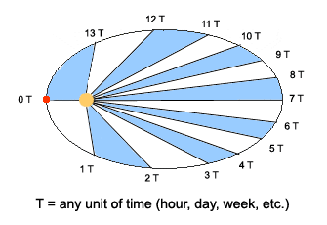
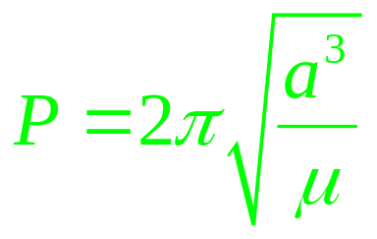
Kepler’s 2nd and 3rd Laws
Kepler’s 2nd law means that two lines going from a focus to the ellipse, separated by some fixed elapsed time T, always sweep out equal area
Kepler’s 3rd law says that the time to complete one orbit is given by
where: a is the semi-major axis of Body 2’s ellipse
  μ is a measure of the mass of Body 1
7/5/2007

Slide 15



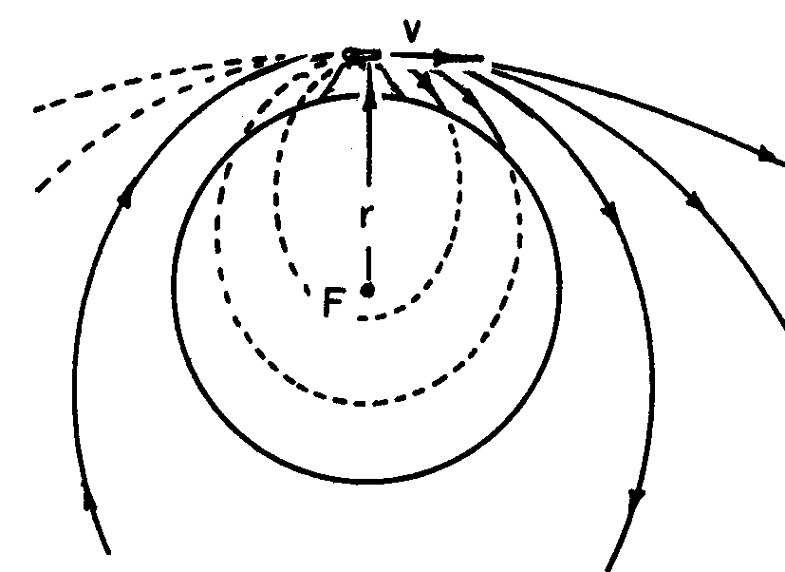
Generalizing Kepler and Newton’s Cannonball
Understood within the context of Newton, Kepler’s Laws are seen to be universal. They can be generalized to any two-body system.
Newton explained the motion under gravity as “freefall”.
To illustrate, he proposed a cannon firing horizontally atop a mountain
The cannonball eventually lands on the earth’s surface.
Now, shoot the cannonball with more velocity.
Eventually, a high enough velocity will allow the cannonball to “clear” the earth!
This cleared path is an orbit, which obeys Kepler’s Laws but with the Earth at one focus instead of the Sun.
The most common example is the application to man-made satellites about the Earth
  low-Earth observational spacecraft
  Geosynchronous spacecraft
  Weather satellites
  Spy satellites
7/5/2007

Slide 16
Interlude #2
If the period of an orbit is to be one civilian day (86400 seconds) what must be the semi-major axis of the orbit? (use the period formula on slide 14)
By convention, Body 2’s energy is negative when it is bound to Body 1 (either sitting on the surface or in elliptical orbit). Also by convention, the energy of Body 2 is zero when it ‘escapes’ from Body 1.
  What is the general formula for the escape velocity of Body 2, assuming it is launched from rest from the surface of Body 1? (use the energy formula on slide 10)
  What is the escape velocity for the Earth (μ = 398600 km^3/sec^2)? What about the moon (μ = 4903 km^3/sec^2)?
7/5/2007

Slide 17
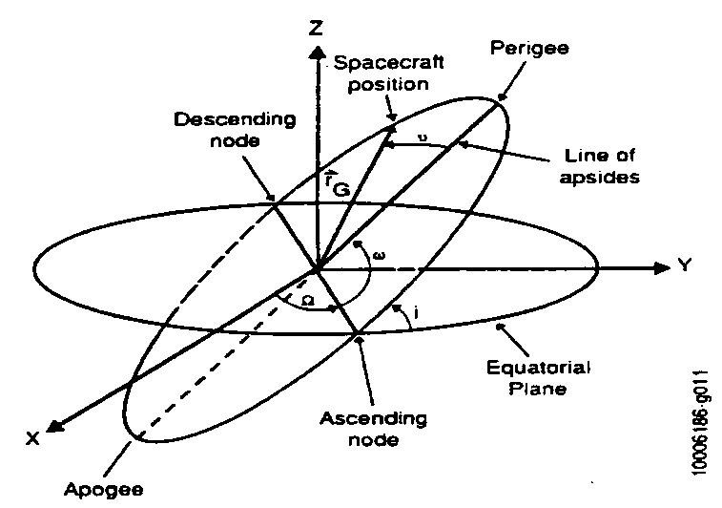
Keplerian Elements (1/2)
Keplerian orbits are a set of descriptive parameters for orbits
They are better than usual position and velocity for most applications because:
  The Keplerian elements have a clear geometric interpretation
  Most of the elements are constants
For describing the orbit size and shape, two elements are required (constant)
  Semi-major axis – a
  Eccentricity – e
For describing the orbit orientation in space, three elements are required (constant)
  Inclination – i
  Right Ascension of Ascending Node – Ω
  Argument of Perigee – ω
For describing the position of a spacecraft in orbit, one element is required (varies)
  True Anomaly – ν
7/5/2007

Slide 18
Keplerian Elements (2/2)
Why are there 6 Keplerian elements?
  As we stated earlier, the description of the orbit requires knowing the position and velocity of the body. There are 3 position components (3 spatial dimensions) and 3 velocity components corresponding to moving in the 3 spatial dimensions.
  The Keplerian elements are a mixture of the position and velocity components – the energy equation on slide 10 is a specific example.
  The fact that the energy is conserved and that the energy depends only on the semi-major axis explains why the semi-major axis is constant.
Are all constant Keplerian elements explained by conserved physical quantities like energy?
  Yes!
  In addition to energy there are two other conserved physical quantities: angular momentum and something called the Laplace-Lenz-Runge or eccentricity vector.
7/5/2007

Slide 19
Changing an Orbit (1/3)
Since the Keplerian elements are ‘protected’ by conserved physical quantities, changing an orbit requires an additional, man-made force
The man-made force is most often supplied by a chemical thrust produced by a rocket or a set of thrusters
If the force is applied over a ‘short’ time, then it is termed an ideal impulsive thrust or simply an impulsive delta-V
A delta-V is represented as a instantaneous change in velocity with no change in position
Different delta-V directions lead to changes in different Keplerian elements
A delta-V performed along the direction of the velocity makes a change in the energy (semi-major axis) and for a given size this change is the easiest
NASA almost always starts with a delta-V since it allows us to focus on the change without worrying about exactly how much fuel is needed.
7/5/2007

Slide 20
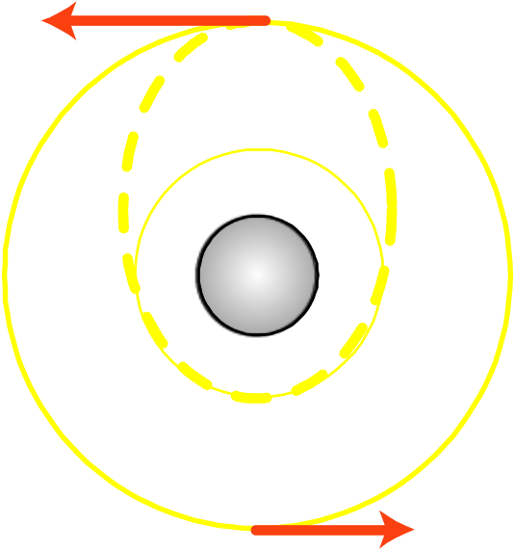
Changing an Orbit (2/3)
The most ‘classic’ problem involving changing orbits is the Hohmann transfer
In the Hohmann transfer, we want to go from one circular orbit to another of different size, where both orbits are in the same plane
The transfer picture looks like:
  The red arrows are the forces expressed in terms delta-Vs
  The dotted-line orbit is called a transfer orbit
7/5/2007

Slide 21
Changing an Orbit (3/3)
It took over 50 years to prove that the Hohmann transfer is fuel optimal
The concept of a Hohmann transfer birthed a whole industry of optimal control and targeting that is usually called mission design
Very sophisticated mathematical techniques exist and are being continuously developed to find the ‘optimal’ mission
Sometimes these kinds of pursuits led to un-intuitive results
7/5/2007

Slide 22
Interlude #3
Suppose a launch vehicle drops off three probes, one at a time.
Based on the spring forces and conservation of momentum (see slide 8), the delta-V imparted to probe 1 is larger than that imparted to 2 which is larger than that imparted to probe 3
Assuming each delta-V only increases the energy,
  which probe has the largest semi-major axis, which has the smallest?
  Which probe has the longest period, which has the smallest?
3
2
1
2
3
1
Initial time
Later time
7/5/2007

Slide 23
References
Wikipedia.org
NASA Jet Propulsion Lab, “Basics of Space Flight”, http://www2.jpl.nasa.gov/basics/
‘Fundamentals of Astrodynamics’, Bate, Mueller, & White, Dover, New York, 1971.
‘Thinking Physics’, L. C. Epstein
Physics Teacher and American Journal of Physics – published by the AAPT
7/5/2007

