Slide 1
Notes on E&M
Conrad Schiff
Last revision – 7/23/12

Slide 2
References
[1]: Electromagnetic Theory – Frankl
[2]: Foundations of Electromagnetic Theory – Reitz, Milford, & Christie
[3]: Lectures on Electromagnetic Theory - Solymar
[4]: Maxwell’s Equations – wikipedia.org http://en.wikipedia.org/wiki/Maxwell_Equations
[5]: Nonlinear optics – wikipedia.org http://en.wikipedia.org/wiki/Nonlinear_optics#Wave-equation_in_a_nonlinear_material
[6]: Nonlinear magnetic materials – wikipedia.org http://en.wikipedia.org/wiki/Permeability_(electromagnetism)
[7]: Google search on ‘nonlinear electrical conductivity’

Slide 3
E&M Equations
The equations of electromagnetic theory are built on
  Maxwell’s equations – 4 linear PDEs in 5 vector functions and 1 scalar function (16 variables) [1.142]
    E – electric field [N/C] or [V/m]
    D – electric displacement [C/m²]
    B – magnetic flux density [Ns/Cm] or [kg/Cs]
    H – magnetic intensity [A/m]
    J – electric current density [C/m²/s]
    ρ – electric charge density [C/m³]
  Lorentz Force law – F = q(E + v x B) vector equation relating the force on a charge q to applied electric field, E, the velocity of the charge, v, and the applied magnetic flux density, B
  Constitutive equations for matter
    D = D(E); usually through D = E + P(E) = ε E for linear polarization
    H = H(B); usually through H = B + M(B) = 1/μ B for linear magnetic materials
    J = J(E); usually J = g E linear conductivity for conductors
    Note that ε [C²/Nm], μ [N/A²], & g [A/V] can be either scalars or tensors for isotropic or anisotropic materials
    Nonlinear behavior occurs for all three cases

Slide 4
General Theory

Slide 5
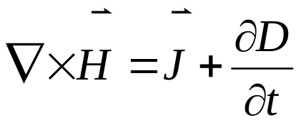
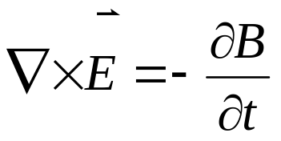


Maxwell’s Equations (1/21)
The Maxwell Equations are [1.142,2.389] (mks units – see previous slide):
Ampere’s Law
Faraday’s Law
Coulomb’s Law
Monopole Law

Slide 6
Maxwell’s Equations (2/21)
The Maxwell Equations exhibit:
  Charge conservation
  Well-posed initial value problem
  Compact expression in terms of potentials
    Vector & Scalar Potentials – connected to fields
    Connecting Potentials & Sources – inhomogeneous wave eqns
    Super potential – all from one
    Gauge invariance
    Lorentz gauge
    Coulomb gauge
  Wave excitations
    Magnetic Intensity
    Electric Field
  Conservation of Energy
    Poynting Theorem
    Interpretation in terms of energy & momentum flow
  Well-defined Boundary Conditions

Slide 7
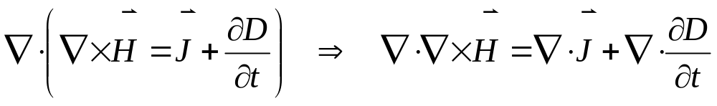
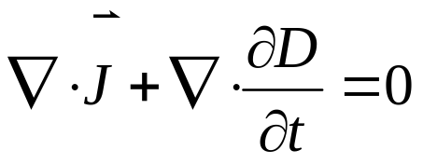
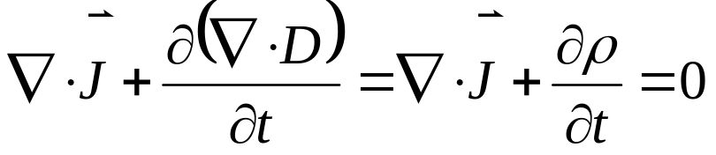
Maxwell’s Equations (3/21)
Charge conservation [1.143-4]:
  Start with Ampere’s Law
  Take the divergence
  Since the divergence of a curl is zero
  Finally interchange the divergence and the time derivative and use Coulomb’s law
Ampere’s Law

Slide 8
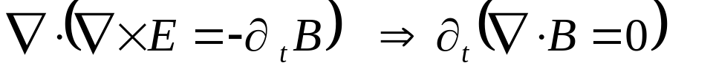
Maxwell’s Equations (4/21)
Initial Value Formulation [1.144-7]:
  Take the divergence of Ampere’s law
  Using charge conservation, eliminate div(J) in favor of ∂_{t}ρ
  Likewise take the divergence of Faraday’s law
  Thus, once both Coulomb’s Law and the Monopole Law are satisfied at at the initial conditions, they stay satisfied for all time

Slide 9

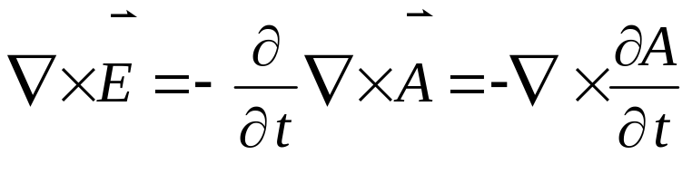
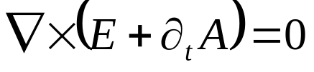
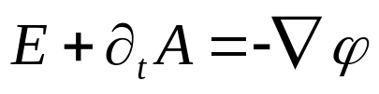
Maxwell’s Equations (5/21)
Vector & Scalar Potentials [1.144-7]:
  The Monopole Law implies
  Substitute into Faraday’s law yields
  Which can be written
  When the curl of a vector field is zero then there is a scalar potential such that
Minus sign chosen by convention

Slide 10

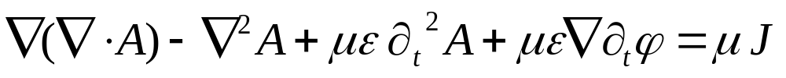
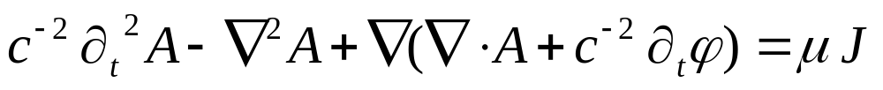
Maxwell’s Equations (6/21)
Connecting Potentials and Sources [1.145] – Vector
  Start with the B-field definition
  Take the curl of both sides, assuming a linear constant medium and using Ampere’s law
  Multiply out and use curl(curl()) = grad(div())-laplacian()
  Rearrange, simplify, and substitute 1/c² = μ ε (2.403)
B-field Definition

Slide 11
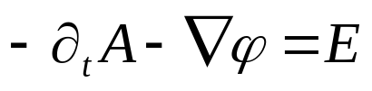
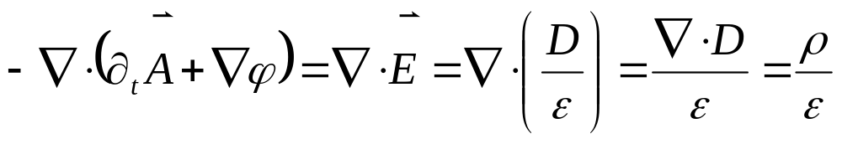
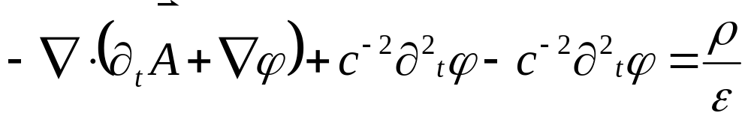
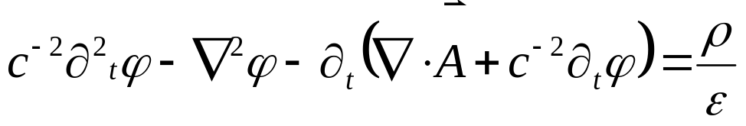
Maxwell’s Equations (7/21)
Connecting Potentials and Sources [1.145] – Scalar
  Start with the E-field definition
  Take the divergence of both sides, assuming a linear constant medium and using Coulomb’s law
  Now add and subtract c⁻²∂²_{t}ϕ on the LHS
  and simplify
E-field Definition

Slide 12

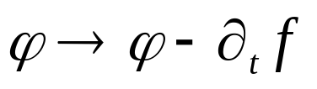
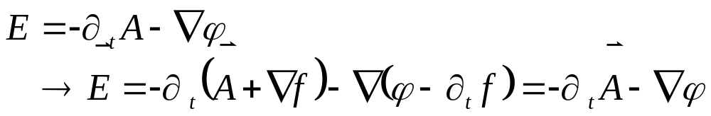
Maxwell’s Equations (8/21)
Gauge Invariance [1.144-7]:
  The definition relations between the field and their potentials allow for a functional invariance
  Consider the transformation
  The magnetic field is unaffected since:
  And the electric field is also unaffected provided that:
  Since

Slide 13
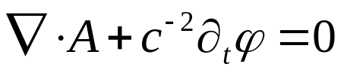
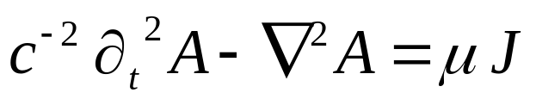
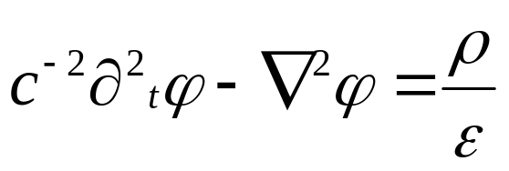
Maxwell’s Equations (9/21)
Lorentz Gauge [1.144-7]:
  Using the gauge degrees of freedom, select:
  Substituted into the inhomogeneous wave equations gives:
  and
  Note that the second equation also follows from the first by taking a time derivative

Slide 14

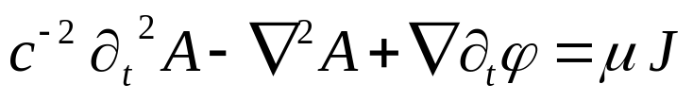
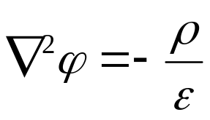
Maxwell’s Equations (10/21)
Coulomb Gauge [1.144-7]:
  Using the gauge degrees of freedom, select:
  Substitute into the inhomogeneous wave equations to get:
  and
  This gauge choice makes the scalar potential look like the electrostatic case
  Note that the scalar equation follows from the vector

Slide 15
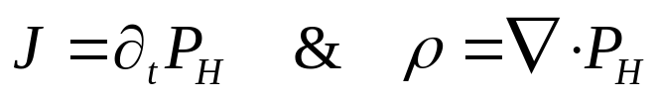
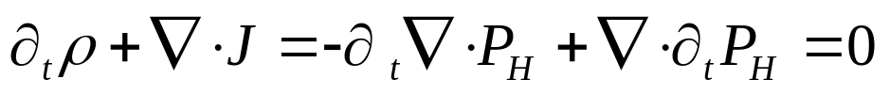
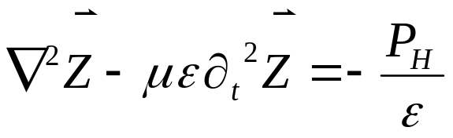
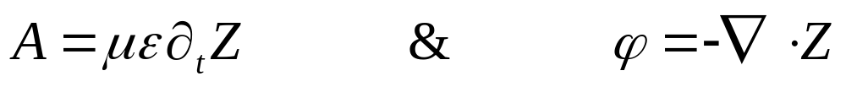
Maxwell’s Equations (11/21)
Superpotential (Hertz potential) [1.144-7,2.410-1]:
  Charge & current connected through continuity equation
  Define the Hertz polarization
  The continuity equation is automatically satisfied since:
  Now define the superpotential
  Then the standard potentials are given by (using Lorentz gauge wave equations):

Slide 16

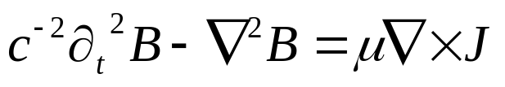
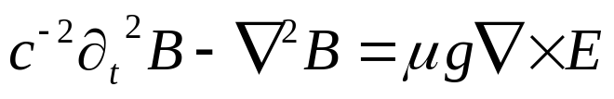
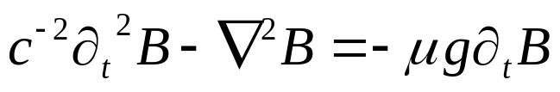
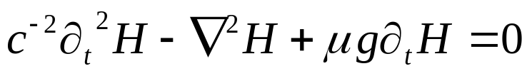
Maxwell’s Equations (12/21)
Wave Excitations - Magnetic Density & Intensity:
  Start with vector potential wave equation [2.403]
  Take the curl
  Use Ohms law to relate current to electric field
  Then use Faraday’s law to replace E with B
  Finally use μ H = B [2.394]
Vector potential wave equation

Slide 17
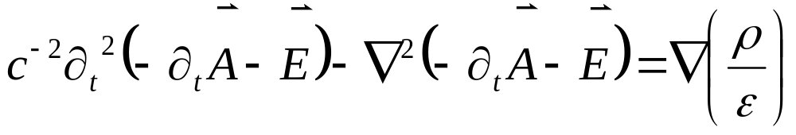
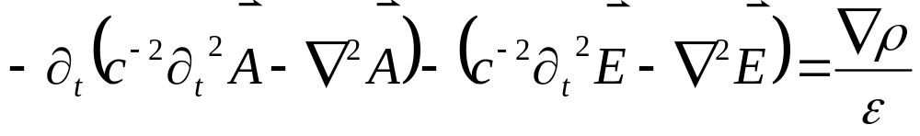
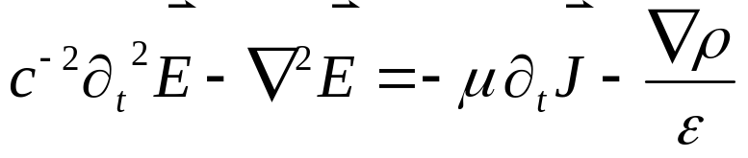
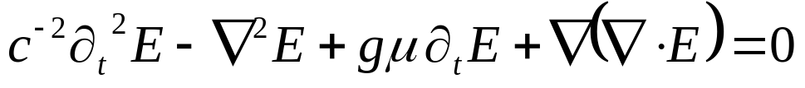
Maxwell’s Equations (13/21)
Wave Excitations – Electric Field and Displacement:
  Start with scalar potential wave equation [2.403]
  Take the gradient
  Factor A out
  Then use vector potential wave equation
  Finally substitute in Ohms law and express ρ in terms of D/E
Scalar potential wave equation

Slide 18
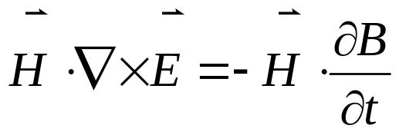
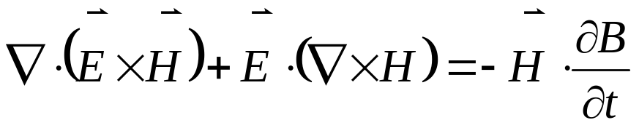
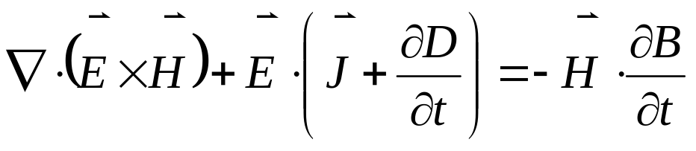
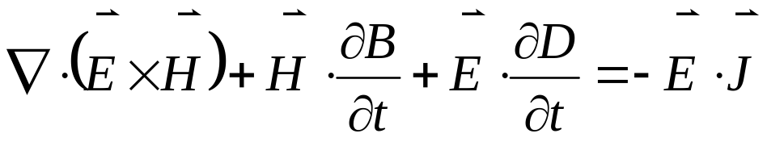
Maxwell’s Equations (14/21)
Poynting Theorem [2.390-393]
  Start with Faraday’s law and dot both sides by H
  Rewrite LHS with div(cross(A,B)) =div(cross(A),B) – div(A,cross(B))
  Use Ampere’s law
  Rearrange to produce the Poynting theorem

Slide 19
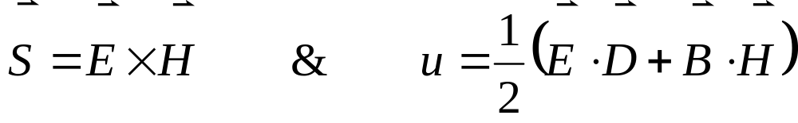
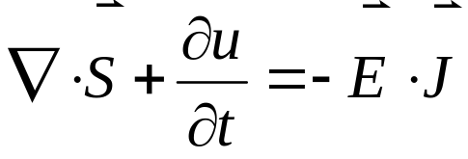
Maxwell’s Equations (15/21)
Energy & Momentum Flow [1.200-207]
  Make following identifications (assuming linear constant media)
  Then the Poynting theorem can be written in flux-conservative form as
    u has units [N/C][C/m²] + [Ns/Cm][C/sm]=[N/m²] = [J/m³]
    S has units [N/C][C/sm] = [N/ms] = [Nm/m²s] = [J/m²s]
    dot(E,J) has units [N/C][C/m²s]=[Nm/m³s] = [J/m³s]
    div(S) has units [N/m²s] = [Nm/m³s] = [J/m³s]
    diff(u,t) has units [J/m³][1/s] = [J/m³s]
  The obvious interpretation is that u is an energy density, S is the energy flow (flux) and the dot(E,J) is the work done

Slide 20
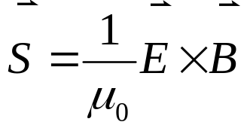
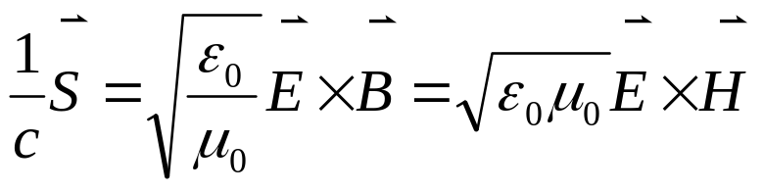
Maxwell’s Equations (16/21)
Energy & Momentum Flow [1.200-207]
  There is way to connect the Poynting theorem to momentum since photons obey E² = c² p²
  Poynting vector in free space (absence of matter)
  Check the Poynting vector units [A²/N][N/C][Ns/Cm] = [N/ms]
    = [Nm/m³][m/s] = [J/m³][m/s] = energy density * speed
    = [Nm][1/m²/s] = [J/m²/s] = [J/s/m²] = [W/m²] = energy flux
  Now divide by the speed of light (c = 1/μ₀ ε₀)
  The units of S/c are then [s/m][N/ms] = [kg/ms²]
    = [kg m/s²][1/m²] = [kg m/s] [1/m²/s] = momentum flux
    = [kg m/s][1/m³][m/s] = momentum density *speed

Slide 21
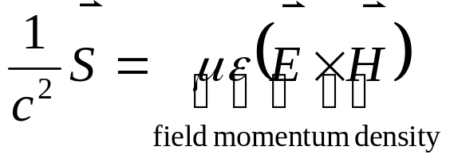
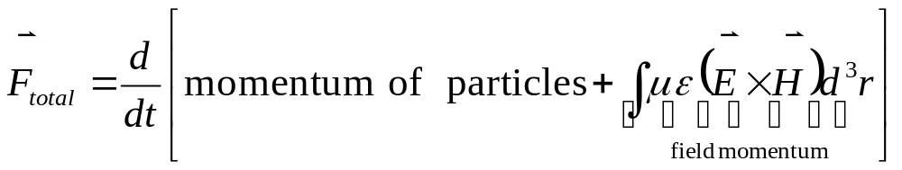
Maxwell’s Equations (17/21)
Energy & Momentum Flow [1.200-207]
  Since S/c has unit of momentum density * speed one may guess that S/c² is the field momentum density
  In fact, it is true that (even in the presence of matter)
  Frankl [1.203-4], presents a nice argument based on Lorentz force law that shows
  To see this start with the Lorentz force law in terms of densities (using Ampere’s and Coulomb’s laws)

Slide 22
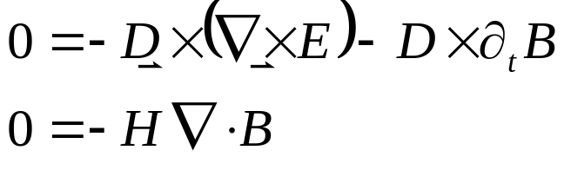
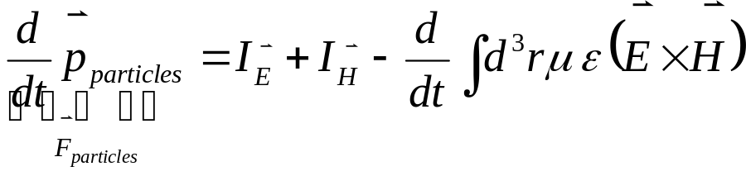
Maxwell’s Equations (18/21)
Energy & Momentum Flow [1.200-207]
  Using the monopole and Faraday’s laws gives
  Adding the above relation to the Lorentz force law gives
  Integrate over all space to get the force on the particles and use
  to transform two of the volume integrals to surface integrals resulting in

Slide 23
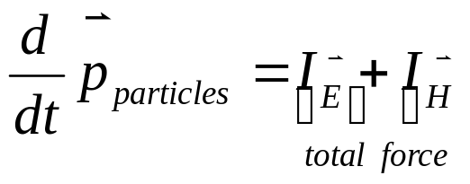
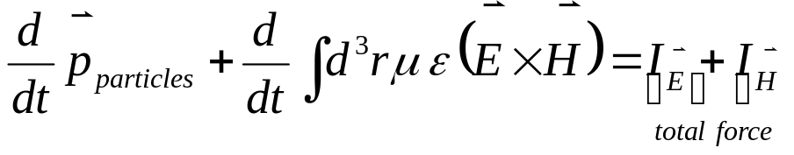
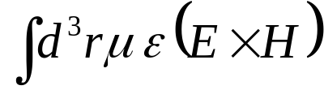
Maxwell’s Equations (19/21)
Energy & Momentum Flow [1.200-207]
  Finally attach meaning to the surface integrals I_{E} & I_{H} by first looking at the situation when the fields are static
  From this equation, identify I_{E} + I_{H} is the total force being exerted on the particles
  Since the instantaneous configuration of the fields and the particles cannot ‘know’ the future, I_{E} + I_{H} must always be the total force
  So define the field momentum as

Slide 24




Maxwell’s Equations (20/21)
Boundary Conditions - Approach [1.209-211]
  At boundaries between materials, some components of the fields will be continuous and some will jump
  To determine which is which
    Pillbox for those Maxwell equations expressed in terms of div
      Integrate over the pillbox volume as it shrinks to zero
    Rectangular loop for those Maxwell equations expressed in terms of curl
      Integrate around the circuit of the loop as its area goes to zero
interface
interface
Medium 1
Medium 1
Medium 2
Medium 2
Pillbox
Rectangular Loop

Slide 25



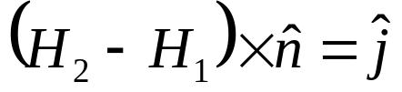
Maxwell’s Equations (21/21)
Boundary conditions [1.209-211,1.237-238]
  Using the pillbox on Coulomb’s law shows a jump discontinuity in the normal component of D is possible
  Using the rectangular loop on Faraday’s law shows that the tangential component of E is always continuous
  Using the pillbox on the Monopole law shows that the normal component of B is always continuous
  Using the rectangular loop on Ampere’s law shows that the tangential component of H can have a jump discontinuity
σ – surface charge density
j – surface current density

Slide 26
On Dielectrics

Slide 27
Basic Definitions and Observations
By definition, an ideal dielectric has no free charges [2.97]
All matter is composed of charged particles (protons and electrons) which due to competing effects, cannot exactly neutralize each others forces
  Quantum effects (uncertainty principle) tend to keep them separated
  Coloumbic forces tend to keep them close
Overall effect is that bulk material is typically neutral but with ‘stray’ fields
Stray fields are due to multipole moments of charge neutral configurations
Simplest being a dipole
- +

Slide 28



Dipole Field (1/3)
The electric dipole field
Positive and negative charges at z = d/2 and z = -d/2, respectively
Observer located at R = [X,Y,Z]
- +
Exact Expression
1
2
Imagine |R| > d as would be for molecules in a human-scale lab
Where the dipole moment p = q d z

Slide 29



Dipole Field (2/3)
The potential for a dipole is derived similarly
Positive and negative charges at z = d/2 and z = -d/2, respectively
Observer located at R = [X,Y,Z]
- +
Exact Expression
1
2
Imagine |R| > d as would be for molecules in a human-scale lab (same approx. on previous slide)
Where the dipole moment p = q d z

Slide 30


Dipole Field (3/3)
The interaction energy for a dipole placed in an external field
with the identification that p = q d
Assuming that the electric field is –grad(ϕ) (i.e. ∂_{t}A is zero)
Positive and negative charges at r+l and r respectively
- +

Slide 31
Basic Images and Definitions
An ideal dielectric has no free charges [2.97]
All matter is composed of protons and electrons which leads to an electric center
- +
- +
- +
- +
- +
- +
- +
- +
- +
- +
- +
- +
- +
- +
- +
- +
- +
- +
- +
- +
- +
- +
- +
- +
- +
- +
- +
- +
- +
- +
- +
- +
- +
- +

Slide 32

Electrostatic Force (1/2)
Experiments lead to the observation that the forces between two charges q1 and q2 can be repulsive
or attractive
but is always equal in magnitude to and along the direction joining the charges
where by convention F₁₂ is the force on q1 due to q2 and r₁ – r₂ is the vector from q2 to q1 (mnemonic: all vectors start at the object with the second index)
F₁₂
q1
q2
F₂₁
q1 & q2 same sign
q1
F₁₂
F₂₁
q2
q1 & q2 opposite sign

Slide 33





Electrostatic Force (2/2)
Easy to confuse signs, directions, and conventions
The case when q1 and q2 have same sign
The case when q1 and q2 have opposite signs
F₁₂
q1
q2
The mnemonic checks
F₁₂
q1
q2
The mnemonic checks

Slide 34



The Electric Field (1/2)
E – the electric field (strength) has units of N/C (or V/m) and is defined as the force a unit charge q would feel at r
In the previous case (q2 acting on q), the electric field would be written as
where we imagine that r, the location of the test charge, can be anywhere in space.
The generalization to a set of discrete charges and a continuous distribution are

Slide 35



The Electric Field (1/2)
Special cases [1.8-10]
  Uniform line of charge (λ linear density, s cylindrical radius)
  Uniform plane of charge (σ planar density)
  Uniform ring of charge (λ linear density, a ring radius)

