Slide 1
Producing Surfaces in Matlab
C. Schiff
8/25/05

Slide 2
Outline
Basic concepts from differential geometry
Parameterizing Surfaces
  Hyperbolic Paraboloid
  Ellipsoid
  Torus
  Klein Bottle
Customizing look and feel (a quick trip through computer aided vision)

Slide 3
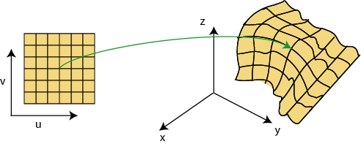
Basic Differential Geometry (1/2)
A surface can be parametrized as a mapping from two independent parameters (u,v) to the space in which the surface will be embedded

Slide 4
Basic Differential Geometry (2/2)
For our purposes this means that we need to supply three functions, each depending on (u,v), in order to specify the position of a point on our surface.
The Matlab functions mesh, surf, and their relations will take matrices x(i,j), y(i,j), and z(i,j).

Slide 5
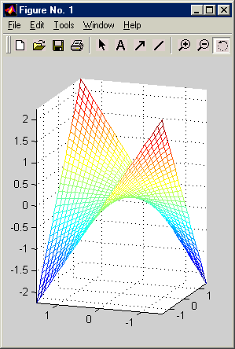
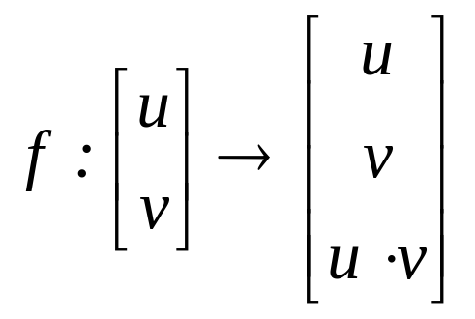
Parametrizing Surfaces: Hyperbolic Paraboloid
An example of a ‘simple’, ‘single-valued’ function
The parametrization is:

Slide 6
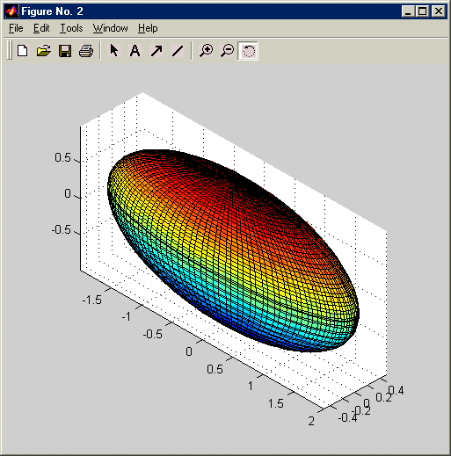
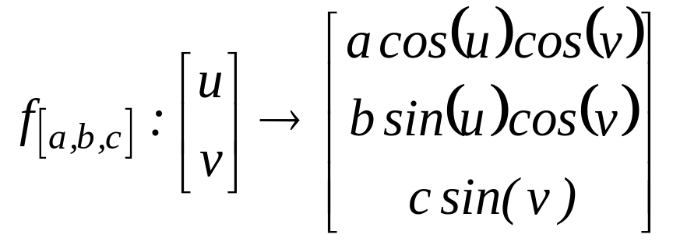
Parametrizing Surfaces: Ellipsoid
The surface we
wish to model
The parametrization is:

Slide 7
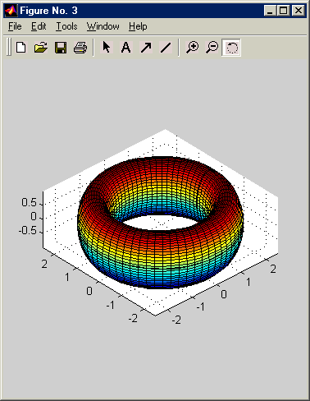
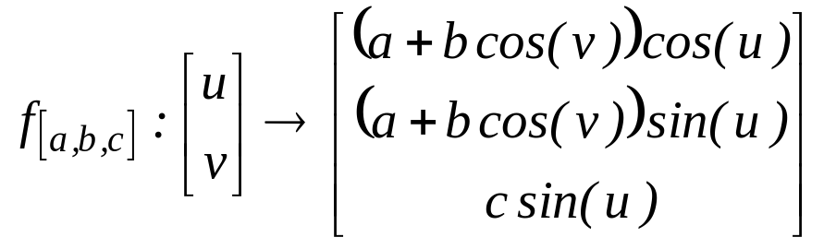
Parametrizing Surfaces:
Torus
Even surfaces with ‘holes’ (umh… doughnuts)
The parametrization for a torus is:

Slide 8
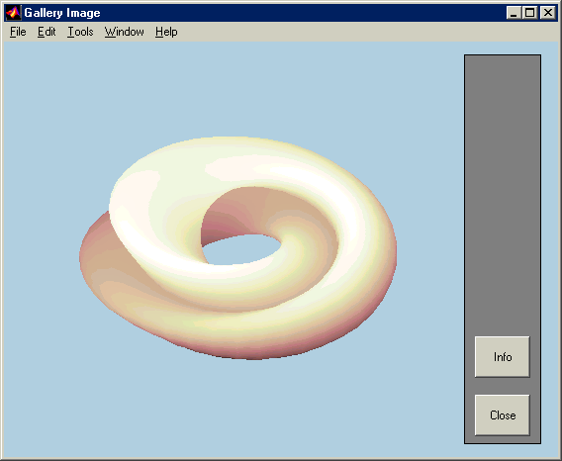
Parametrizing Surfaces:
Klein Bottle

Slide 9
Customizing the look and feel (1/3)
Ordinarily the mesh or surf plots are not too attractive
Common modifications are:
  FaceLighting – changes how the surface is rendered when a light source is added (none,flat,gourad,phong)
  FaceColor – color of each patch
  light(‘Position’,[x,y,z],’style’,’infinite’)
  material <property> (dull, shiny, metal)

Slide 10
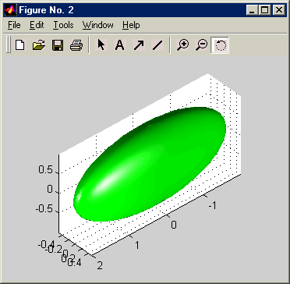
Customizing the look and feel (2/3)
a = 2;
b = 0.5;
c = 1;
u = 0:0.1:2*pi+0.1;
v = 0:0.1:2*pi+0.1;
for i = 1:1:max(size(u))
for j = 1:1:max(size(v))
x(i,j) = a * cos(u(i)) * cos(v(j));
y(i,j) = b * sin(u(i)) * cos(v(j));
z(i,j) = c * sin(v(j));
end
end
figure(2)
surf(x,y,z,'FaceColor','green','EdgeColor','none','FaceLighting','phong');
light('Position',[1,0,0],'style','infinite');
light('Position',[0,1,0],'style','infinite');
material shiny;
axis equal;

Slide 11
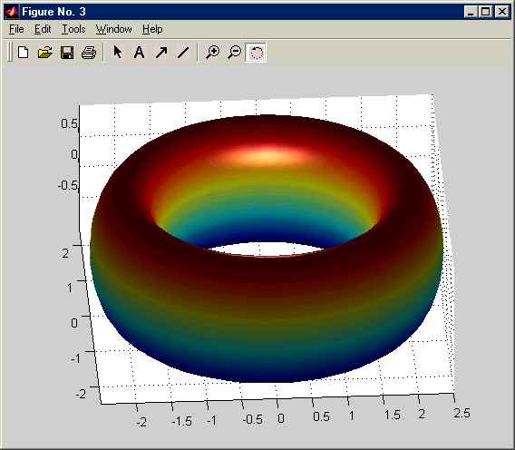
Customizing the look and feel (3/3)
a = 2;
b = 0.5;
c = 1;
u = 0:0.1:2*pi+0.1;
v = 0:0.1:2*pi+0.1;
for i = 1:1:max(size(u))
for j = 1:1:max(size(v))
x(i,j) = ( a + b * cos(v(j)) ) * cos(u(i));
y(i,j) = ( a + b * cos(v(j)) ) * sin(u(i));
z(i,j) = c * sin(v(j));
end
end
figure(3)
surf(x,y,z,'FaceLighting','phong','FaceColor','interp','EdgeColor','none');
light('Position',[0,0,1],'style','local');
material metal
axis equal;

Slide 12
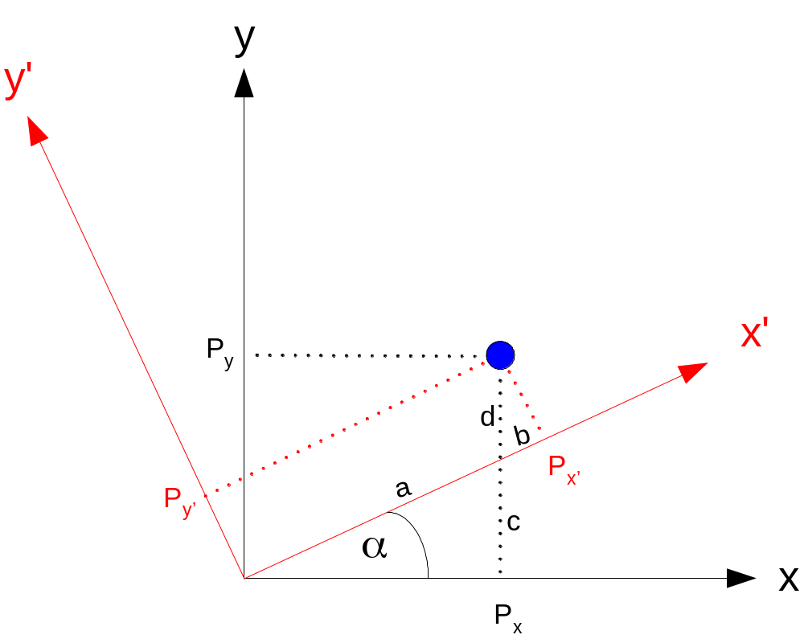
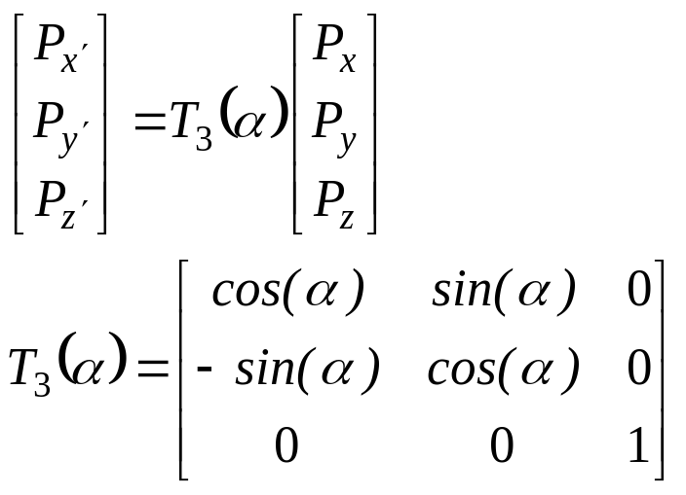
Orienting the Ellipsoid (1/2)

Slide 13
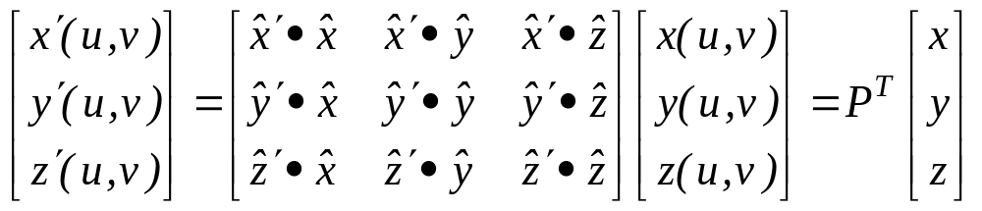
Orienting the Ellipsoid (2/2)
Assume the covariance matrix, M, is given
Then [P,Q] = eig(M) (Matlab call) gives
  P – matrix of eigenvectors of M, column-wise
  Q – diagonal matrix of eigenvectors of M

