Slide 1
Maxima My Way
Conrad Schiff
Last revision – 12/14/12

Slide 2
References
[1]: http://www.ma.utexas.edu/maxima (specific sub-pages referenced when cited)
[2]: Foundations of Electromagnetic Theory – Reitz, Milford, & Christie
[3]: Lectures on Electromagnetic Theory - Solymar
[4]: Maxwell’s Equations – wikipedia.org http://en.wikipedia.org/wiki/Maxwell_Equations
[5]: Nonlinear optics – wikipedia.org http://en.wikipedia.org/wiki/Nonlinear_optics#Wave-equation_in_a_nonlinear_material
[6]: Nonlinear magnetic materials – wikipedia.org http://en.wikipedia.org/wiki/Permeability_(electromagnetism)
[7]: Google search on ‘nonlinear electrical conductivity’

Slide 3
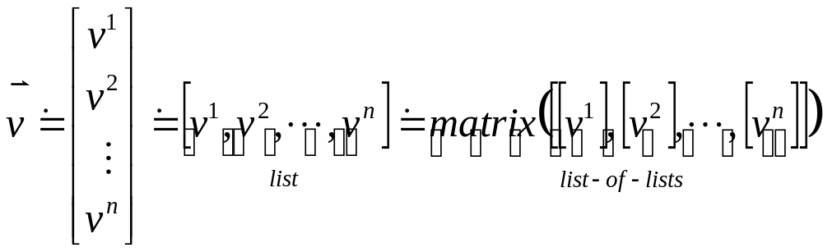
General Strategy (1/2)
Use lists to represent arrays of objects
  Real numbers – time series, statistical data, etc.
  Expressions – vector fields, etc.
Use the matrix function to provide the usual multiplication
The need here is to convert between lists and list-of-lists
  since always typing and representing a list of
  numbers/expressions as a list-of-lists is cumbersome

Slide 4
General Strategy (2/2)
Lisp notation and ‘head-changing’ functions make this easy
Use the matrix function to provide the usual multiplication
The need here is to convert between lists and list-of-lists
  since always typing and representing a list of
  numbers/expressions as a list-of-lists is cumbersome

Slide 5
Data Types
Maxima seems to support 4 data types out of the box [1]/maxima_36.html
  Arrays
  Hash tables
  Lists
  Numbers
Lists are the basic building blocks for maxima (and lisp) [1]/maxima_36.html
Other, arbitrary data types are built by ‘changing the head’

Slide 6
Lists

Slide 7
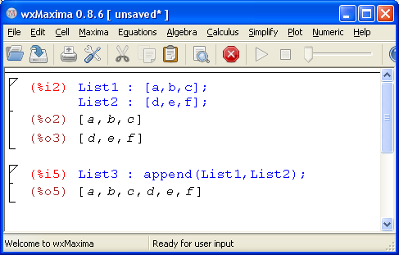
Functions for Lists
append – returns a single list from several

Slide 8
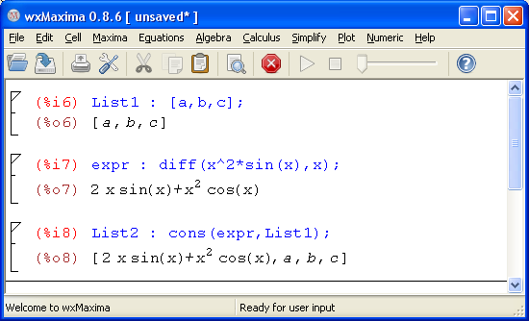
Functions for Lists
cons – constructs a new list from a expr and a list by pushing the expression onto the front of the list

Slide 9
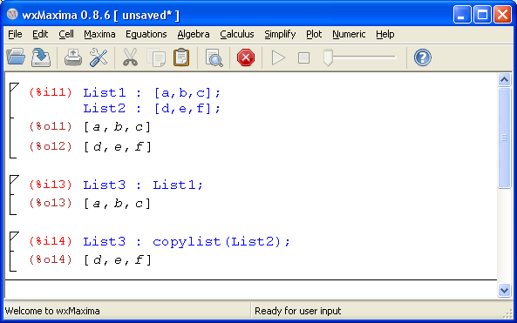
Functions for Lists
copylist – creates a copy of a list
It seems that the assignment operator ‘:’ is functionally equivalent on lists as ‘copylist’

Slide 10
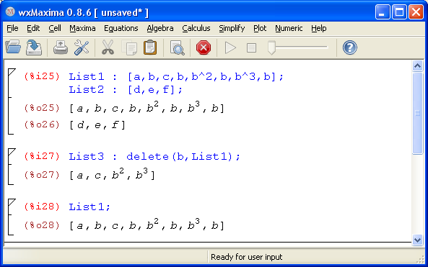
Functions for Lists
delete - removes all occurrences of <expr> from a list

Slide 11
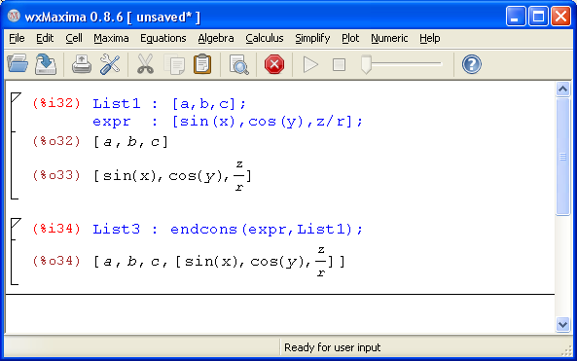
Functions for Lists
endcons – constructs a new list from a expr and a list by pushing the expression onto the back of the list

Slide 12
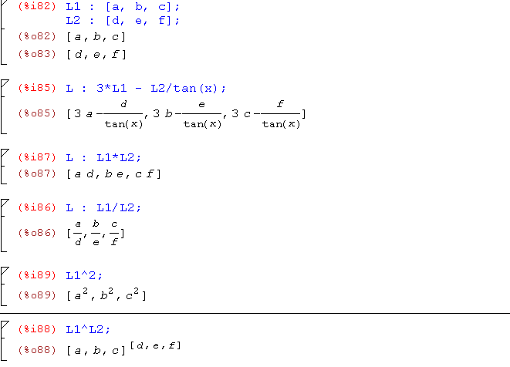
List Operators
‘+’, ‘-’, ‘*’, ‘/’ add, subtract, multiply, and divide lists element-by-element (lists must be the same size)
Scalars work as if they multiply a list [1,1,…,1] of the correct size
Exponentiation works differently (see last two lines below)

