Slide 1
Why Don’t We Teach the Helmholtz Theorem
Conrad Schiff
Chesapeake Chapter of AAPT
10/25/2014

Slide 2
Spirit of the Talk
My question isn’t philosophical
I’m not Socrates and none of you are Euthyphro
It’s meant to open or reopen a dialog
Full Disclosure
I’m not an educator
I’m not an expert in Electromagnetism
I was (and perhaps am) a student who finds the way we commonly teach E&M inadequate
My aim is to make E&M more dynamic both literally and pedagogically

Slide 3
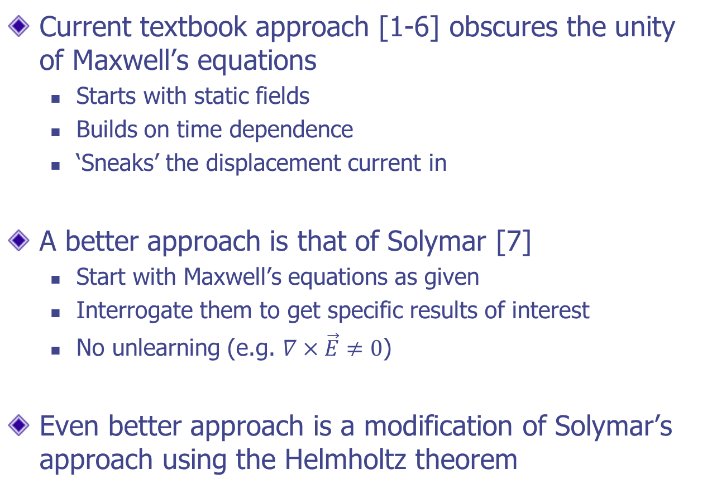
Outline
Current textbook approach [1-6] obscures the unity of Maxwell’s equations
Starts with static fields
Builds on time dependence
‘Sneaks’ the displacement current in
A better approach is that of Solymar [7]
Start with Maxwell’s equations as given
Interrogate them to get specific results of interest
No unlearning (e.g. $∇×\vec{E}≠0$)
Even better approach is a modification of Solymar’s approach using the Helmholtz theorem

Slide 4
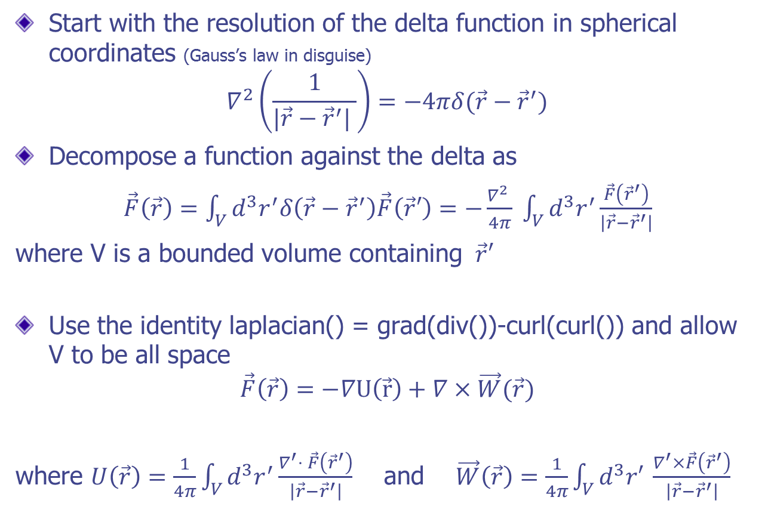
Helmholtz Theorem [8-10]
Start with the resolution of the delta function in spherical coordinates (Gauss’s law in disguise)
$$∇^{2}\left(\frac{1}{|\vec{r}−{\vec{r}}^{′}| }\right)=−4πδ(\vec{r}−{\vec{r}}^{′})$$
Decompose a function against the delta as
$\vec{F}\left(\vec{r}\right)=\int_{V}{d^{3}r^{′}δ\left(\vec{r}−{\vec{r}}^{′}\right)\vec{F}\left(\vec{r}′\right)}=−\frac{∇^{2} }{4π} \int_{V}{d^{3}r^{′}\frac{\vec{F}\left({\vec{r}}^{′}\right)}{\left|\vec{r}−{\vec{r}}^{′}\right|}}$
where V is a bounded volume containing $\vec{r}′$
Use the identity laplacian() = grad(div())-curl(curl()) and allow V to be all space
$$\vec{F}\left(\vec{r}\right)=−∇U\left(\vec{r}\right)+∇×\vec{W}(\vec{r})$$
where $U\left(\vec{r}\right)=\frac{1}{4π}\int_{V}{d^{3}r^{′}}\frac{∇^{′}⋅ \vec{F}\left({\vec{r}}^{′}\right)}{\left|\vec{r}−{\vec{r}}^{′}\right|}$ and $\vec{W}\left(\vec{r}\right)=\frac{1}{4π}\int_{V}{d^{3}r′ }\frac{∇^{′}×\vec{F}\left({\vec{r}}^{′}\right)}{\left|\vec{r}−{\vec{r}}^{′}\right|}$

Slide 5
Pedagogical Advantages
From the structure of the theorem the divergence and curl is sufficient to specify the field
Justifies why Maxwell’s equations deal only with div() and curl() (no symmetric, traceless derivative)
Contrasts with ‘ordinary functions’ that need a constant of integration
Early exposure to the delta-function
Introduces a Green function early on in a meaningful way
Breaks what I call the ‘tyranny of analytic functions’ – Penrose’s ‘message driven economy’ [11]
Derivation of Coulomb’s and Biot-Savart’s laws
These ‘laws’ fall out simply (see following slide)
No special symmetry, no idealized cases, no hand-waving

Slide 6
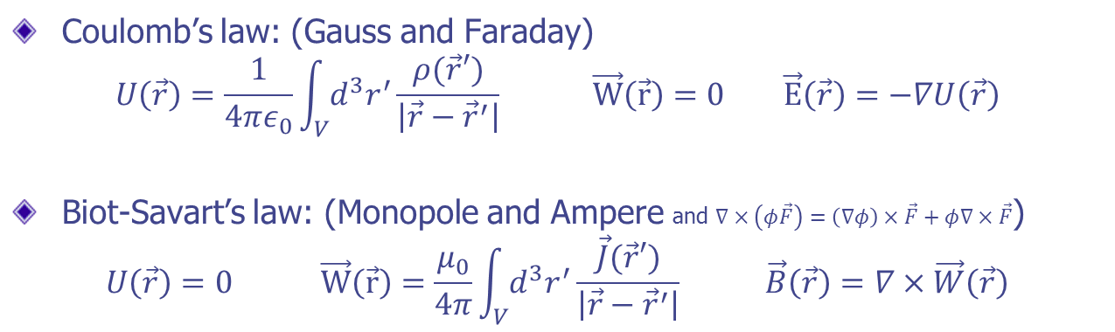
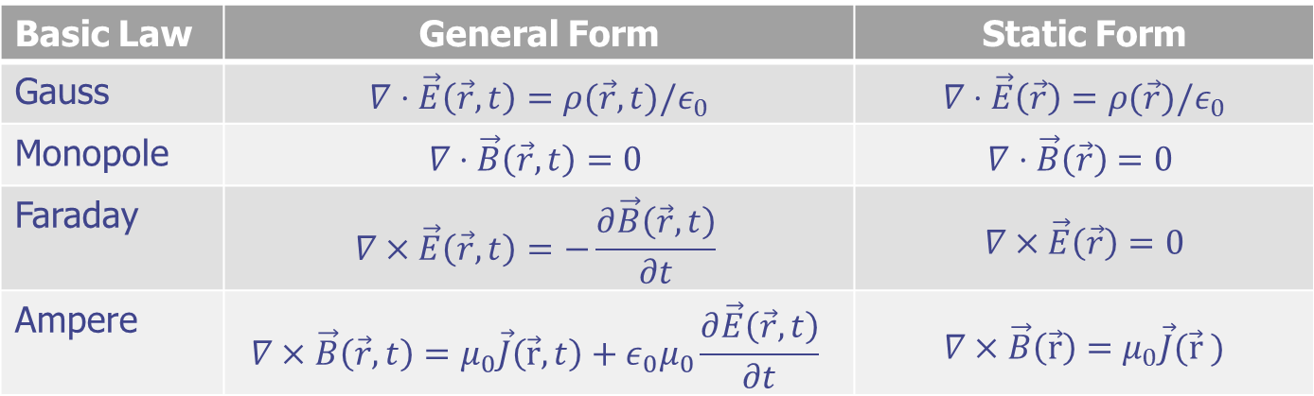
Maxwell’s Equations (mks units)
Basic Law | General Form | Static Form
Gauss | $$∇⋅\vec{E}\left(\vec{r},t\right)=ρ(\vec{r},t)/ε_{0}$$ | $$∇⋅\vec{E}\left(\vec{r}\right)=ρ(\vec{r})/ε_{0}$$
Monopole | $$∇⋅\vec{B}\left(\vec{r},t\right)=0$$ | $$∇⋅\vec{B}\left(\vec{r}\right)=0$$
Faraday | $$∇×\vec{E}\left(\vec{r},t\right)=−\frac{∂\vec{B}\left(\vec{r},t\right)}{∂t}$$ | $$∇×\vec{E}\left(\vec{r}\right)=0$$
Ampere | $$∇×\vec{B}\left(\vec{r},t\right)=μ_{0}\vec{J}\left(\vec{r},t\right)+ε_{0}μ_{0}\frac{∂\vec{E}\left(\vec{r},t\right)}{∂t}$$ | $$∇×\vec{B}\left(\vec{r}\right)=μ_{0}\vec{J}(\vec{r} )$$
Coulomb’s law: (Gauss and Faraday)
$$U\left(\vec{r}\right)=\frac{1}{4πε_{0}}\int_{V}{d^{3}r^{′}}\frac{ρ(\vec{r}′)}{\left|\vec{r}−{\vec{r}}^{′}\right|} \vec{W}\left(\vec{r}\right)=0 \vec{E}\left(\vec{r}\right)=−∇U\left(\vec{r}\right)$$
Biot-Savart’s law: (Monopole and Ampere and $∇×\left(φ\vec{F}\right)=\left(∇φ\right)×\vec{F}+φ∇×\vec{F}$)
$$U\left(\vec{r}\right)=0 \vec{W}\left(\vec{r}\right)=\frac{μ_{0}}{4π}\int_{V}{d^{3}r^{′}}\frac{\vec{J}(\vec{r}′)}{\left|\vec{r}−{\vec{r}}^{′}\right|} \vec{B}\left(\vec{r}\right)=∇×\vec{W}\left(\vec{r}\right)$$

Slide 7
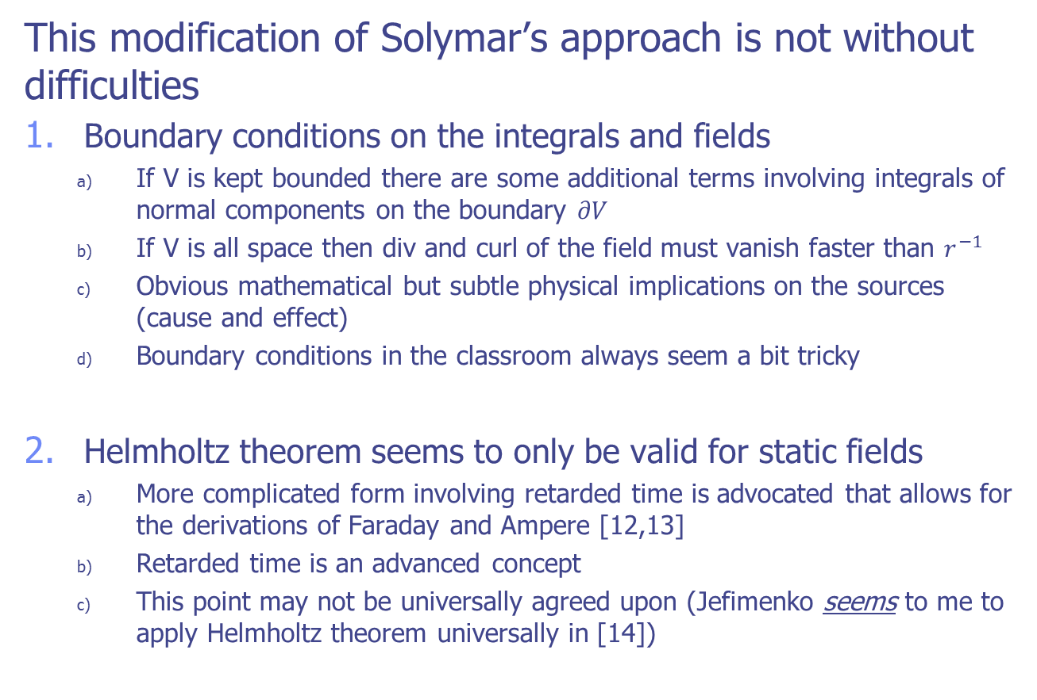
Critique
This modification of Solymar’s approach is not without difficulties
Boundary conditions on the integrals and fields
If V is kept bounded there are some additional terms involving integrals of normal components on the boundary $∂V$
If V is all space then div and curl of the field must vanish faster than $r^{−1}$
Obvious mathematical but subtle physical implications on the sources (cause and effect)
Boundary conditions in the classroom always seem a bit tricky
Helmholtz theorem seems to only be valid for static fields
More complicated form involving retarded time is advocated that allows for the derivations of Faraday and Ampere [12,13]
Retarded time is an advanced concept
This point may not be universally agreed upon (Jefimenko seems to me to apply Helmholtz theorem universally in [14])

Slide 8
Thanks for Your Attention

Slide 9
References
[1]: Physics, Parts 1& 2 Combined – Halliday & Resnick
[2]: Foundations of Electromagnetic Theory – Reitz, Milford, & Christie
[3]: Classical Electrodynamics - Jackson
[4]: Electromagnetic Theory – Frankl
[5]: Electromagnetism – Slater & Frank
[6]: Intro. to Electrodynamics – Griffiths
[7]: Lectures on Electromagnetic Theory – Solymar
[8]: Mathematical Methods for Physicists – Afken
[9]: Miller, Am. J. Phys 52, 948 (1984)
[10]: Mirman, Am. J. Phys 33, 503 (1965)
[11]: The Road to Reality – Penrose
[12]: Davis, Am. J. Phys 74, 72 (2006)
[13]: Hera, Am. J. Phys 74, 743 (2006)
[14]: Causality, Electromagnetic Induction, and Gravitation - Jefimenko

