Slide 1
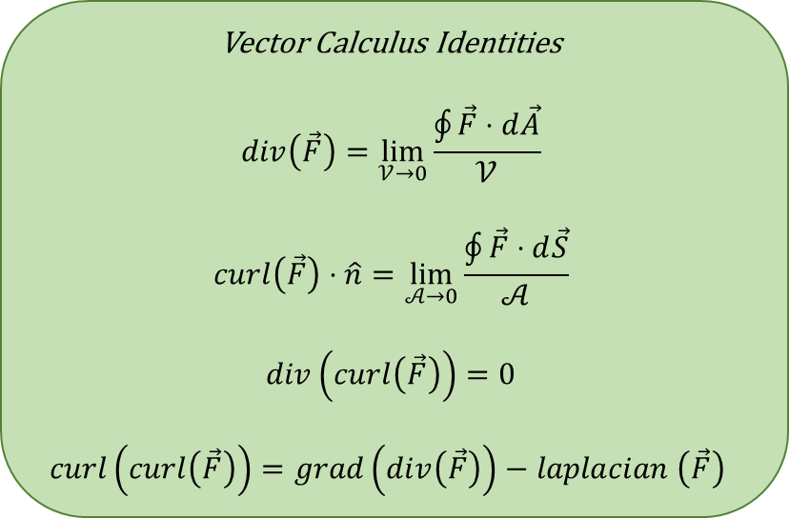
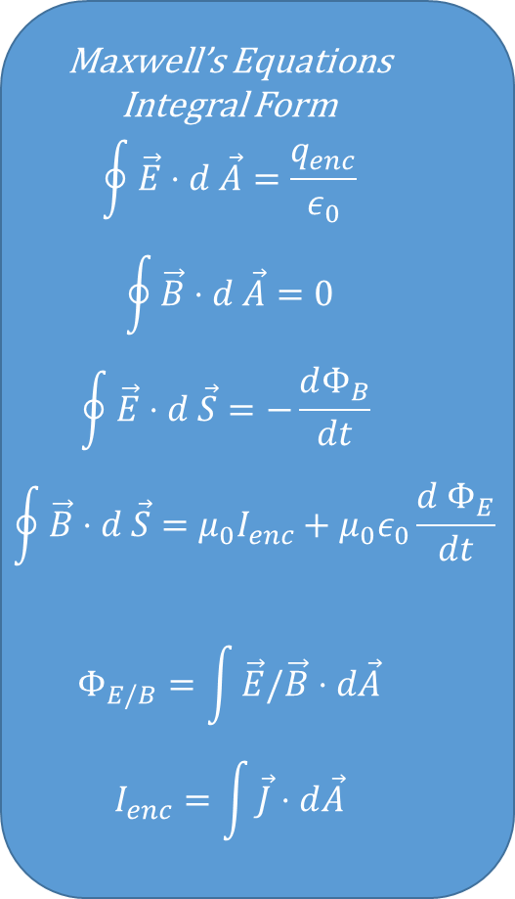
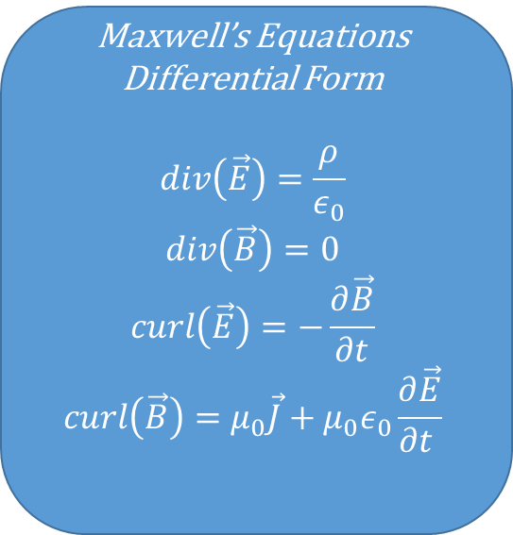
Maxwell’s Equations Integral Form
$$\oint{\vec{E}⋅d \vec{A}}=\frac{q_{enc}}{ε_{0}}$$
$$\oint{\vec{B}⋅d \vec{A}=0}$$
$$\oint{\vec{E}⋅d \vec{S}=−\frac{dΦ_{B}}{dt} }$$
$$\oint{\vec{B}⋅d \vec{S}=μ_{0}I_{enc}+μ_{0}ε_{0}\frac{d Φ_{E}}{dt}}$$
$$Φ_{E/B}=\int{\vec{E}/\vec{B}⋅d\vec{A}}$$
$$I_{enc}=\int{\vec{J}⋅d\vec{A}}$$
Maxwell’s Equations Differential Form
$$div\left(\vec{E}\right)=\frac{ρ}{ε_{0}}$$
$$div\left(\vec{B}\right)=0$$
$$curl\left(\vec{E}\right)=−\frac{∂\vec{B}}{∂t}$$
$$curl\left(\vec{B}\right)=μ_{0}\vec{J}+μ_{0}ε_{0}\frac{∂\vec{E}}{∂t }$$
Vector Calculus Identities
$$div\left(\vec{F}\right)=\lim_{𝒱→0}{\frac{\oint{\vec{F}⋅d\vec{A}}}{𝒱}}$$
$$curl\left(\vec{F}\right)⋅\hat{n}=\lim_{𝒜→0}{\frac{\oint{\vec{F}⋅d\vec{S}}}{𝒜}}$$
$$div\left(curl\left(\vec{F}\right)\right)=0$$
$$curl\left(curl\left(\vec{F}\right)\right)=grad\left(div\left(\vec{F}\right)\right)−laplacian \left(\vec{F}\right)$$

