Slide 1
Particle Physics
Conrad Schiff
Notes:
Presentation slide for courses, classes, lectures et al.

Slide 2
Run Thru of Griffiths

Slide 3
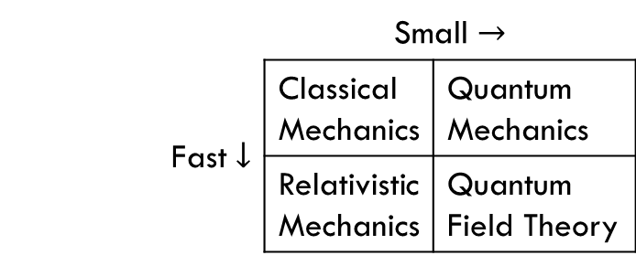
Introduction (1/4)
Elementary Particle Physics (EPP)
Addresses what matter is made of
Deals with indistinguishable particles – e.g. all electrons are the same
Discovers their interactions
Scattering experiments
Decay observations
Investigations of bound states
Models of physics
 | Small $→$
Fast $↓$ | Classical Mechanics | Quantum Mechanics
 | Relativistic Mechanics | Quantum Field Theory

Slide 4
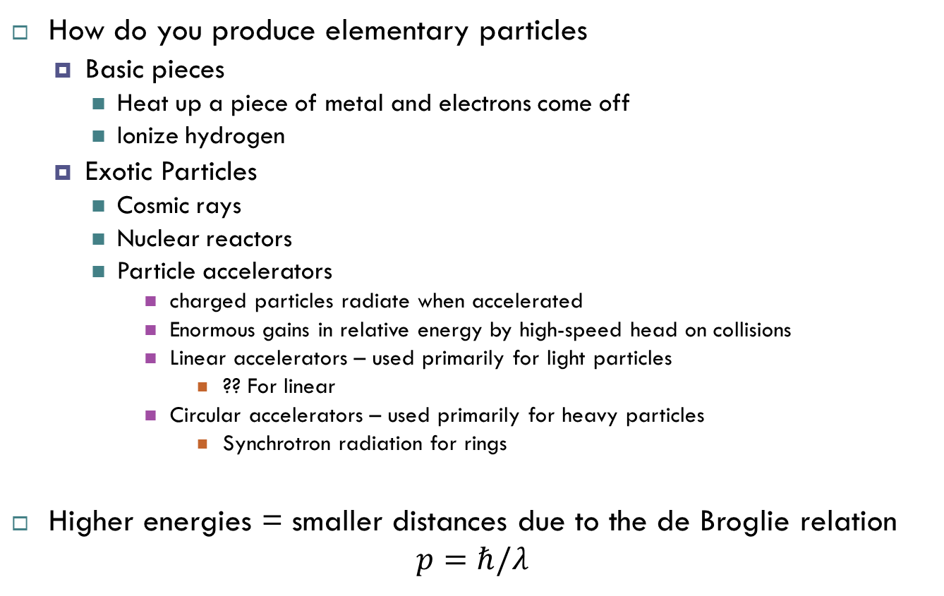
Introduction (2/4)
How do you produce elementary particles
Basic pieces
Heat up a piece of metal and electrons come off
Ionize hydrogen
Exotic Particles
Cosmic rays
Nuclear reactors
Particle accelerators
charged particles radiate when accelerated
Enormous gains in relative energy by high-speed head on collisions
Linear accelerators – used primarily for light particles
?? For linear
Circular accelerators – used primarily for heavy particles
Synchrotron radiation for rings
Higher energies = smaller distances due to the de Broglie relation
$$p=ℏ/λ$$

Slide 5
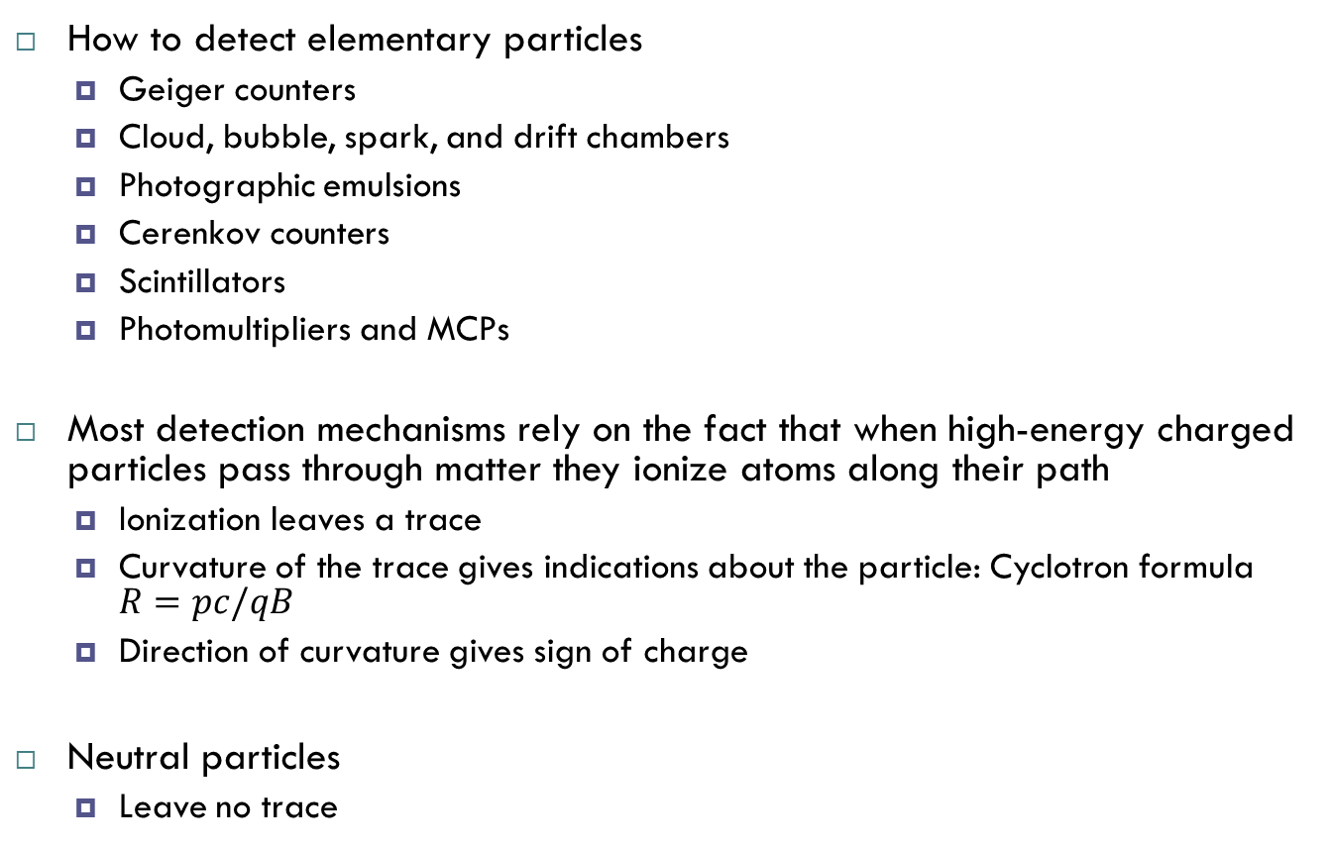
Introduction (3/4)
How to detect elementary particles
Geiger counters
Cloud, bubble, spark, and drift chambers
Photographic emulsions
Cerenkov counters
Scintillators
Photomultipliers and MCPs
Most detection mechanisms rely on the fact that when high-energy charged particles pass through matter they ionize atoms along their path
Ionization leaves a trace
Curvature of the trace gives indications about the particle: Cyclotron formula $R=pc/qB$
Direction of curvature gives sign of charge
Neutral particles
Leave no trace

Slide 6
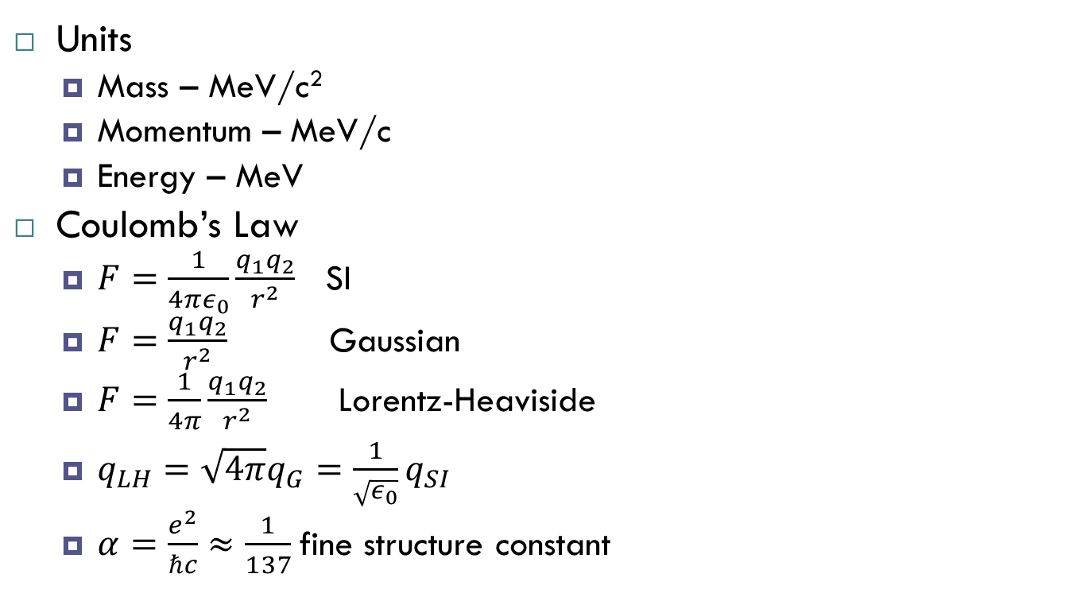
Introduction (4/4)
Units
Mass – MeV/c²
Momentum – MeV/c
Energy – MeV
Coulomb’s Law
$F=\frac{1}{4πε_{0}}\frac{q_{1}q_{2}}{r^{2}}$ SI
$F=\frac{q_{1}q_{2}}{r^{2}}$ Gaussian
$F=\frac{1}{4π}\frac{q_{1}q_{2}}{r^{2}}$ Lorentz-Heaviside
$q_{LH}=\sqrt{4π}q_{G}=\frac{1}{\sqrt{ε_{0}}}q_{SI}$
$α=\frac{e^{2}}{ℏc}≈\frac{1}{137}$fine structure constant

Slide 7

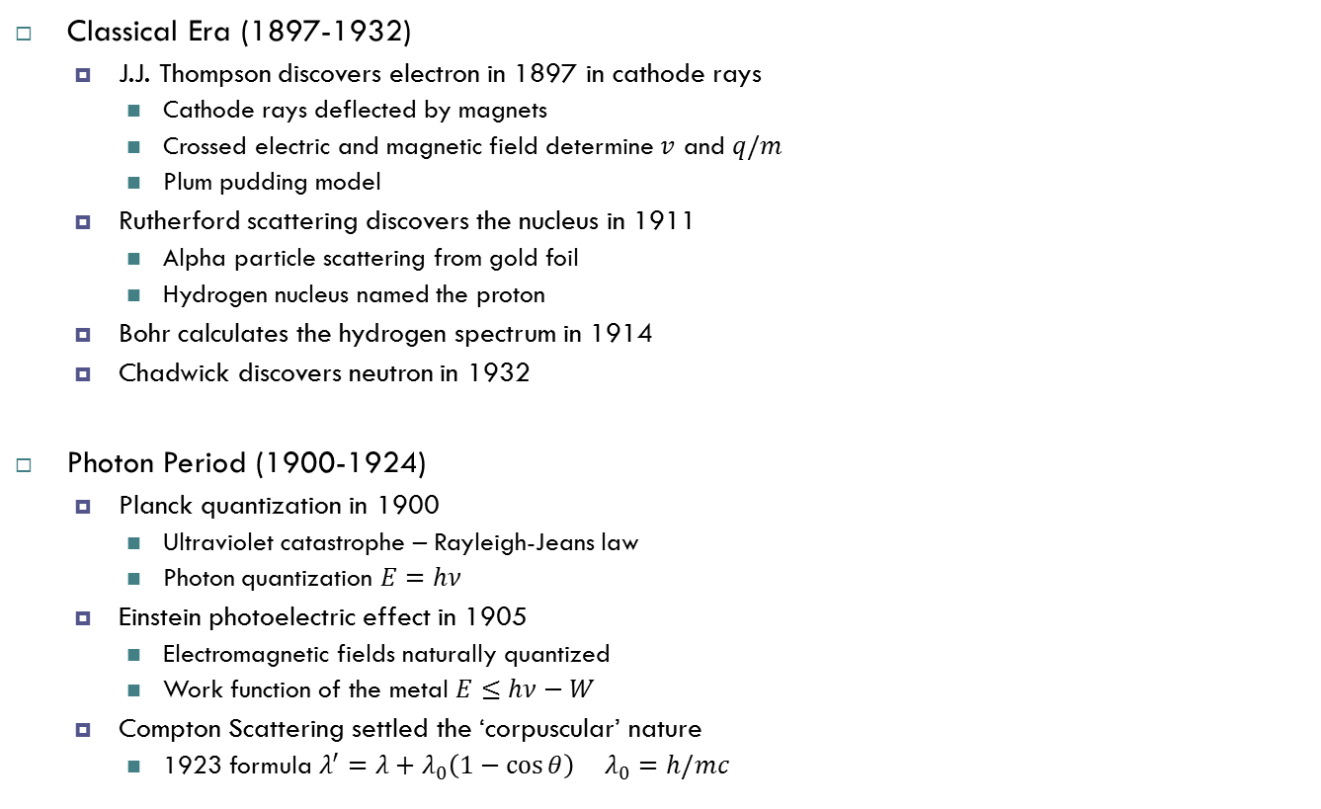


Chapter 1- Early Period (1/7)
Classical Era (1897-1932)
J.J. Thompson discovers electron in 1897 in cathode rays
Cathode rays deflected by magnets
Crossed electric and magnetic field determine $v$ and $q/m$
Plum pudding model
Rutherford scattering discovers the nucleus in 1911
Alpha particle scattering from gold foil
Hydrogen nucleus named the proton
Bohr calculates the hydrogen spectrum in 1914
Chadwick discovers neutron in 1932
Photon Period (1900-1924)
Planck quantization in 1900
Ultraviolet catastrophe – Rayleigh-Jeans law
Photon quantization $E=hν$
Einstein photoelectric effect in 1905
Electromagnetic fields naturally quantized
Work function of the metal $E≤hν−W$
Compton Scattering settled the ‘corpuscular’ nature
1923 formula $λ^{′}=λ+λ_{0}\left(1−\cos{θ}\right) λ_{0}=h/mc$
Compton Scattering
$$γ(λ)$$
e⁻
before
$$γ(λ′)$$
$$θ$$
e⁻
after

Slide 8
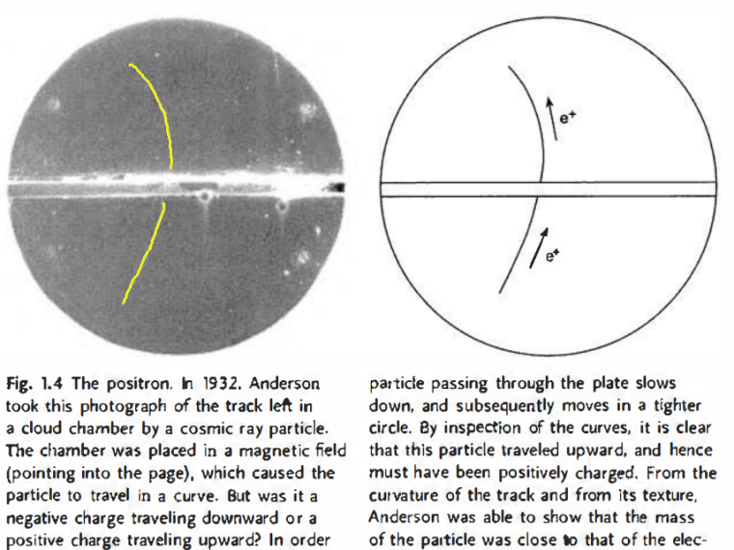
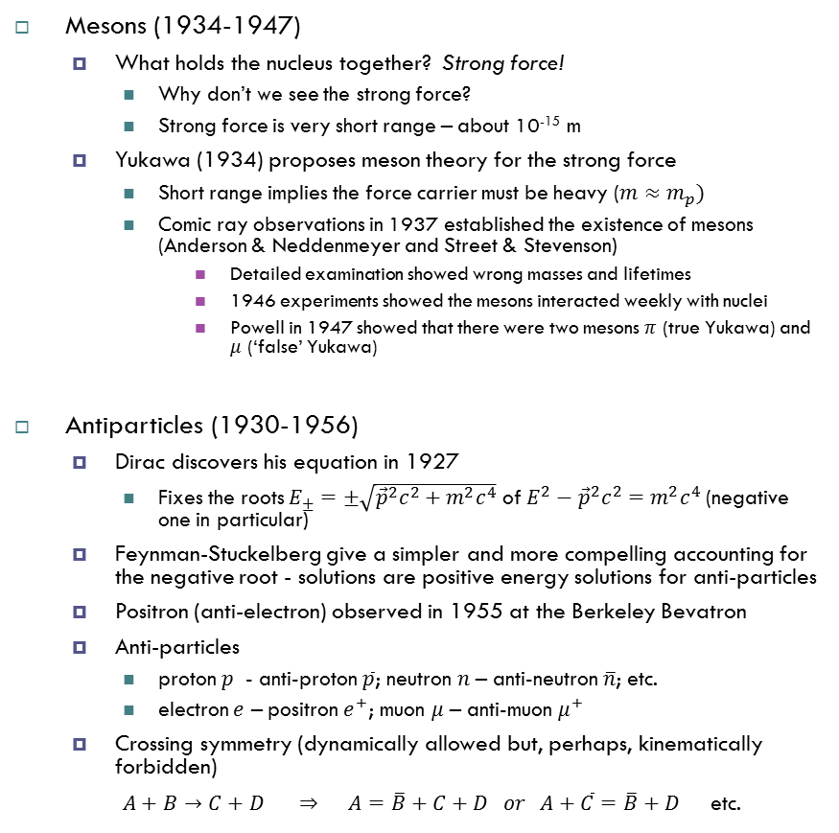
Chapter 1 – Middle Period (2/7)
Mesons (1934-1947)
What holds the nucleus together? Strong force!
Why don’t we see the strong force?
Strong force is very short range – about 10⁻¹⁵ m
Yukawa (1934) proposes meson theory for the strong force
Short range implies the force carrier must be heavy ($m≈m_{p})$
Comic ray observations in 1937 established the existence of mesons (Anderson & Neddenmeyer and Street & Stevenson)
Detailed examination showed wrong masses and lifetimes
1946 experiments showed the mesons interacted weekly with nuclei
Powell in 1947 showed that there were two mesons $π$ (true Yukawa) and $μ$ (‘false’ Yukawa)
Antiparticles (1930-1956)
Dirac discovers his equation in 1927
Fixes the roots $E_{±}=±\sqrt{{\vec{p}}^{2}c^{2}+m^{2}c^{4}}$ of $E^{2}−{\vec{p}}^{2}c^{2}=m^{2}c^{4}$ (negative one in particular)
Feynman-Stuckelberg give a simpler and more compelling accounting for the negative root - solutions are positive energy solutions for anti-particles
Positron (anti-electron) observed in 1955 at the Berkeley Bevatron
Anti-particles
proton $p$ - anti-proton $\overline{p}$; neutron $n$ – anti-neutron $\overline{n}$; etc.
electron $e$ – positron $e^{+}$; muon $μ$ – anti-muon $μ^{+}$
Crossing symmetry (dynamically allowed but, perhaps, kinematically forbidden)
$A+B→C+D ⇒ A=\overline{B}+C+D or A+\overline{C}=\overline{B}+D$ etc.

Slide 9
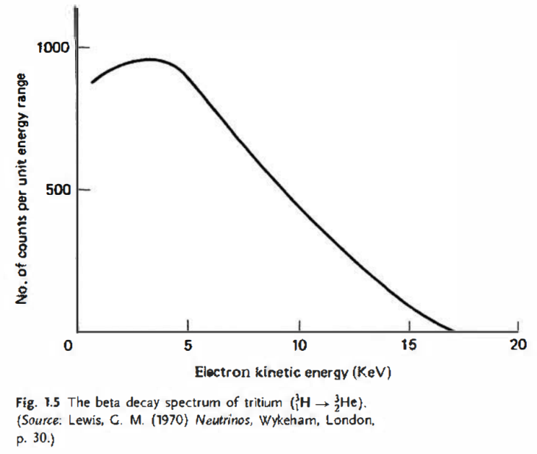
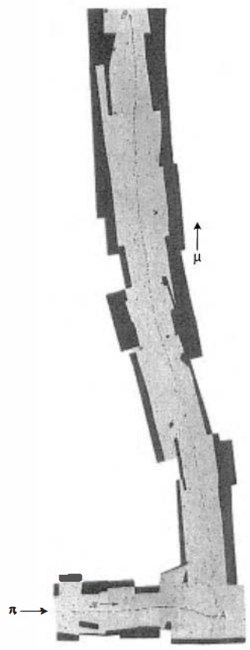

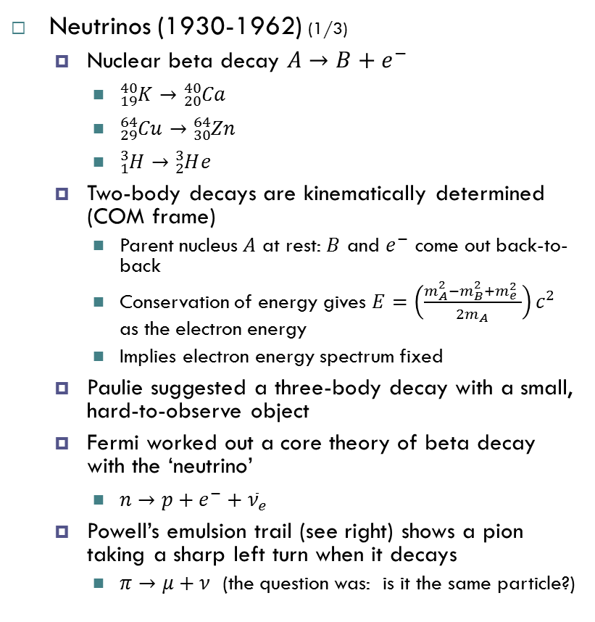


Chapter 1- Middle Period (cont’d) (3/7)
Neutrinos (1930-1962) (1/3)
Nuclear beta decay $A→B+e^{−}$
${}_{19}^{40}K→{}_{20}^{40}{Ca}$
${}_{29}^{64}{Cu}→{}_{30}^{64}{Zn}$
${}_{1}^{3}H→{}_{2}^{3}He$
Two-body decays are kinematically determined (COM frame)
Parent nucleus $A$ at rest: $B$ and $e^{−}$ come out back-to-back
Conservation of energy gives $E=\left(\frac{m_{A}^{2}−m_{B}^{2}+m_{e}^{2} }{2m_{A}}\right)c^{2}$ as the electron energy
Implies electron energy spectrum fixed
Paulie suggested a three-body decay with a small, hard-to-observe object
Fermi worked out a core theory of beta decay with the ‘neutrino’
$n→p+e^{−}+{\overline{ν}}_{e}$
Powell’s emulsion trail (see right) shows a pion taking a sharp left turn when it decays
$π→μ+ν$ (the question was: is it the same particle?)
$$π$$
$$μ$$
$$ν?$$

Slide 10
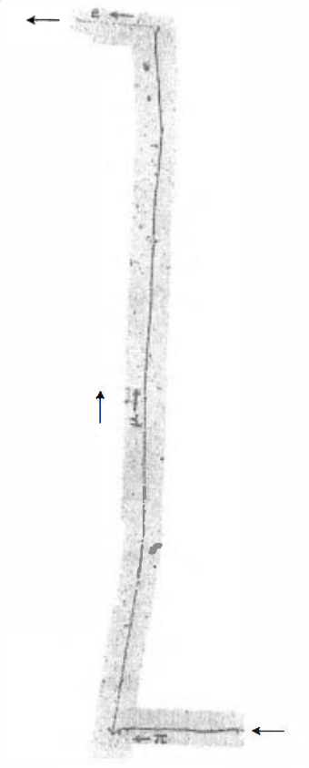


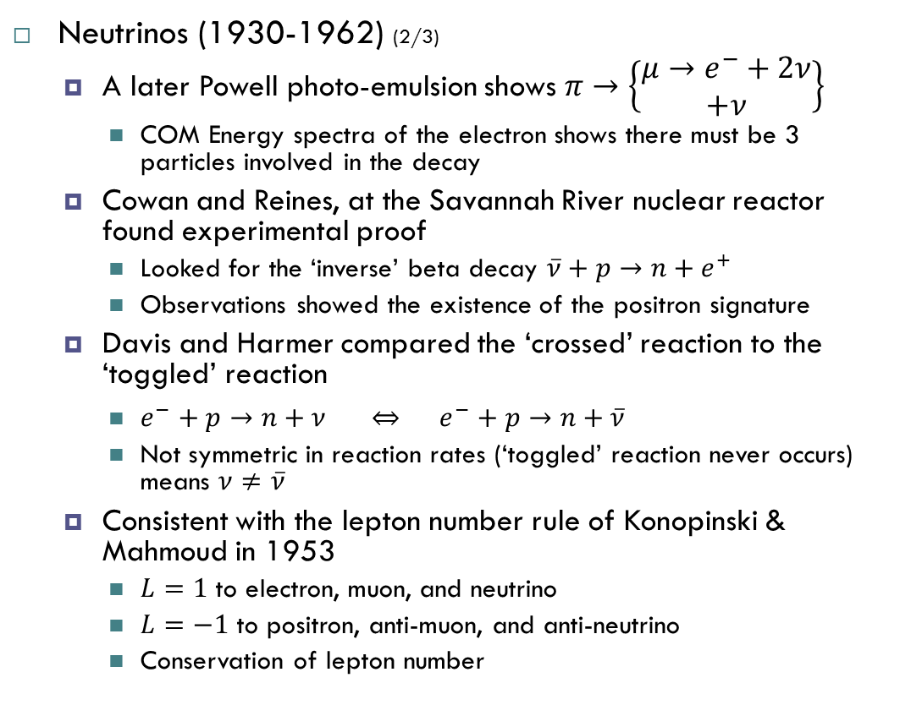



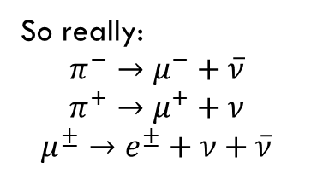
Chapter 1- Middle Period (cont’d) (4/7)
Neutrinos (1930-1962) (2/3)
A later Powell photo-emulsion shows $π→\left\{\begin{matrix}μ→e^{−}+2ν \\ +ν\end{matrix}\right\}$
COM Energy spectra of the electron shows there must be 3 particles involved in the decay
Cowan and Reines, at the Savannah River nuclear reactor found experimental proof
Looked for the ‘inverse’ beta decay $\overline{ν}+p→n+e^{+}$
Observations showed the existence of the positron signature
Davis and Harmer compared the ‘crossed’ reaction to the ‘toggled’ reaction
$e^{−}+p→n+ν ⇔ e^{−}+p→n+\overline{ν}$
Not symmetric in reaction rates (‘toggled’ reaction never occurs) means $ν≠\overline{ν}$
Consistent with the lepton number rule of Konopinski & Mahmoud in 1953
$L=1$ to electron, muon, and neutrino
$L=−1$ to positron, anti-muon, and anti-neutrino
Conservation of lepton number
$$e^{−}$$
$$2ν?$$
$$μ$$
$$π$$
$$ν?$$
So really:
$$π^{−}→μ^{−}+\overline{ν}$$
$$π^{+}→μ^{+}+ν$$
$$μ^{±}→e^{±}+ν+\overline{ν}$$

Slide 11


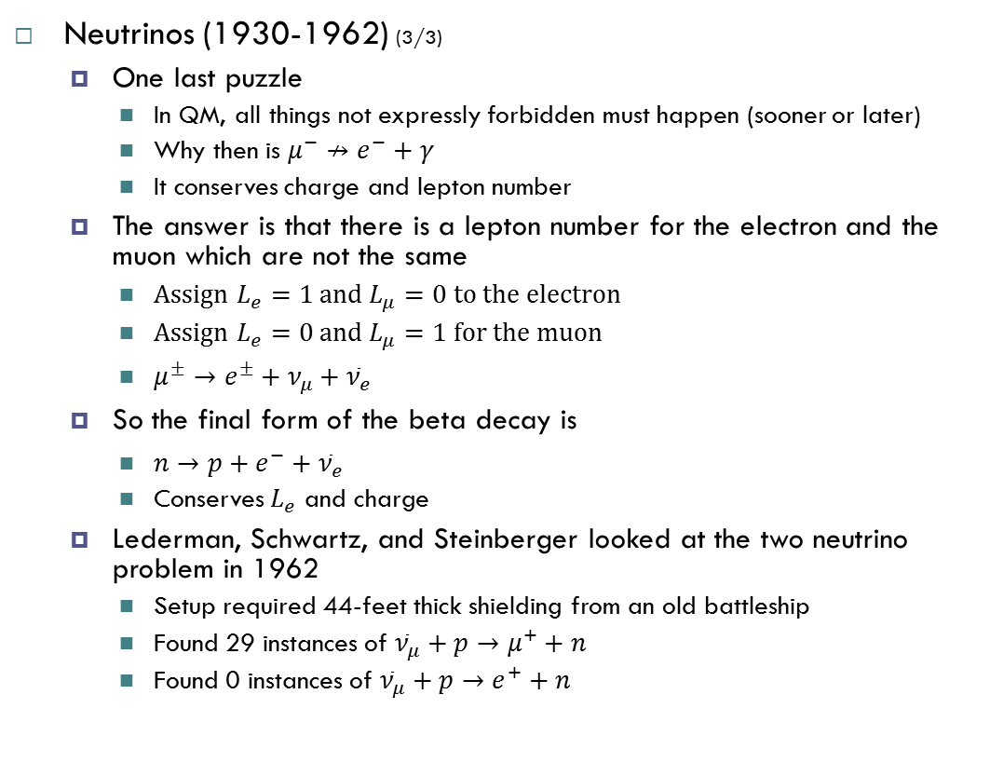
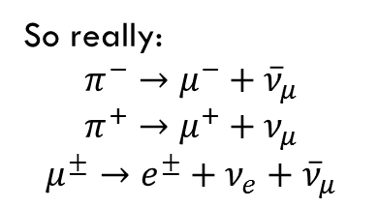
Chapter 1- Middle Period (cont’d) (5/7)
Neutrinos (1930-1962) (3/3)
One last puzzle
In QM, all things not expressly forbidden must happen (sooner or later)
Why then is $μ^{−}↛e^{−}+γ$
It conserves charge and lepton number
The answer is that there is a lepton number for the electron and the muon which are not the same
Assign $L_{e}=1$ and $L_{μ}=0$ to the electron
Assign $L_{e}=0$ and $L_{μ}=1$ for the muon
$μ^{±}→e^{±}+ν_{μ}+{\overline{ν}}_{e}$
So the final form of the beta decay is
$n→p+e^{−}+{\overline{ν}}_{e}$
Conserves $L_{e}$ and charge
Lederman, Schwartz, and Steinberger looked at the two neutrino problem in 1962
Setup required 44-feet thick shielding from an old battleship
Found 29 instances of ${\overline{ν}}_{μ}+p→μ^{+}+n$
Found 0 instances of ${\overline{ν}}_{μ}+p→e^{+}+n$
$$e^{−}$$
$$2ν$$
$$μ$$
$$π$$
$$ν$$
So really:
$$π^{−}→μ^{−}+{\overline{ν}}_{μ}$$
$$π^{+}→μ^{+}+ν_{μ}$$
$$μ^{±}→e^{±}+ν_{e}+{\overline{ν}}_{μ}$$

Slide 12
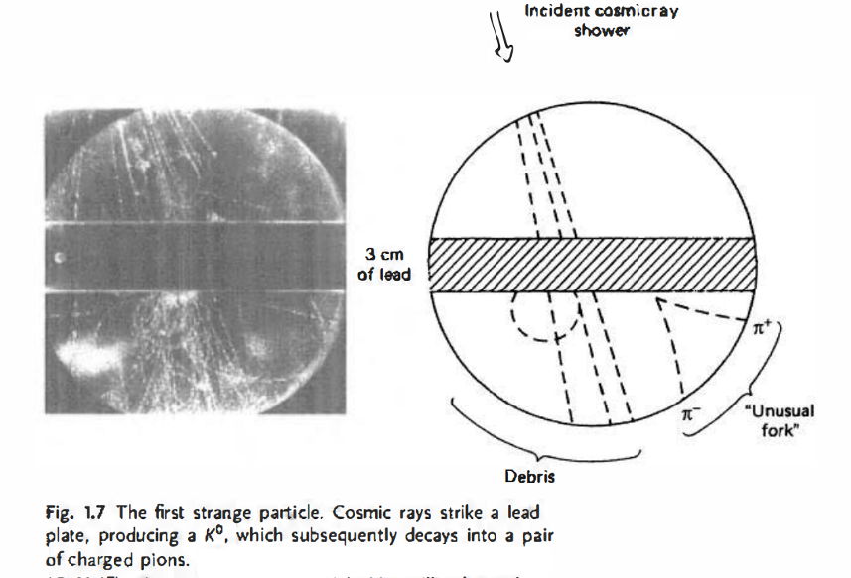
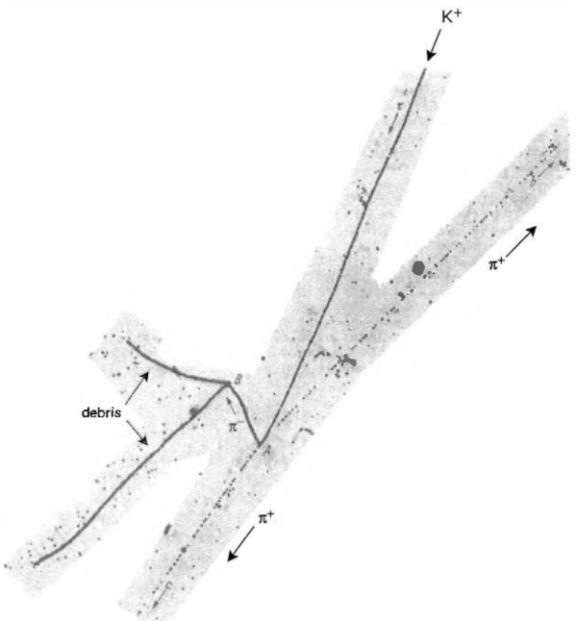
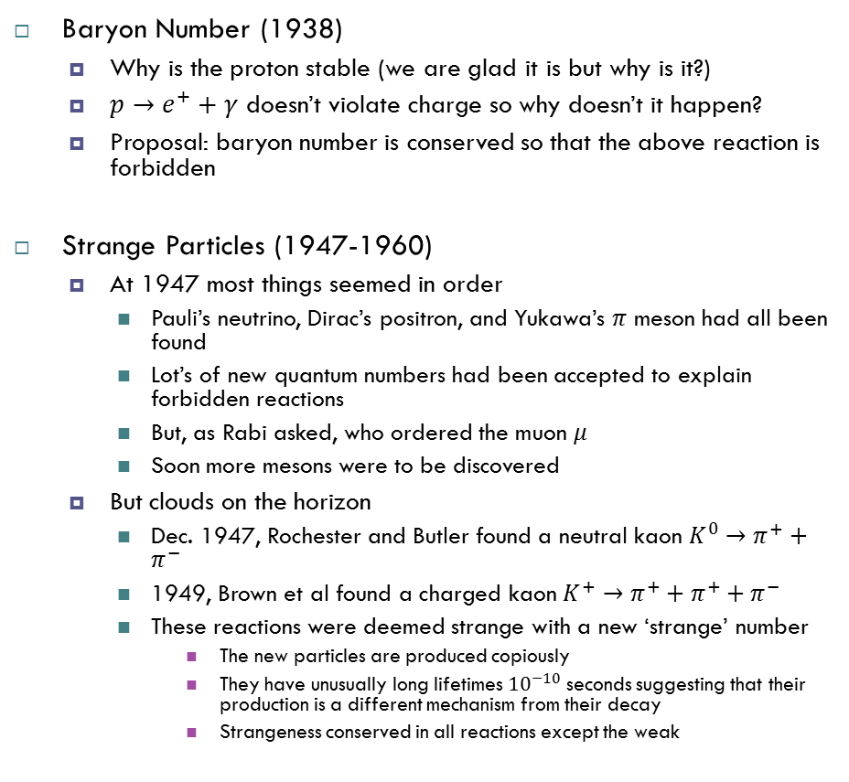
Chapter 1- Middle Period (cont’d) (6/7)
Baryon Number (1938)
Why is the proton stable (we are glad it is but why is it?)
$p→e^{+}+γ$ doesn’t violate charge so why doesn’t it happen?
Proposal: baryon number is conserved so that the above reaction is forbidden
Strange Particles (1947-1960)
At 1947 most things seemed in order
Pauli’s neutrino, Dirac’s positron, and Yukawa’s $π$ meson had all been found
Lot’s of new quantum numbers had been accepted to explain forbidden reactions
But, as Rabi asked, who ordered the muon $μ$
Soon more mesons were to be discovered
But clouds on the horizon
Dec. 1947, Rochester and Butler found a neutral kaon $K^{0}→π^{+}+π^{−}$
1949, Brown et al found a charged kaon $K^{+}→π^{+}+π^{+}+π^{−}$
These reactions were deemed strange with a new ‘strange’ number
The new particles are produced copiously
They have unusually long lifetimes ${10}^{−10}$ seconds suggesting that their production is a different mechanism from their decay
Strangeness conserved in all reactions except the weak

Slide 13


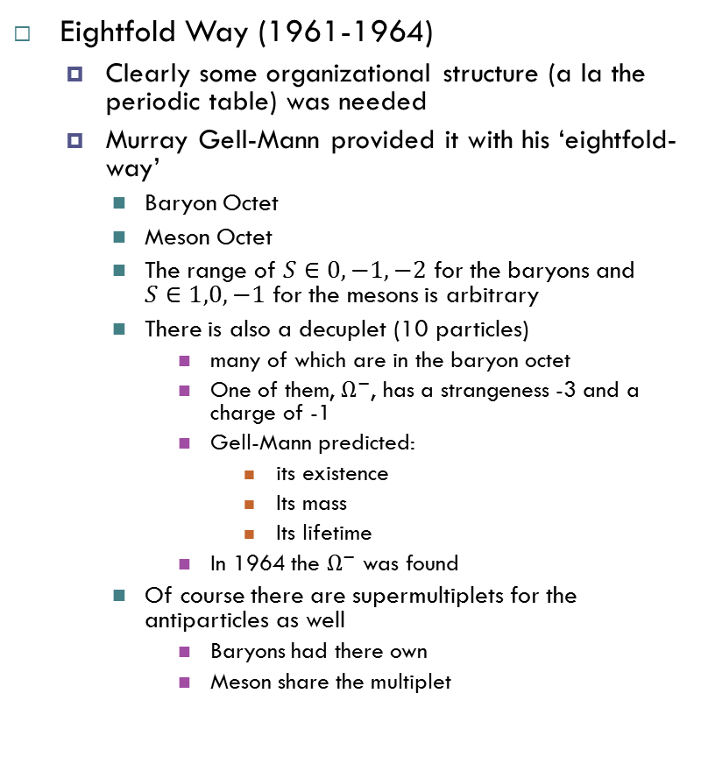




Chapter 1- Middle Period (cont’d) (7/7)
Eightfold Way (1961-1964)
Clearly some organizational structure (a la the periodic table) was needed
Murray Gell-Mann provided it with his ‘eightfold-way’
Baryon Octet
Meson Octet
The range of $S∈0,−1,−2$ for the baryons and $S∈1,0,−1$ for the mesons is arbitrary
There is also a decuplet (10 particles)
many of which are in the baryon octet
One of them, $Ω^{−}$, has a strangeness -3 and a charge of -1
Gell-Mann predicted:
its existence
Its mass
Its lifetime
In 1964 the $Ω^{−}$ was found
Of course there are supermultiplets for the antiparticles as well
Baryons had there own
Meson share the multiplet
$$S=0$$
$$n$$
$$p$$
Baryon octet
$$S=−1$$
$$Σ^{−}$$
$$Σ^{0}$$
$$Σ^{+}$$
$$Λ$$
$$S=−2$$
$$Ξ^{−}$$
$$Ξ^{0}$$
$$Q=+1$$
$$Q=−1$$
$$Q=0$$
$$S=1$$
$$K^{0}$$
$$K^{+}$$
Meson octet
$$S=0$$
$$π^{−}$$
$$π^{0}$$
$$π^{+}$$
$$η$$
$$S=−1$$
$$K^{−}$$
$${\overline{K}}^{0}$$
Precursor to the quark model
$$Q=+1$$
$$Q=−1$$
$$Q=0$$

Slide 14
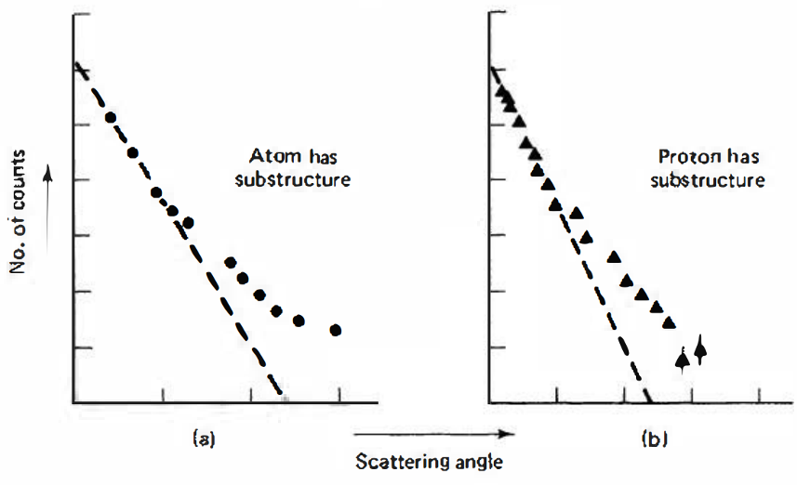
Chapter 1 - Modern Period (8/7)
Quark Model (1964)
Gell-Mann and Zweig proposed the quark model
Quarks have fractional charge
Possess a new type of charge called color
Every baryon is composed of three quarks
Every meson is composed of a quark and an anti-quark
All Eightfold Way supermultiplets are reproduced (and more)
Does require two new ways of thinking
Quark confinement
Colorless combinations
Explorations of the inner workings of the proton using so-called ‘deep inelastic scattering’ showed that most particles passed through the proton with minimal scattering while some small number bounced sharply back – the proton as a lumpy interior like the atom, as discovered in Rutherford scattering (dotted line is based on a uniform smear of charge)

Slide 15
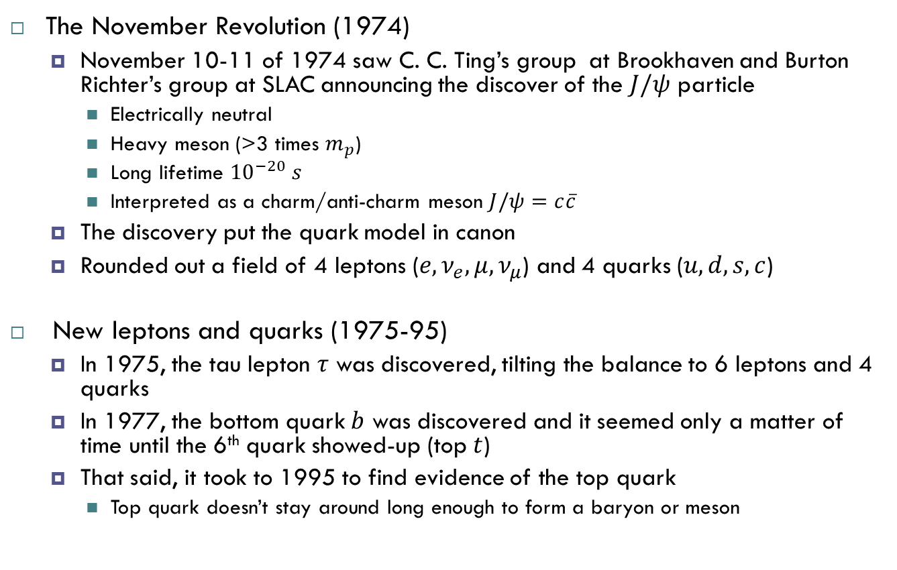
Chapter 1 - Modern Period (cont’d) (9/7)
The November Revolution (1974)
November 10-11 of 1974 saw C. C. Ting’s group at Brookhaven and Burton Richter’s group at SLAC announcing the discover of the $J/ψ$ particle
Electrically neutral
Heavy meson (>3 times $m_{p}$)
Long lifetime ${10}^{−20} s$
Interpreted as a charm/anti-charm meson $J/ψ=c\overline{c}$
The discovery put the quark model in canon
Rounded out a field of 4 leptons ($e,ν_{e},μ,ν_{μ}$) and 4 quarks ($u,d,s,c$)
New leptons and quarks (1975-95)
In 1975, the tau lepton $τ$ was discovered, tilting the balance to 6 leptons and 4 quarks
In 1977, the bottom quark $b$ was discovered and it seemed only a matter of time until the 6th quark showed-up (top $t$)
That said, it took to 1995 to find evidence of the top quark
Top quark doesn’t stay around long enough to form a baryon or meson

Slide 16
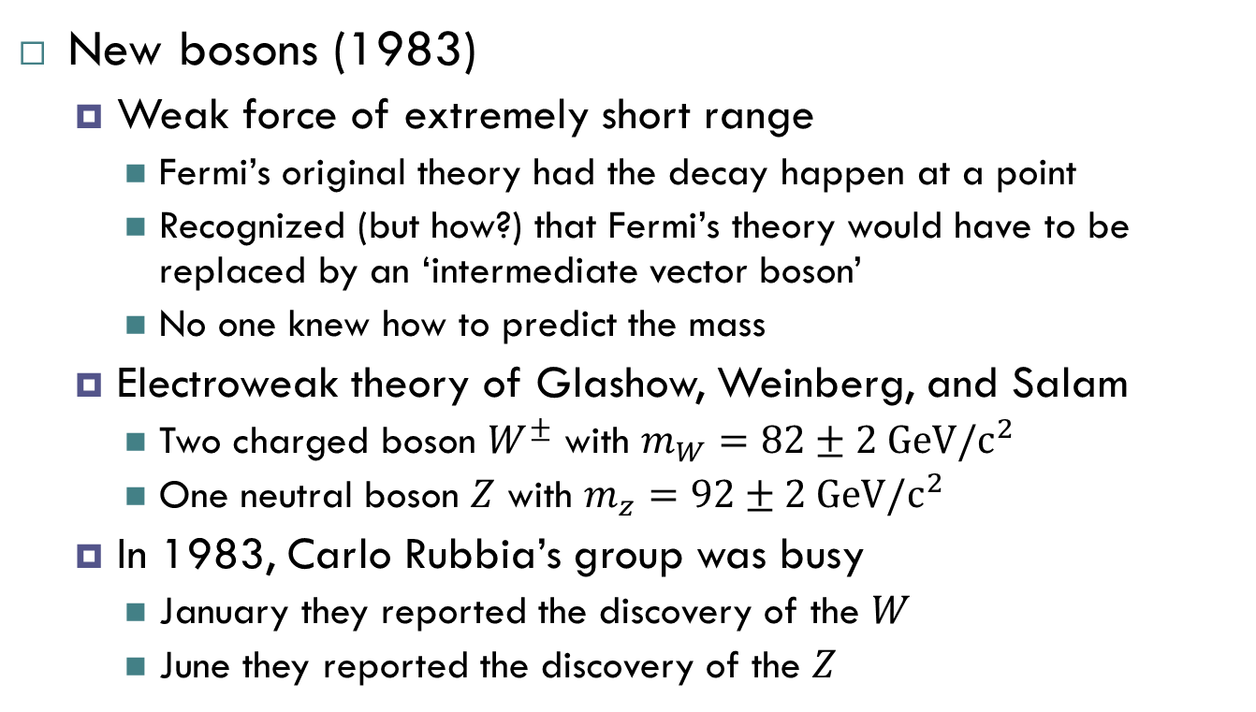
Chapter 1 - Modern Period (cont’d) (10/7)
New bosons (1983)
Weak force of extremely short range
Fermi’s original theory had the decay happen at a point
Recognized (but how?) that Fermi’s theory would have to be replaced by an ‘intermediate vector boson’
No one knew how to predict the mass
Electroweak theory of Glashow, Weinberg, and Salam
Two charged boson $W^{±}$ with $m_{W}=82±2 GeV/c^{2}$
One neutral boson $Z$ with $m_{z}=92±2 GeV/c^{2}$
In 1983, Carlo Rubbia’s group was busy
January they reported the discovery of the $W$
June they reported the discovery of the $Z$

Slide 17
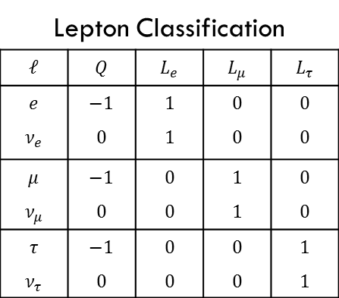
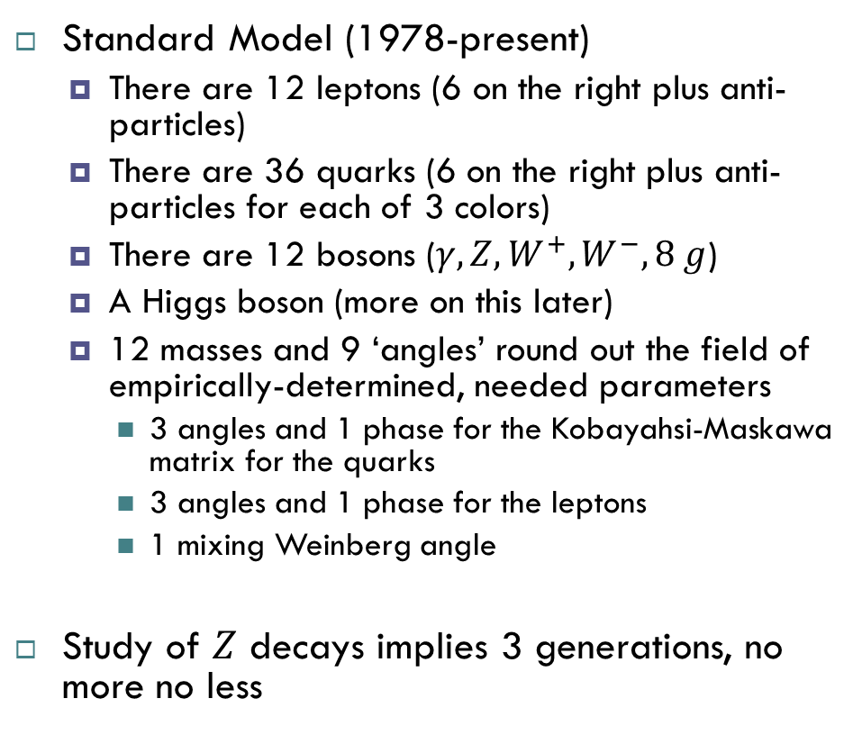
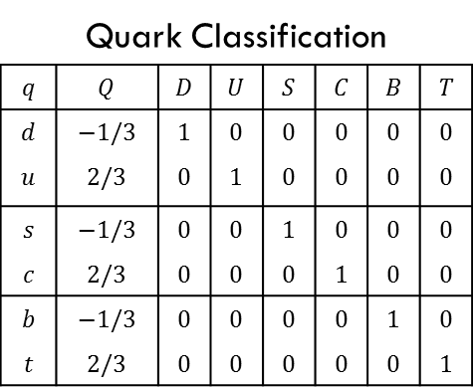
Chapter 1 - Modern Period (cont’d) (11/7)
Standard Model (1978-present)
There are 12 leptons (6 on the right plus anti-particles)
There are 36 quarks (6 on the right plus anti-particles for each of 3 colors)
There are 12 bosons ($γ,Z,W^{+},W^{−},8 g$)
A Higgs boson (more on this later)
12 masses and 9 ‘angles’ round out the field of empirically-determined, needed parameters
3 angles and 1 phase for the Kobayahsi-Maskawa matrix for the quarks
3 angles and 1 phase for the leptons
1 mixing Weinberg angle
Study of $Z$ decays implies 3 generations, no more no less
Lepton Classification
$$ℓ$$ | $$Q$$ | $$L_{e}$$ | $$L_{μ}$$ | $$L_{τ}$$
$$e$$ | $$−1$$ | $$1$$ | $$0$$ | $$0$$
$$ν_{e}$$ | $$0$$ | $$1$$ | $$0$$ | $$0$$
$$μ$$ | $$−1$$ | $$0$$ | $$1$$ | $$0$$
$$ν_{μ}$$ | $$0$$ | $$0$$ | $$1$$ | $$0$$
$$τ$$ | $$−1$$ | $$0$$ | $$0$$ | $$1$$
$$ν_{τ}$$ | $$0$$ | $$0$$ | $$0$$ | $$1$$
Quark Classification
$$q$$ | $$Q$$ | $$D$$ | $$U$$ | $$S$$ | $$C$$ | $$B$$ | $$T$$
$$d$$ | $$−1/3$$ | $$1$$ | $$0$$ | $$0$$ | $$0$$ | $$0$$ | $$0$$
$$u$$ | $$2/3$$ | $$0$$ | $$1$$ | $$0$$ | $$0$$ | $$0$$ | $$0$$
$$s$$ | $$−1/3$$ | $$0$$ | $$0$$ | $$1$$ | $$0$$ | $$0$$ | $$0$$
$$c$$ | $$2/3$$ | $$0$$ | $$0$$ | $$0$$ | $$1$$ | $$0$$ | $$0$$
$$b$$ | $$−1/3$$ | $$0$$ | $$0$$ | $$0$$ | $$0$$ | $$1$$ | $$0$$
$$t$$ | $$2/3$$ | $$0$$ | $$0$$ | $$0$$ | $$0$$ | $$0$$ | $$1$$

Slide 19
Some QFT

Slide 20
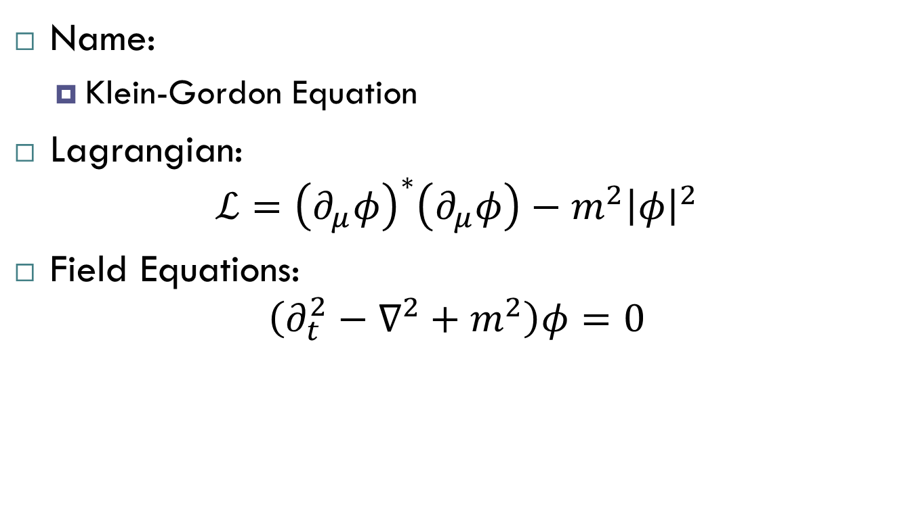
Spin 0 QFT
Name:
Klein-Gordon Equation
Lagrangian:
$$ℒ={\left(∂_{μ}φ\right)}^{∗}\left(∂_{μ}φ\right)−m^{2}{\left|φ\right|}^{2}$$
Field Equations:
$$\left(∂_{t}^{2}−∇^{2}+m^{2}\right)φ=0$$

Slide 21
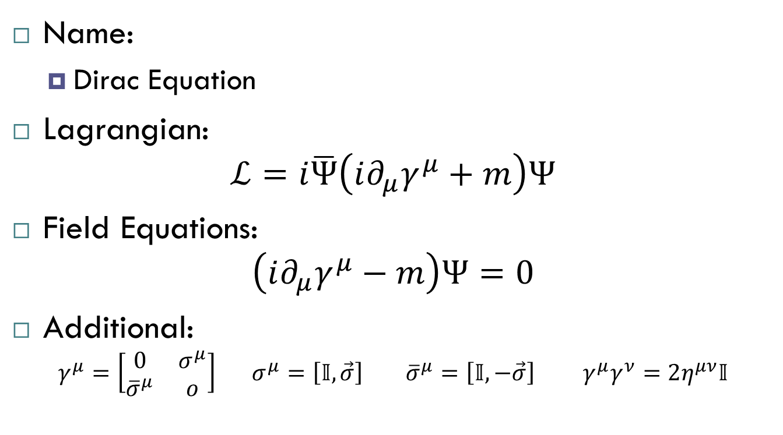
Spin ½ QFT
Name:
Dirac Equation
Lagrangian:
$$ℒ=i\overline{Ψ}\left(i∂_{μ}γ^{μ}+m\right)Ψ$$
Field Equations:
$$\left(i∂_{μ}γ^{μ}−m\right)Ψ=0$$
Additional:
$$γ^{μ}=\left[\begin{matrix}0 & σ^{μ} \\ {\overline{σ}}^{μ} & o\end{matrix}\right] σ^{μ}=\left[𝕀,\vec{σ}\right] {\overline{σ}}^{μ}=\left[𝕀,−\vec{σ}\right] γ^{μ}γ^{ν}=2η^{μν}𝕀$$

Slide 22
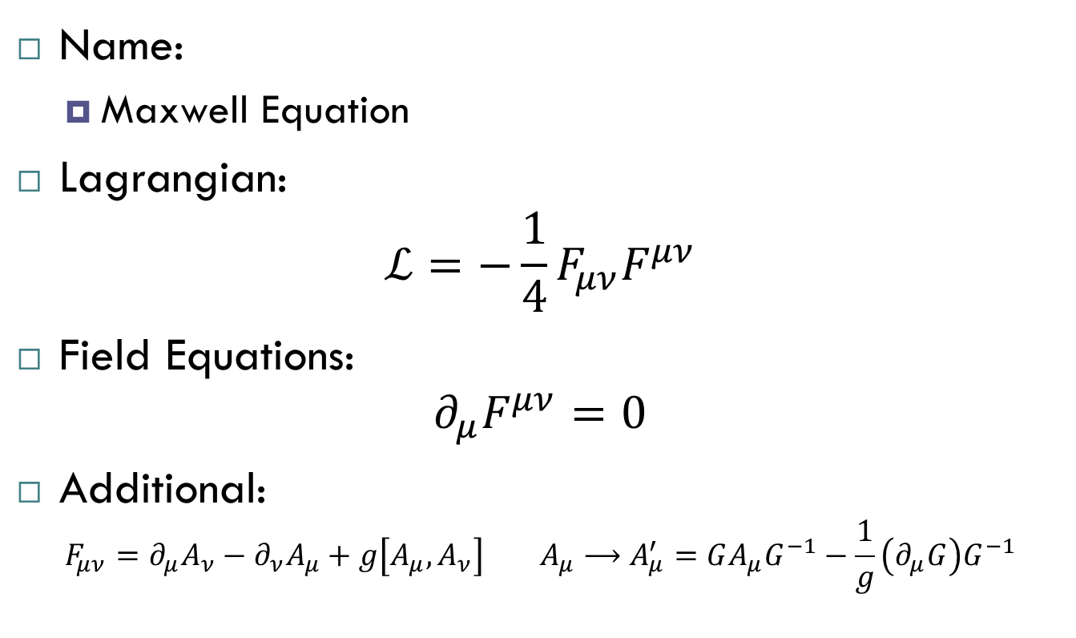
Spin 1 QFT
Name:
Maxwell Equation
Lagrangian:
$$ℒ=−\frac{1}{4}F_{μν}F^{μν}$$
Field Equations:
$$∂_{μ}F^{μν}=0$$
Additional:
$$F_{μν}=∂_{μ}A_{ν}−∂_{ν}A_{μ}+g\left[A_{μ},A_{ν}\right] A_{μ}⟶A_{μ}^{′}=GA_{μ}G^{−1}−\frac{1}{g}\left(∂_{μ}G\right)G^{−1}$$

Slide 23
Spin ½ QFT
Name:
Dirac Equation
Lagrangian:
Field Equations:

Slide 24
Spin ½ QFT
Name:
Dirac Equation
Lagrangian:
Field Equations:

