Slide 1
Why Don’t We Teach the Helmholtz Theorem
Conrad Schiff
Chesapeake Chapter of AAPT
10/25/2014

Slide 2
References
[1]: Electromagnetic Theory – Frankl
[2]: Foundations of Electromagnetic Theory – Reitz, Milford, & Christie
[3]: Lectures on Electromagnetic Theory - Solymar
[4]: Maxwell’s Equations – wikipedia.org http://en.wikipedia.org/wiki/Maxwell_Equations
[5]: Nonlinear optics – wikipedia.org http://en.wikipedia.org/wiki/Nonlinear_optics#Wave-equation_in_a_nonlinear_material
[6]: Nonlinear magnetic materials – wikipedia.org http://en.wikipedia.org/wiki/Permeability_(electromagnetism)
[7]: Google search on ‘nonlinear electrical conductivity’

Slide 3
Helmholtz Theorem

Slide 4
Outline
Common textbook approach to justifying Maxwell’s equations (see references)
  Start with the experiment evidence as if we are the 18th and 19th centuries
  Electric field introduced in the context of static situations
  Gauss’s law used to link
  Wash, rinse, repeat for the magnetic field
  is inadequate for most students
  Long road to travel before

Slide 5
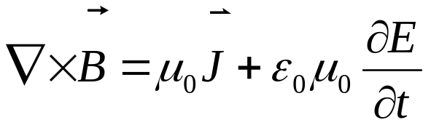
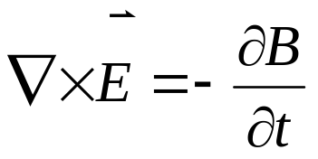
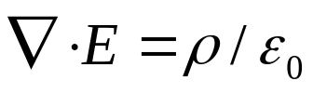

Maxwell’s Equations (1/21)
The Maxwell Equations are (mks units):
Ampere’s Law
Faraday’s Law
Gauss’s Law
Monopole Law

Slide 6
Helmholtz Theorem

Slide 7
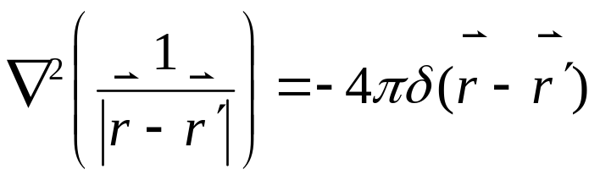
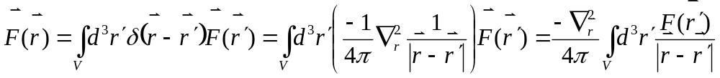
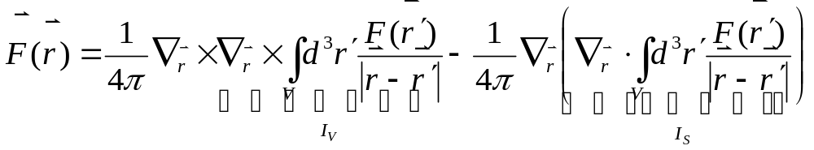
Helmholtz Theorem (1/4)
Start with the resolution of the delta function in spherical coordinates
And decompose a function against the delta as
where V is a bounded volume containing r’
Now use the identity laplacian() = grad(div())-curl(curl()), to get

Slide 8
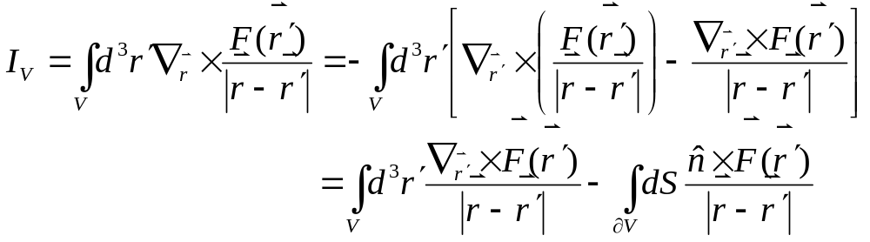
Helmholtz Theorem (2/4)
The strategy for handling these terms is to
  bring the derivative operator wrt r into the integral
  switch it with r’, at the cost of a minus sign
  integrate by parts
  apply the appropriate boundary integral version of the divergence theorem to the total derivative piece
  allow the surface for evaluation in step 4 to go to infinity
Application of this to the first integral I_{V} yields (where the I01 form for the divergence theorem is used)

Slide 9
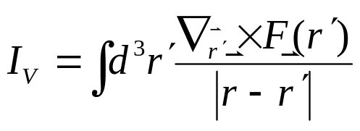
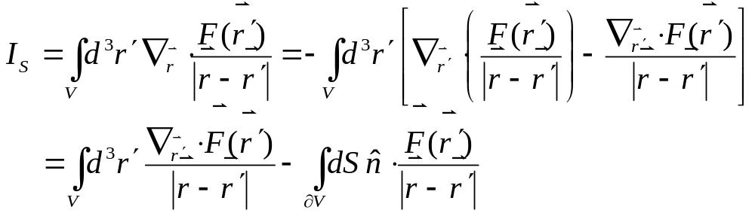
Helmholtz Theorem (3/4)
Letting the surface recede to infinity (volume becomes all space), assuming the field F falls off faster than 1/r for convergence, gives
Next manipulate the I_{S} integral

Slide 10
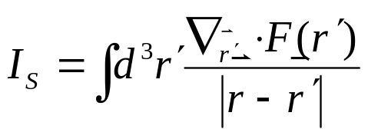

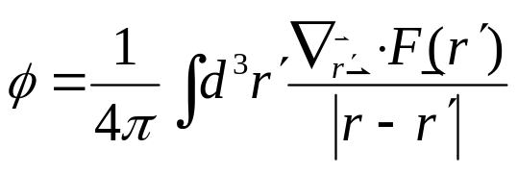
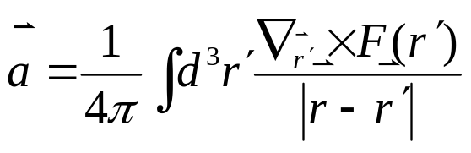
Helmholtz Theorem (4/4)
Again assuming that the field falls off faster than 1/r so that the surface can be taken to infinity
So in general a vector field (falling off faster than 1/r) can always be decomposed as

Slide 11
On Deriving the Conventional Laws of Electro- and Magnetostatics

Slide 12
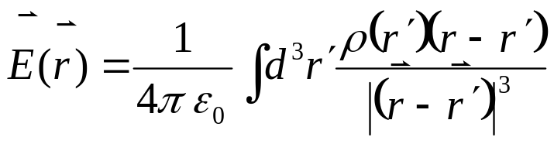
Deriving Coloumb’s Law
Start with Maxwell’s equations that specify div(E) and curl(E) (Gauss’s and Faraday’s laws)
Assume
  no time varying fields (electrostatic assumption)
  bare charge in vacuum
As a consequence of those assumptions, div(E) = ρ/ε₀ and curl(E) = 0
Using Helmholtz’s theorem gives Coulomb’s law

Slide 13
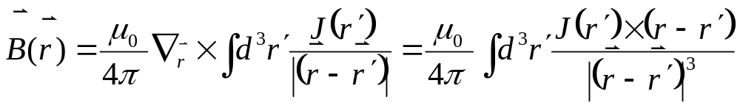
Deriving Biot-Savart’s Law
Start with Maxwell’s equations that specify div(B) and curl(B) (Monopole and Ampere’s laws)
Assume
  no time varying fields (magnetostatic assumption)
  bare current in vacuum
As a consequence of those assumptions, div(B) = 0 and curl(B) =μ₀ J
Using Helmholtz’s theorem (& D09) gives Biot-Savart’s law

