Slide 1
Test Monitoring Tool
Single App to monitor several servers for exceptions and alarms during testing!
June 18, 2014
Notes:
1
1

Slide 2
Test Monitoring Tool
Helps testers monitor log files for exceptions or other keywords
Monitor any text-based file for a specific keyword
Highlights matched keywords to your preferred color
Displays n messages before and after the match to provide context
Monitor several servers/log files from a single app window
Configuration to suit any needs
Connects to any server through Telnet or SSH
Auto-scroll, auto-refresh for new log files, windows flashes on new exception/matched keyword
Configurable terminal buffer size, customizable font & color
Much more…
Use the tool in 3 easy steps:
Set up your Template Log Files
Add servers and select log files to monitor
Start monitoring!

Slide 3
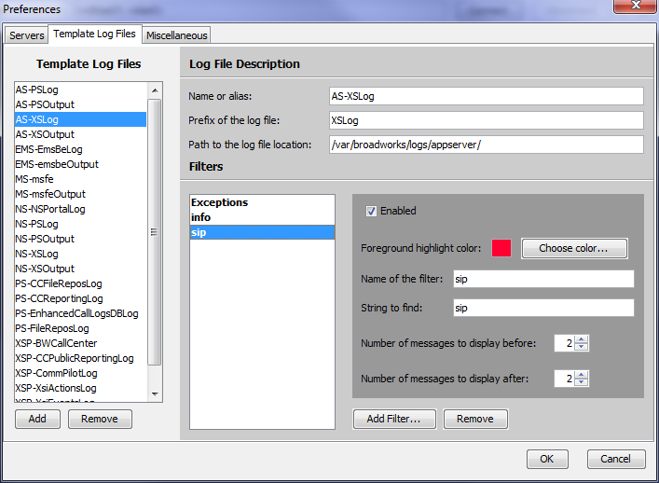
Step 1: Set up your Template Log files
Use pre-defined templates to monitor for exceptions, or create new ones:
Go to the preferences (Edit → Preferences) and to the Template Log Files tab
Click Add to create new templates or select an existing one to modify
Set the path and prefix of the log filename to monitor (ex.: XSLog for a file that would be called XSLog[Date]-[Hour].txt)
Add filters to watch for specific keyword in the selected log file. Filters determine which messages will be displayed on screen
[Optional] Customize the filter highlight color and number of messages to display before/after
2
1
3

Slide 4
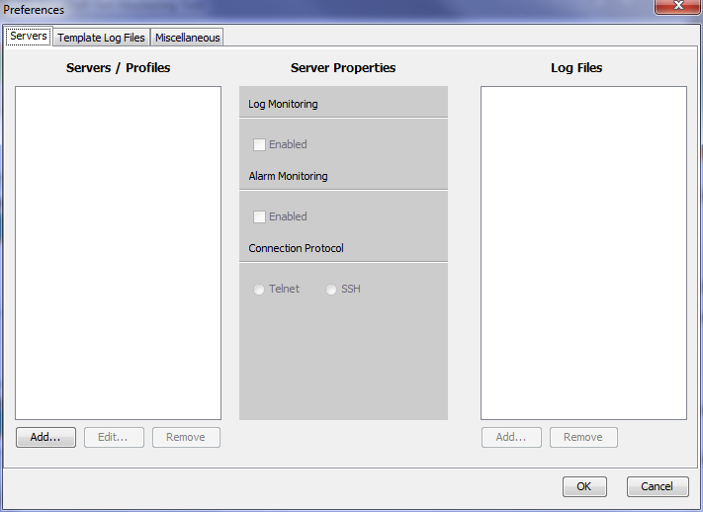
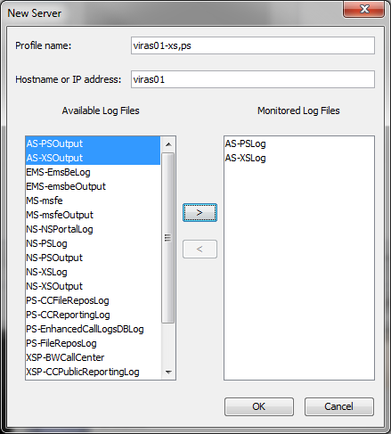
Step 2: Add servers and select log files to monitor
Click Add to create a server you want to monitor
Select log files to monitor (which correspond to the templates you created in the previous step)
Enable the server
[Optional] Select the connection protocol to use (default is SSH)
3
2
1

Slide 5
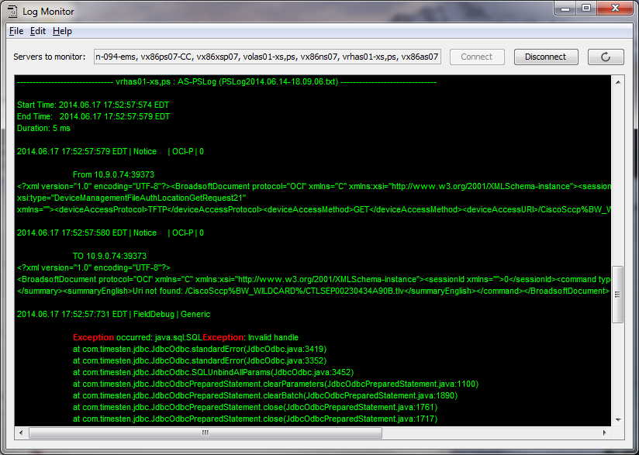
Step 3: Start Monitoring!
Press the connect button
Enjoy!
Note: You can disconnect or “refresh” the connection to manually check for a new version of the log files

Slide 6
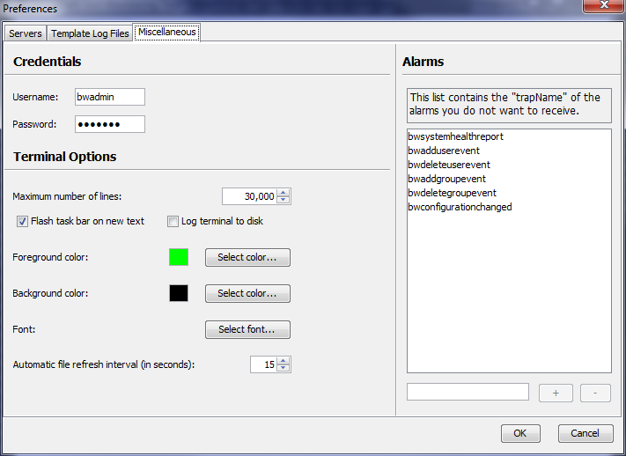
[Optional] Step 4: Customize the misc. preferences
You can change the credentials used to connect to the servers
You can modify the maximum number of lines displayed in the terminal
You can make the program flash its taskbar icon on a new message if you are currently using another program
You can log the terminal output to a file in the logs folder relative to the tool executable.
You can change the terminal text and background color as well as the font
You can also modify the automatic refresh interval. This is the interval at which the program will automatically verify if there is a new version of the log files available on the server

Slide 7
Notes for the Test Monitoring Tool
Created by system test intern, Christian Artin; supervised by Khang Dang
Preferences are only saved to disk if you press OK. They are not always backward compatible.
Log files are only compatible if they have a header in the following format
XX.XX.XX XX:XX:XX (where X is a number)
Known bugs
Preferences are only saved when the focus from the text box is lost (i.e. you cannot click on another item in the list while modifying the name of the currently selected item)
Future features: single line matching (for logs with non-standard headers), system resources, etc.
Tool location
http://beach/svn/working/verification/tools/TestMonitoringTool/dist
Execute by double-clicking on TestMonitoringTool.jar

Slide 8
Thank you for using this tool!

