Slide 1
Applied Data Science Capstone Project
https://github.com/gray117/IBM_Data_Science

Slide 2
Outline
Executive Summary
Introduction
Methodology
Results
Conclusion
Appendix

Slide 3
Executive Summary
Collected data from public SpaceX API and SpaceX Wikipedia page. Created labels column ‘class’ which classifies successful landings. Explored data using SQL, visualization, folium maps, and dashboards. Gathered relevant columns to be used as features. Changed all categorical variables to binary using one hot encoding. Standardized data and used GridSearchCV to find best parameters for machine learning models. Visualize accuracy score of all models.
Four machine learning models were produced: Logistic Regression, Support Vector Machine, Decision Tree Classifier, and K Nearest Neighbors. All produced similar results with accuracy rate of about 83.33%. All models over predicted successful landings. More data is needed for better model determination and accuracy.

Slide 4
Introduction
Background:
Commercial Space Age is Here
Space X has best pricing ($62 million vs. $165 million USD)
Largely due to ability to recover part of rocket (Stage 1)
Space Y wants to compete with Space X
Problem:
Space Y tasks us to train a machine learning model to predict successful Stage 1 recovery

Slide 5
Methodology – SpaceX API
Request (SpaceX API)
.JSON file and Lists
Json_normalize to DF from JSON
Amputate missing PayloadMassvalues with mean
Dictionary relevant data
Cast dictionary to DF
Filter data for Falcon 9 launches

Slide 6
Methodology – Web Scrapping
Request (Wiki html)
BeautifulSoup html5lib Parser
Find launch info html table
Create dictionary
Iterate through table cells to extract data to dictionary
Cast dictionary to DF

Slide 7
Methodology – Predictive Analysis
Split label column 'Class' from dataset
Fit and transform feature using Standard Scaler
Train test split data
GridSearchCV to find optimal parameters
Use GridSearchCV on LogReg, SVM, Decision Tree and KNN models
Score models on split test set
Confusion Matrix for all models
Bar plot to compare scores of models

Slide 8
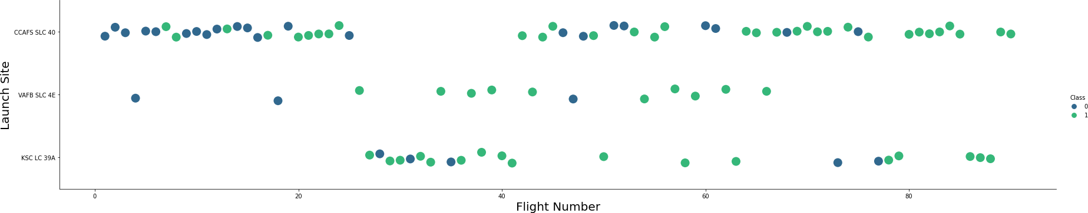
Results - Flight Number vs. Launch Site
Success rate increases with number of flights indicating improvement and fine tuning along the way.

Slide 9
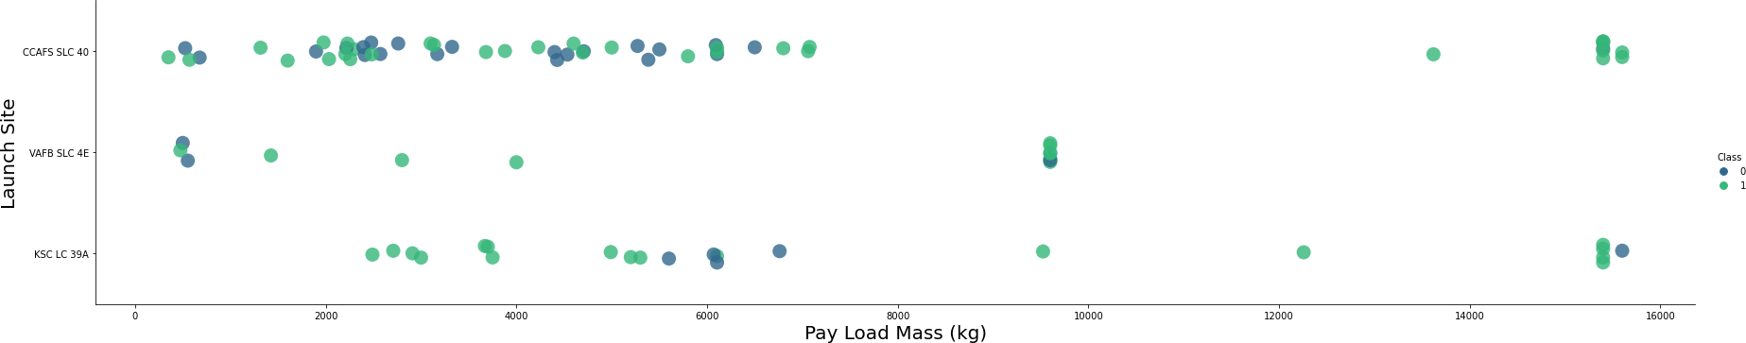
Results – Payload vs. Launch Site
Better success rate appears to occur at higher Payload mass

Slide 10
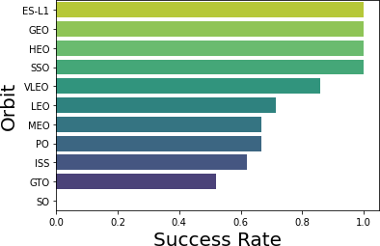
Results – Success rate vs. Orbit type
ES-L1, GEO, HEO and SSO seem to have higher success rate than the others

Slide 11
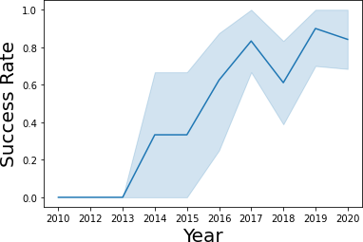
Results – Year vs. Success Rate
Success rate increases over the years

Slide 12
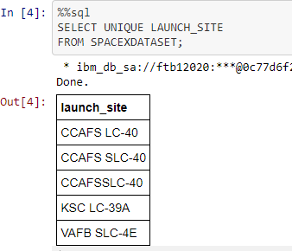
Results –EDA with SQL
Query unique launch site names from database.

Slide 13
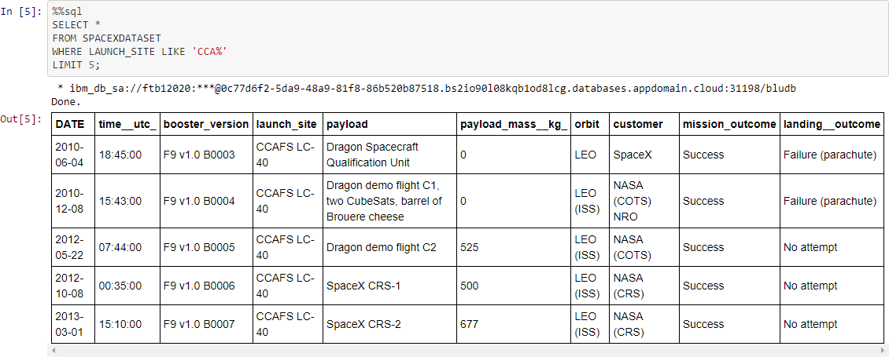
Results –EDA with SQL
First five entries in database with Launch Site name beginning with CCA.

Slide 14
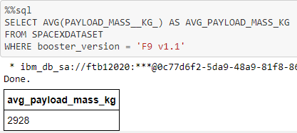
Results –EDA with SQL
This query calculates the average payload mass or launches which used booster version F9 v1.1

Slide 15
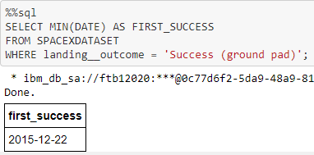
Results –EDA with SQL
This query returns the first successful ground pad landing date.

Slide 16
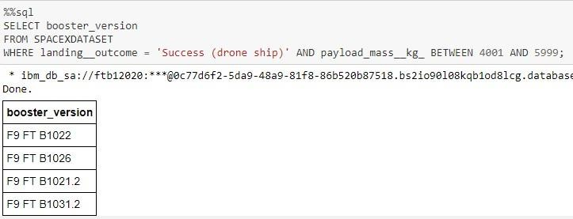
Results –EDA with SQL
This query returns the four booster versions that had successful drone ship landings and a payload mass between 4000 and 6000 noninclusively.

Slide 17
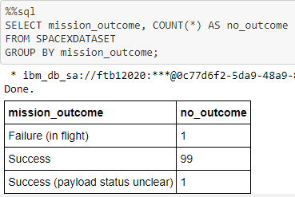
Results –EDA with SQL
This query returns a count of each mission outcome.

Slide 18
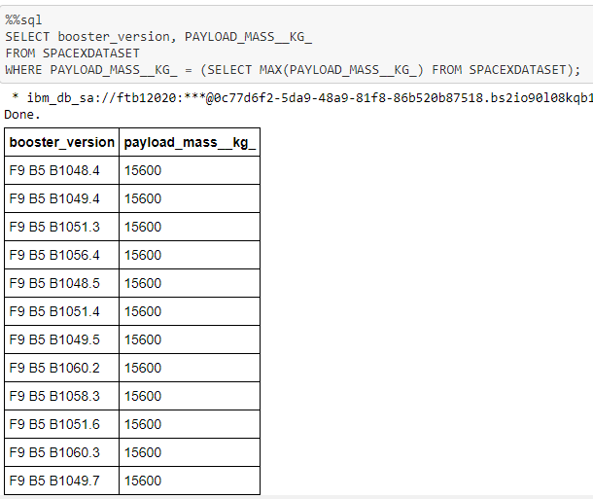
Results –EDA with SQL
This query returns the booster versions that carried the highest payload mass of 15600 kg.

Slide 19
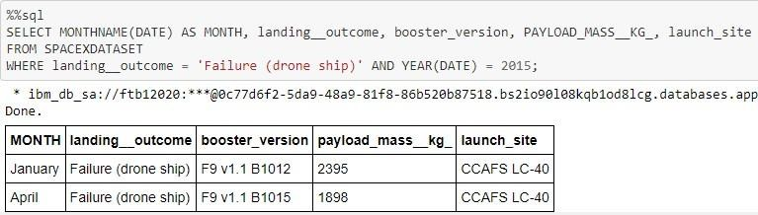
Results –EDA with SQL
This query returns the Month, Landing Outcome, Booster Version, Payload Mass (kg), and Launch site of 2015 launches where stage 1 failed to land on a drone ship. There were two such occurrences.

Slide 20
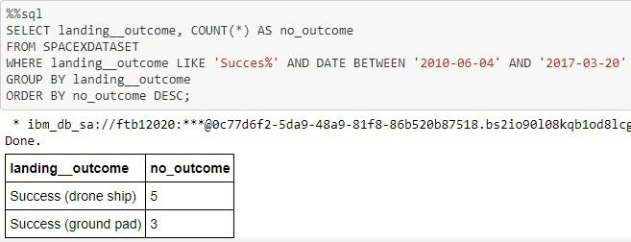
Results –EDA with SQL
This query returns a list of successful landings and between 2010-06-04 and 2017-03-20 inclusively.

Slide 21
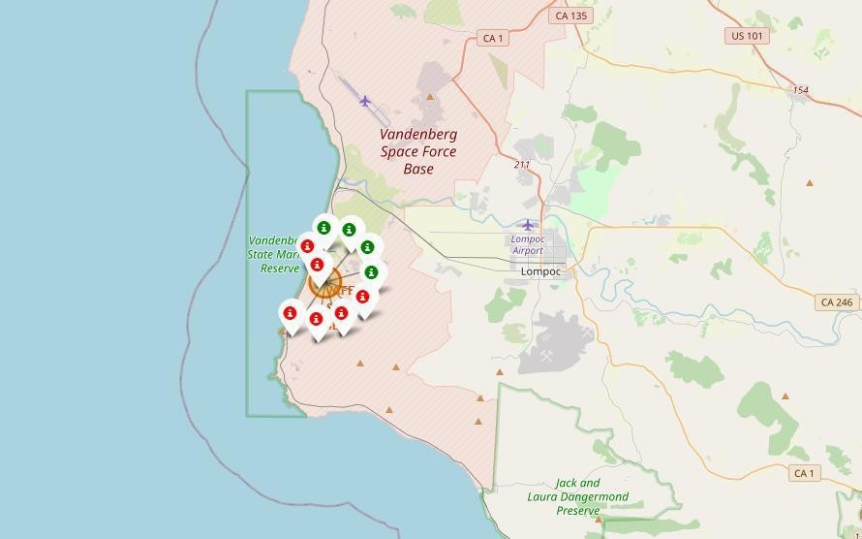
Results – Folium Interactive Map
Clusters on Folium map can be clicked on to display each successful landing (green icon) and failed landing (red icon). In this example VAFB SLC-4E shows 4 successful landings and 6 failed landings.

Slide 22
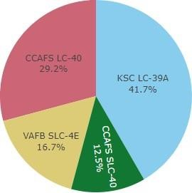

Results – Plotly Dash
This pie chart depicts the successful landings across the different launch site.

Slide 23
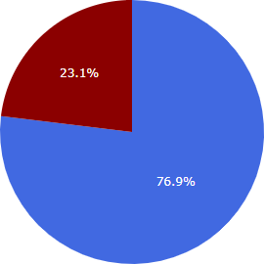

Results – Plotly Dash
KSC LC39A, the site with the highest success rate, has a 76.1% success rate

Slide 24
Conclusion
We were tasked with creating a machine learning model for Space Y to compete with SpaceX. The model's purpose was to predict successful Stage 1 landings, potentially saving $100 million USD. We gathered data from a SpaceX API and Wikipedia, established data labels, and stored everything in a DB2 SQL database. A visualization dashboard was created, and our model achieved an 83% accuracy rate.
Allon Mask of SpaceY can now use this model for pre-launch predictions on successful Stage 1 landings, aiding launch decisions. To enhance accuracy further, we suggest collecting more data for model refinement.

