Slide 1
ULI101: Introduction to Unix / Linux and the Internet Week 7: INSTALLING LINUX / LIVE LINUX DISTRIBUTIONS
Photos and icons used in this slide show are licensed under CC BY-SA

Slide 2
Lesson 1 topics
Installing Linux
Purpose / Linux Distributions
Linux Installation Methods
Live Linux Distributions
Purpose
Run Knoppix from your home computer (as a Virtual Machine)
Week 7 Tutorial (Optional, but really cool!)
INVESTIGATIONS 1 & 2
Work on Assignment 2 (sections: 1, 2 and 3)

Slide 3
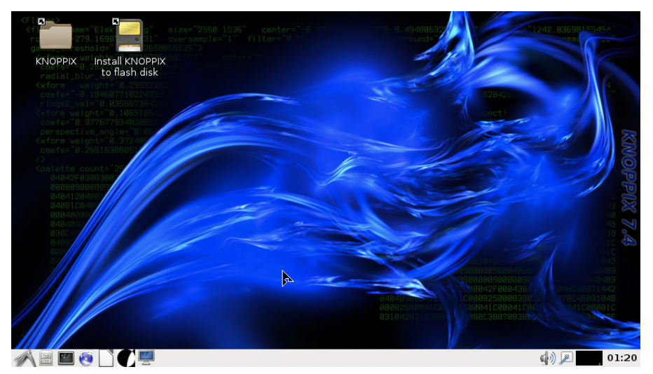
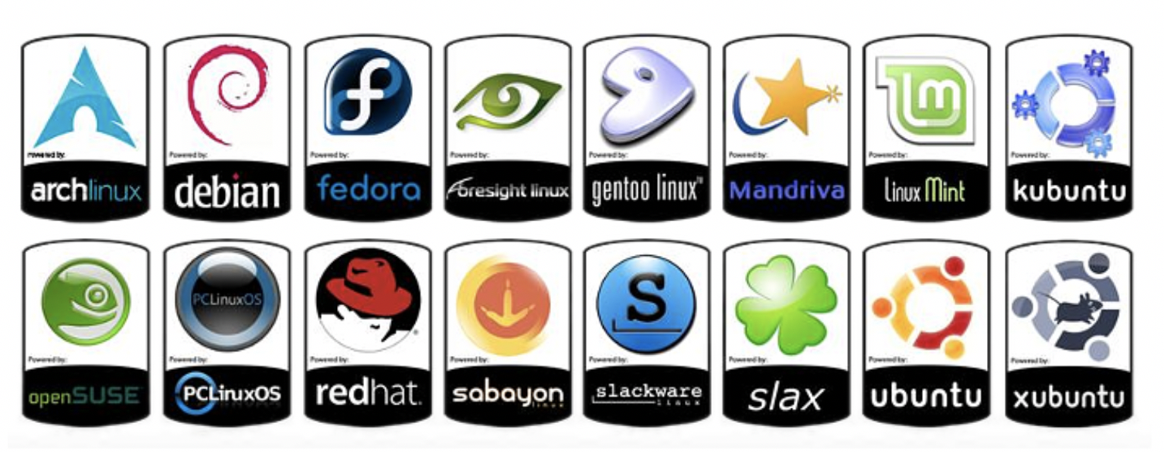
Installing Linux
Having a Linux system on your home computer provides access to a large library of open source software.
Also, installing your own version of Linux on your notebook or desktop computer teaches you how to:
Work in the Linux environment
Run graphical applications
Perform routine Linux OS administration tasks

Slide 4
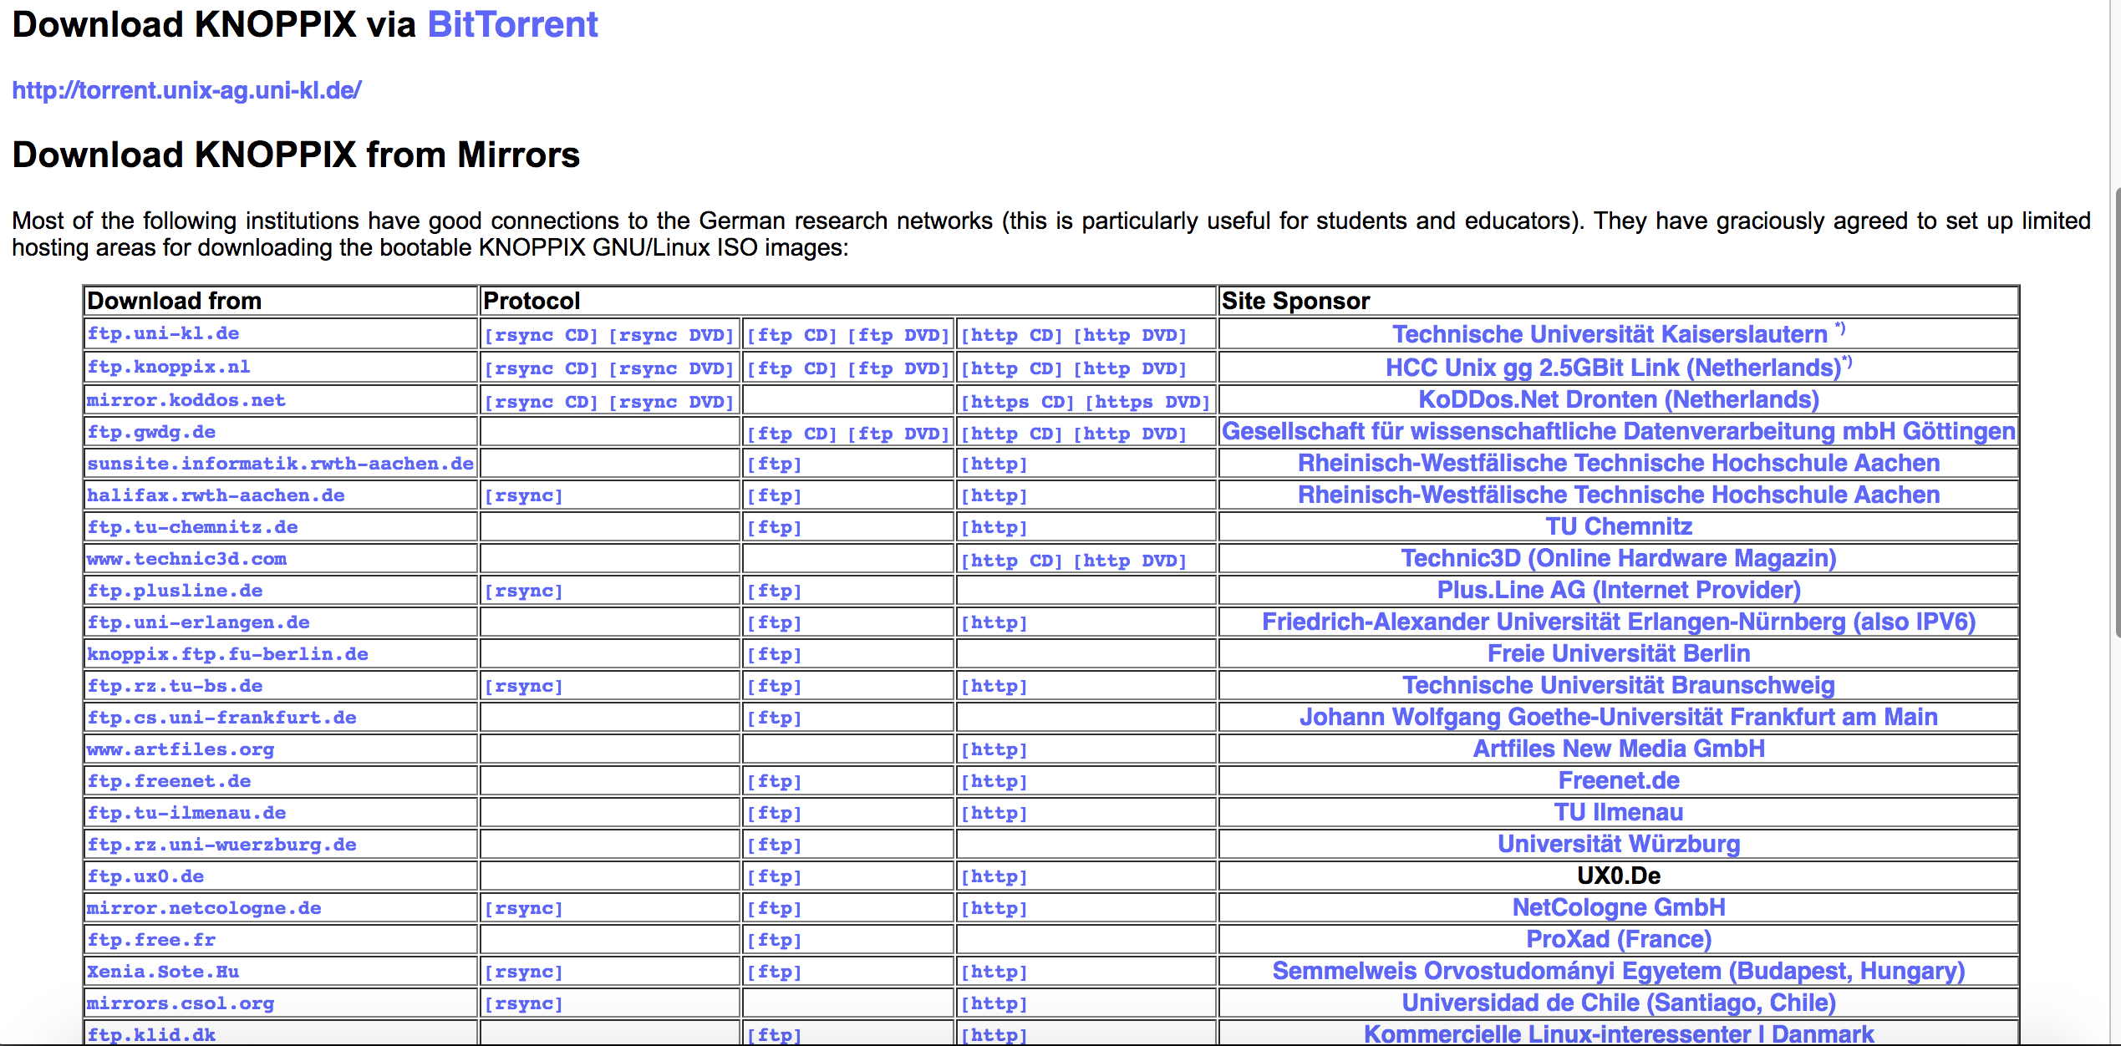
TRADITIONAL LINUX INSTALLATION
STEPS:
Select a Linux Distribution and download a Linux Distribution Install ISO file to your Computer (Note: Be aware of any required Hardware Requirements for the Linux OS prior to installation.) Knoppix Link: https://www.knopper.net/knoppix-mirrors/index-en.html
Burn a Linux Distribution CD/DVD, or USB Key. How to Burn CD: Install Knoppix LInux How to Burn USB Key: How to Boot Knoppix from USB
For most distributions, the installation involves a guided graphical environment.

Slide 5
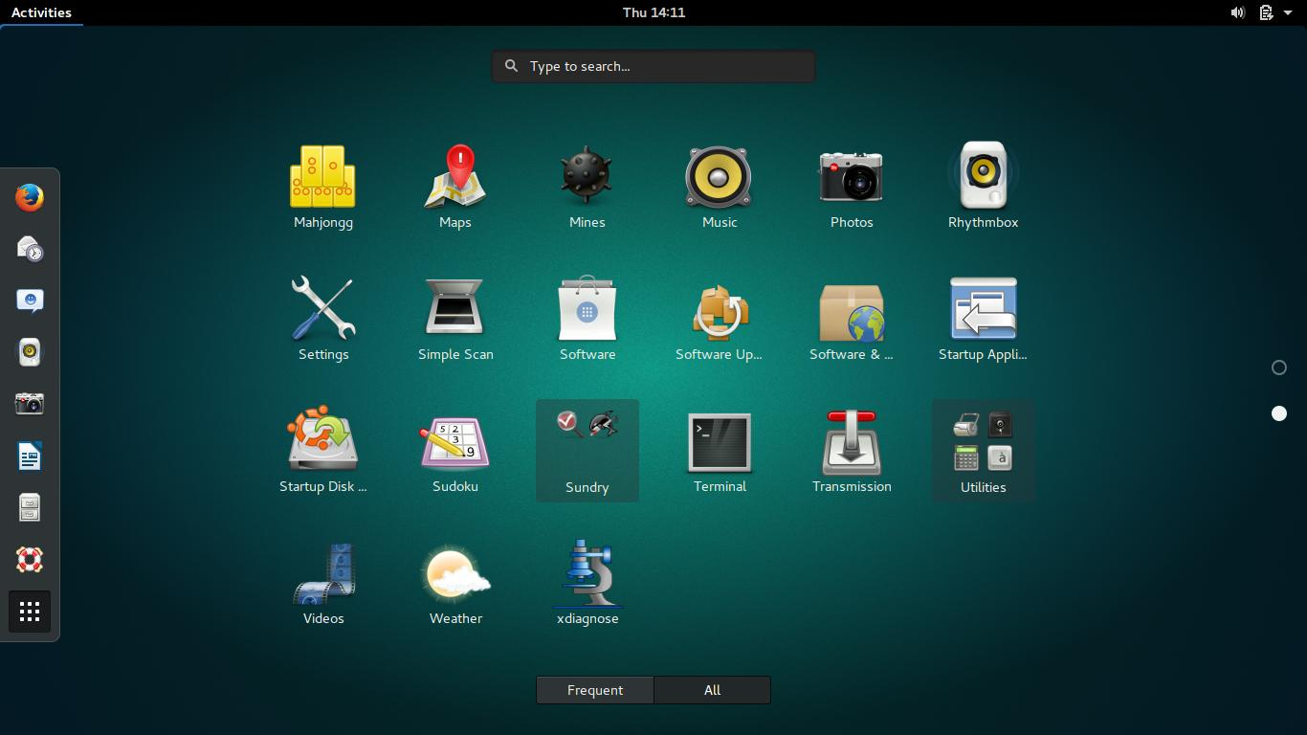
LINUX INSTALLATION METHODS
Standalone Installation
Linux is the only OS on the computer.
Any existing data on disk will be erased.

Slide 6
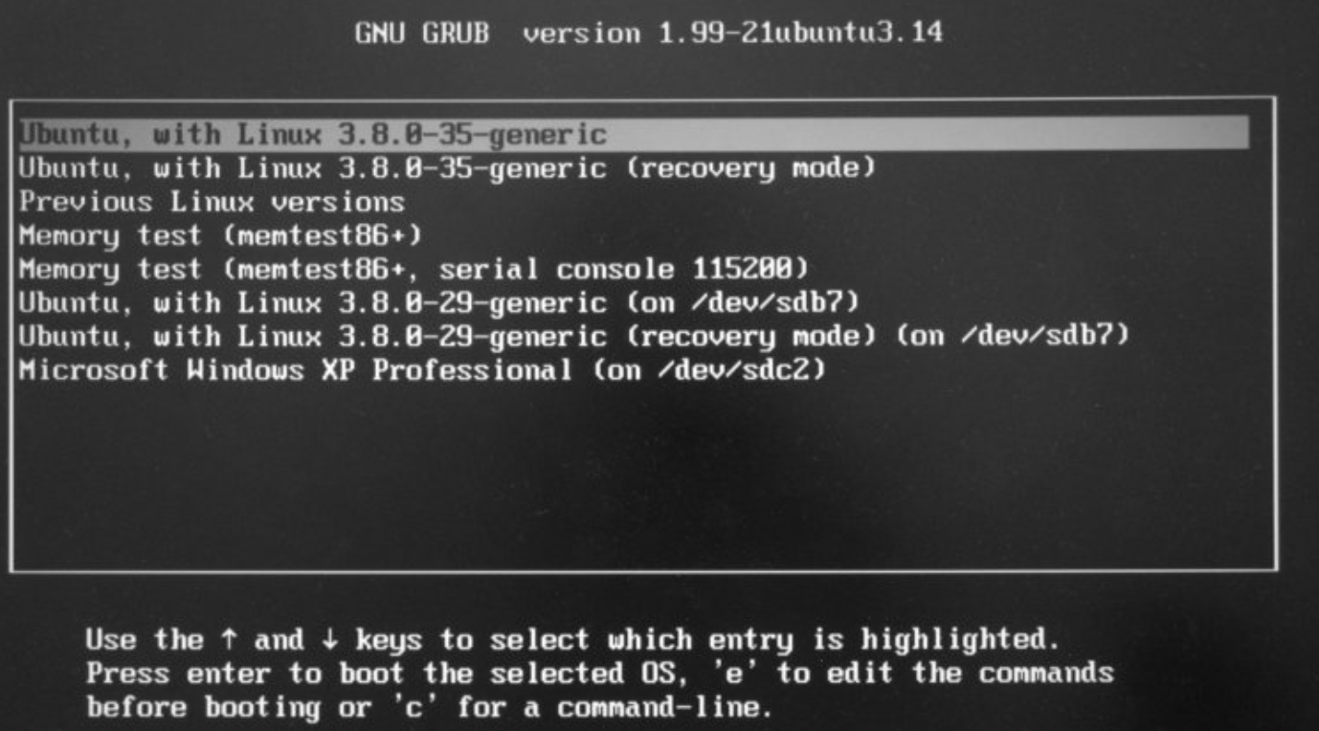
LINUX INSTALLATION METHODS
Dual-boot / Multi-boot Installation
A boot menu allows the user to select the desired OS.
Advantages of Dual-Boot or Multi-Boot:
This option provides a method to access your computer if one OS fails to boot-up.
Access the Windows partition if your Windows OS cannot boot-up.
This booting method is great for troubleshooting (for example: boot into Linux OS to eliminate a hardware issue).
Installation Tips:
It is recommended to back up important data before proceeding.
It is recommended to install the Linux operating system last, as other operating systems may NOT offer a multi-boot option.

Slide 7
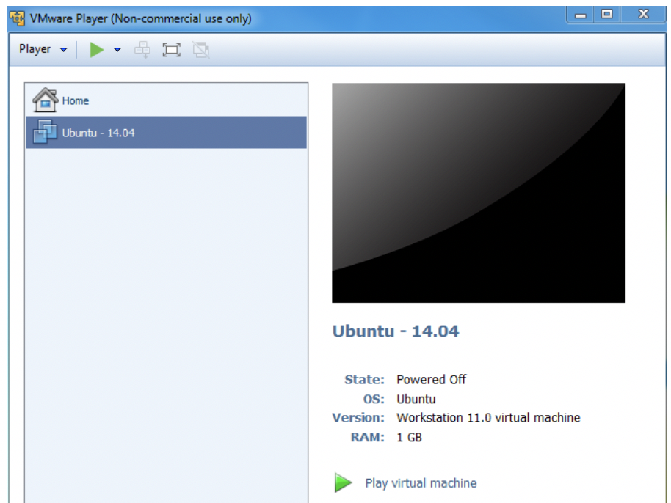
LINUX INSTALLATION METHODS
Virtualization Machine Installation
Virtualization is the process of running a virtual instance of a computer system in a layer abstracted from the actual hardware. Reference: https://opensource.com/resources/virtualization
The virtualized (guest) operating system is installed and run in a window under another (host) computer’s operating system. Special software is used to manage the entire process, referred to as the hypervisor.

Slide 8
LINUX INSTALLATION METHODS
Virtualization Machine Installation
Advantages of Virtualization:
You can run VM from an ISO image file or a VM file.
One or more virtual machines can be run at the same time.
The guest OS shares hardware with the host OS and possibly other virtualized systems.
The guest systems have network access through the host.
Installation Tips:
Virtualization requires a compatible processor: not all processors support that feature.
Your BIOS should be set to enable Virtualization.
Popular VM software for Windows, Apple and Linux OS include:
VMware
Oracle Virtual Box

Slide 9
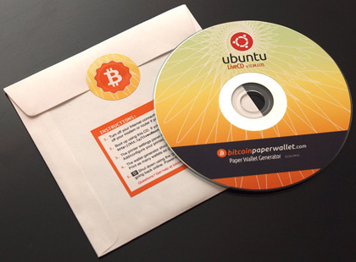
RUNNING Live linux
Live Linux CD/DVD/USB
A live CD (also live DVD, live disc, or live operating system) is a complete bootable computer installation including operating system which runs directly from a CD-ROM or similar storage device into a computer's memory, rather than loading from a hard disk drive. A Live CD allows users to run an operating system for any purpose without installing it or making any changes to the computer's configuration. Live CDs can run on a computer without secondary storage, such as a hard disk drive, or with a corrupted hard disk drive or file system, allowing data recovery. Reference: https://en.wikipedia.org/wiki/Live_CD

Slide 10
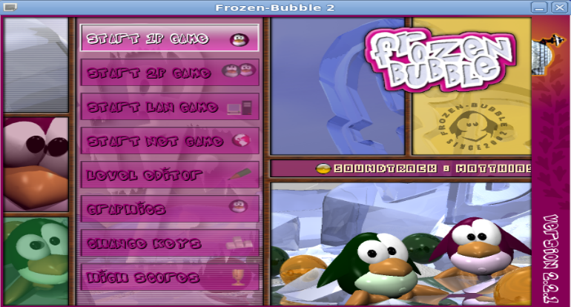
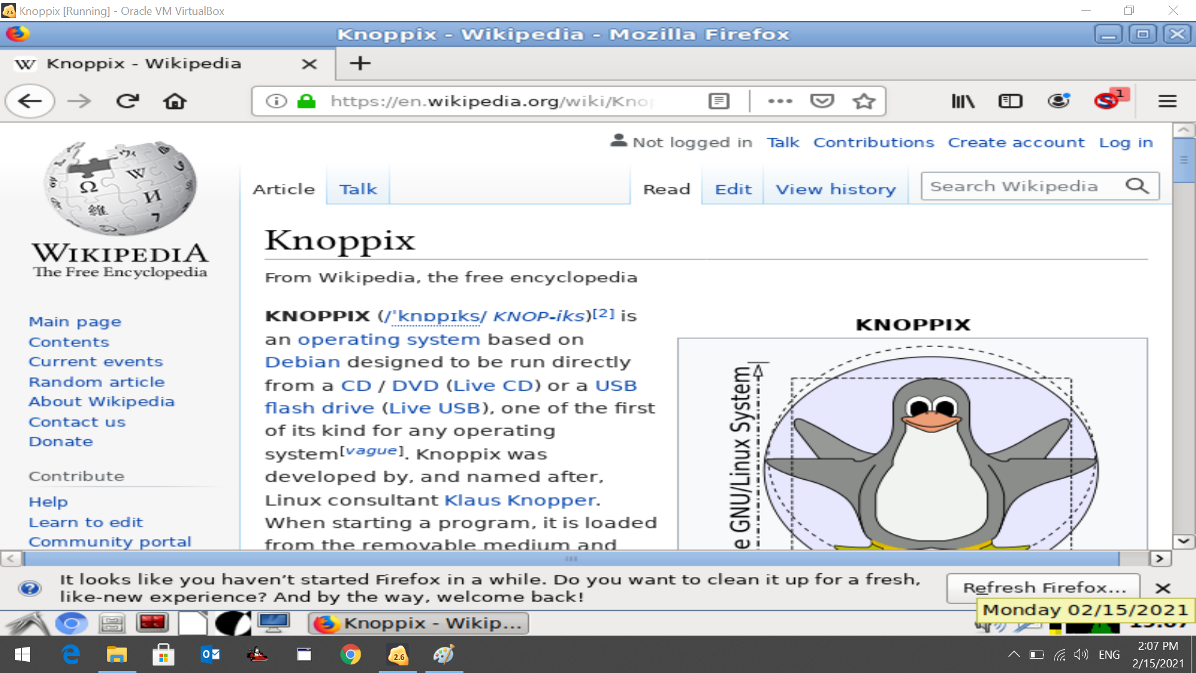
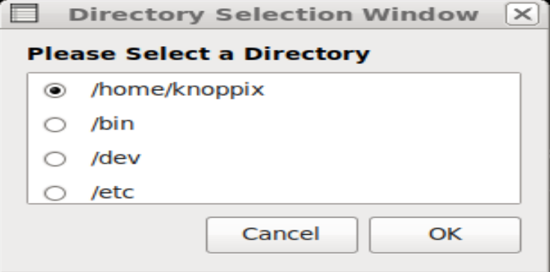
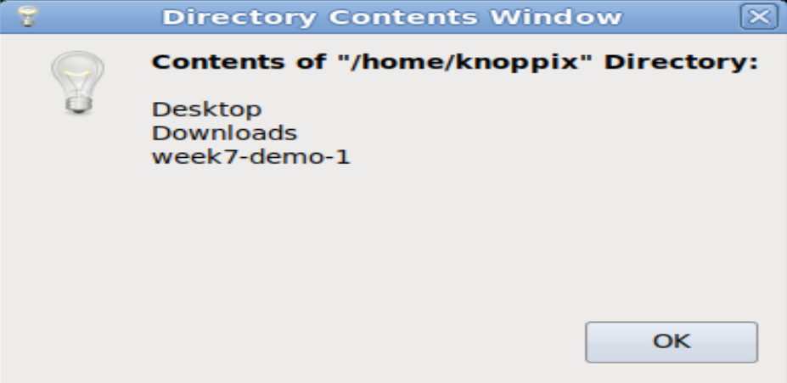
RUNNING LIVE LINUX (KNOPPIX)
Tutorial 7 (in ULI101 WIKI)
Tutorial 7 contained in the Weekly Schedule of the ULI101 WIKI allows a person to run the Knoppix Live Linux distribution without installing the Linux OS to your home computer.
In this tutorial, you can run graphical applications and download and run a shell script that runs graphical dialog boxes for user input and to display output.

Slide 11
Live linux
Getting Practice
Although NOT required for this course’s evaluation, you can get practice by performing the OPTIONAL Week 7 Tutorial:
INVESTIGATION 1: BOOTING KNOPPIX (LIVE LINUX) VIA VIRTUALBOX
INVESTIGATION 2: USING THE GRAPHICAL KNOPPIX VM
Work on Assignment 2 (sections: 1, 2 and 3)

